Slide 1
Cluster-based Genetic Segmentation of Time Series with DWT
Pattern Recognition Letters 30 (2009) 1190–1197
Vincent S. Tseng, Chun-Hao Chen, Pai-Chieh Huang,
Tzung-Pei Hong
Presenter: 許竣傑
2013/4/15

Slide 2
Abstract
A time series is composed of lots of data points, each of which represents a value at a certain time. Many phenomena can be represented by time series, such as electrocardiograms in medical science, gene expressions in biology and video data in multimedia. Time series have thus been an important and interesting research field due to their frequent appearance in different applications. This paper proposes a time series segmentation approach by combining the clustering technique, the discrete wavelet transformation and the genetic algorithm to automatically find segments and patterns from a time series. The genetic algorithm is used to find the segmentation points for deriving appropriate patterns. In fitness evaluation, the proposed approach first divides the segments in a chromosome into k groups according to their slopes by using clustering techniques.

Slide 3
Abstract
The Euclidean distance is then used to calculate the distance of each subsequence and evaluate a chromosome. The discrete wavelet transformation is also used to adjust the length of the subsequences for calculating the similarity since their length may be different. The evaluation results are utilized to choose appropriate chromosomes for mating. The offspring then undergo recursive evolution until a good result has been obtained. Experimental results show that the proposed approach can get good results in finding appropriate segmentation patterns in time series.

Slide 4
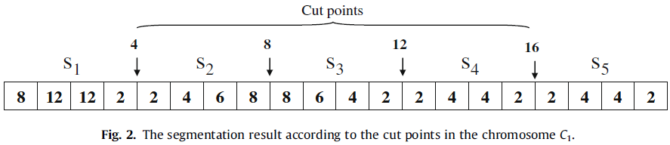

Chromosome Representation
T = {$d_{1},d_{2}$, $d_{3}$,…, $d_{n}$}
C = {4,8,12,16}

Slide 5

K - mean
S₁ = {8,12,12,2}
S₁ = {8,12,2}
Slope of segment S₁ = {2.66,-6.66}
S₂ = {2,4,6,8}
S₂ = {2,5,8}
Slope of segment S₂ = {2,2}
S₃ = {8,6,4,2}
S₃ = {8,5,2}
Slope of segment S₃ = {-2,-2}
S₄ = {2,4,4,2}
S₄ = {2,4,2}
Slope of segment S₄ = {1.33,-1.33}
S₅ = {2,4,4,2}
S₅ = {2,4,2}
Slope of segment S₅ = {1.33,-1.33}

Slide 6
K - mean
K = 2
(2,2)
X
(0,0)
(-2,-2)
(1.33,-1.33)
(2.66,-6.66)
Y

Slide 7
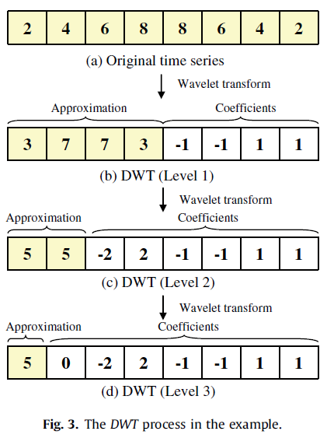


Discrete Wavelet Transformation
Approximation = $\frac{x+y}{2}$
Coefficients = $\frac{x−y}{2}$

Slide 8

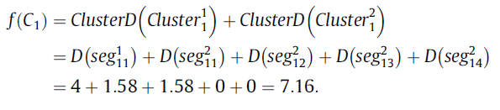
Fitness and selection

Slide 9
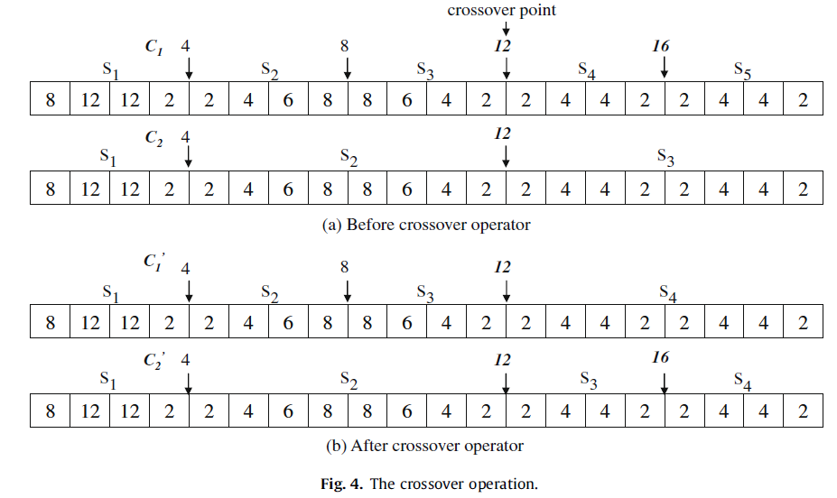
Genetic Operators

Slide 10
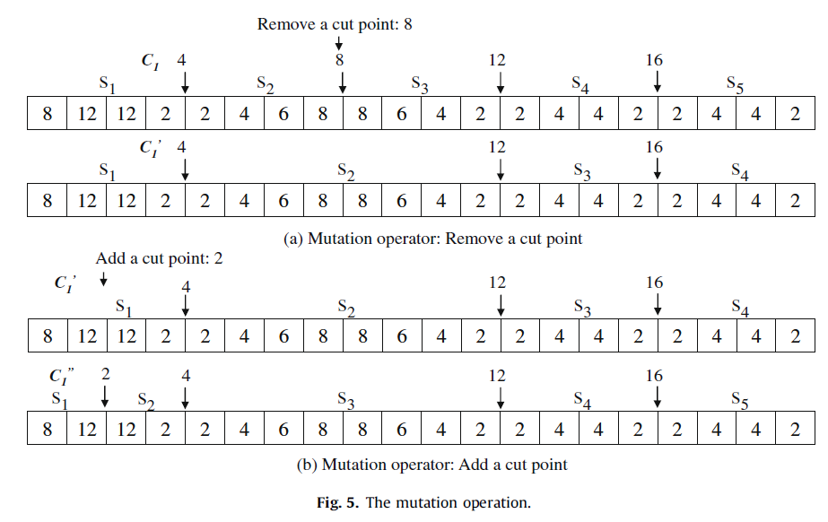
Genetic Operators

Slide 11
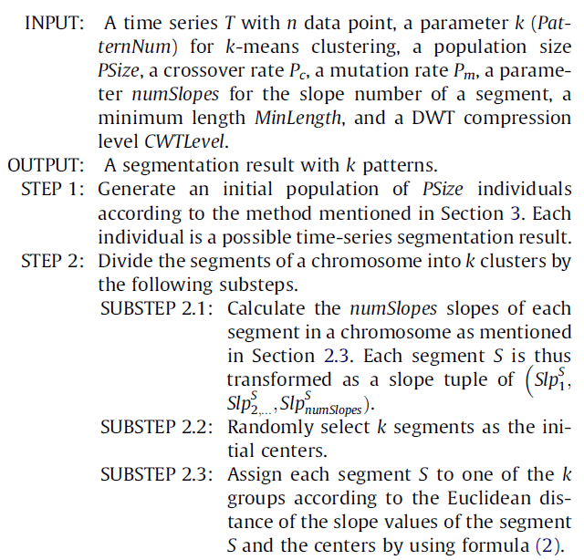
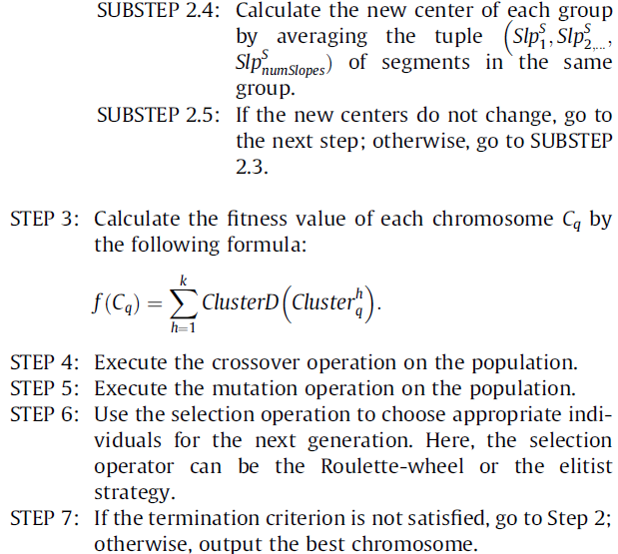
Time-series Segmentation Algorithm

Slide 12
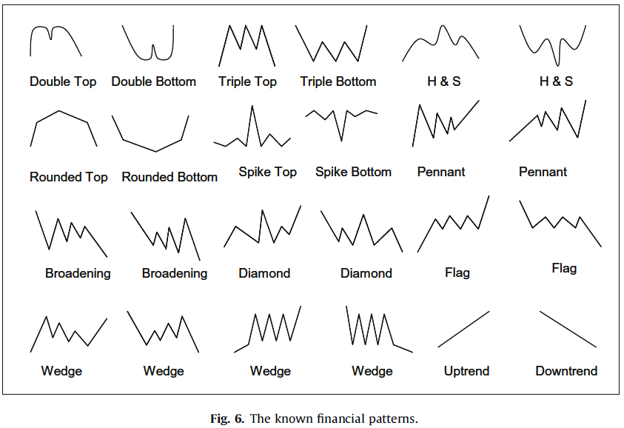
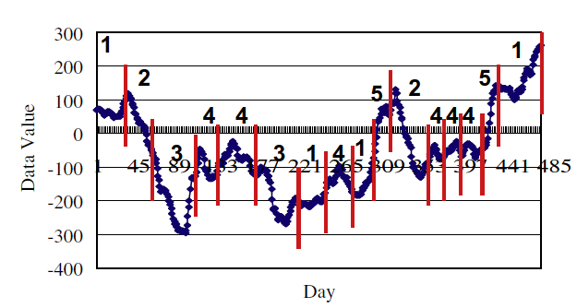
2 = Downtrend
3 = Spike Bottom
4 = Rounded top
5 = Uptrend

Slide 13
