Slide 1
Weakly Supervised Deep Detection Networks
Hakan Bilen, Andrea Vedalai
IEEE Conference on Computer Vision and Patter Recognization, 2016
Presenter: Wei-Hao Fu
Date: 2016/05/23

Slide 2
Abstract(1/3)
Weakly supervised learning of object detection is an important problem in image understanding that still does not have a satisfactory solution.
In this paper, we address this problem by exploiting the power of deep convolutional neural networks pre-trained on large-scale image-level classification tasks.

Slide 3
Abstract(2/3)
We propose a weakly supervised deep detection architecture that modifies one such network to operate at the level of image regions, performing simultaneously region selection and classification.
Trained as an image classifier, the architecture implicitly learns object detectors that are better than alternative weakly supervised detection systems on the PASCAL VOC data.

Slide 4
Abstract(3/3)
The model, which is a simple and elegant end-to-end architecture, outperforms standard data augmentation and fine-tuning techniques for the task of image-level classification as well.

Slide 5
Weakly Supervised Learning
Use a limited amount of labeled data
Q: How to choose the data?
A: Pre-trained CNN
Object detector emerge in deep scene CNNs(2015)

Slide 6
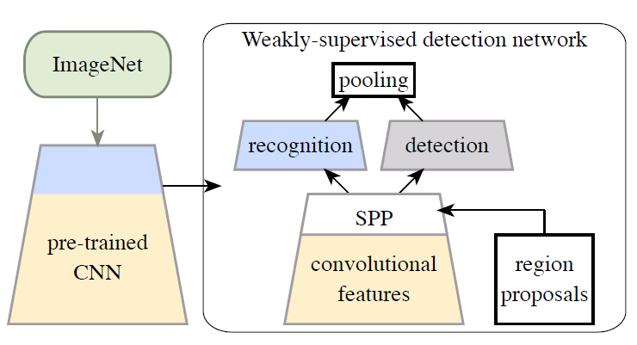
Idea
Weakly Supervised Deep Detection Networks
Pre-trained CNN
ImageNet Classification with Deep Convolutional Neural Networks(2012)

Slide 7
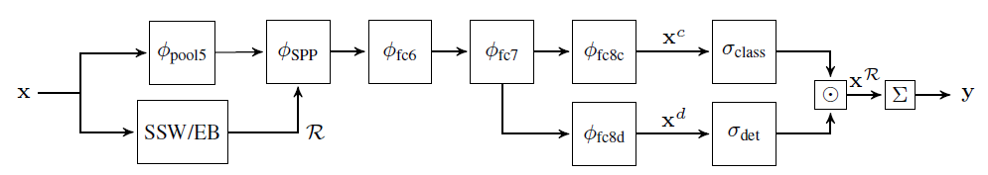

Method(1/3)
Region-level descriptors: $φ\left(x; R\right)$
$φ\left(x;R\right)=φ_{spp}\left(．;R\right)。φ_{relu5}\left(x\right)$
Spatial pyramid pooling in deep convolutional networks for visual recognition(2014)
Selective Search Window(SSW) and Edge Boxes(EB) obtained a shortlist of candidate regions.

Slide 8

Method(2/3)
Two data streams
Recognition: ${[σ}_{class}(x^{c})]_{ij}=\frac{e^{x_{ij}^{c}}}{\sum_{k=1}^{C}{e^{x_{kj}^{c}}}}$
Detection:${ [σ}_{det}\left(x^{d}\right)]_{ij}=\frac{e^{x_{ij}^{d}}}{\sum_{k=1}^{|R|}{e^{x_{kj}^{d}}}}$
${\text{ℝ}}^{C∗|R|}$

Slide 9
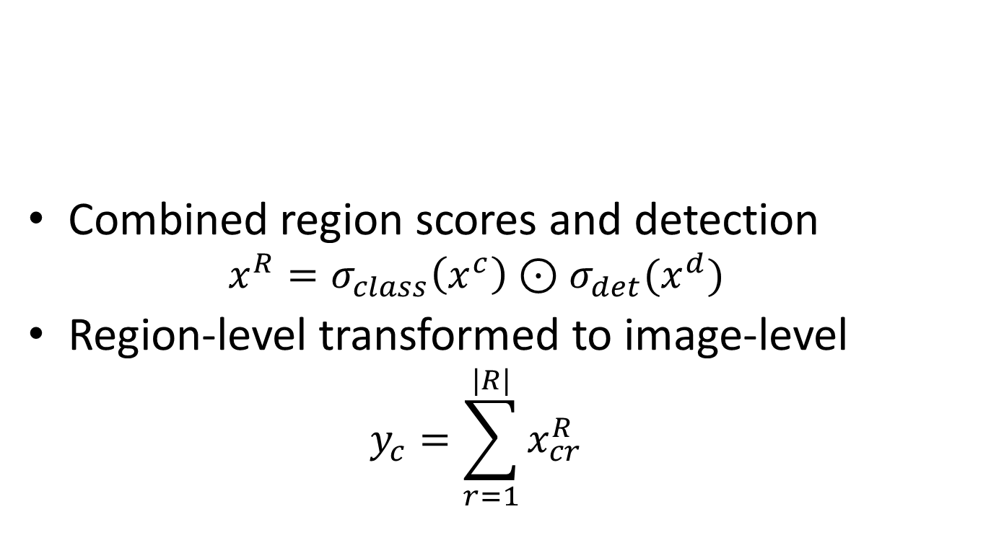
Method(3/3)
Combined region scores and detection
$$x^{R}=σ_{class}\left(x^{c}\right)⊙σ_{det}(x^{d})$$
Region-level transformed to image-level
$$y_{c}=\sum_{r=1}^{|R|}{x_{cr}^{R}}$$

Slide 10
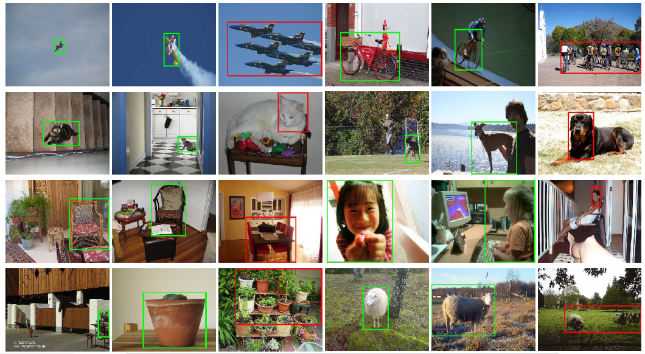
Experiment result

