Slide 1
Mixed dissimilarity measure for piecewise linear approximation based time series applications
Zoltan Banko , Janos Abonyi
Expert Systems with Applications 42 (2015) 7664–7675
Presenter: Shu-Kai Hung

Slide 2
Abstract(1/3)
In recent years, expert systems built around time series-based methods have been enthusiastically adopted in engineering applications, thanks to their ease of use and effectiveness. This effectiveness depends on how precisely the raw data can be approximated and how precisely these approximations can be compared. When performance of a time series-based system needs to be improved, it is desirable to consider other time series representations and comparison methods. The approximation, however, is often generated by a non-replaceable element and eventually the only way to find a more advanced comparisonmethod is either by creating a new dissimilarity measure or by improving the existing one further.

Slide 3
Abstract(2/3)
In this paper, it is shown how a mixture of different comparison methods can be utilized to improve the effectiveness of a system without modifying the time series representation itself. For this purpose, a novel, mixed comparison method is presented for the widely used piecewise linear approximation (PLA),called mixed dissimilarity measure for PLA (MDPLA). It combines one of the most popular dissimilarity measure that utilizes the means of PLA segment

Slide 4
Abstract(3/3)
On the basis of empirical studies three advantages of such combined dissimilarity measures are presented. First, it is shown that the mixture ensures that MDPLA outperforms the most popular dissimilarity measures created for PLA segments. Moreover, in many cases, MDPLA provides results that makes the application of dynamic time warping (DTW) unnecessary, yielding improvement not only in accuracy but also in speed. Finally, it is demonstrated that a mixed measure, such as MDPLA, shortens the warping path of DTW and thus helps to avoid pathological warpings, i.e. the unwanted alignments of DTW. This way, DTW can be applied without penalizing or constraining the warping path itself while the chance of the unwanted alignments are significantly lowered.

Slide 5
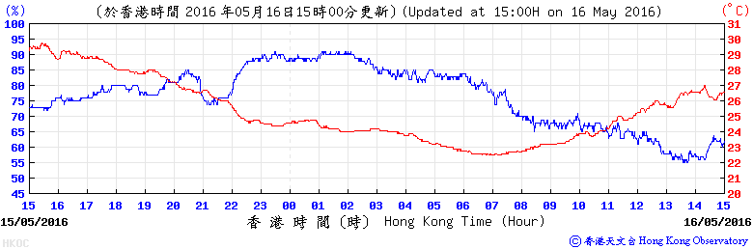
Theoretical background-Time series classification
Time series : A time series is a sequence of data points, measured typically at successive times spaced at uniform time intervals.
Classification : 要以某個 algorithm 把不同的time series 作分類

Slide 6
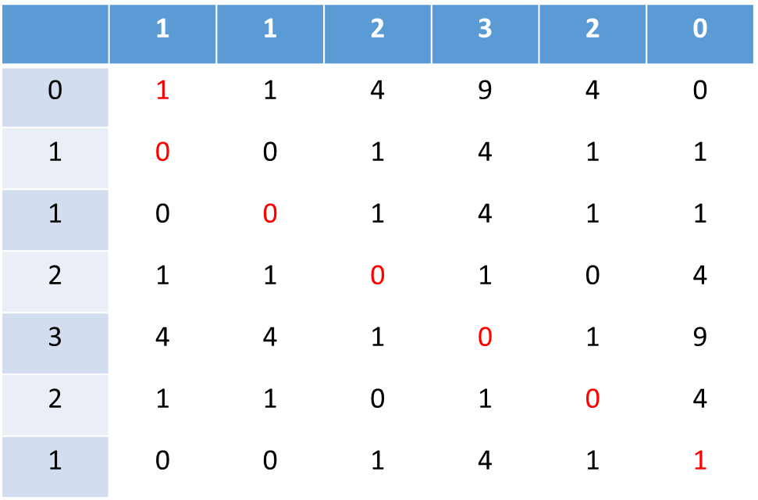
dynamic time warping(DTW)
Two times series:
X = (1,1,2,3,2,0)
Y = (0,1,1,2,3,2,1)

Slide 7

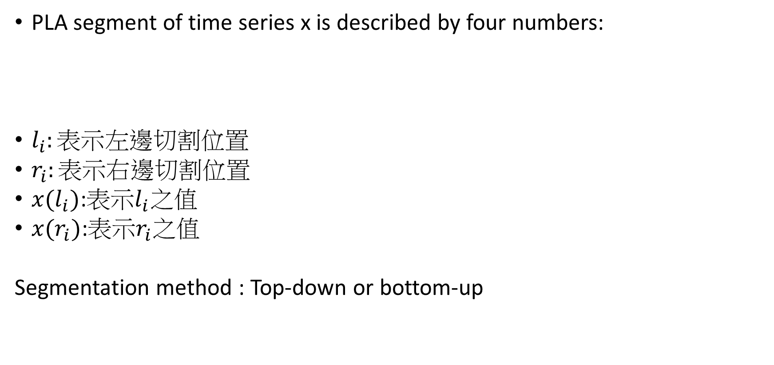
Piecewise linear approximation
PLA segment of time series x is described by four numbers:
$l_{i}:表示$左邊切割位置
$r_{i}:表示右$邊切割位置
$x(l_{i})$:表示$l_{i}$之值
$x(r_{i})$:表示$r_{i}$之值
Segmentation method : Top-down or bottom-up

Slide 8
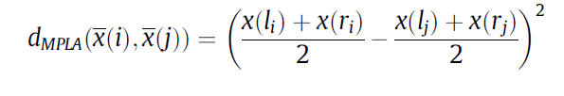
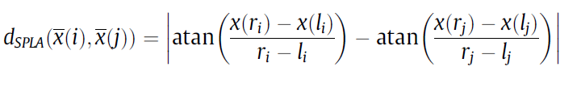

MPLA(means of Piecewise linear approximation)
generalized dissimilarity measure between two PLA segments $\overline{x}(i)$ and $\overline{x}(j)$ for DTW by comparing the means of segments:
SPLA(slope-based of Piecewise linear approximation)
y = mx +c

Slide 9
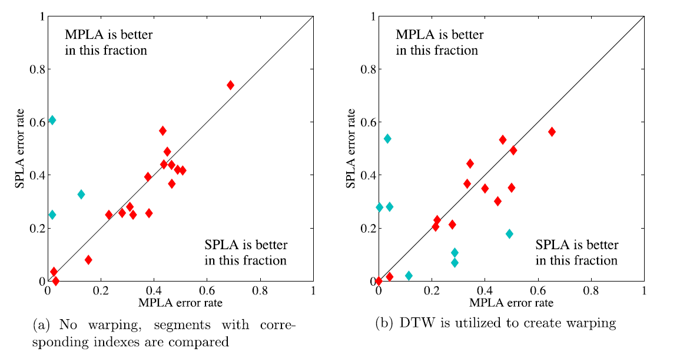
Using 1-NN classification

Slide 10

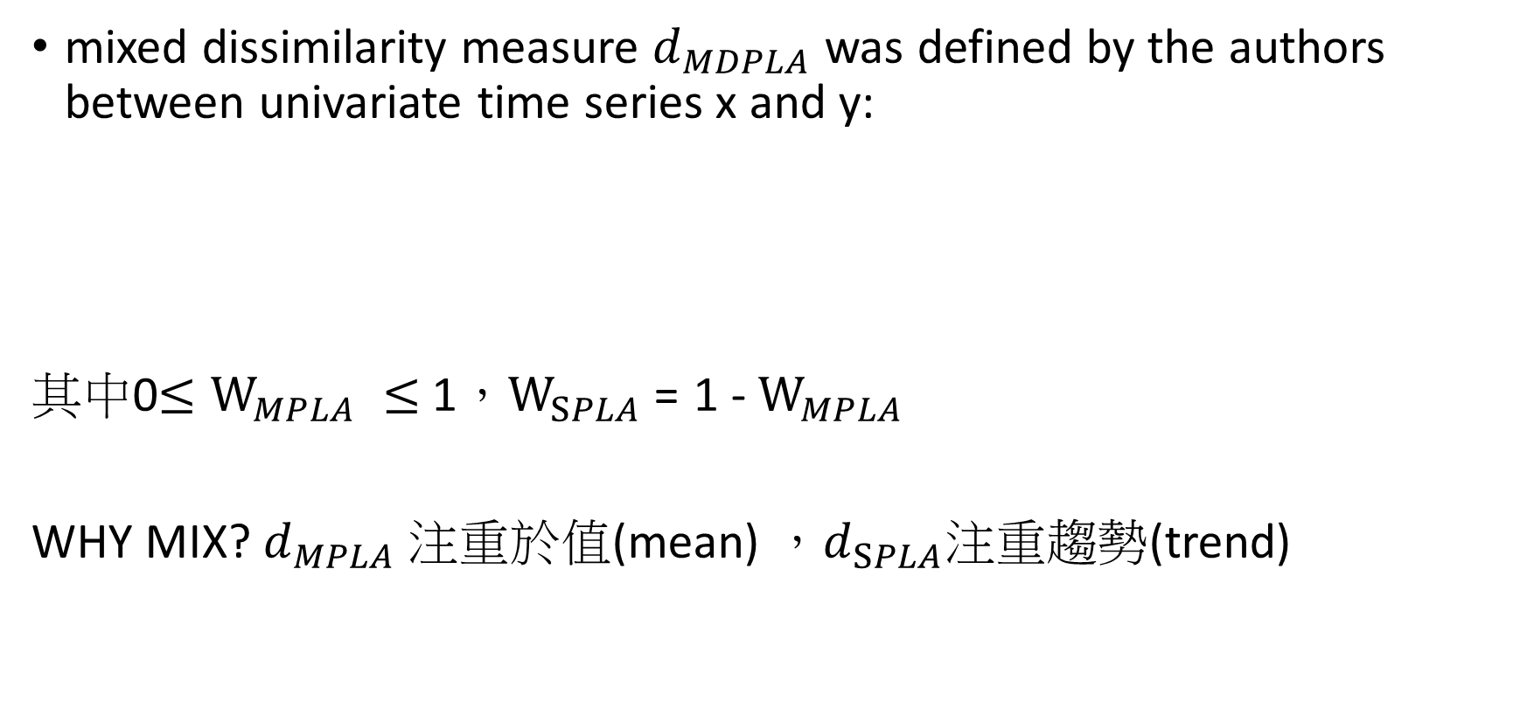
MDPLA (Mixed dissimilarity measure for piecewise linear approximation)
mixed dissimilarity measure $d_{MDPLA}$ was defined by the authors between univariate time series x and y:
其中0$≤W_{MPLA} ≤$1，$W_{SPLA}$= 1 - $W_{MPLA}$
WHY MIX? $d_{MPLA} 注重於$值(mean) ，$d_{SPLA}注重趨勢$(trend)

Slide 11
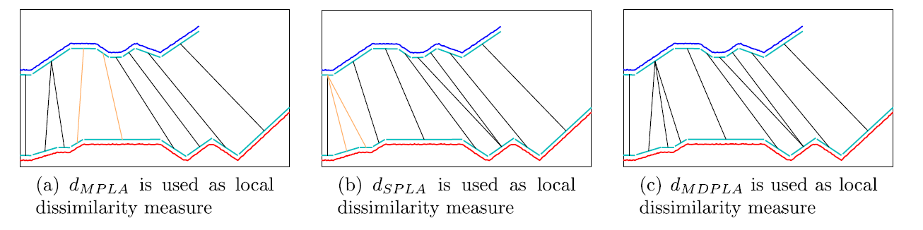
Validation results
Segmentation
Alignment:算出DTW的TABLE(MPLA,SPLA,MDPLA)

Slide 12
SAX(symbolic aggregate approximation)
Allows a time series of arbitrary length n to be reduced to a string of arbitrary length w (w<<n)
Step 1: Reduce dimension by PAA
example:

Slide 13
Step 2: Discretization (Words: 8 Alphabet: 3)
Determine breakpoints that will produce a equal-sized areas under Gaussian curve(常態分布).
c
c
c
b
b
b
a
a
-
-
0
0
20
40
60
80
100
120

Slide 14
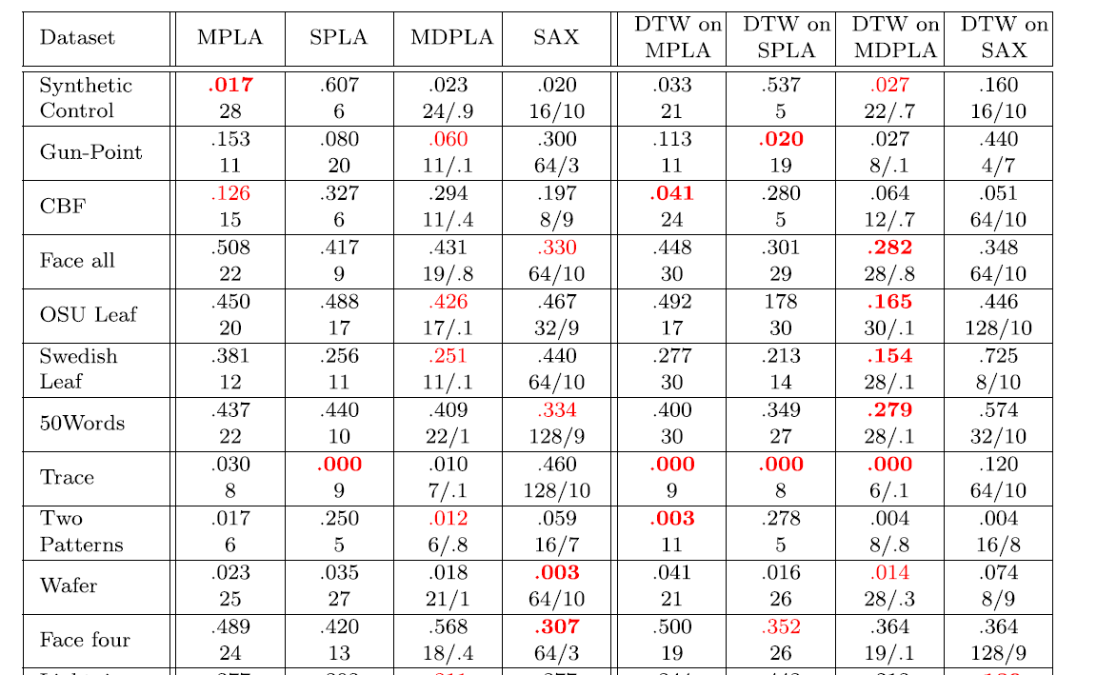

Slide 15
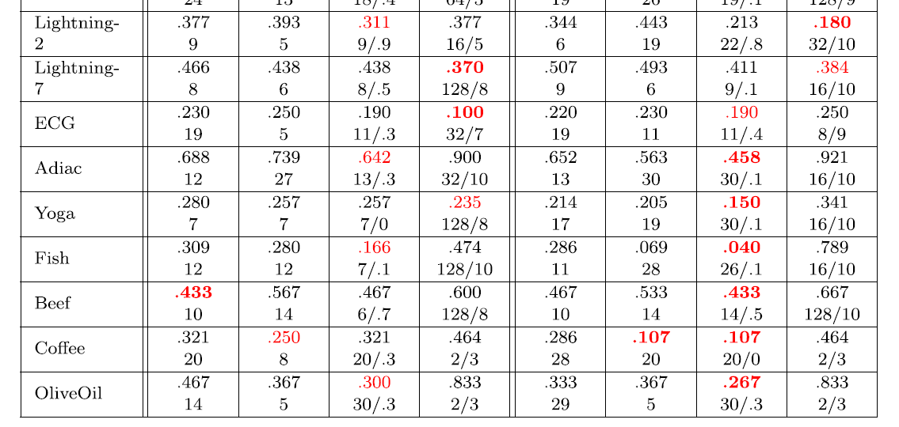
MPLA : 3 SPLA : 2 MDPLA : 8 SAX : 7 MPLA : 3 SPLA : 4 MDPLA : 14 SAX :2 (warping)

