Slide 1
Suffix Tree Clustering –
Data maining algorithm
Milos Ilic, Petar Spalevic, Mladen Veinovic
ERK'2014, Portorož, B:15-18
  Presenter：Jyun-Hao Lai
  Date：2016 / 05 / 23

Slide 2
Abstract
Data Mining as a process of finding new, useful knowledge from data using different techniques. Using these techniques we getting faster and better search of large amounts of data that we facing every day.Clustering of data is one of the techniques that are used in data mining. Authors explore clustering algorithms and take suffix tree clustering algorithm for the best of them. Authors create an application that use this algorithm in the process of clustering, and search of clustered documents.

Slide 3
Suffix Tree
S = xabxa$
xabxa$ | S1
abxa$ | S2
bxa$ | S3
xa$ | S4
a$ | S5
$ | S6
xa
bxa$
a
bxa$
1
$
$
3
bxa$
4
$
6
2
5

Slide 4
Clustering
簡單的說就是把相似的東西分到同一組。
和Classification(分類)不一樣的是，對於一個分類器(Classifier)通常你要告訴他這個東西被分到某一類的例子。
而Clustering並不關心是甚麼類別，目標是只要把相似的東西歸在一起就好了，因此一個分群的演算法，只要知道如何計算兩兩之間的相似度就可以開始工作了。

Slide 5
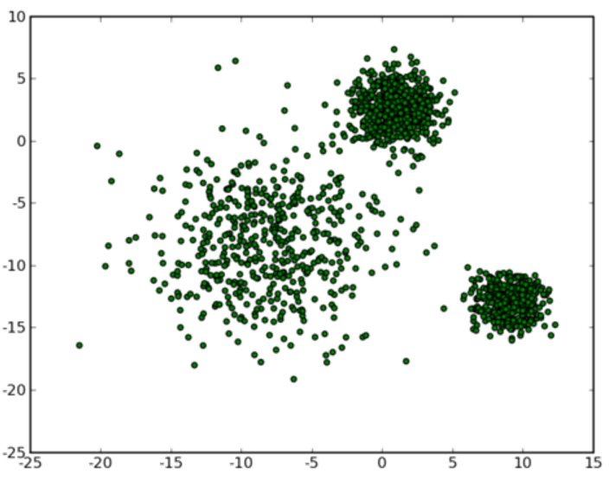
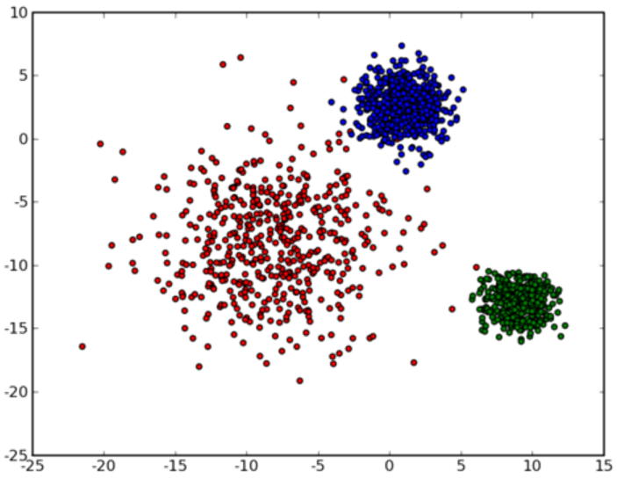
Clustering
舉例來說，現在有一群小學生，你要把他們分組，組內之間盡量相似一些，且組之間的差別則大一些，最後分出怎麼樣的結果，就取決於你對相似的定義了。

Slide 6
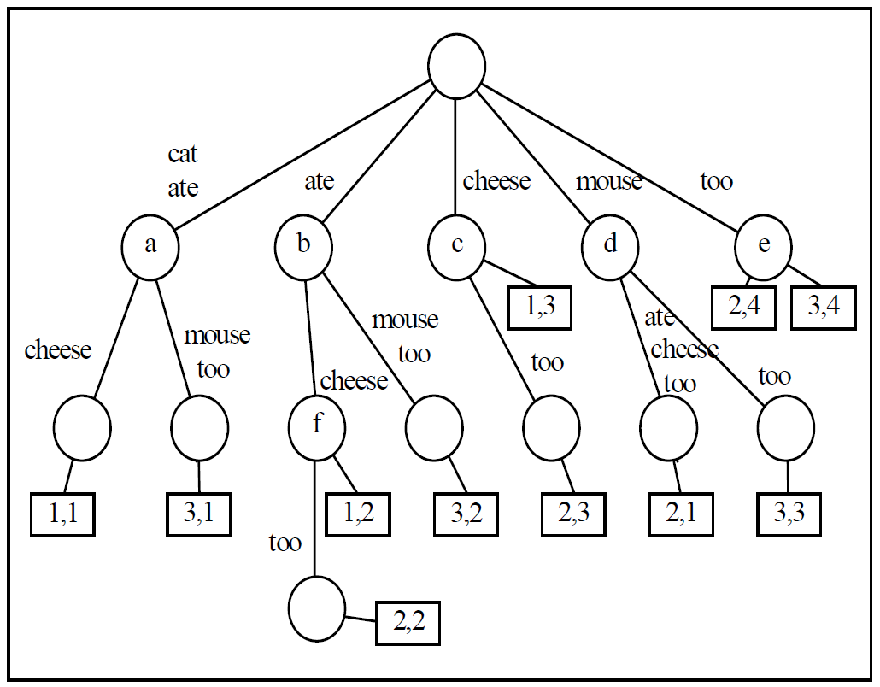

Suffix Tree Clustering
“cat ate cheese “
“ mouse ate cheese too “
“ cat ate mouse too “

Slide 7
假設有三個文件，分別是D1 = “貓吃魚”，D2 = “老鼠吃魚肉”，D3 = “貓吃老鼠肉”
root
貓吃
肉
吃
老鼠
魚
老
鼠
肉
老
鼠
肉
魚
肉
吃
魚
肉
肉
2, 5
3, 5
1, 3
肉
1, 1
1, 2
3, 2
3, 1
2, 4
2, 1
3, 3
2, 3

Slide 8
Suffix Tree Clustering
Combining base clusters into clusters.
Node | Phrase | Documents
a | cat ate | 1, 3
b | ate | 1, 2, 3
c | cheese | 1, 2
d | mouse | 2, 3
e | too | 2, 3
f | ate cheese | 1, 2

Slide 9
Combining Base Clusters
Define a binary similarity measure to calculate whether base clusters should be merged or not.
The binary similarity will be 1 iff：
|B_{m}∩B_{n}| / | B_{m} | > 0.5 and
|B_{m}∩B_{n}| / | B_{n} | > 0.5
Otherwise, their similarity is defined to be 0.

Slide 10
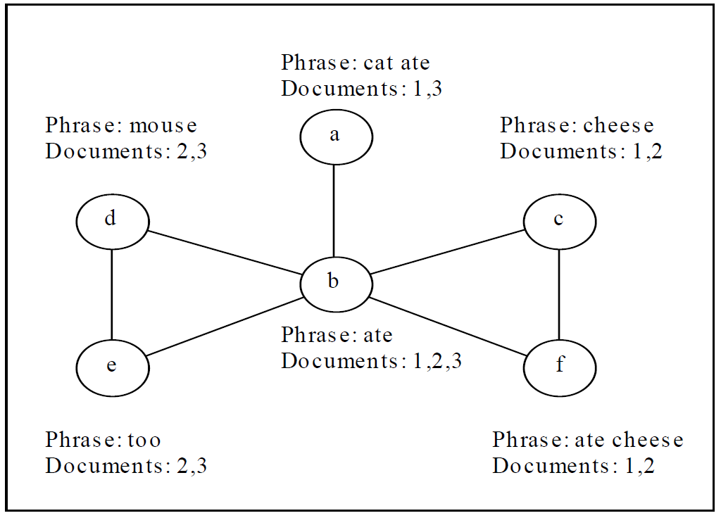
Cluster Graph
This figure explains the base cluster graph of the six base clusters.

