Slide 1
SOAP: short oligonucleotide alignment program
Ruiqiang Li, Yingrui Li, Karsten Kristiansen and Jun Wang
Beijing Genomics Institute at Shenzhen
BIOINFORMATICS Vol. 24 no. 5 2008, pages 713–714
Presenter: Chong-Xuan Lo
Date:2016/5/23

Slide 2
Abstract
We have developed a program SOAP for efficient gapped and ungapped alignment of short oligonucleotides onto reference sequences. The program is designed to handle the huge amounts of short reads generated by parallel sequencing using the new generation Illumina-Solexa sequencing technology. SOAP is compatible with numerous applications, including single-read or pair-end resequencing, small RNA discovery and mRNA tag sequence mapping. SOAP is a command-driven program, which supports multi-threaded parallel computing, and has a batch module for multiple query sets.

Slide 3
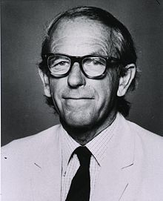
傳統:DNA sequencing( DNA定序)
Sanger sequencing: Chain termination (雙脫氧鏈終止法)
在1958年及1980年兩度獲得諾貝爾化學獎，
是第四位兩度獲得諾貝爾獎，以及唯一獲得
兩次諾貝爾化學獎的人。
弗雷德里克·桑格

Slide 4
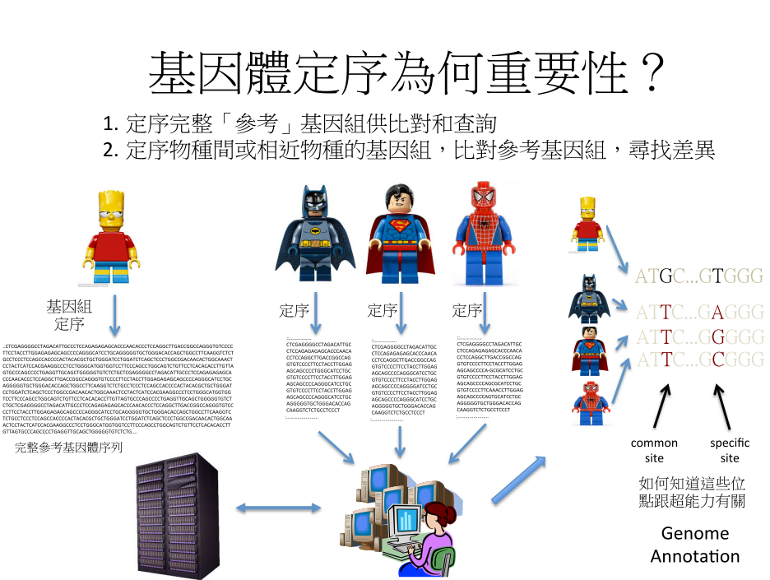

Slide 5
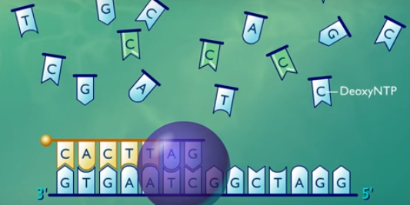
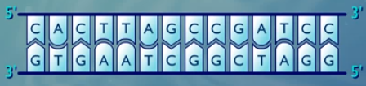
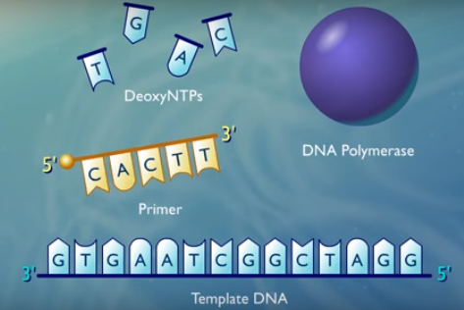
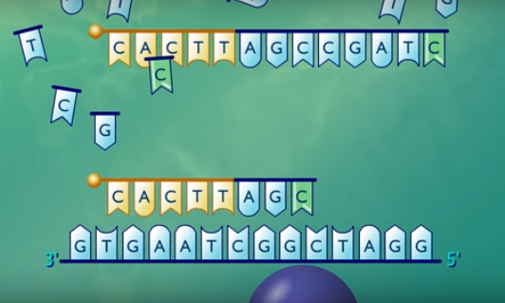
傳統:DNA sequencing( DNA定序)
主要是先進行DNA 合成，利用DNA引子和DNA聚合酶(PCR反應)使DNA鏈得以展開複製，再利用雙脫氧核苷酸(Dideoxy)來終止DNA鏈的合成。實驗會獲得不同長度的DNA片段

Slide 6
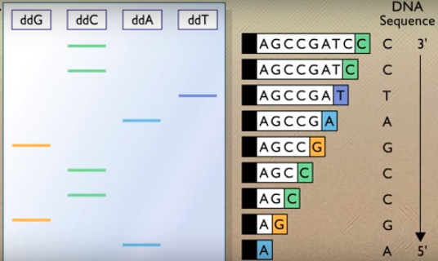
傳統:DNA sequencing( DNA定序)
將PCR反應獲得的總DNA通過毛細管電泳分離，跑到最末端的DNA就可以在雷射的作用下發出螢光。由於ddATP, ddGTP, ddCTP, ddTTP（4種雙脫氧核糖核苷酸）螢光標記不同。

Slide 7
次世代定序 (Next Generation Sequencing, NGS)
自動定序儀器: Illumina的Solexa、ABI的SOLiD與Roche的454 皆可稱為次世代定序儀

Slide 8
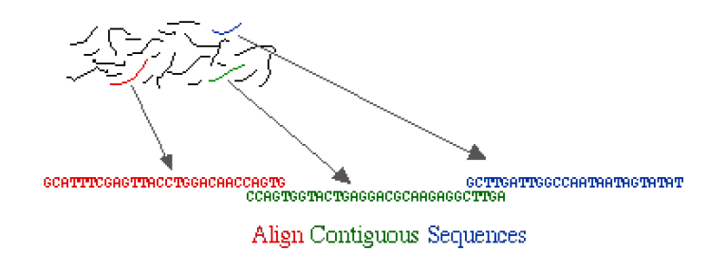
次世代定序 (Next Generation Sequencing, NGS)
目前沒有儀器和方法，可以一次重頭到尾定序整條染色體
定序長度(read lenth)：只能數十到數千鹼基(bp)
至今的定序方法­ ‐ 先定序產生許多的short read ，再利用有效率的演算法將這些read mapping起來
short read meaning short sequences of <~200 bp
(as compared to long reads by Sanger sequencing, which cover ~1000 bp)

Slide 9
Mapping Method
Hash Table(Lookup table)
– FAST, but requires perfect matches.
Dynamic Programming (Smith -Waterman)
– Indels.
– Mathematically optimal solution.
– Slow. (most programs use Hash Mapping as a preﬁlter)
Burrows-­‐Wheeler Transform (BW Transform)
– FAST. (without mismatch/gap)
– Memory eﬃcient.
– But for gaps/mismatches, it lacks sensitivity.

Slide 10

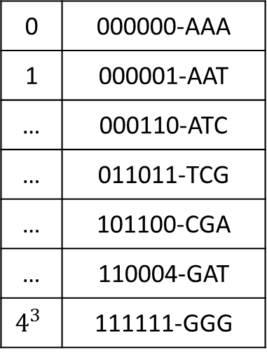
Soap
The program will load reference sequences into RAM, create hash tables for seed indexing.
Example: seed size=3
Reference sequence | A | T | C | G | A | T | C | G
position | 0 | 1 | 2 | 3 | 4 | 5 | 6 | 7
Hash table
A | 00
T | 01
C | 10
G | 11
AAA | 000000
AAT | 000001
AAC | 000010
AAG | 000011
… | …
Ф
$${=>4}^{3}種$$
0 | 000000-AAA
1 | 000001-AAT
… | 000110-ATC
… | 011011-TCG
… | 101100-CGA
… | 110004-GAT
$$4^{3}$$ | 111111-GGG
Ф
0 | 4
1 | 5
2
3
Ф

Slide 11
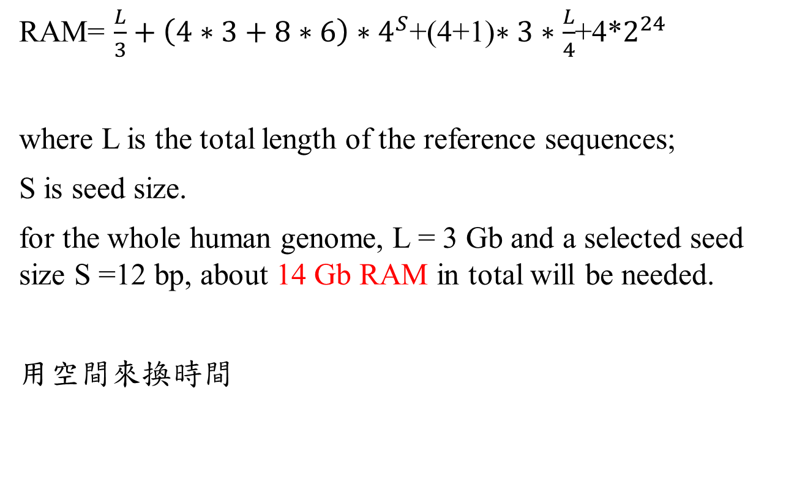
Soap
RAM= $\frac{L}{3}+\left(4∗3+8∗6\right)∗4^{S}$+(4+1)$∗3∗\frac{L}{4}$+4*$2^{24}$
where L is the total length of the reference sequences;
S is seed size.
for the whole human genome, L = 3 Gb and a selected seed size S =12 bp, about 14 Gb RAM in total will be needed.
用空間來換時間

Slide 12
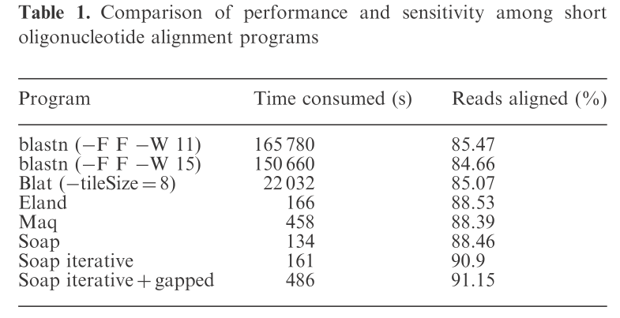
Soap
Soap iterative:
Reads always exhibit a much higher number of sequencing errors at the 3’-end

Slide 13
Ultrafast and memory-efficient alignment of short DNA sequences to the human genome
Ben Langmead, Cole Trapnell, Mihai Pop and Steven L Salzberg
Genome Biology 2009, 9, Volume 10, Issue 3, R25.1–R25.10
Presenter: Chong-Xuan Lo
Date:2016/5/23

Slide 14
Abstract
Bowtie is an ultrafast, memory-efficient alignment program for aligning short DNA sequence reads to large genomes. For the human genome, Burrows-Wheeler indexing allows Bowtie to align more than 25 million reads per CPU hour with a memory footprint of approximately 1.3 gigabytes. Bowtie extends previous Burrows-Wheeler techniques with a novel quality-aware backtracking algorithm that permits mismatches. Multiple processor cores can be used simultaneously to achieve even greater alignment speeds.

Slide 15
Exact string matching problem
Example:
Text=acaacg$
Pattern=aac
Solution:
T=acaacg$ T=acaacg$ T=acaacg$
aac aac aac
The brute force window sliding algorithm costs O(mn).

Slide 16
Burrows-Wheeler Transform(BWT)
T=acaacg$
SA
1 | a | c | a | a | c | g | $
2 | c | a | a | c | g | $ | a
3 | a | a | c | g | $ | a | c
4 | a | c | g | $ | a | c | a
5 | c | g | $ | a | c | a | a
6 | g | $ | a | c | a | a | c
7 | $ | a | c | a | a | c | g

Slide 17
Burrows-Wheeler Transform(BWT)
we lexicographically sort these rows to construct a BWT matrix:
Our BWT = “gc$aaac” is on the last column of the BWT matrix.
Construct and sort all suffix’s Time complexity : O(M)
row | SA
1 | 7 | $ | a | c | a | a | c | g
2 | 3 | a | a | c | g | $ | a | c
3 | 1 | a | c | a | a | c | g | $
4 | 4 | a | c | g | $ | a | c | a
5 | 2 | c | a | a | c | g | $ | a
6 | 5 | c | g | $ | a | c | a | a
7 | 6 | g | $ | a | c | a | a | c

Slide 18

Burrows-Wheeler Transform(BWT)
row | SA
1 | 7 | $ | a | c | a | a | c | g
2 | 3 | a | a | c | g | $ | a | c
3 | 1 | a | c | a | a | c | g | $
4 | 4 | a | c | g | $ | a | c | a
5 | 2 | c | a | a | c | g | $ | a
6 | 5 | c | g | $ | a | c | a | a
7 | 6 | g | $ | a | c | a | a | c
T=acaacg$
BWT= gc$aaac
We define $SA[i]$= (7, 3, 1, 4, 2, 5, 6).
$${BWT[i]}_{}=T[SA\left[i\right]−1]$$

Slide 19
Burrows-Wheeler Transform(BWT)
This matrix has a property called 'last first (LF) mapping'.
row | SA
1 | 7 | $ | a | c | a | a | c | g
2 | 3 | a | a | c | g | $ | a | c
3 | 1 | a | c | a | a | c | g | $
4 | 4 | a | c | g | $ | a | c | a
5 | 2 | c | a | a | c | g | $ | a
6 | 5 | c | g | $ | a | c | a | a
7 | 6 | g | $ | a | c | a | a | c
Consider row 2, BWT[2]=c.
Row 2 starts with “aa”.
This actually means that
there exists a suffix starting
with “caa” in row 5.

Slide 20
Burrows-Wheeler Transform(BWT)
For every pattern P, there are two corresponding
s(P),e(P) associated with this pattern P.
s and e denote starting and ending locations respectively.
row | SA
1 | 7 | $ | a | c | a | a | c | g
2 | 3 | a | a | c | g | $ | a | c
3 | 1 | a | c | a | a | c | g | $
4 | 4 | a | c | g | $ | a | c | a
5 | 2 | c | a | a | c | g | $ | a
6 | 5 | c | g | $ | a | c | a | a
7 | 6 | g | $ | a | c | a | a | c
P = a
s(“a”) = 2, e(“a”) = 4.
P = ca
s(“ca”) = 5, e(“ca”) = 5.
Thus, our job is to find the
s(P) and e(P) for a given
pattern.

Slide 21
Burrows-Wheeler Transform(BWT)
Apply the BWT’s ‘last first (LF) mapping’ property to exact string matching : backtracking
C(x): the number of characters in the text T that are lexicographically smaller than x.
Occ(i, x): the number of character x that occurs in BWT[1..i].
T=acaacg$
C($) = 0
C(a) = 1
C(c) = 4
C(g) = 6
 | 1 | 2 | 3 | 4 | 5 | 6 | 7
BWT= | g | c | $ | a | a | a | c
Occ(5,a)=2
Occ(7,a)=3
Occ(5,c)=1

Slide 22
Burrows-Wheeler Transform(BWT)
We can store C (x) and Occ(i,x) as matrixes in pre-processing time:
row | SA
1 | 7 | $ | a | c | a | a | c | g
2 | 3 | a | a | c | g | $ | a | c
3 | 1 | a | c | a | a | c | g | $
4 | 4 | a | c | g | $ | a | c | a
5 | 2 | c | a | a | c | g | $ | a
6 | 5 | c | g | $ | a | c | a | a
7 | 6 | g | $ | a | c | a | a | c
C (x)
$ | a | c | g
0 | 1 | 4 | 6
Occ(i,x)
 | $ | a | c | g
1 | 0 | 0 | 0 | 1
2 | 0 | 0 | 1 | 1
3 | 1 | 0 | 1 | 1
4 | 1 | 1 | 1 | 1
5 | 1 | 2 | 1 | 1
6 | 1 | 3 | 1 | 1
7 | 1 | 3 | 2 | 1
x
i
Occ(i, x) can be performed in constant time

Slide 23
Burrows-Wheeler Transform(BWT)
Given the range [s(Y), e(Y)] of a string Y, computing the range [s(xY), e(xY)] for the string xY for any character x can be done by the following formulas:
s(xY) = C(x) + Occ(s(Y)-1,x) + 1
e(xY) = C(x) + Occ(e(Y), x)
s(xY) ≤ e(xY) if and only if “xY” is a substring of T
Proved by Ferragina,P. and Manzini,G. (2000) Opportunistic data structures with applications.

Slide 24
Burrows-Wheeler Transform(BWT)
s(xY) = C(x) + Occ(s(Y)-1,x) + 1
e(xY) = C(x) + Occ(e(Y), x)
T=acaacg$
P=ac
Initially, s(Nil)=1, e(Nil) = 7.
We start with x=‘c’ and Y = Nil.
C(c)=4,
Occ(s(Nil)-1,c)=0,
Occ(e(Nil) ,c)=2.
s(c)=4+0+1=5, e(c) = 4+2=6.
row | SA
1 | 7 | $ | a | c | a | a | c | g
2 | 3 | a | a | c | g | $ | a | c
3 | 1 | a | c | a | a | c | g | $
4 | 4 | a | c | g | $ | a | c | a
5 | 2 | c | a | a | c | g | $ | a
6 | 5 | c | g | $ | a | c | a | a
7 | 6 | g | $ | a | c | a | a | c

Slide 25
Burrows-Wheeler Transform(BWT)
s(xY) = C(x) + Occ(s(Y)-1,x) + 1
e(xY) = C(x) + Occ(e(Y), x)
T=acaacg$
P=ac
Next, s(c)=5, e(c) = 6.
We start with x=‘a’ and Y = ‘ c’.
C(a)=1,
Occ(s(c)-1,a)=1,
Occ(e(c),a)=3.
s(ac)=1+1+1=3, e(ac) = 1+3=4.
Occ(i, x) can be performed in constant time, so count can complete in linear time in the length of the pattern: O(p) time.
row | SA
1 | 7 | $ | a | c | a | a | c | g
2 | 3 | a | a | c | g | $ | a | c
3 | 1 | a | c | a | a | c | g | $
4 | 4 | a | c | g | $ | a | c | a
5 | 2 | c | a | a | c | g | $ | a
6 | 5 | c | g | $ | a | c | a | a
7 | 6 | g | $ | a | c | a | a | c

Slide 26
Burrows-Wheeler Transform(BWT)
s(xY) = C(x) + Occ(s(Y)-1,x) + 1
e(xY) = C(x) + Occ(e(Y), x)
T=acaacg$
P=gac
Next, s(ac)=3, e(ac) = 4.
We start with x=‘g’ and Y =‘ ac’.
C(g)=6,
Occ(s(ac)-1,g)=1,
Occ(e(ac),g)=1.
s(gac)=6+1+1=8, e(gac) = 6+1=7.
s(gac)>e(gac),so ‘gac’does not exist in text T.
row | SA
1 | 7 | $ | a | c | a | a | c | g
2 | 3 | a | a | c | g | $ | a | c
3 | 1 | a | c | a | a | c | g | $
4 | 4 | a | c | g | $ | a | c | a
5 | 2 | c | a | a | c | g | $ | a
6 | 5 | c | g | $ | a | c | a | a
7 | 6 | g | $ | a | c | a | a | c

Slide 27
Bowtie
EXACTMATCH is insufficient for short read alignment
because alignments may contain mismatches, which may be
due to sequencing errors, genuine differences between refer-
ence and query organisms, or both.

Slide 28
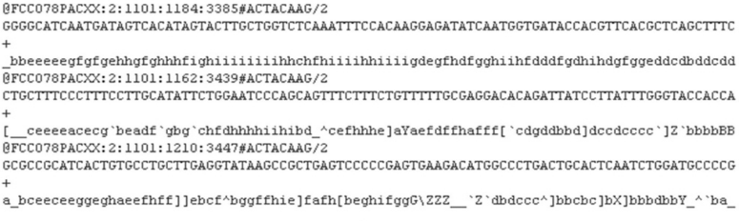
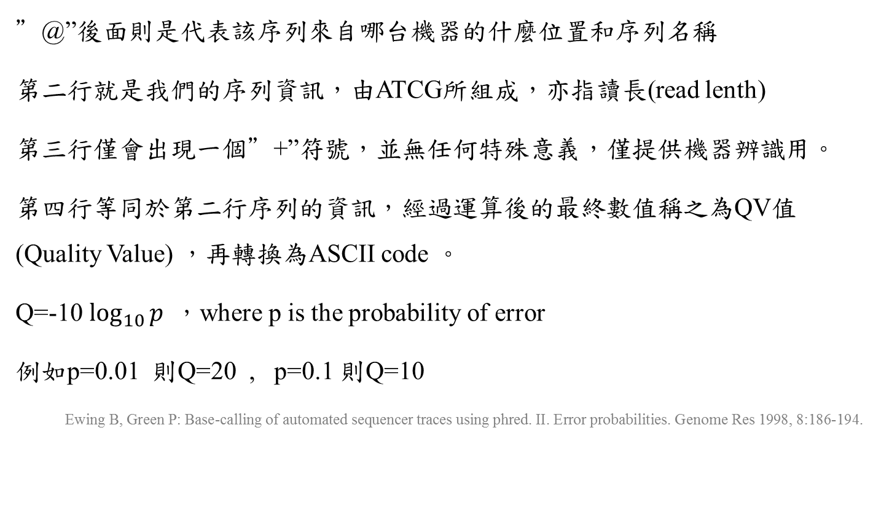
FASTQ
”@”後面則是代表該序列來自哪台機器的什麼位置和序列名稱
第二行就是我們的序列資訊，由ATCG所組成，亦指讀長(read lenth)
第三行僅會出現一個”+”符號，並無任何特殊意義，僅提供機器辨識用。
第四行等同於第二行序列的資訊，經過運算後的最終數值稱之為QV值(Quality Value) ，再轉換為ASCII code 。
Q=-10 $\log_{10}{p} ，$where p is the probability of error
例如p=0.01 則Q=20 , p=0.1 則Q=10
Ewing B, Green P: Base-calling of automated sequencer traces using phred. II. Error probabilities. Genome Res 1998, 8:186-194.

Slide 29
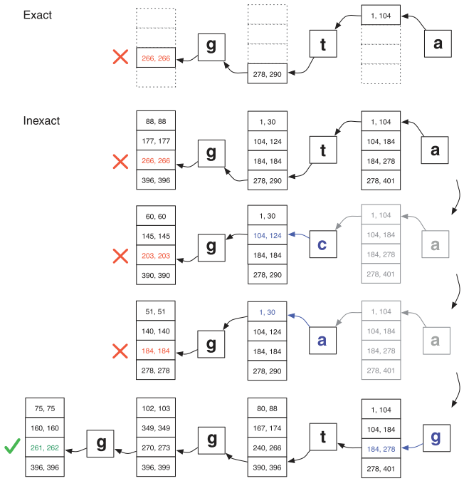
there is no exact match
for query 'ggta' but there
is a one-mismatch alignment
when 'a' is replaced by 'g'.

Slide 30
Excessive backtracking
Double indexing:
1. containing the BWT of the genome, called the 'forward' index,
2. containing the BWT of the genome with its character sequence reversed called the 'mirror' index.

Slide 31
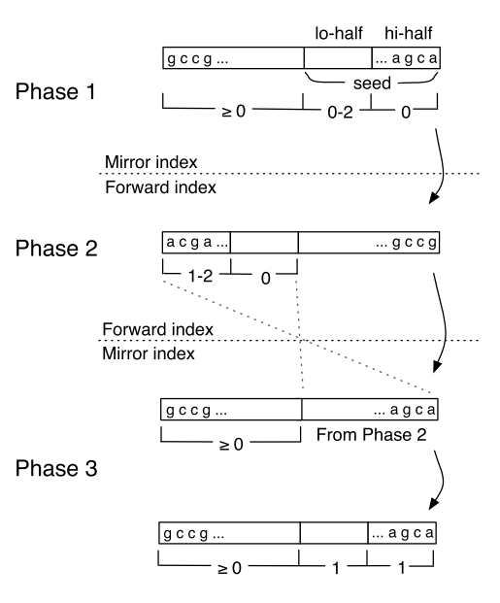
Excessive backtracking
In our experiments, we have observed that excessive backtracking is significant only when a read has many low-quality positions and does not align or aligns poorly to the reference sequence.
We mitigate this cost by enforcing a limit on the number of backtracks

Slide 32
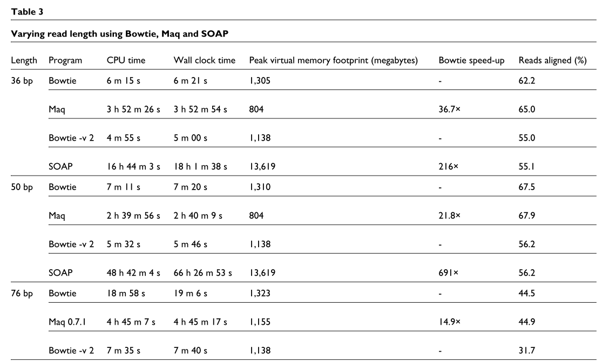

Slide 33
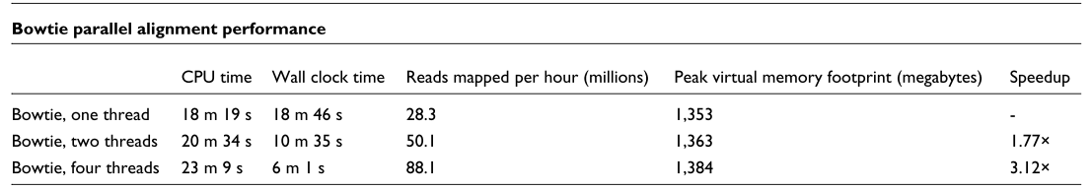

Slide 34
Fast and accurate short read alignment with Burrows–Wheeler transform
Heng Li and Richard Durbin
BIOINFORMATICS, Vol. 25 no. 14 2009, pages 1754–1760
Presenter: Chong-Xuan Lo
Date:2016/5/23

Slide 35
Abstract
We implemented Burrows-Wheeler Alignment tool (BWA), a new read alignment package that is based on backward search with Burrows–Wheeler Transform (BWT), to efﬁciently align short sequencing reads against a large reference sequence such as the human genome, allowing mismatches and gaps. BWA supports both base space reads, e.g. from Illumina sequencing machines, and color space reads from AB SOLiD machines. Evaluations on both simulated and real data suggest that BWA is ∼ 10–20 × faster than MAQ, while achieving similar accuracy. In addition, BWA outputs alignment in the new standard SAM (Sequence Alignment/Map) format. Variant calling and other downstream analyses after the alignment can be achieved with the open source SAMtools software package.

Slide 36
BWA
Bowtie講求速度快，但結果不一定準確。
而BWA的概念(BWT)跟Bowtie大致相同，但他會輸出各種比對的情形，結果比較準確。

Slide 37
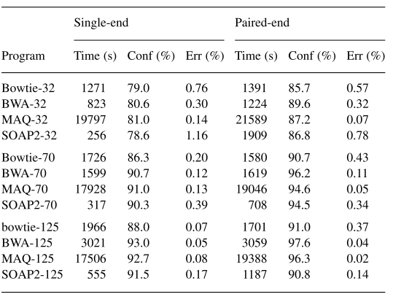
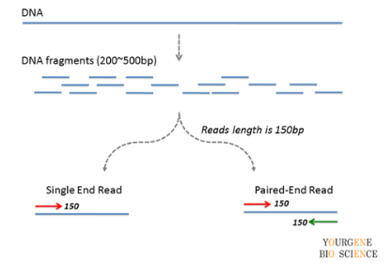
BWA
Single-end:只讀取DNA片段
的一端。
Paired-end:讀取兩端

Slide 38
Thank you

