Slide 1
Some APX-completeness results for cubic graphs
Paola Alimonti
Viggo Kann
Theoretical Computer Science, Vol.237, pp.123-134 (2000)
Presenter: Shiou-Zong Chiou
Date:2016/06/07

Slide 2
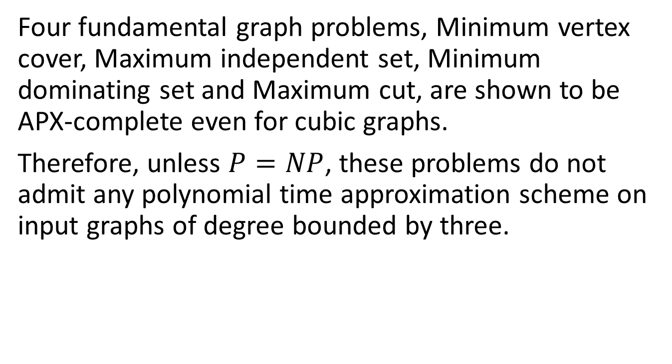
Abstract
Four fundamental graph problems, Minimum vertex cover, Maximum independent set, Minimum dominating set and Maximum cut, are shown to be APX-complete even for cubic graphs.
Therefore, unless $P=NP$, these problems do not admit any polynomial time approximation scheme on input graphs of degree bounded by three.

Slide 3
APX problem
APX is the set of NP optimization problems that allow polynomial-time approximation algorithms with approximation ratio bounded by a constant.

Slide 4
APX-complete problem
A problem is said to be APX-hard if there is a PTAS reduction from every problem in APX to that problem, and to be APX-complete if the problem is APX-hard and also in APX.

Slide 5

L-reduction
${OPT}_{G}(F(x))≤α×{OPT}_{F}(x)$
$\left|{OPT}_{F}\left(x\right)−c_{1}\right|≤β×\left|{OPT}_{G}\left(F\left(x\right)\right)−c_{2}\right|$

Slide 6
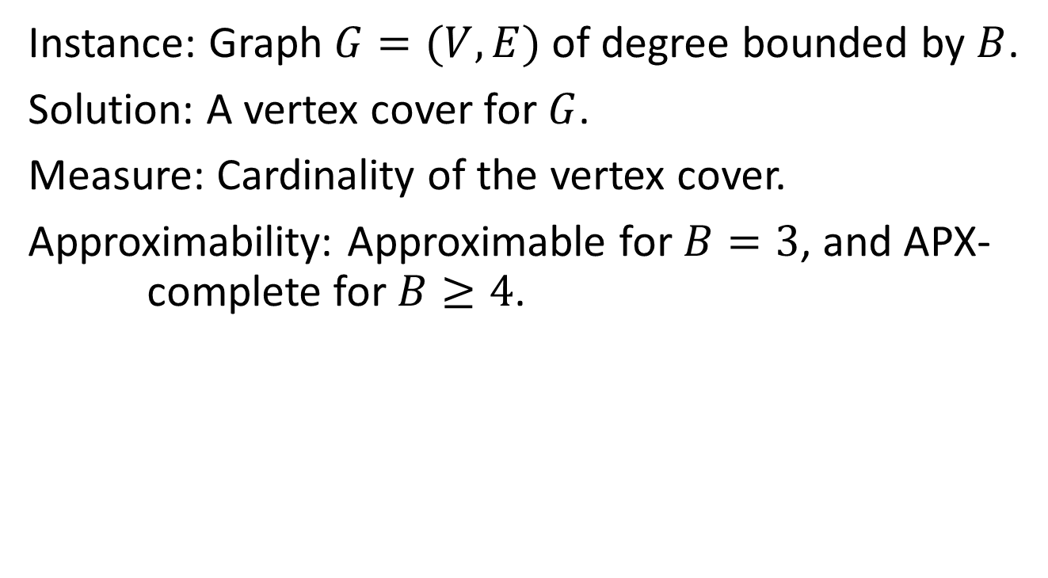
MIN VERTEX COVER-B
Instance: Graph $G=(V,E)$ of degree bounded by $B$.
Solution: A vertex cover for $G$.
Measure: Cardinality of the vertex cover.
Approximability: Approximable for $B=3$, and APX- complete for $B≥4$.

Slide 7
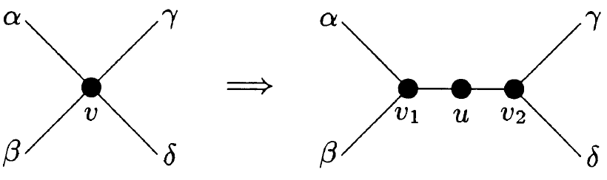
MIN VERTEX COVER-3
L-reduction from MIN VERTEX COVER-4 to MIN VERTEX COVER-3.

Slide 8
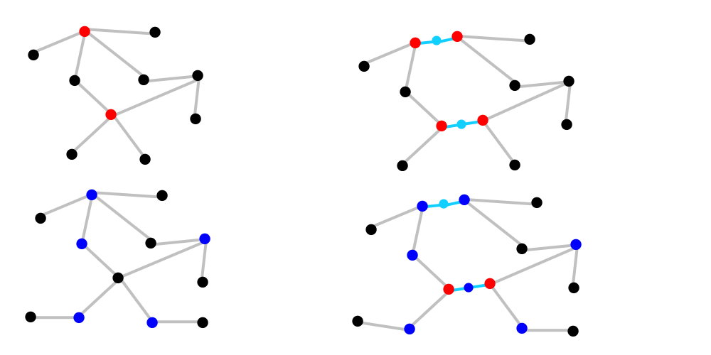
MIN VERTEX COVER-3

Slide 9

MIN VERTEX COVER-3
$$s≤|V|≤|E|≤\sum_{v∈C}{d\left(v\right)}≤4|C|$$
$$\left|C^{′}\right|=\left|C\right|+s≤5\left|C\right|$$
$$\left|C\right|≤\left|C^{′}\right|−s$$

Slide 10
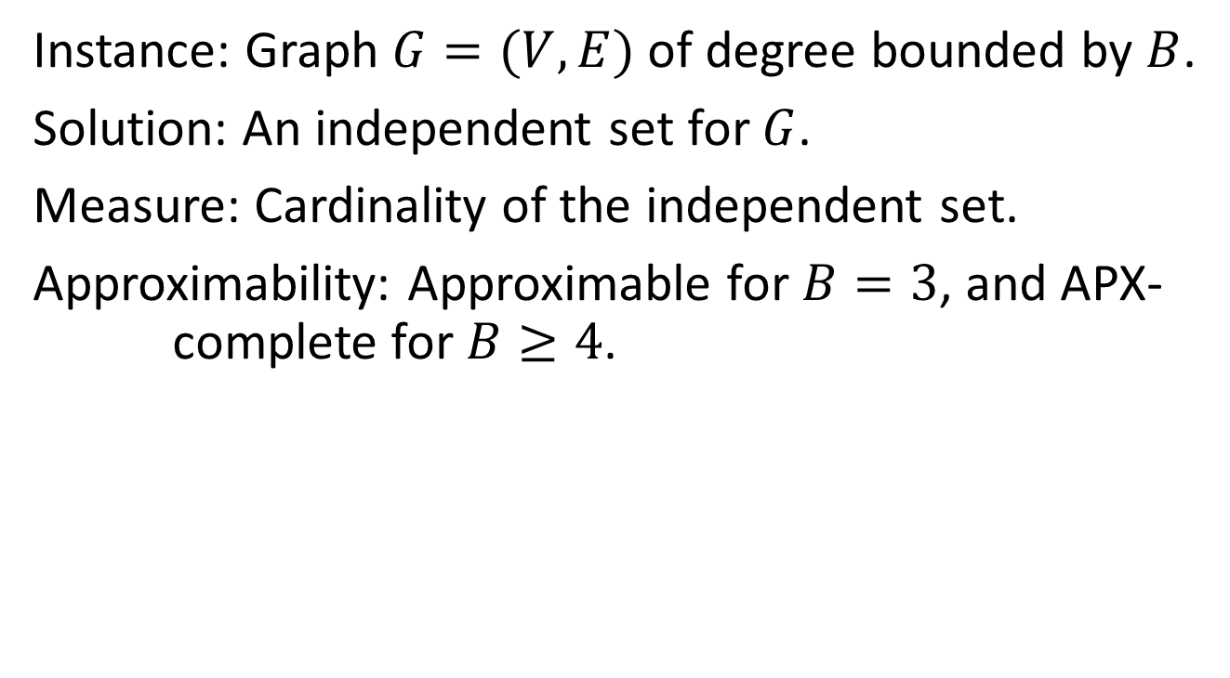
MAX IND SET-B
Instance: Graph $G=(V,E)$ of degree bounded by $B$.
Solution: An independent set for $G$.
Measure: Cardinality of the independent set.
Approximability: Approximable for $B=3$, and APX- complete for $B≥4$.

Slide 11
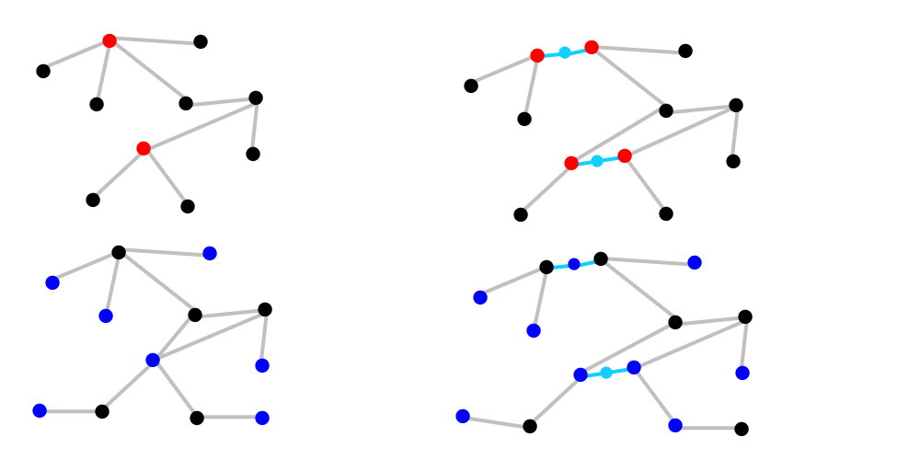
MAX IND SET-3

Slide 12
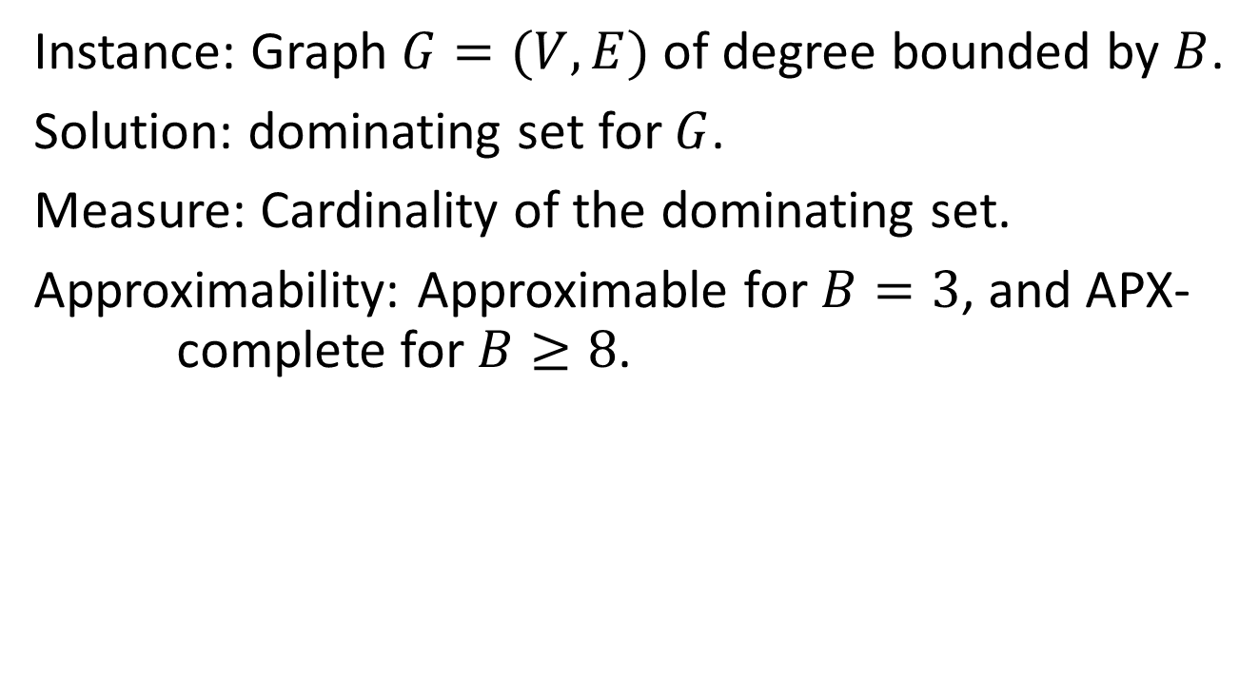
MIN DOM SET-B
Instance: Graph $G=(V,E)$ of degree bounded by $B$.
Solution: dominating set for $G$.
Measure: Cardinality of the dominating set.
Approximability: Approximable for $B=3$, and APX- complete for $B≥8$.

Slide 13
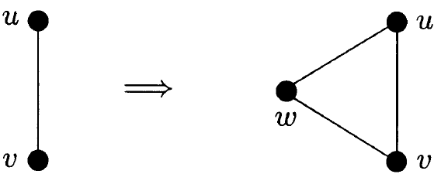
MIN DOM SET-3
L-reduction from MIN VERTEX COVER-3 MIN DOM SET-6, and then L-reduction from MIN DOM SET-6 to MIN DOM SET-3.

Slide 14
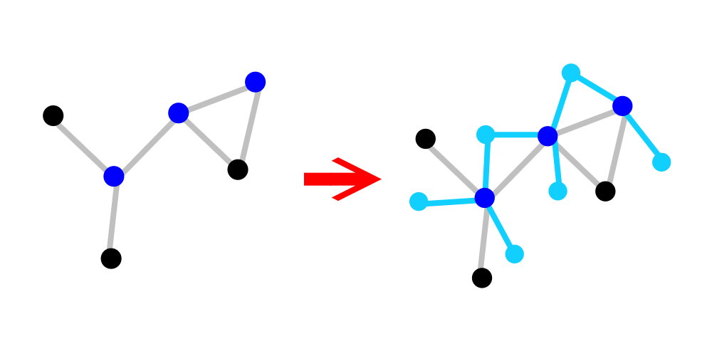
MIN DOM SET-3

Slide 15
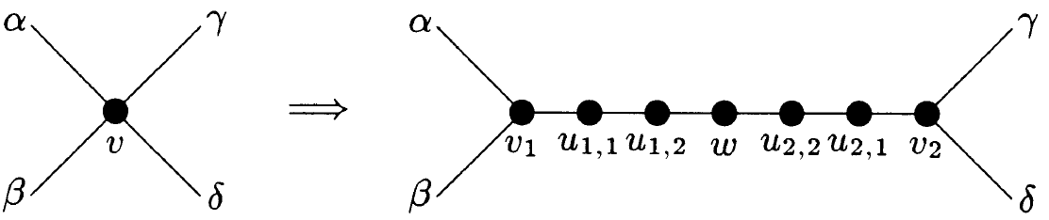
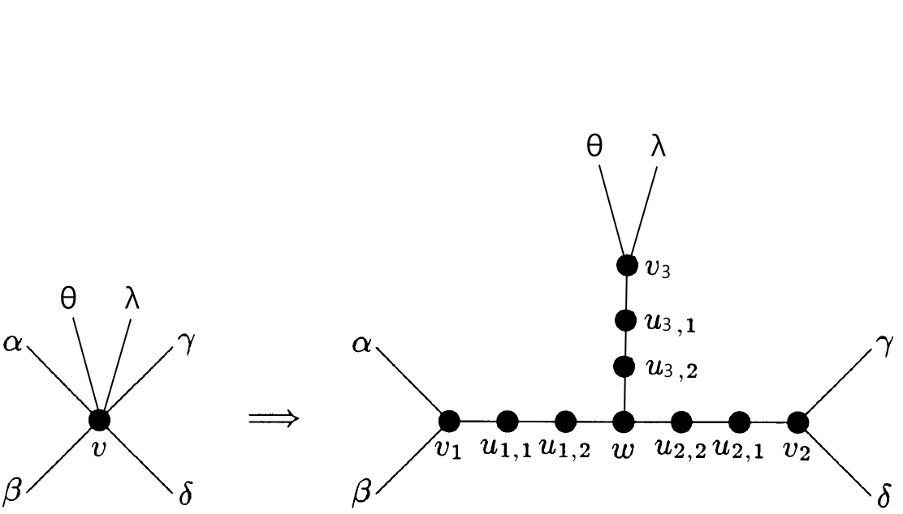
MIN DOM SET-3

Slide 16
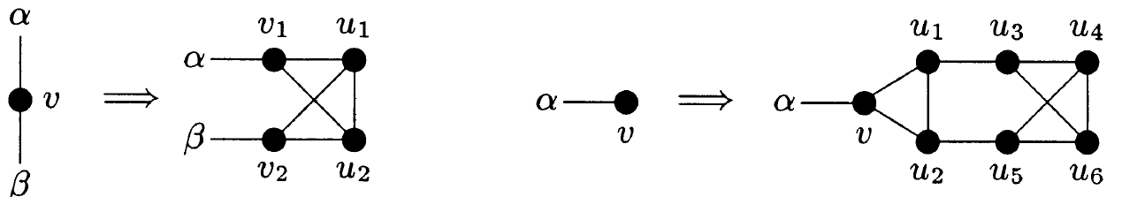
Cubic graph

Slide 17
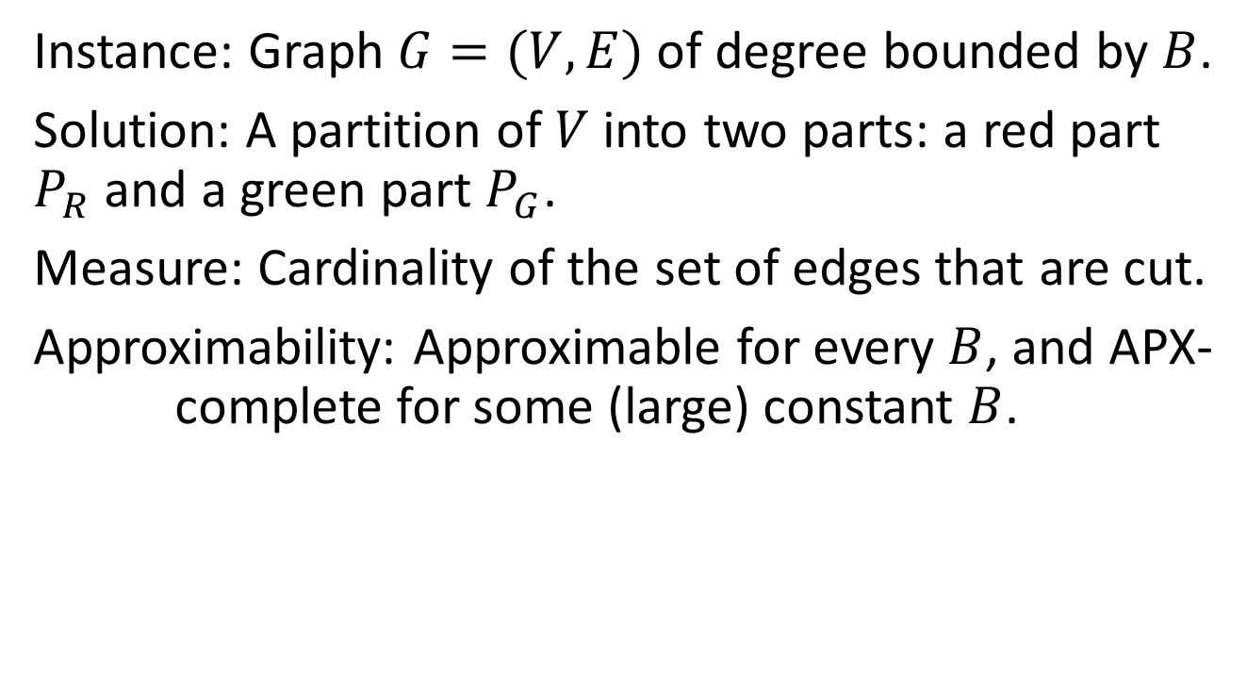
MAX CUT-B
Instance: Graph $G=(V,E)$ of degree bounded by $B$.
Solution: A partition of $V$ into two parts: a red part $P_{R}$ and a green part $P_{G}$.
Measure: Cardinality of the set of edges that are cut.
Approximability: Approximable for every $B$, and APX- complete for some (large) constant $B$.

Slide 18
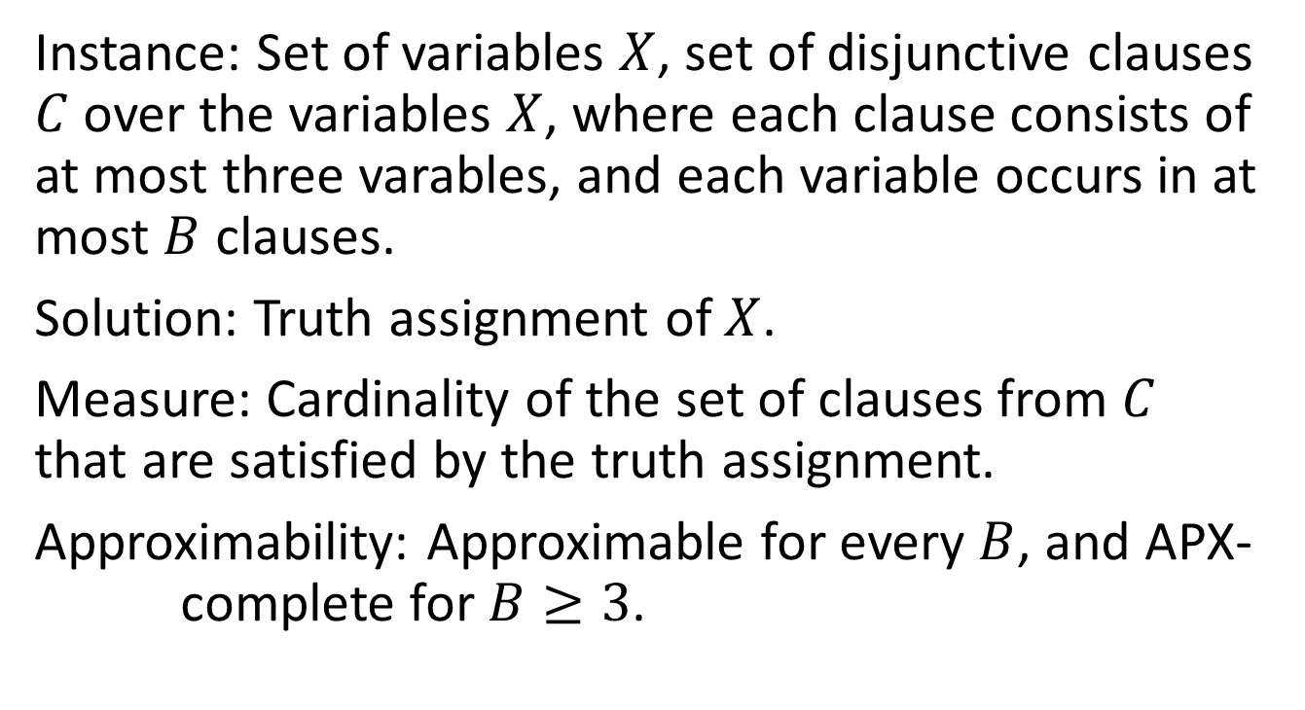
MAX 3-SAT-B
Instance: Set of variables $X$, set of disjunctive clauses $C$ over the variables $X$, where each clause consists of at most three varables, and each variable occurs in at most $B$ clauses.
Solution: Truth assignment of $X$.
Measure: Cardinality of the set of clauses from $C$ that are satisfied by the truth assignment.
Approximability: Approximable for every $B$, and APX- complete for $B≥3$.

Slide 19
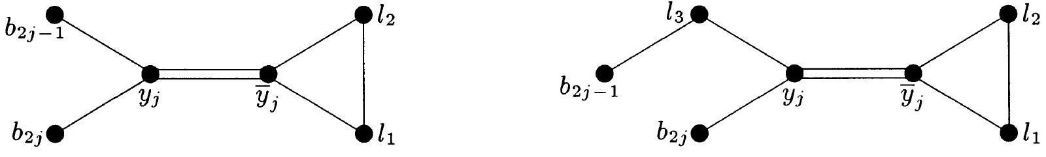
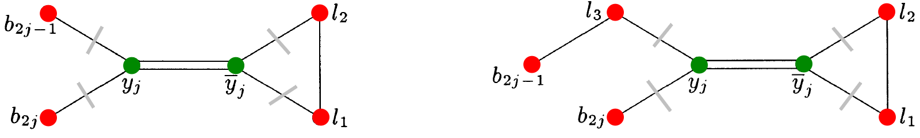
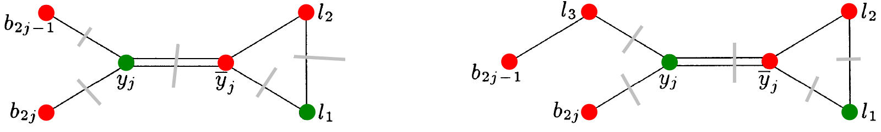
MAX CUT-6

Slide 20
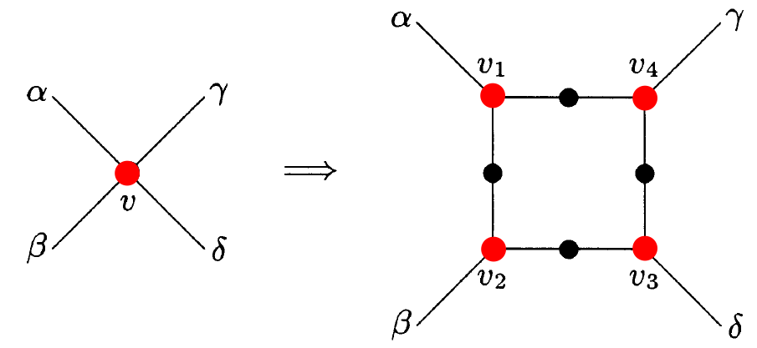
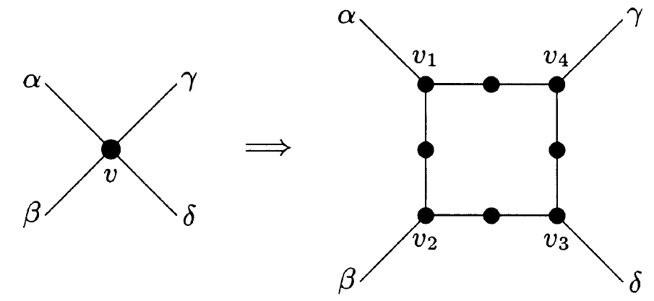
MAX CUT-3

Slide 21
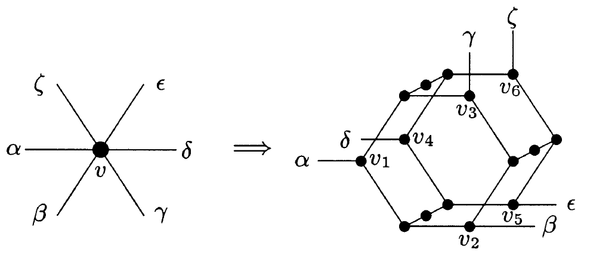
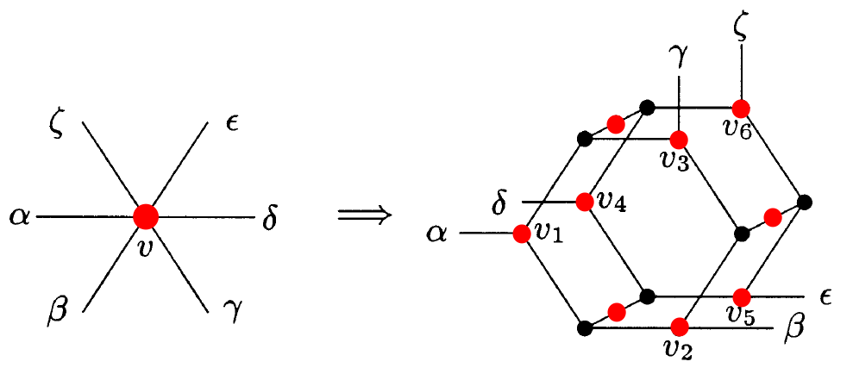
MAX CUT-3

Slide 22
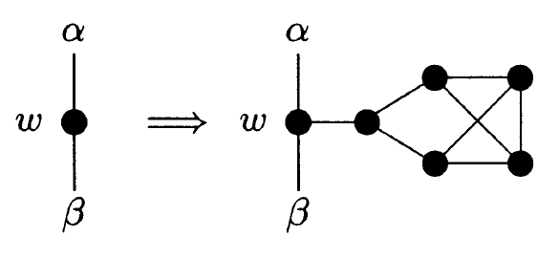
Cubic graph

