Slide 1
scalable time series classification
Patrick Schäfer
Data Mining and Knowledge Discovery
13 November 2015(1-26)
Presenter: Shu-Kai Hung

Slide 2
Abstract
Time series classification tries to mimic the human understanding of similarity. When it comes to long or larger time series datasets, state-of-the-art classifiers reach their limits because of unreasonably high training or testing times. One representative example is the 1-nearest-neighbor dynamic time warping classifier (1-NN DTW) that is commonly used as the benchmark to compare to. It has several shortcomings: it has a quadratic time complexity in the time series length and its accuracy degenerates in the presence of noise. To reduce the computational complexity, early abandoning techniques, cascading lower bounds, or recently, a nearest centroid classifier have been introduced. Still, classification times on datasets of a few thousand time series are in the order of hours. We present our Bag-Of-SFA-Symbols in Vector Space classifier that is accurate, fast and robust to noise. We show that it is significantly more accurate than 1-NN DTW while being multiple orders of magnitude faster. Its low computational complexity combined with its good classification accuracy makes it relevant for use cases like long or large amounts of time series or real-time analytics.

Slide 3

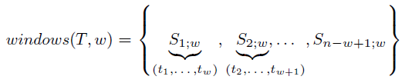

A time series is a sequence of $nεℕ$ real values, which are recorded over time
Definition 1:
$$S_{i,w}=(t_{i},…..,t_{i+w−1})$$

Slide 4
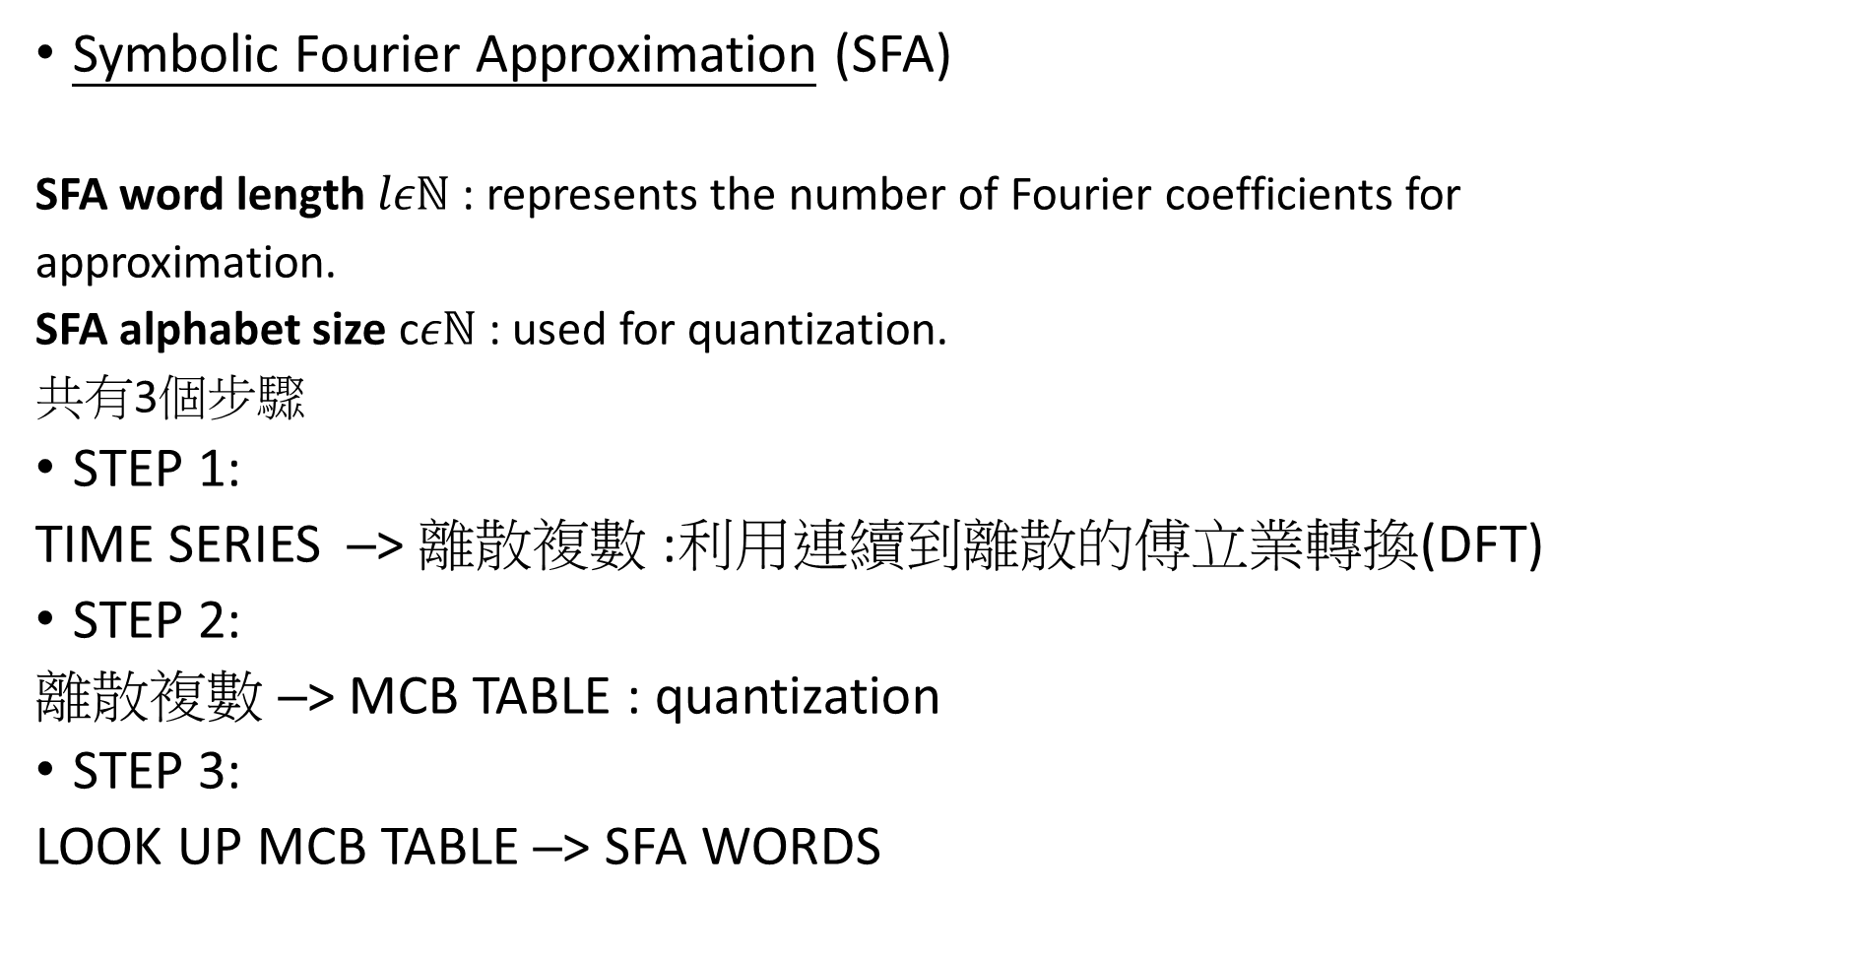
From Real Values to Words
Symbolic Fourier Approximation (SFA)
SFA word length $lεℕ$ : represents the number of Fourier coefficients for
approximation.
SFA alphabet size c$εℕ$ : used for quantization.
共有3個步驟
STEP 1:
TIME SERIES ─> 離散複數 :利用連續到離散的傅立業轉換(DFT)
STEP 2:
離散複數 ─> MCB TABLE : quantization
STEP 3:
LOOK UP MCB TABLE ─> SFA WORDS

Slide 5
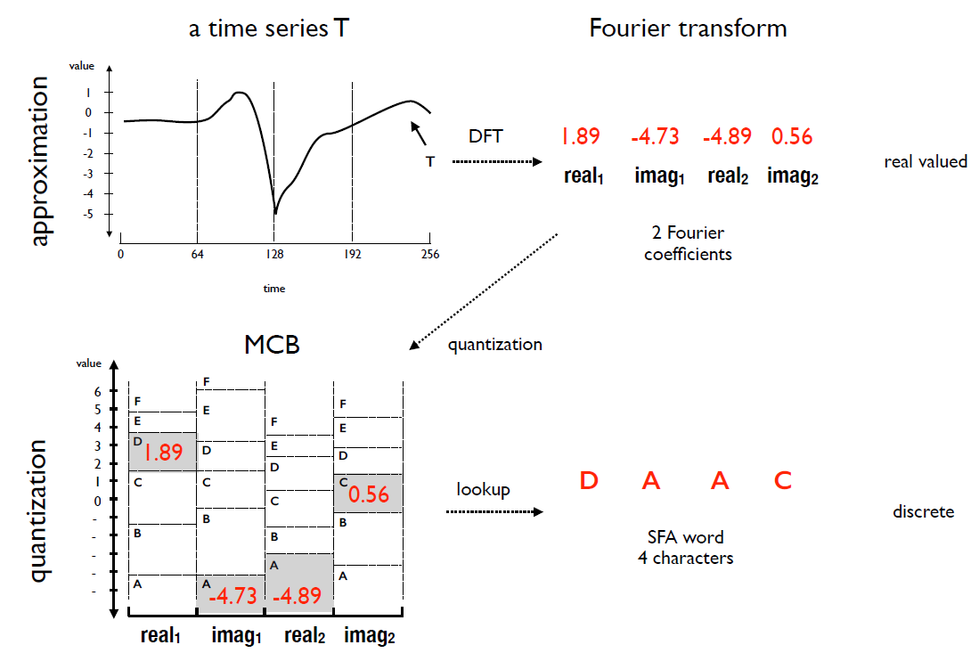

Slide 6
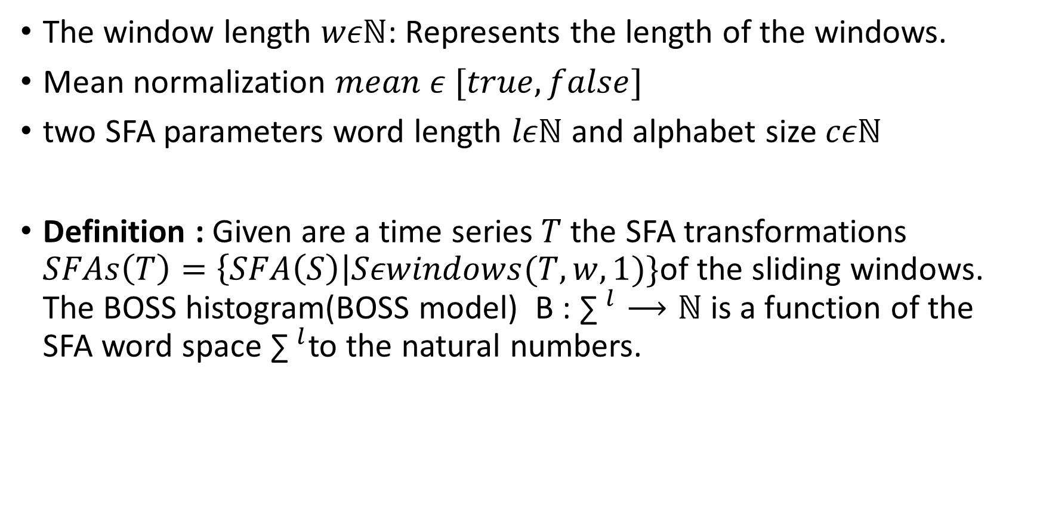
The Bag-of-SFA-Symbols (BOSS) Model
The window length $wεℕ$: Represents the length of the windows.
Mean normalization $mean ε [true,false]$
two SFA parameters word length $lεℕ$ and alphabet size $cεℕ$
Definition : Given are a time series$T$ the SFA transformations $SFAs\left(T\right)=\left\{SFA\left(S\right)\right|Sεwindows(T,w,1)\}\text{of} \text{the} \text{sliding} \text{windows}\text{.}$ The BOSS histogram(BOSS model) B : ${\text{∑} }^{l}⟶ℕ$is a function of the SFA word space ${\text{∑} }^{l}$to the natural numbers.

Slide 7
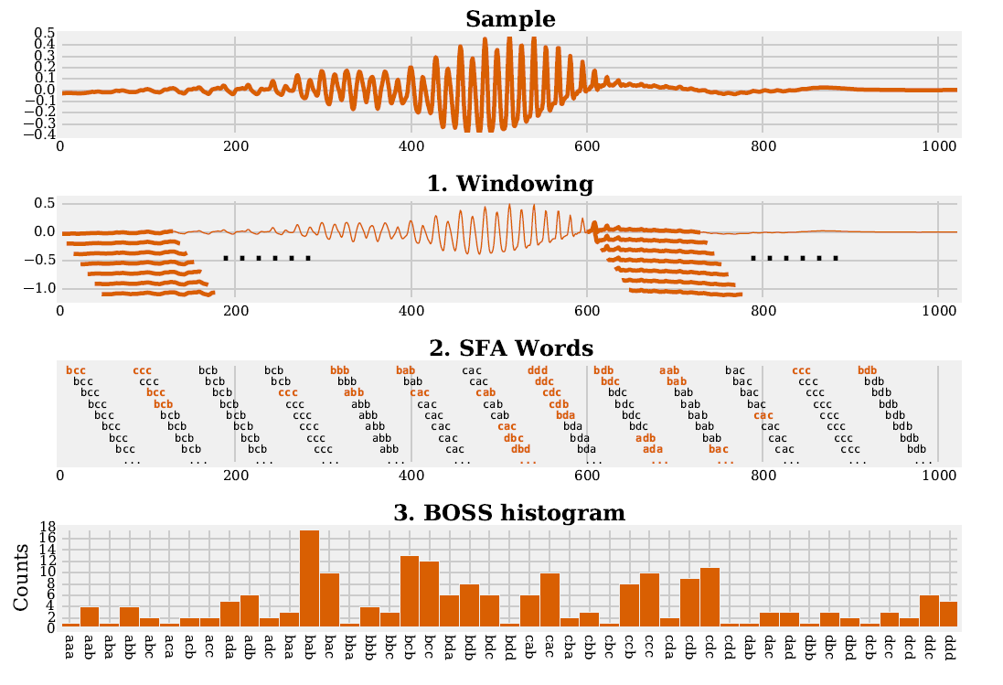
Word length= 3 , symbol size = 4(a-d)

Slide 8
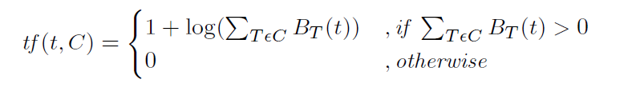
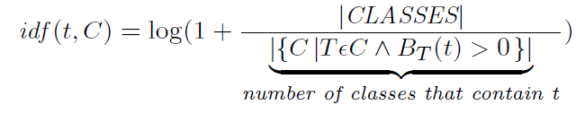
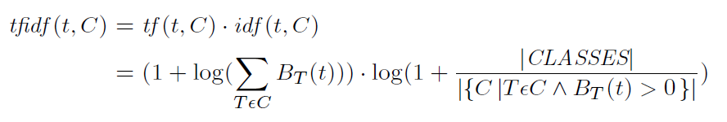
To solve big data using vector space
Term frequency inverse document frequency(tf-idf)
常用於 文件比對 算frequency
主要用於評估weight of word
於此篇論文:Term 代表SFA word , document 代表1個time series
High tf-idf weights are obtained by SFA words with a high frequency that occur only in a specic class.

Slide 9
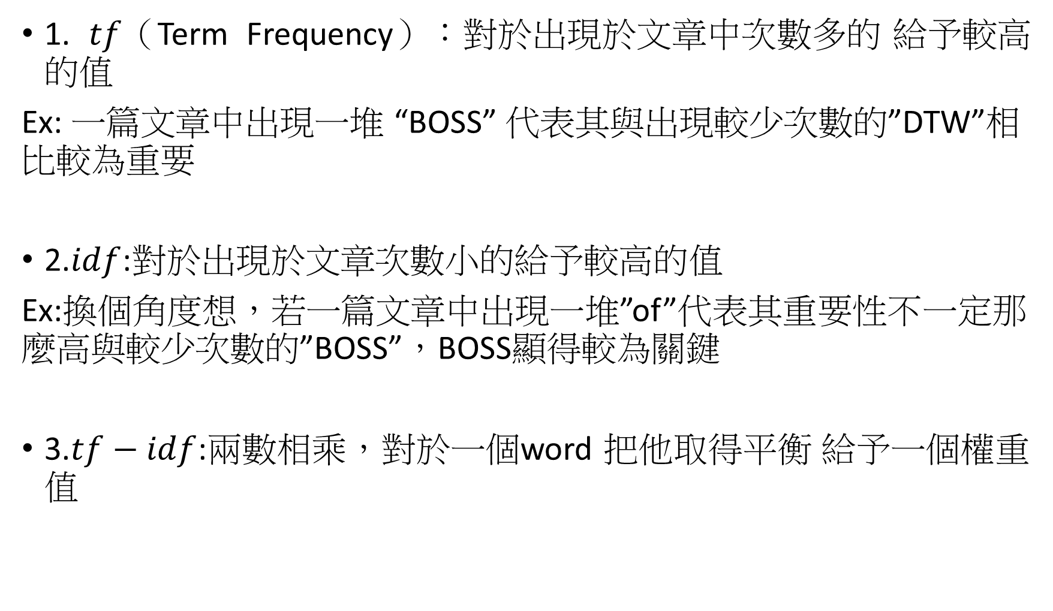
1. $tf$（Term Frequency）：對於出現於文章中次數多的 給予較高的值
Ex: 一篇文章中出現一堆 “BOSS” 代表其與出現較少次數的”DTW”相比較為重要
2.$idf$:對於出現於文章次數小的給予較高的值
Ex:換個角度想，若一篇文章中出現一堆”of”代表其重要性不一定那麼高與較少次數的”BOSS”，BOSS顯得較為關鍵
3.$tf−idf$:兩數相乘，對於一個word 把他取得平衡 給予一個權重值

Slide 10
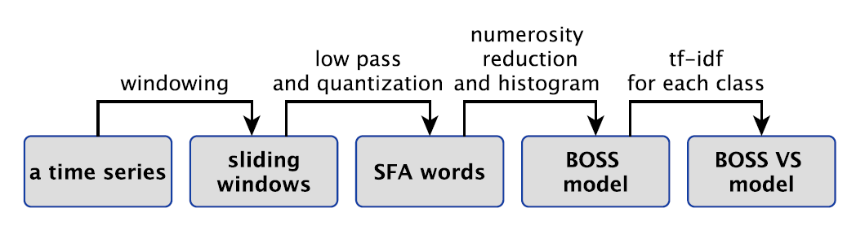
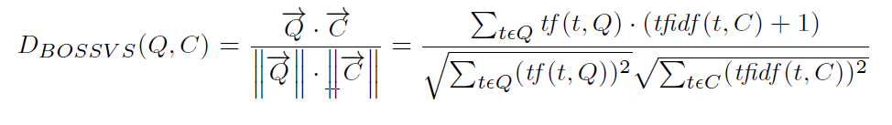


BOSS VS
The similarity of a $tf$ vector of query Q to an $tf−idf$class vector of sample C can then be computed using the Cosine similarity metric:
Cosine similarity 常用於文件比對
Complexity:

Slide 11
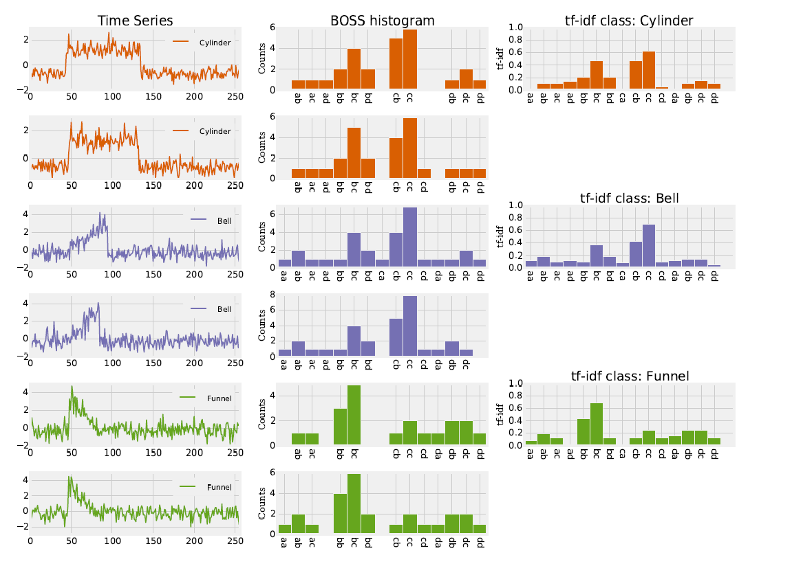

Slide 12
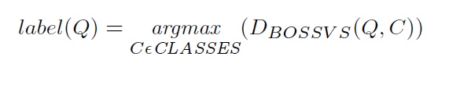
Time Series Classification
An unlabeled time series Q is assigned to the class C that
maximizes the Cosine similarity:
Using 1-NN classification

Slide 13
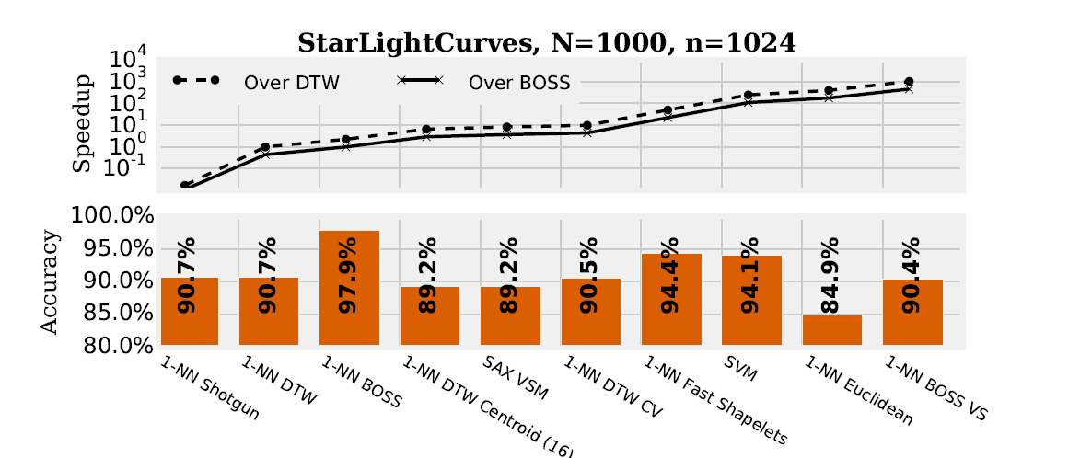
Experiments

Slide 14
