Slide 1
Spatial Pyramid Pooling in Deep Convolutional Networks for Visual Recognition
Kaiming He, Xiangyu Zhang, Shaoqing Ren, and Jian Sun, IEEE Transactions on Pattern Analysis and Machine Intelligence (volume: 37), 2015
Presenter: Wei-Hao Fu
Date: 2016/06/14
Notes:
IEEE Transactions on Pattern Analysis and Machine Intelligence(TPAMI) is published monthly. Its editorial board strives to present most important research results in areas within TPAMI's scope.

Slide 2
Abstract(1/3)
Existing deep convolutional neural networks (CNNs) require a fixed-size (e.g., 224*224) input image. This requirement is “artificial” and may reduce the recognition accuracy for the images or sub-images of an arbitrary size/scale. In this work, we equip the networks with another pooling strategy, “spatial pyramid pooling”, to eliminate the above requirement. The new network structure, called SPP-net, can generate a fixed-length representation regardless of image size/scale. Pyramid pooling is also robust to object deformations. With these advantages, SPP-net should in general improve all CNN-based image classification methods.

Slide 3
Abstract(2/3)
On the ImageNet 2012 dataset, we demonstrate that SPP-net boosts the accuracy of a variety of CNN architectures despite their different designs. On the Pascal VOC 2007 and Caltech101 datasets, SPP-net achieves state-of-the-art classification results using a single full-image representation and no fine-tuning. The power of SPP-net is also significant in object detection. Using SPP-net, we compute the feature maps from the entire image only once, and then pool features in arbitrary regions (sub-images) to generate fixed-length representations for training the detectors.

Slide 4
Abstract(3/3)
This method avoids repeatedly computing the convolutional features. In processing test images, our method is 24-102 faster than the R-CNN method, while achieving better or comparable accuracy on Pascal VOC 2007. In ImageNet Large Scale Visual Recognition Challenge (ILSVRC) 2014, our methods rank #2 in object detection and #3 in image classification among all 38 teams. This manuscript also introduces the improvement made for this competition.

Slide 5
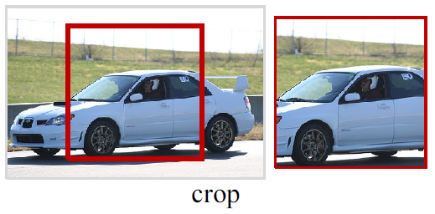
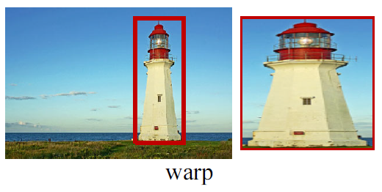
Motivation
The prevalent CNNs require a fixed input image size(e.g., 224*224), and this requirement may reduce the recognition accuracy.
In fact, convolutional layers don’t require a fixed image size.
Notes:
On the other hand, the fully-connected layers need to have fixed-size/length input by their definition.
Cropping:
May not contain the entire object.
Warping:
Result in unwanted geometric distortion.

Slide 6
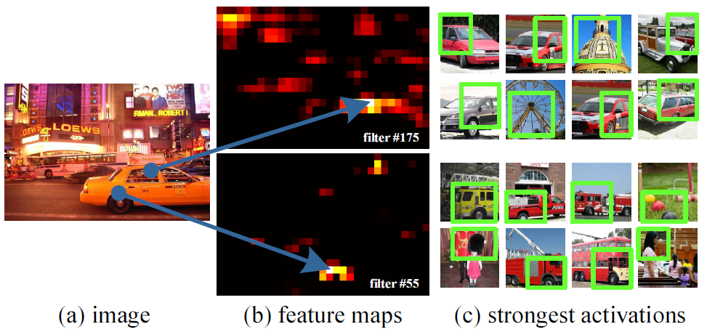
Feature Map
Notes:
#55 is most activated by a circle shape
#175 is most activated by a ┐-shape

Slide 7
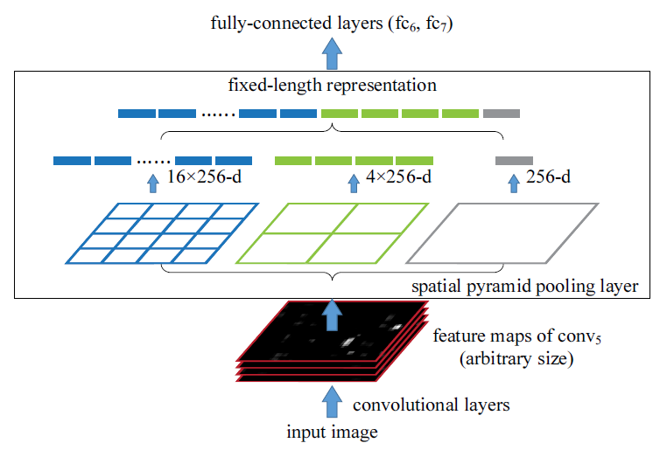

SPP-net
Feature map size=13*13
Pyramid level of 3*3 bins
Pooling window size=$\left\lceil \frac{13}{3}\right\rceil =5$
Pooling window stride=$\left\lfloor \frac{13}{3}\right\rfloor =4$
Notes:
SPP improves BoW in that it can maintain spatial information by pooling in local spatial bins.
Global pooling:
single bin that covers the entire image.
It is used to reduce the model size and also reduce overfitting.
It corresponds to the traditional BoW method.

Slide 8
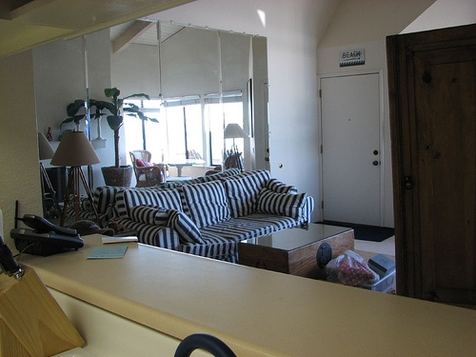
SPP-net V.S R-CNN
R-CNN is an object detection method that means Region proposal with CNN
feature
R-CNN
SPP-net
Notes:
R-CNN is time-consuming, because it repeatedly applies the deep convolutional networks to the raw pixels of thousands of warped regions per image.

Slide 9
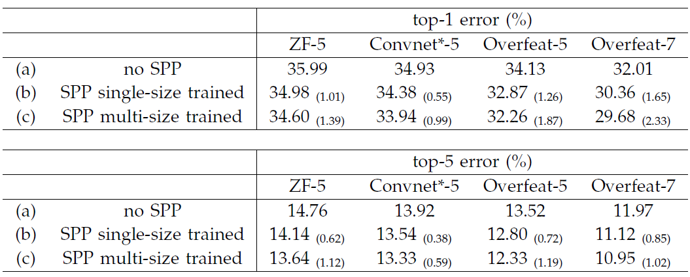
Classification Result
ImageNet 2012

Slide 10
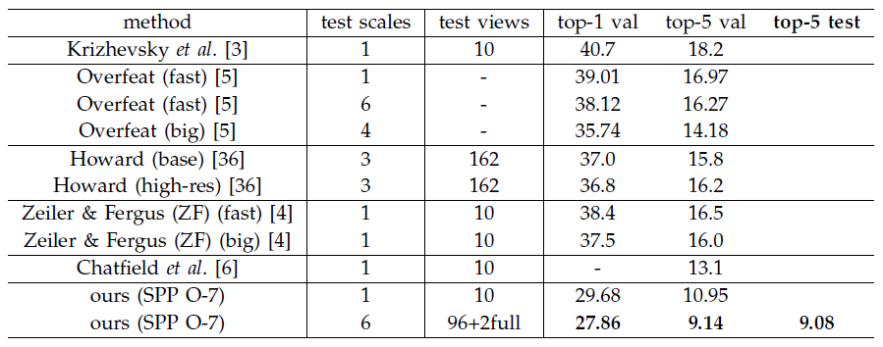
Classification Result
ImageNet 2012

Slide 11
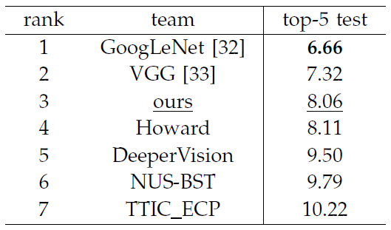
Classification Result
ILSVRC 2014

Slide 12
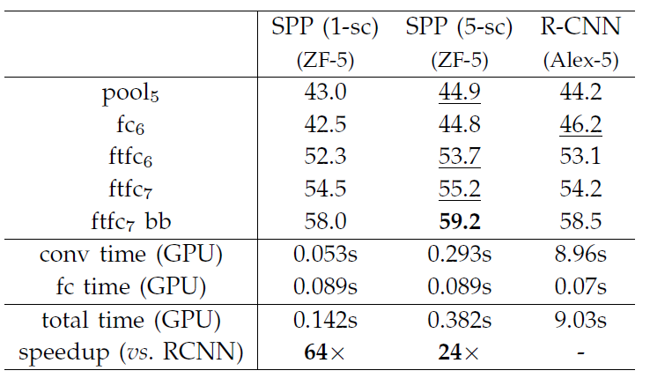
Detection Result
Pascal VOC 2007

Slide 13
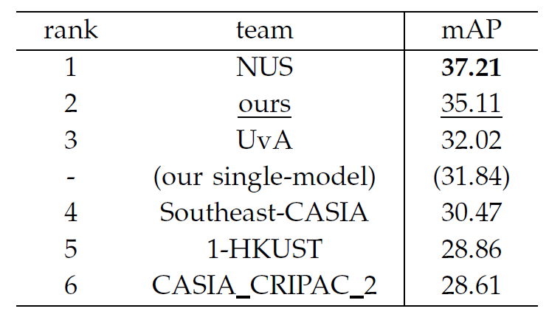
Detection Result
ILSVRC 2014

