Slide 1
Expert Systems with Applications, Vol. 38 2758–2765 Wen Zhang , Taketoshi Yoshida , Xijin Tang (2011)
A comparative study of TFIDF, LSI and multi-words for text classification
Presenter：Jyun-Hao Lai
Date：2016 / 06 / 21
Notes:
1

Slide 2
Abstract
One of the main themes in text mining is text representation, which is fundamental and indispensable for text-based intellegent information processing. Generally, text representation inludes two tasks: indexing and weighting. This paper has comparatively studied TFIDF, LSI and multi-word for text representation. We used a Chinese and an English document collection to respectively evaluate the three methods in information retreival and text categorization. Experimental results have demonstrated that in text categorization, LSI has better performance than other methods in both document collections. Also, LSI has produced the best performance in retrieving English documents. This outcome has shown that LSI has both favorable semantic and statistical quality and is different with the claim that LSI can not produce discriminative power for indexing.

Slide 3
TF*IDF
TF：單詞出現在類別中的頻率值。
IDF ：單詞出現的類別數。
若關鍵字出現在文件中的頻率越高則TF值越高，但是必須考量到此關鍵字對該文件的影響力。
因此必須透過IDF值加以衡量，若關鍵字出現在越少量的文件中，則IDF值越高，代表此關鍵字對該文件具有影響力，反之， IDF值越低，代表此關鍵字對於該文件不具影響力。

Slide 4
Latent semantic indexing, LSI
LSI 以字詞—文件矩陣 (term-document matrix) 表示字詞與文件之間的關聯，習慣以列 (row) 代表字詞 (term)，以行 (column) 代表文件 (document)。
 | D1 | D2 | D3
two | 1.0986 | 0 | 0
tea | 0.4055 | 0.4055 | 0
me | 0 | 0.2916 | 0.4621
you | 0 | 0.2916 | 0.4621
for | 0 | 0 | 0
and | 0 | 0 | 0
Log Entropy Weighting

Slide 5
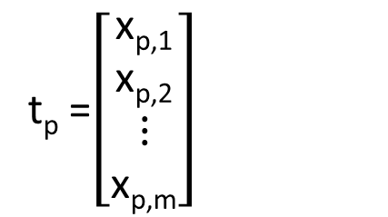
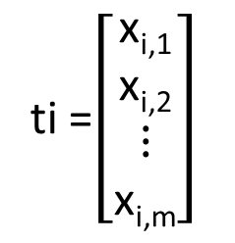
Dot Product of Terms
ti =$\left[\begin{matrix}\text{x}\text{i}\text{,1} \\ \text{x}\text{i}\text{,2} \\ ⋮ \\ \text{x}\text{i}\text{,}\text{m}\end{matrix}\right]$
T
t_{i} = (x_{i,1}， x_{i,2}，... ， x_{i,m})
 | D1 | D2 | D3
two | 1.0986 | 0 | 0
tea | 0.4055 | 0.4055 | 0
me | 0 | 0.2916 | 0.4621
you | 0 | 0.2916 | 0.4621
for | 0 | 0 | 0
and | 0 | 0 | 0
t_{p} =$\left[\begin{matrix}\text{x}\text{p}\text{,1} \\ \text{x}\text{p}\text{,2} \\ ⋮ \\ \text{x}\text{p}\text{,}\text{m}\end{matrix}\right]$
T
t_{p} = (x_{p,1}， x_{p,2}，... ， x_{p,m})
Dot Product： t_{i} t_{p}
T

Slide 6

Dot Product of Terms
XX = $\left[\begin{matrix}\text{x}\text{1}\text{,1} & ⋯ & \text{x}\text{1}\text{,}m \\ ⋮ & ⋱ & ⋮ \\ \text{x}\text{n}\text{,1} & ⋯ & \text{x}\text{n}\text{,}\text{m}\end{matrix}\right]\left[\begin{matrix}\text{x}\text{1}\text{,1} & ⋯ & \text{x}\text{n}\text{,1} \\ ⋮ & ⋱ & ⋮ \\ \text{x}\text{1}\text{,}m & ⋯ & \text{x}\text{n}\text{,}\text{m}\end{matrix}\right]$
=$\left[\begin{matrix}t1t1 & ⋯ & t1tn \\ ⋮ & ⋱ & ⋮ \\ tnt1 & ⋯ & tntn\end{matrix}\right]$
T
T
T
T
T

Slide 7
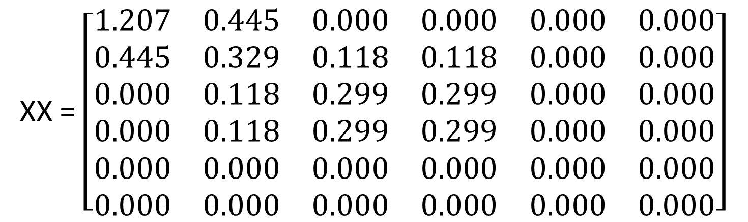
 | D1 | D2 | D3
two | 1.0986 | 0 | 0
tea | 0.4055 | 0.4055 | 0
me | 0 | 0.2916 | 0.4621
you | 0 | 0.2916 | 0.4621
for | 0 | 0 | 0
and | 0 | 0 | 0
X =
XX = $\left[\begin{matrix}1.207 & 0.445 & 0.000 & 0.000 & 0.000 & 0.000 \\ 0.445 & 0.329 & 0.118 & 0.118 & 0.000 & 0.000 \\ 0.000 & 0.118 & 0.299 & 0.299 & 0.000 & 0.000 \\ 0.000 & 0.118 & 0.299 & 0.299 & 0.000 & 0.000 \\ 0.000 & 0.000 & 0.000 & 0.000 & 0.000 & 0.000 \\ 0.000 & 0.000 & 0.000 & 0.000 & 0.000 & 0.000\end{matrix}\right]$
T

Slide 8
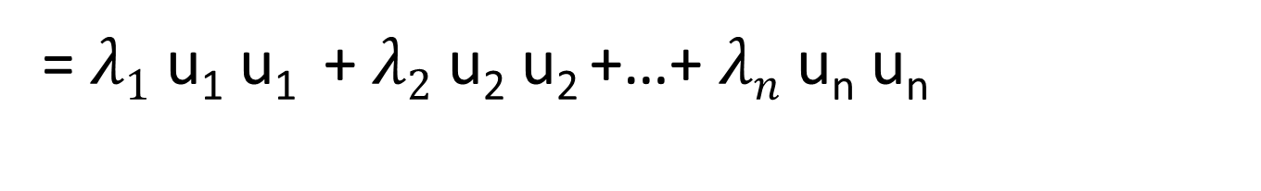
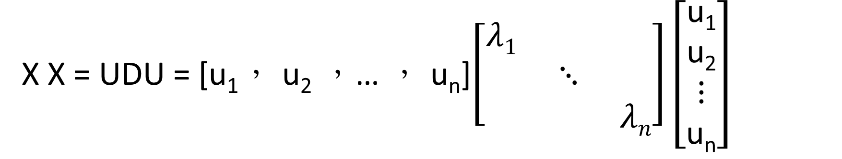
T
X X = UDU = [u₁， u₂ ，… ， u_{n}]$\left[\begin{matrix}λ1 & & \\ & ⋱ & \\ & & λn\end{matrix}\right]\left[\begin{matrix}\text{u}\text{1} \\ \text{u}\text{2} \\ ⋮ \\ \text{u}\text{n}\end{matrix}\right]$
T
T
T
T
T
T
T
=$λ1$ u₁ u₁ + $λ2$ u₂ u₂ +…+ $λn$ u_{n} u_{n}

Slide 9
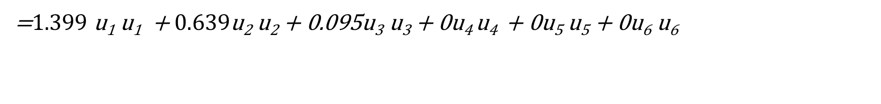
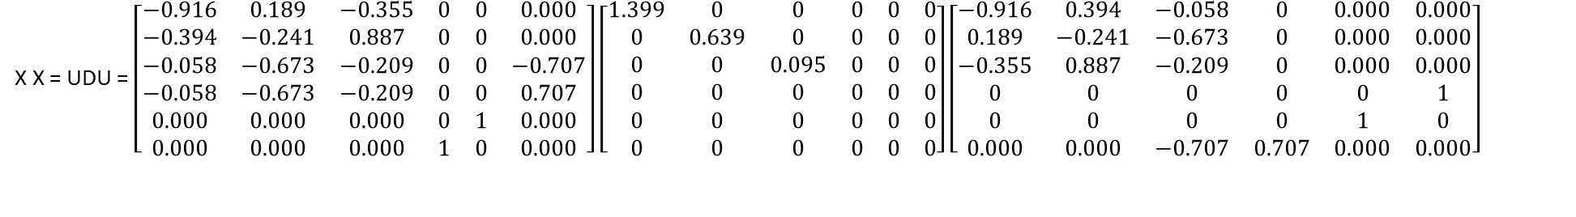
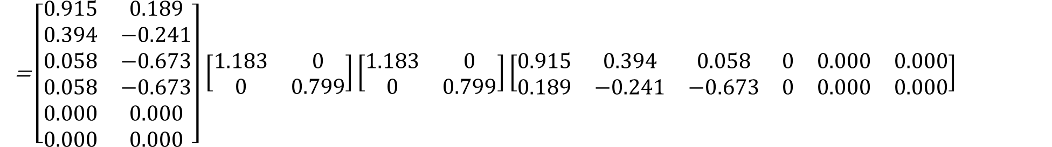
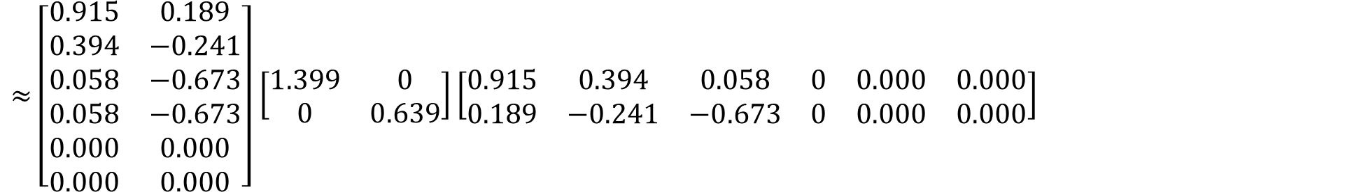
X X = UDU = $\left[\begin{matrix}−0.916 & 0.189 & −0.355 & 0 & 0 & 0.000 \\ −0.394 & −0.241 & 0.887 & 0 & 0 & 0.000 \\ −0.058 & −0.673 & −0.209 & 0 & 0 & −0.707 \\ −0.058 & −0.673 & −0.209 & 0 & 0 & 0.707 \\ 0.000 & 0.000 & 0.000 & 0 & 1 & 0.000 \\ 0.000 & 0.000 & 0.000 & 1 & 0 & 0.000\end{matrix}\right]$ $\left[\begin{matrix}1.399 & 0 & 0 & 0 & 0 & 0 \\ 0 & 0.639 & 0 & 0 & 0 & 0 \\ 0 & 0 & 0.095 & 0 & 0 & 0 \\ 0 & 0 & 0 & 0 & 0 & 0 \\ 0 & 0 & 0 & 0 & 0 & 0 \\ 0 & 0 & 0 & 0 & 0 & 0\end{matrix}\right]\left[\begin{matrix}−0.916 & 0.394 & −0.058 & 0 & 0.000 & 0.000 \\ 0.189 & −0.241 & −0.673 & 0 & 0.000 & 0.000 \\ −0.355 & 0.887 & −0.209 & 0 & 0.000 & 0.000 \\ 0 & 0 & 0 & 0 & 0 & 1 \\ 0 & 0 & 0 & 0 & 1 & 0 \\ 0.000 & 0.000 & −0.707 & 0.707 & 0.000 & 0.000\end{matrix}\right]$
T
T
T
T
T
T
T
T
=$1.399$ u₁ u₁ + $0.639$u₂ u₂ + 0.095u₃ u₃ + 0u₄ u₄ + 0u₅ u₅ + 0u₆ u₆
$≈$ $\left[\begin{matrix}0.915 & 0.189 \\ 0.394 & −0.241 \\ 0.058 & −0.673 \\ 0.058 & −0.673 \\ 0.000 & 0.000 \\ 0.000 & 0.000\end{matrix}\right]$ $\left[\begin{matrix}1.399 & 0 \\ 0 & 0.639\end{matrix}\right]\left[\begin{matrix}0.915 & 0.394 & 0.058 & 0 & 0.000 & 0.000 \\ 0.189 & −0.241 & −0.673 & 0 & 0.000 & 0.000\end{matrix}\right]$
=$\left[\begin{matrix}0.915 & 0.189 \\ 0.394 & −0.241 \\ 0.058 & −0.673 \\ 0.058 & −0.673 \\ 0.000 & 0.000 \\ 0.000 & 0.000\end{matrix}\right]$ $\left[\begin{matrix}1.183 & 0 \\ 0 & 0.799\end{matrix}\right]\left[\begin{matrix}1.183 & 0 \\ 0 & 0.799\end{matrix}\right]\left[\begin{matrix}0.915 & 0.394 & 0.058 & 0 & 0.000 & 0.000 \\ 0.189 & −0.241 & −0.673 & 0 & 0.000 & 0.000\end{matrix}\right]$

Slide 10

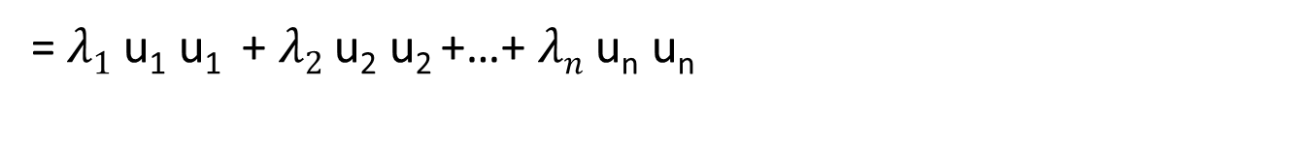

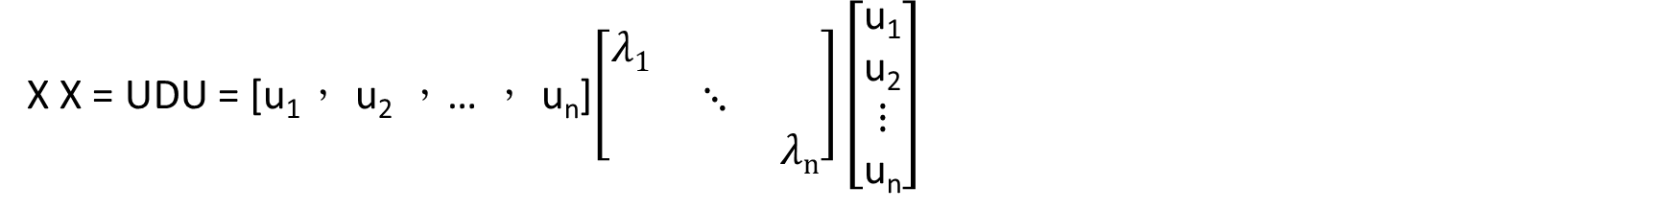
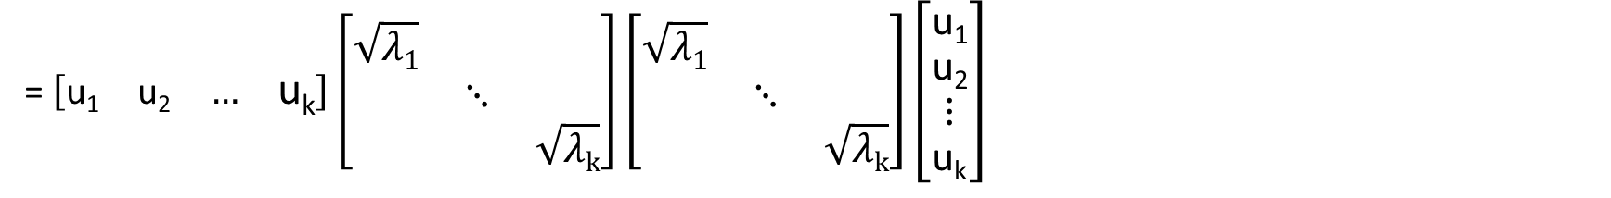
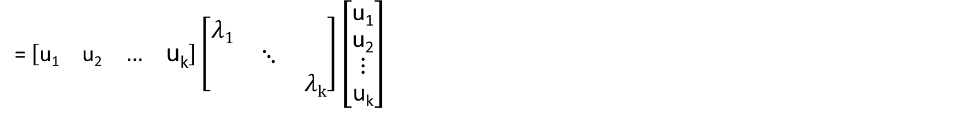
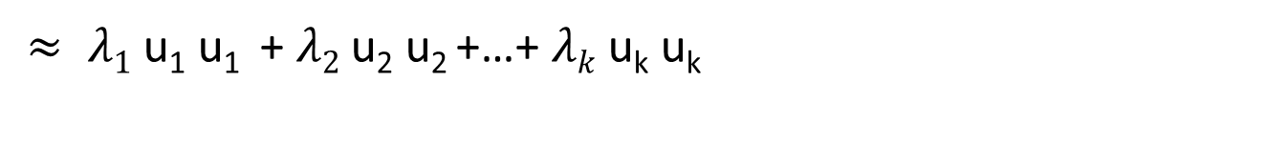
T
X X = UDU = [u₁， u₂ ，… ， u_{n}]$\left[\begin{matrix}λ1 & & \\ & ⋱ & \\ & & λn\end{matrix}\right]\left[\begin{matrix}\text{u}\text{1} \\ \text{u}\text{2} \\ ⋮ \\ \text{u}\text{n}\end{matrix}\right]$
T
T
T
T
T
T
=$λ1$ u₁ u₁ + $λ2$ u₂ u₂ +…+ $λn$ u_{n} u_{n}
T
T
T
$≈ λ1$ u₁ u₁ + $λ2$ u₂ u₂ +…+ $λk$ u_{k} u_{k}
T
= $\left[\begin{matrix}\text{u}\text{1} & \text{u}\text{2} & … & \text{u}\text{k}\end{matrix}\right]\left[\begin{matrix}λ1 & & \\ & ⋱ & \\ & & λk\end{matrix}\right]\left[\begin{matrix}\text{u}\text{1} \\ \text{u}\text{2} \\ ⋮ \\ \text{u}\text{k}\end{matrix}\right]$
T
T
T
= $\left[\begin{matrix}\text{u}\text{1} & \text{u}\text{2} & … & \text{u}\text{k}\end{matrix}\right]\left[\begin{matrix}\sqrt{λ1} & & \\ & ⋱ & \\ & & \sqrt{λk}\end{matrix}\right]\left[\begin{matrix}\sqrt{λ1} & & \\ & ⋱ & \\ & & \sqrt{λk}\end{matrix}\right]\left[\begin{matrix}\text{u}\text{1} \\ \text{u}\text{2} \\ ⋮ \\ \text{u}\text{k}\end{matrix}\right]$
T
T
T
T
T
T
= $U_{K}Σ_{K}Σ_{K}U_{K}$= ${(U}_{K}Σ_{K})\left(U_{K}Σ_{K}\right)= \hat{Χ}\hat{Χ}$

Slide 11


two | 1.0986 | 0 | 0
tea | 0.4055 | 0.4055 | 0
me | 0 | 0.2916 | 0.4621
you | 0 | 0.2916 | 0.4621
for | 0 | 0 | 0
and | 0 | 0 | 0
$$Χ =$$
two | 1.0824 | 0.1510
tea | 0.4661 | -0.1926
me | 0.0686 | -0.5377
you | 0.0686 | -0.5377
for | 0.0000 | 0.0000
and | 0.0000 | 0.0000
$\hat{Χ}=U_{K}Σ_{K}$ $=$

Slide 12
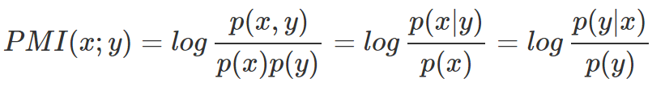
Multi-word
想要探討兩個字之間, 是否存在某種關係, 例如某些字比較容易一起出現, 這些字一起出現時, 可能帶有某種訊息
例如, 在新聞報導中, 有 New , York , 這兩個字一起出現, 可以代表一個地名 New York , 所以當出現了 New 這個字, 則有可能出現 York
P(X)表是文字X出現的機率， P(Y)表是文字Y出現的機率，P(X,Y)表示X,Y同時出現的機率。
這可以使用Pointwise Mutual Information(PMI) 計算，公式如下:
如果某兩個字的出現是獨立事件, 則 PMI 為 0
若有兩個字出現的機率不是獨立事件, 某個字出現時提昇另一個字的出現的機率, 則 PMI 大於 0
也就是說, 如果這兩個字的出現越不是偶然, 則 Pointwise Mutual Information 算出來的值越高, 越有可能帶有某種訊息。

Slide 13
Datasets
Chinese corpus：
TanCorpV1.0 is used in this research.
This corpus has 14,150 documents with 20 categories from Chinese academic journals. In this paper, documents from four categories as ‘‘agriculture”, ‘‘history”, ‘‘politics” and ‘‘economy” are selected as target Chinese document collection.

Slide 14
Datasets
English corpus：
Reuters-21578 distribution 1.0 is used in this paper.
It collects 21,578 news from Reuters newswire in 1987. Since 1991, it appeared as Reuters-22173 and was assembled and indexed with 135 categories by the personnel from Reuters Ltd in 1996.

Slide 15
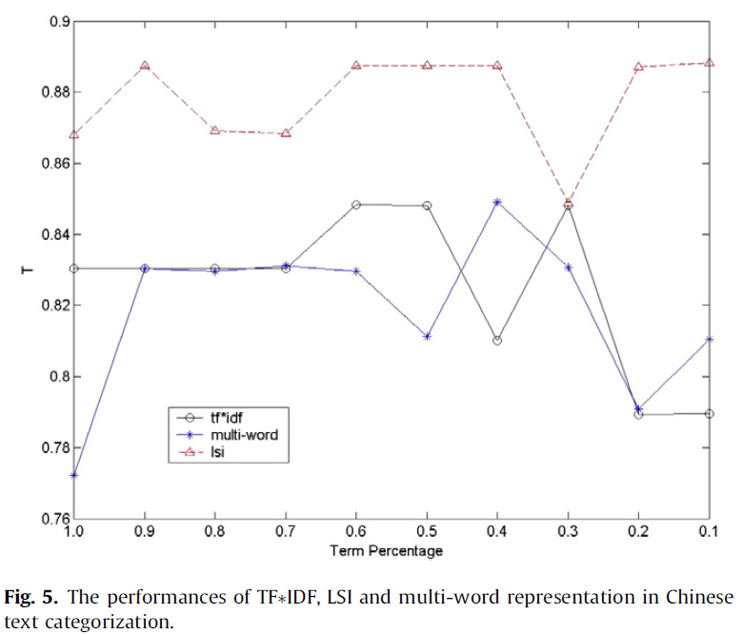
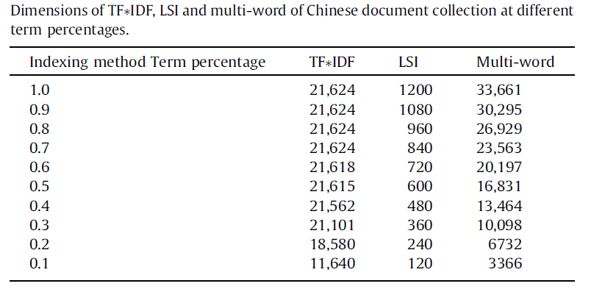

Slide 16
