Slide 1
An improved algorithm to find the length of the longest common subsequence of two strings
Shufen Kuo ,George R. Cross
ACM SIGIR Forum
Volume 23 Issue 3-4, Spring 1989
Pages 89-99
ACM New York, NY, USA
Presenter: Chong-Xuan Lo
Date:2016/6/21

Slide 2
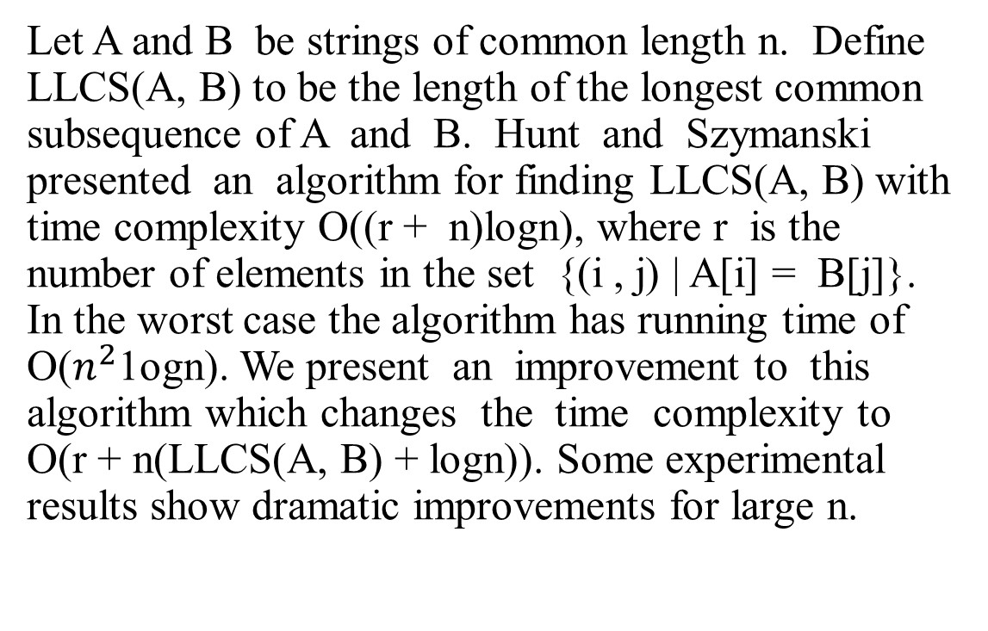
Abstract
Let A and B be strings of common length n. Define LLCS(A, B) to be the length of the longest common subsequence of A and B. Hunt and Szymanski presented an algorithm for finding LLCS(A, B) with time complexity O((r + n)logn), where r is the number of elements in the set {(i , j) | A[i] = B[j]}. In the worst case the algorithm has running time of O($n^{2}$1ogn). We present an improvement to this algorithm which changes the time complexity to O(r + n(LLCS(A, B) + logn)). Some experimental results show dramatic improvements for large n.

Slide 3
Hunt-Szymanski algorithm
Example
A=abcbdda B=badbabd
MATCHLIST[1] = (5, 2)
MATCHLIST[2] = (6, 4, 1)
MATCHLIST[3] = ( )
MATCHLIST[4] = MATCHLIST[2]
MATCHLIST[5] = (7, 3)
MATCHLIST[6] = MATCHLIST[5]
MATCHLIST[7] = MATCHLIST[1]
Time complexity = nlogn

Slide 4
Hunt-Szymanski algorithm
A=abcbdda
B=badbabd
binary search 插入
r = number of matches
Time complexity=rlogn
LCS length = 4
LCS = abbd
LCS
 | 0 | 1 | 2 | 3 | 4 | 5 | 6 | 7 | 8
initial | 0 | 8 | 8 | 8 | 8 | 8 | 8 | 8 | 8
1 | 0 | 5 | 8 | 8 | 8 | 8 | 8 | 8 | 8
1 | 0 | 2 | 8 | 8 | 8 | 8 | 8 | 8 | 8
2 | 0 | 2 | 6 | 8 | 8 | 8 | 8 | 8 | 8
2 | 0 | 2 | 4 | 8 | 8 | 8 | 8 | 8 | 8
2 | 0 | 1 | 4 | 8 | 8 | 8 | 8 | 8 | 8
4 | 0 | 1 | 4 | 6 | 8 | 8 | 8 | 8 | 8
5 | 0 | 1 | 4 | 6 | 7 | 8 | 8 | 8 | 8
5 | 0 | 1 | 3 | 6 | 7 | 8 | 8 | 8 | 8
7 | 0 | 1 | 3 | 5 | 7 | 8 | 8 | 8 | 8
7 | 0 | 1 | 2 | 5 | 7 | 8 | 8 | 8 | 8
A
MATCHLIST[1] = (5, 2)
MATCHLIST[2] = (6, 4, 1)
MATCHLIST[3] = ( )
MATCHLIST[4] = MATCHLIST[2]
MATCHLIST[5] = (7, 3)
MATCHLIST[6] = MATCHLIST[5]
MATCHLIST[7] = MATCHLIST[1]

Slide 5
Hunt-Szymanski algorithm
 | b | a | d | b | a | b | d
a |  | v |  |  | v
b | v |  |  | v |  | v
c
b | v |  |  | v |  | v
d |  |  | v |  |  |  | v
d |  |  | v |  |  |  | v
a |  | v |  |  | v

Slide 6
Improved algorithm
Suppose
MATCHLIST[i] =< 52, 20, 17, 14, 13, 10, 8, 3, 1 >,
index | 0 | 1 | 2 | 3 | 4 | 5 | 6 | …
Contents | 0 | 2 | 4 | 30 | 32 | 41 | 78 | …

Slide 7
Improved algorithm
Suppose
MATCHLIST[i] =< 52, 20, 17, 14, 13, 10, 8, 3, 1 >,
index | 0 | 1 | 2 | 3 | 4 | 5 | 6 | …
Contents | 0 | 2 | 4 | 30 | 32 | 41 | 52 | …

Slide 8
Improved algorithm
Suppose
MATCHLIST[i] =< 52, 20, 17, 14, 13, 10, 8, 3, 1 >,
index | 0 | 1 | 2 | 3 | 4 | 5 | 6 | …
Contents | 0 | 2 | 4 | 20 | 32 | 41 | 52 | …

Slide 9
Improved algorithm
Suppose
MATCHLIST[i] =< 52, 20, 17, 14, 13, 10, 8, 3, 1 >,
index | 0 | 1 | 2 | 3 | 4 | 5 | 6 | …
Contents | 0 | 2 | 4 | 17 | 32 | 41 | 52 | …

Slide 10
Improved algorithm
Suppose
MATCHLIST[i] =< 52, 20, 17, 14, 13, 10, 8, 3, 1 >,
index | 0 | 1 | 2 | 3 | 4 | 5 | 6 | …
Contents | 0 | 2 | 4 | 14 | 32 | 41 | 52 | …

Slide 11
Improved algorithm
Suppose
MATCHLIST[i] =< 52, 20, 17, 14, 13, 10, 8, 3, 1 >,
index | 0 | 1 | 2 | 3 | 4 | 5 | 6 | …
Contents | 0 | 2 | 4 | 13 | 32 | 41 | 52 | …

Slide 12
Improved algorithm
Suppose
MATCHLIST[i] =< 52, 20, 17, 14, 13, 10, 8, 3, 1 >,
index | 0 | 1 | 2 | 3 | 4 | 5 | 6 | …
Contents | 0 | 2 | 4 | 10 | 32 | 41 | 52 | …

Slide 13
Improved algorithm
Suppose
MATCHLIST[i] =< 52, 20, 17, 14, 13, 10, 8, 3, 1 >,
index | 0 | 1 | 2 | 3 | 4 | 5 | 6 | …
Contents | 0 | 2 | 4 | 8 | 32 | 41 | 52 | …

Slide 14
Improved algorithm
Suppose
MATCHLIST[i] =< 52, 20, 17, 14, 13, 10, 8, 3, 1 >,
index | 0 | 1 | 2 | 3 | 4 | 5 | 6 | …
Contents | 0 | 2 | 3 | 8 | 32 | 41 | 52 | …

Slide 15
Improved algorithm
Suppose
MATCHLIST[i] =< 52, 20, 17, 14, 13, 10, 8, 3, 1 >,
The value in THRESH[3] will be overwritten six times
index | 0 | 1 | 2 | 3 | 4 | 5 | 6 | …
Contents | 0 | 1 | 3 | 8 | 32 | 41 | 52 | …

Slide 16
Improved algorithm
Suppose
MATCHLIST[i] =< 1, 3, 8, 10, 13, 14, 17, 20, 52 >,
index | 0 | 1 | 2 | 3 | 4 | 5 | 6 | …
Contents | 0 | 2 | 4 | 30 | 32 | 41 | 78 | …

Slide 17
Improved algorithm
Suppose
MATCHLIST[i] =< 1, 3, 8, 10, 13, 14, 17, 20, 52 >,
index | 0 | 1 | 2 | 3 | 4 | 5 | 6 | …
Contents | 0 | 1 | 4 | 30 | 32 | 41 | 78 | …

Slide 18
Improved algorithm
Suppose
MATCHLIST[i] =< 1, 3, 8, 10, 13, 14, 17, 20, 52 >,
index | 0 | 1 | 2 | 3 | 4 | 5 | 6 | …
Contents | 0 | 1 | 3 | 30 | 32 | 41 | 78 | …

Slide 19
Improved algorithm
Suppose
MATCHLIST[i] =< 1, 3, 8, 10, 13, 14, 17, 20, 52 >,
temp=30
Linear search
index | 0 | 1 | 2 | 3 | 4 | 5 | 6 | …
Contents | 0 | 1 | 3 | 8 | 32 | 41 | 78 | …

Slide 20
Improved algorithm
Suppose
MATCHLIST[i] =< 1, 3, 8, 10, 13, 14, 17, 20, 52 >,
temp=78
Linear search
index | 0 | 1 | 2 | 3 | 4 | 5 | 6 | …
Contents | 0 | 1 | 3 | 8 | 32 | 41 | 52 | …

Slide 21
Conclusion
Hunt-Szymanski Algorithm: Time complexity:O((r + n) log n)
Worst case:O(n² log n)
Improved algorithm
Time complexity:O(r+ n*LLCS(A,B)+nlog n)

Slide 22
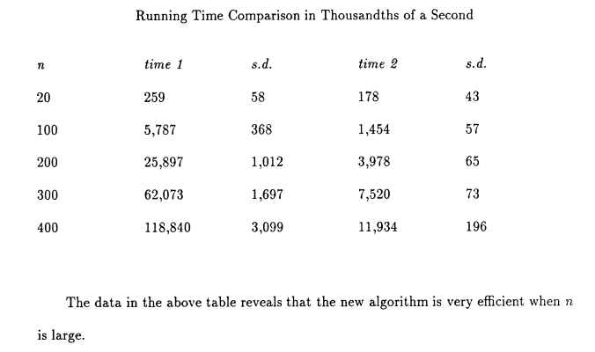
Conclusion

