Slide 1
IEEE International Conference on Computer Vision, 2011, Y. Chai, V. Lempitsky, and A. Zisserman
BiCoS: A Bi-level Co-Segmentation Method for Image Classification
Presenter：Wei-Hao Fu
Date：105/ 08/ 02
Notes:
1

Slide 2
Abstract(1/2)
The objective of this paper is the unsupervised segmentation of image training sets into foreground and background in order to improve image classification performance.
To this end we introduce a new scalable, alternation-based algorithm for co-segmentation, BiCoS, which is simpler than many of its predecessors, and yet has superior performance on standard benchmark image datasets.

Slide 3
Abstract(2/2)
We argue that the reason for this success is that the cosegmentation task is represented at the appropriate levels – pixels and color distributions for individual images, and super-pixels with learnable features at the level of sharing across the image set – together with powerful and efficient inference algorithms (GrabCut and SVM) for each level.
We assess both the segmentation and classification performance of the algorithm and compare to previous results on Oxford Flowers 17 & 102, Caltech-UCSD Birds-200, the Weizmann Horses, Caltech-4 benchmark datasets.

Slide 4

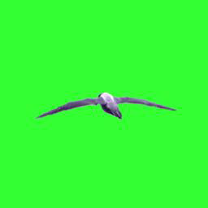
Image Segmentation
Partitioning an image into multiple segments.

Slide 5
Co-Segmentation
Consider sets of images where the appearance of foreground and/or background share some similarities, and try to leverage these similarities to obtain accurate foreground-background segmentations either totally-unsupervised, or with a small amount of interactive supervision.

Slide 6
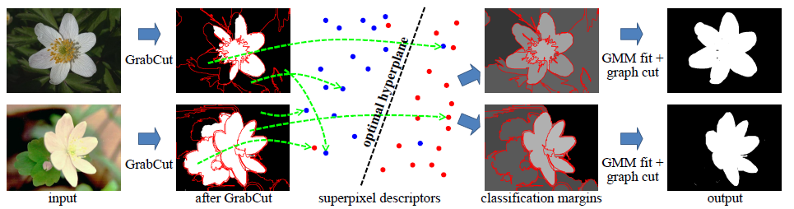
Bi-Level Co-Segmentation(BiCoS)
Initialization at the image level
Image level: GrabCut
Propagation at the dataset level
Dataset level: Co-Segmentation
Update at the image level

Slide 7
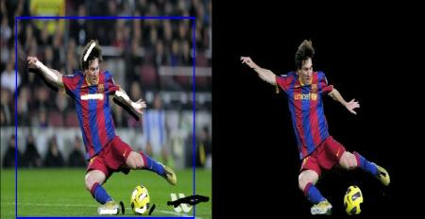
Image level: GrabCut
Use a mask to assign the foreground and the rest to background.
User can draw some pixels to improve the result.

Slide 8
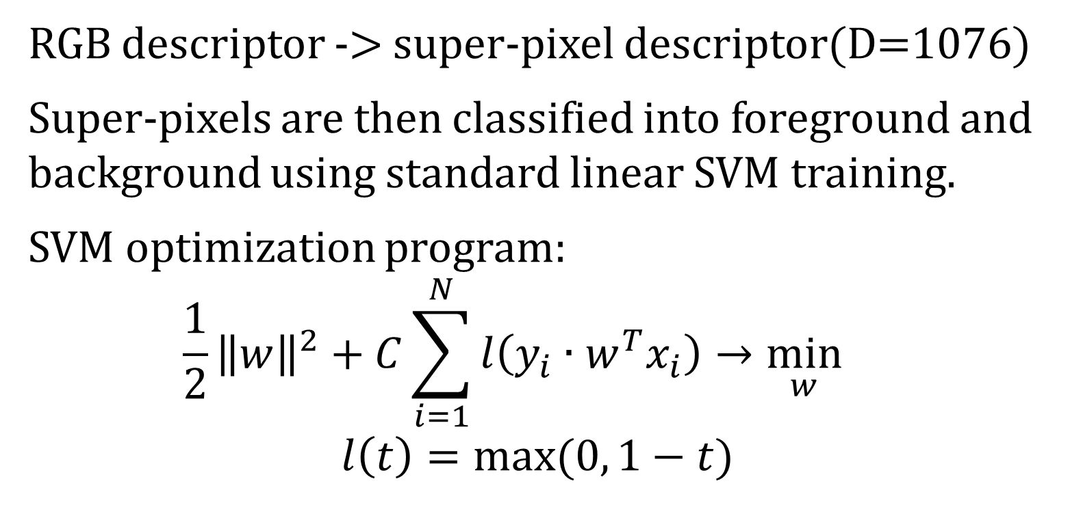
Dataset level: Co-Segmentation
RGB descriptor -> super-pixel descriptor(D=1076)
Super-pixels are then classified into foreground and background using standard linear SVM training.
SVM optimization program:
$$\frac{1}{2}{\left\|w\right\|}^{2}+C\sum_{i=1}^{N}{l\left(y_{i}∙w^{T}x_{i}\right)→\min_{w}{}}$$
$$l\left(t\right)=max⁡(0, 1−t)$$
Notes:
W: hyperplane
C: constant=10
yi: the binary label
xi: superpixels descriptor

Slide 9
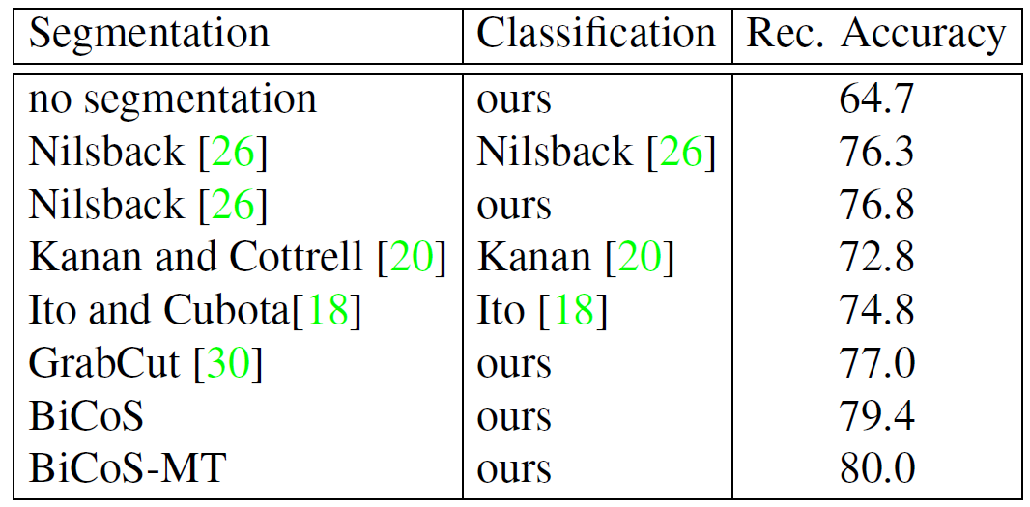
Result
Oxford Flowers 102

