Slide 1
A study of correlations in the stock market
Chandradew Sharma, Kinjal Banerjee
Physica A 432, pp.321-330, 2015
Presenter:Shih-jhan Huang

Slide 2
Abstract(1/2)
We study the various sectors of the Bombay Stock Exchange (BSE) for a period of 8 years from April 2006 to March 2014. Using the data of daily returns of a period of eight years, we make a direct model free analysis of the pattern of the sectorial indices movement and the correlations among them. Our analysis shows significant auto correlation among the individual sectors and also strong cross-correlation among sectors. We also find that auto correlations in some of the sectors persist in time. This is a very significant result and has not been reported so far in Indian context.

Slide 3
Abstract(2/2)
These findings will be very useful in model building for prediction of price movement of equities, derivatives and portfolio management.We show that the Random Walk Hypothesis is not applicable in modeling the Indian market and mean–variance–skewness–kurtosis based portfolio optimization might be required. We also find that almost all sectors are highly correlated during large fluctuation periods and have only moderate correlation during normal periods.

Slide 4
Study of this paper
How one stock movement affects the others within the same sector.
How the overall prices of the various sectors are correlated.

Slide 5
Data
Data consists of the daily returns of 12 sectors of stocks of the BSE for Financial Year 2006 to 2013. i.e. 1990 days from 3rd April 2006 to 31st March 2014.

Slide 6

If Pi(t) is the index of the sector i = 1, . . . , N at time t, then the (logarithmic) return of the ith sector over a time interval t = 1 to t = T days in the interval is defined as
In our case T = 1900, the number of days we have considered, and N = 13

Slide 7
The following 12 sectors :
1. S&P BSE Auto (Auto)
2. S&P BSE Bankex (Bankex)
3. S&P BSE Consumer Durables (CD)
4. S&P BSE Capital Goods (CG)
5. S&P BSE FMCG (FMCG)
6. S&P BSE Health care (HC)
7. S&P BSE IT (IT)
8. S&P BSE Metal (Metal)
9. S&P BSE Oil and Gas (Oil and Gas)
10. S&P BSE Power (Power)
11. S&P BSE Realty (Realty)
12. S&P BSE Teck (Teck)
S&P BSE SENSEX (Sensex) which serves as the benchmark.

Slide 8

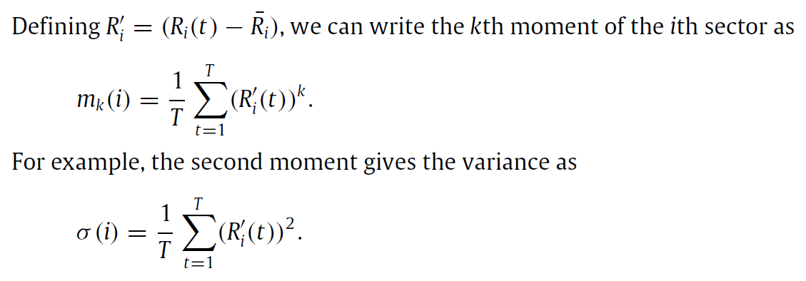
Mean return of the i_{th} sector

Slide 9
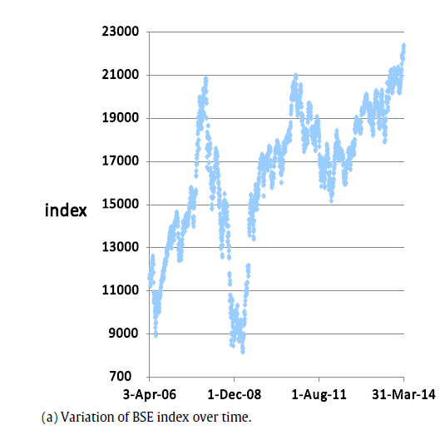
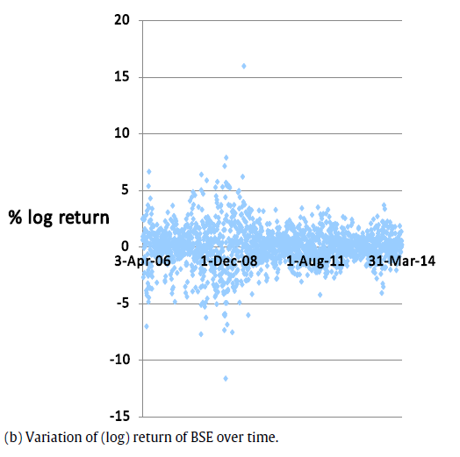
It is clear that we can divide the entire period in two sub interval (i) from FY 2006 to FY 2009 as large fluctuation period and (ii) from FY 2010 to FY 2013 for normal period.
large fluctuation
large fluctuation
normal
normal

Slide 10
這篇論文研究表示，任何Return基於常態分佈的預測都會失測。尤其是，有些存在偏差於常態分佈中，那麼Random Walk Hypothesis 將失證。
隨機漫步理論 (Random Walk Theory) ：
證券價格的波動是隨機的，像一個醉漢行走一樣，價格的下一步將走向哪裡，是沒有規律的。市場中，價格的走向受到多方面因素的影響。一件不起眼的小事也可能對市場產生巨大的影響。從長時間的價格走勢圖上也可以看出，價格的上下起伏的機會差不多是均等的。
市價會圍繞著內在價值而上下波動。這些波動卻是隨意而沒有任何軌跡可循。

Slide 11
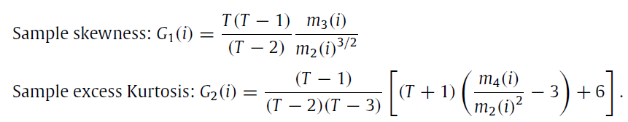
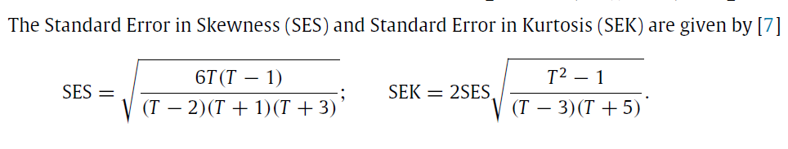
skewness and kurtosis
備註：Skewness
等於0 : 分佈對稱
大於0 : 分佈偏右
小於0 : 分佈偏左
備註：Kurtosis
等於0 : 常態峰
大於0 : 低闊峰
小於0 : 高狹峰

Slide 12
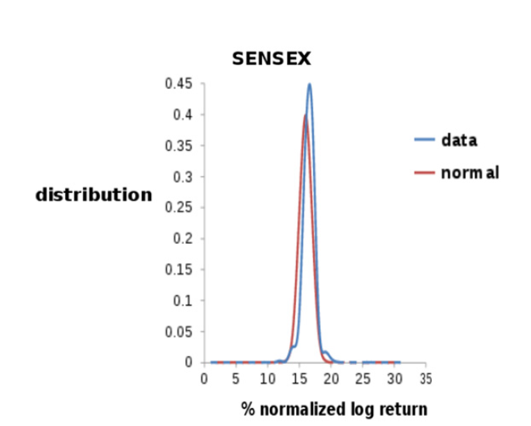
本篇論文data分佈呈高狹峰，如下圖所示 :

Slide 13
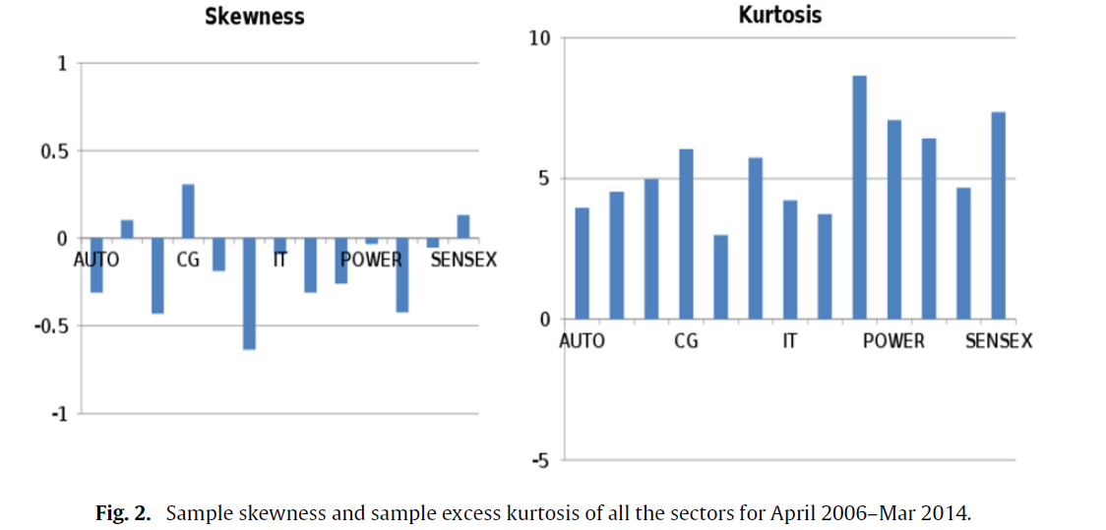
SEC=0.06 SEK=0.11

Slide 14
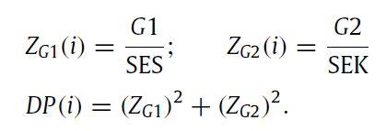
D’Agostino–Pearson omnibus test
If the distribution of ith sector is normal, the DP(i) should be that of χ distribution.
If DP(i) > χ² _{critical} , then the distribution of the ith sector is not normal.
For a normal distribution of ith sector, χ² _{critical}(2df ) should be 13.82 with significance level of 0.1%.
DP values for all the sectors are much larger than 13.82. Therefore, the statistical results clearly indicate that the data does not satisfy the normality.

Slide 15
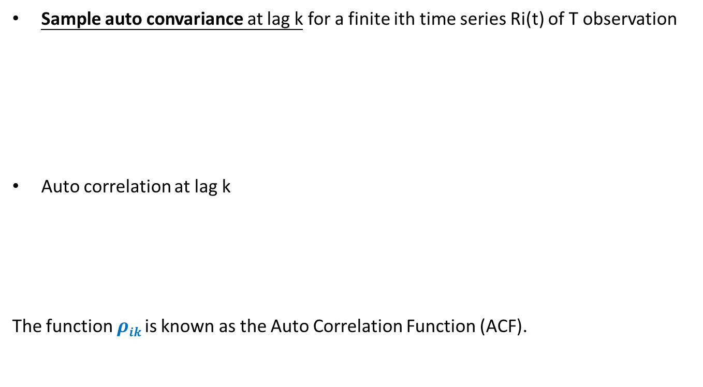
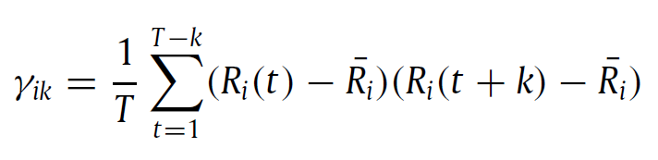
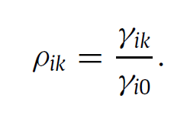
Auto correlation in the time series

Slide 16
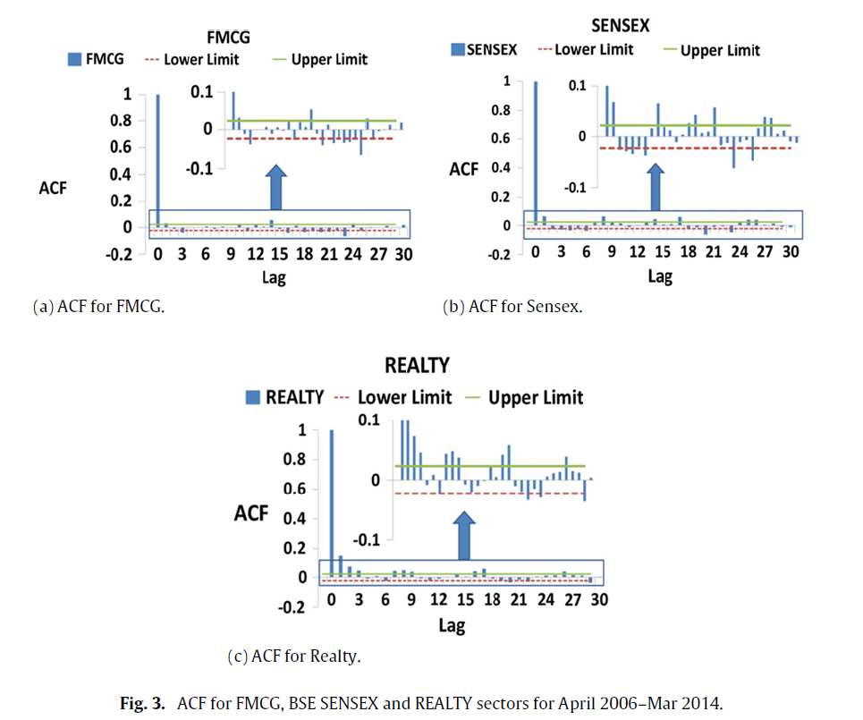
明顯可見，大部份的sectors of BSE at lag 1是有auto correlation的

Slide 17
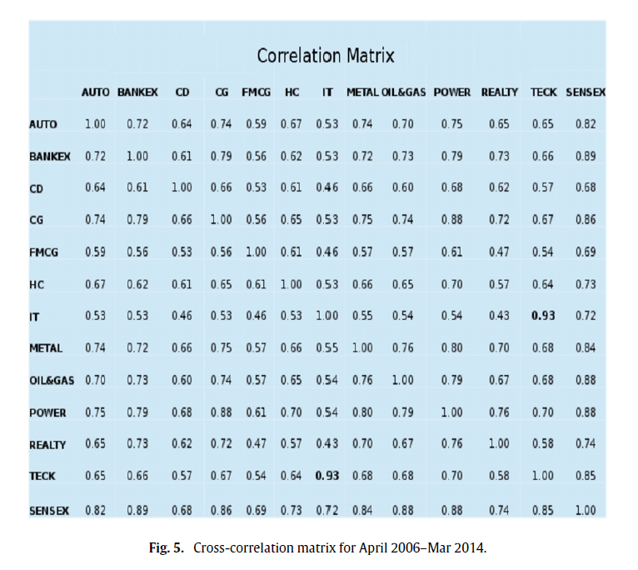
Cross-correlation
We estimate the sample cross correlation matrix for our data set. (N=13 T=1990)

Slide 18
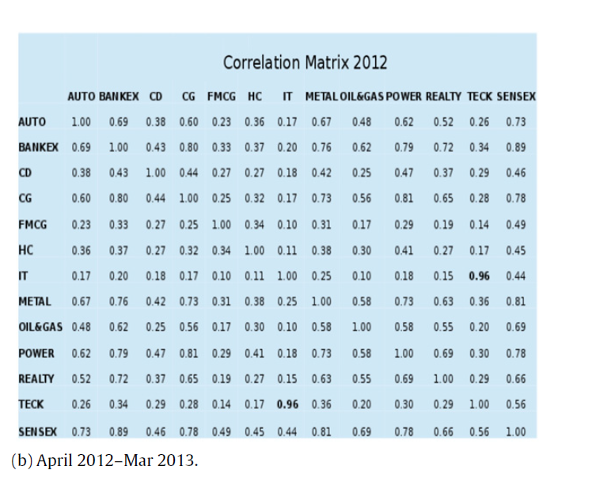
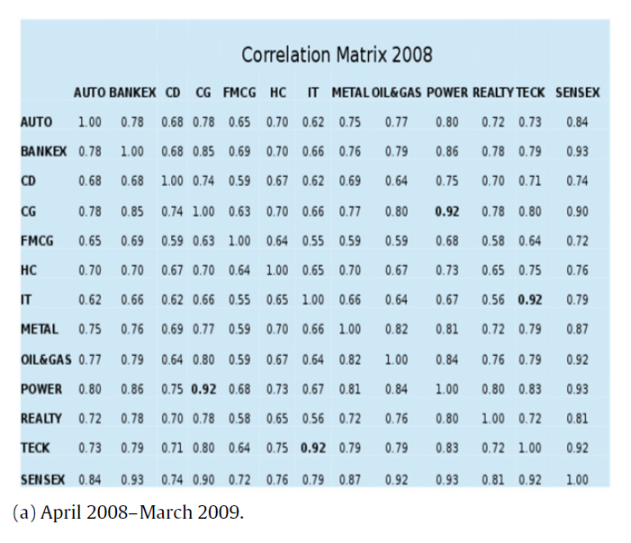
由下列結果可知： 當發生大幅度波動，此時間區間的的Cross correlation比較明顯；
而平緩的波動，此時間區間的Cross correlation比較不明顯。
此篇論文提出，Cross correlation值大時，是因為外力所影響，所以事實上平常的cross correlation值並不是那麼明顯。

Slide 19
結論
We found the presence of significant auto correlations in all the sectors clearly demonstrating that the movement of the stock prices cannot be modeled via random walk.
The ACF is significant for all sectors at lag one and there are certain sectors where this auto correlation persists at higher lags.
There exist a very large cross correlation but that correlation is due to some external force which drives the market as a whole.
The effect of sectors on each other is smaller but not insignificant and will be the focus of a future work.

