Slide 1
Efﬁcient algorithms for ﬁnding interleaving relationship between sequences
Kuo-Si Huang, Chang-Biau Yang, Kuo-Tsung Tseng,
Hsing-Yen Ann, Yung-Hsing Peng
Information Processing Letters 105 (2008) 188–193
Presenter: Chong-Xuan Lo
Date:2016/8/9

Slide 2
Abstract
The longest common subsequence and sequence alignment problems have been studied extensively and they can be regarded as the relationship measurement between sequences. However, most of them treat sequences evenly or consider only two sequences.
Recently, with the rise of whole-genome duplication research, the doubly conserved synteny relationship among three sequences should be considered. It is a brand new model to ﬁnd a merging way for understanding the interleaving relationship of sequences.

Slide 3
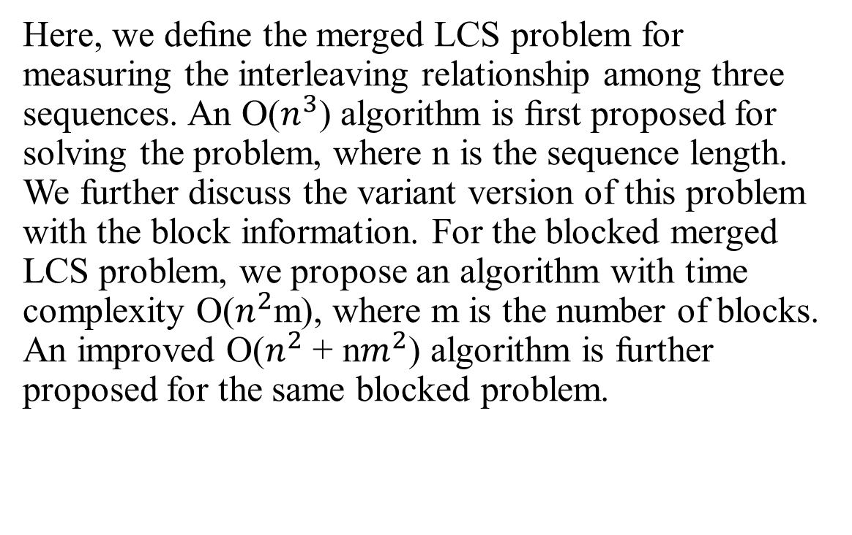
Abstract
Here, we deﬁne the merged LCS problem for measuring the interleaving relationship among three sequences. An O($n^{3}$) algorithm is ﬁrst proposed for solving the problem, where n is the sequence length. We further discuss the variant version of this problem with the block information. For the blocked merged LCS problem, we propose an algorithm with time complexity O($n^{2}$m), where m is the number of blocks. An improved O($n^{2}$ + n$m^{2}$) algorithm is further proposed for the same blocked problem.

Slide 4
Merged sequence
E(A,B) =e1e2e3 ··· e| E(A,B) | is obtained by merging two subsequences of A and B.
The merged sequence is not unique.
A = cgatacc B = aattcgc
E₁(A, B) = cgataaacgc
E₂(A, B) = aattcgcgcatacc
E₃(A, B) = cgaaatactcgc

Slide 5
Merged LCS (MLCS) problem
The merged LCS (MLCS) problem is to ﬁnd the LCS of T and E(A,B), denoted by LCS(T, E(A, B))
T = atacgcgctt
A = cgatacc
B = aattcgc
A = -----cg---at-acc
T = ata--cgcgc-tt---
B = a-att--cgc------
LCS (T , E(A, B) ) = aacgcgct = LCS (T , E₂ (A, B) )
E₁(A, B) = cgataaacgc
E₂(A, B) = aattcgcgcatacc
E₃(A, B) = cgaaatactcgc

Slide 6
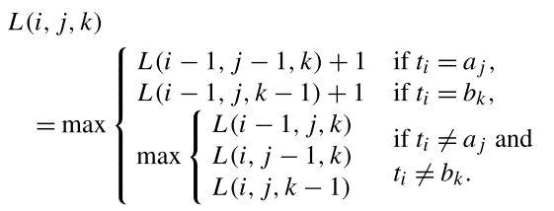
Merged LCS (MLCS) problem
Dynamic programming formula.
Time complexity: O(nm²), n=|T|, m = max{|A|, |B|}
Space complexity: O(nm)

Slide 7
Blocked Merged sequence
An interleaving block sequence of merging block sequences A and B, denoted as E^{b}(A, B)
The blocked merged sequence is not unique.
E^{b}₄(A^{b}, B^{b}) = A^{b}₁B^{b}₁B^{b}₂A^{b}₂ = cgat aat tc acc
E^{b}₅(A^{b}, B^{b}) = B^{b}₁A^{b}₁A^{b}₂B^{b}₂ = aat cgat acc tc
E^{b}₆(A^{b}, B^{b}) = B^{b}₁B^{b}₂A^{b}₁B^{b}₃A^{b}₂ = aat tc cgat gc acc
A^{b} = | cgat | acc
 | A^{b}₁ | A^{b}₂
B^{b} = | aat | tc | gc
 | B^{b}₁ | B^{b}₂ | B^{b}₃

Slide 8
Blocked Merged LCS
The BMLCS problem is to ﬁnd the block constrained LCS of T and E^{b} (A,B) , denoted by bLCS(T, E^{b} (A, B))
T = atacgcgctt
E^{b}₅(A^{b}, B^{b}) = B^{b}₁A^{b}₁A^{b}₂B^{b}₂ = aat cgat acc tc
T = a-ta cg-- -cgc t-t
E^{b}₅ (A^{b}, B^{b}) = aat- cgat ac-c tc-
bLCS (T , E^{b}(A^{b}, B^{b}) ) = atcgcct = bLCS (T , E^{b}₅(A^{b}, B^{b}) )
A^{b} = | cgat | acc
 | A^{b}₁ | A^{b}₂
B^{b} = | aat | tc | gc
 | B^{b}₁ | B^{b}₂ | B^{b}₃

Slide 9
Blocked Merged LCS
Consider the End symbol of block (EOB)
T
A
A^{b}₁
…
A^{b}_{j-1}
A^{b}_{j}
B
B^{b}₁
…
B^{b}_{k-1}
B^{b}_{k}

Slide 10
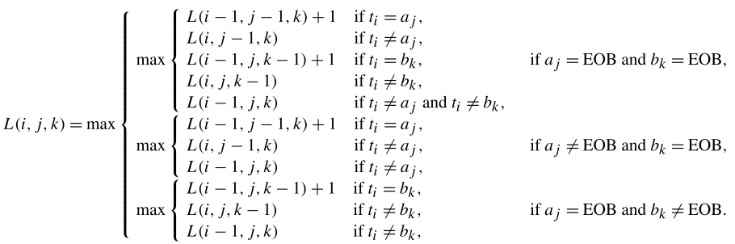
Blocked Merged LCS
Dynamic programing
Consider the symbol End of block (EOB)
time complexity is O(n m m_{b})
m = max{|A^{b}|, |B^{b}|}, m_{b}: max number of blocks in A^{b} and B^{b}

Slide 11
S-table for BMLCS
Step 1. Compute S-table S^{t}(T, A^{b}_{i}) and S^{t}(T, B^{b}_{j})
Step 2. Initialize L^{b}(i, 0, 0) = 0.
Step 3. V^{b}(j, k) =
max{V^{b}(j−1, k) ⊕ S^{t}(T, A^{b}_{j}) , V^{b}(j, k −1) ⊕ S^{t}(T,B^{b}_{k})}.
Step 4. Return L^{b}(|T|, α, β).

Slide 12
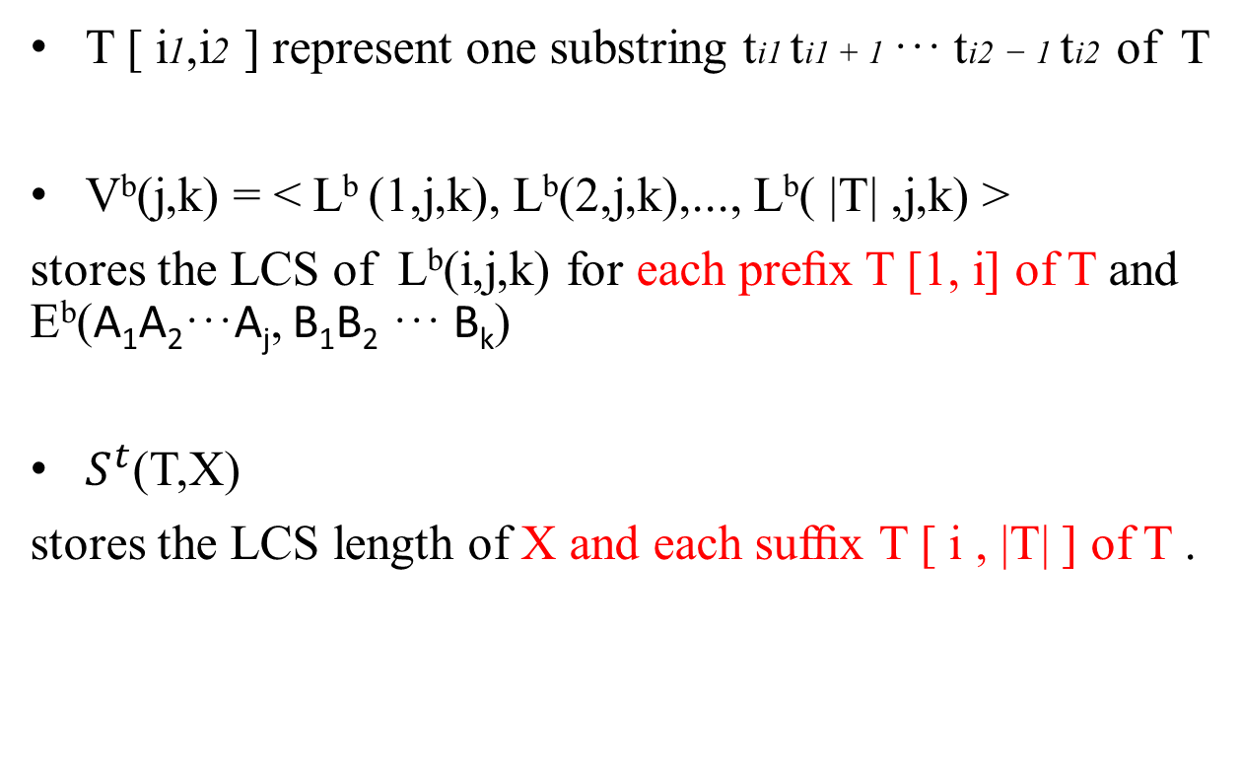
S-table for BMLCS
T [ i1,i2 ] represent one substring ti1 ti1 + 1 ··· ti2 − 1 ti2 of T
V^{b}(j,k) = < L^{b} (1,j,k), L^{b}(2,j,k),..., L^{b}( |T| ,j,k) >
stores the LCS of L^{b}(i,j,k) for each preﬁx T [1, i] of T and E^{b}(A₁A₂···A_{j}, B₁B₂ ··· B_{k})
$S^{t}$(T,X)
stores the LCS length of X and each sufﬁx T [ i , |T| ] of T .

Slide 13
S-table for BMLCS
T = atacgcgctt
A^{b} = | cgat | acc
 | A^{b}₁ | A^{b}₂
B^{b} = | aat | tc | gc
 | B^{b}₁ | B^{b}₂ | B^{b}₃
S^{t}(T, A^{b}₁)
T
 | a | t | a | c | g | c | g | c | t | t
c |  |  |  | v |  | v |  | v
g |  |  |  |  | v |  | v
a | v |  | v
t |  | v |  |  |  |  |  |  | v | v
LCS
A^{b}₁
 | 0 | 1 | 2 | 3
0 | 0 | 1 | 2 | 9
1 | 1 | 2 | 5 | 9
2 | 2 | 3 | 5 | 9
3 | 3 | 4 | 5 | 9
4 | 4 | 5 | 7 | 9
5 | 5 | 6 | 7 | 9
6 | 6 | 7 | 9
7 | 7 | 8 | 9
8 | 8 | 9
9 | 9
i
i = | 0 | 1 | 2 | 3 | 4 | 5 | 6 | 7 | 8 | 9 | 10
 | 0 | 1 | 2 | 2 | 2 | 2 | 2 | 2 | 2 | 3 | 3
LCS(T[1, i] , A^{b}₁)=
LCS(T[2, i] , A^{b}₁)=
LCS(T[3, i] , A^{b}₁)=
i = | 0 | 1 | 2 | 3 | 4 | 5 | 6 | 7 | 8 | 9 | 10
 | 0 | 0 | 1 | 1 | 1 | 2 | 2 | 2 | 2 | 3 | 3
i = | 0 | 1 | 2 | 3 | 4 | 5 | 6 | 7 | 8 | 9 | 10
 | 0 | 0 | 0 | 1 | 1 | 2 | 2 | 2 | 2 | 3 | 3

Slide 14
S-table for BMLCS
T = atacgcgctt
A^{b} = | cgat | acc
 | A^{b}₁ | A^{b}₂
B^{b} = | aat | tc | gc
 | B^{b}₁ | B^{b}₂ | B^{b}₃
S^{t}(T, A^{b}₁)
T
 | a | t | a | c | g | c | g | c | t | t
c |  |  |  | v |  | v |  | v
g |  |  |  |  | v |  | v
a | v |  | v
t |  | v |  |  |  |  |  |  | v | v
LCS
A^{b}₁
 | 0 | 1 | 2 | 3
0 | 0 | 1 | 2 | 9
1 | 1 | 2 | 5 | 9
2 | 2 | 3 | 5 | 9
3 | 3 | 4 | 5 | 9
4 | 4 | 5 | 7 | 9
5 | 5 | 6 | 7 | 9
6 | 6 | 7 | 9
7 | 7 | 8 | 9
8 | 8 | 9
9 | 9
i
i = | 0 | 1 | 2 | 3 | 4 | 5 | 6 | 7 | 8 | 9 | 10
 | 0 | 1 | 2 | 2 | 2 | 2 | 2 | 2 | 2 | 3 | 3
V^{b}(1,0)= LCS(T[1, i] , A^{b}₁)=

Slide 15
S-table for BMLCS
T = atacgcgctt
A^{b} = | cgat | acc
 | A^{b}₁ | A^{b}₂
B^{b} = | aat | tc | gc
 | B^{b}₁ | B^{b}₂ | B^{b}₃
S^{t}(T, B^{b}₁)
T
 | a | t | a | c | g | c | g | c | t | t
a | v |  | v
a | v |  | v
t |  | v |  |  |  |  |  |  | v | v
LCS
B^{b}₁
 | 0 | 1 | 2 | 3
0 | 0 | 1 | 2 | 9
1 | 1 | 2 | 9
2 | 2 | 3 | 9
3 | 3 | 9
4 | 4 | 9
5 | 5 | 9
6 | 6 | 9
7 | 7 | 9
8 | 8 | 9
9 | 9
i
i = | 0 | 1 | 2 | 3 | 4 | 5 | 6 | 7 | 8 | 9 | 10
 | 0 | 1 | 2 | 2 | 2 | 2 | 2 | 2 | 2 | 3 | 3
V^{b}(0, 1)=LCS(T[1, i] , B^{b}₁)=

Slide 16
S-table for BMLCS
Step 1. Compute S-table S^{t}(T, A^{b}_{i}) and S^{t}(T, B^{b}_{j})
Step 2. Initialize L^{b}(i, 0, 0) = 0.
Step 3. V^{b}(j, k) =
max{V^{b}(j−1, k) ⊕ S^{t}(T, A^{b}_{j}) , V^{b}(j, k −1) ⊕ S^{t}(T, B^{b}_{k})}.
Step 4. Return L^{b}(|T|, α, β).

Slide 17
S-table for BMLCS
S^{t}(T, B^{b}₁)
0 | 1 | 2 | 9
1 | 2 | 9
2 | 3 | 9
3 | 9
4 | 9
5 | 9
6 | 9
7 | 9
8 | 9
9
T = atacgcgctt
A^{b} = | cgat | acc
 | A^{b}₁ | A^{b}₂
B^{b} = | aat | tc | gc
 | B^{b}₁ | B^{b}₂ | B^{b}₃
i = | 0 | 1 | 2 | 3 | 4 | 5 | 6 | 7 | 8 | 9 | 10
 | 0 | 1 | 2 | 2 | 2 | 2 | 2 | 2 | 2 | 3 | 3
V^{b}(1, 0)=LCS(T[1, i] , A^{b}₁)=
 | 0 | 1 | 2 | 9
 |  | 1 | 2 | 9
 |  |  | 2 | 3 | 9
⊕ |  |  |  | 9
 | 0 | 1 | 2 | 3 | 9
i = | 0 | 1 | 2 | 3 | 4 | 5 | 6 | 7 | 8 | 9 | 10
 | 0 | 1 | 2 | 3 | 3 | 3 | 3 | 3 | 3 | 4 | 4
V^{b}(1, 1) = V^{b}(1, 0) ⊕ S^{t}(T, B^{b}₁) = LCS(T[1, i] , A^{b}₁ B^{b}₁) =

Slide 18
S-table for BMLCS
S^{t}(T, A^{b}₁)
0 | 1 | 2 | 9
1 | 2 | 5 | 9
2 | 3 | 5 | 9
3 | 4 | 5 | 9
4 | 5 | 7 | 9
5 | 6 | 7 | 9
6 | 7 | 9
7 | 8 | 9
8 | 9
9
T = atacgcgctt
A^{b} = | cgat | acc
 | A^{b}₁ | A^{b}₂
B^{b} = | aat | tc | gc
 | B^{b}₁ | B^{b}₂ | B^{b}₃
i = | 0 | 1 | 2 | 3 | 4 | 5 | 6 | 7 | 8 | 9 | 10
 | 0 | 1 | 2 | 2 | 2 | 2 | 2 | 2 | 2 | 3 | 3
V^{b}(0, 1)=LCS(T[1, i] , B^{b}₁)=
 | 0 | 1 | 2 | 9
 |  | 1 | 2 | 5 | 9
 |  |  | 2 | 3 | 5 | 9
⊕ |  |  |  | 9
 | 0 | 1 | 2 | 3 | 5 | 9
i = | 0 | 1 | 2 | 3 | 4 | 5 | 6 | 7 | 8 | 9 | 10
 | 0 | 1 | 2 | 3 | 3 | 4 | 4 | 4 | 4 | 5 | 5
V^{b}(1, 1) = V^{b}(0, 1) ⊕ S^{t}(T, A^{b}₁) = LCS(T[1, i] , B^{b}₁ A^{b}₁) =

Slide 19
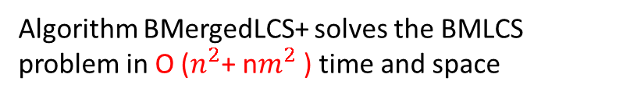
S-table for BMLCS
T = atacgcgctt
A^{b} = | cgat | acc
 | A^{b}₁ | A^{b}₂
B^{b} = | aat | tc | gc
 | B^{b}₁ | B^{b}₂ | B^{b}₃
i = | 0 | 1 | 2 | 3 | 4 | 5 | 6 | 7 | 8 | 9 | 10
 | 0 | 1 | 2 | 3 | 3 | 4 | 4 | 4 | 4 | 5 | 5
V^{b}(1, 1) =max {V^{b}(1, 0) ⊕ S^{t}(T, B^{b}₁), V^{b}(0, 1) ⊕ S^{t}(T, A^{b}₁) } =
Algorithm BMergedLCS+ solves the BMLCS problem in O ($n^{2}$+ n$m^{2}$ ) time and space

