Slide 1
Fully Incremental LCS Computation
Yusuke Ishida, Shunsuke Inenaga,
Ayumi Shinohara, and Masayuki Takeda
Proceedings of the 15th international conference on Fundamentals of Computation Theory 2005. pp. 563-574.
Presenter: Bi-Shiang Lin
Date:2016/8/16

Slide 2
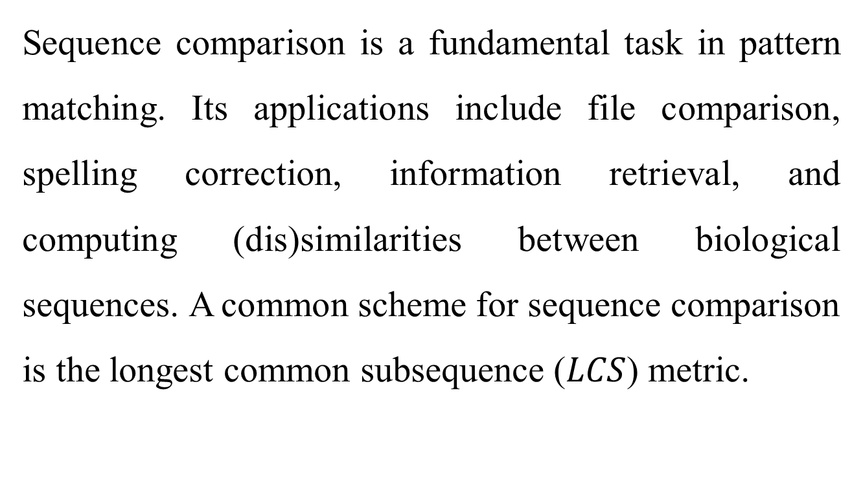
Abstract(1/3)
Sequence comparison is a fundamental task in pattern matching. Its applications include file comparison, spelling correction, information retrieval, and computing (dis)similarities between biological sequences. A common scheme for sequence comparison is the longest common subsequence ($LCS$) metric.

Slide 3
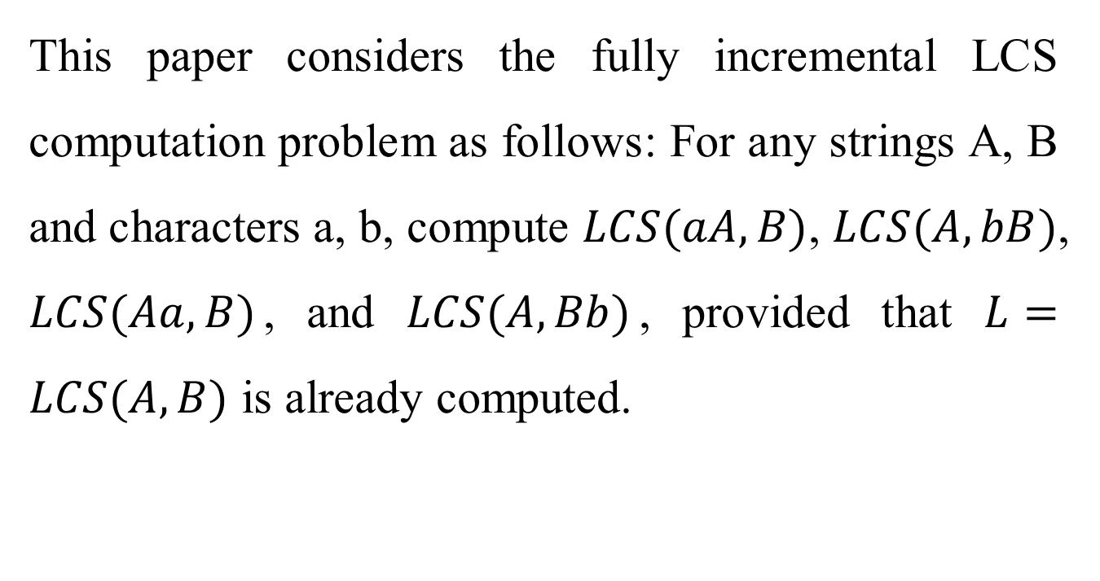
Abstract(2/3)
This paper considers the fully incremental LCS computation problem as follows: For any strings A, B and characters a, b, compute $LCS(aA, B)$, $LCS(A, bB)$, $LCS(Aa, B)$, and $LCS(A, Bb)$, provided that $L=LCS(A,B)$ is already computed.

Slide 4
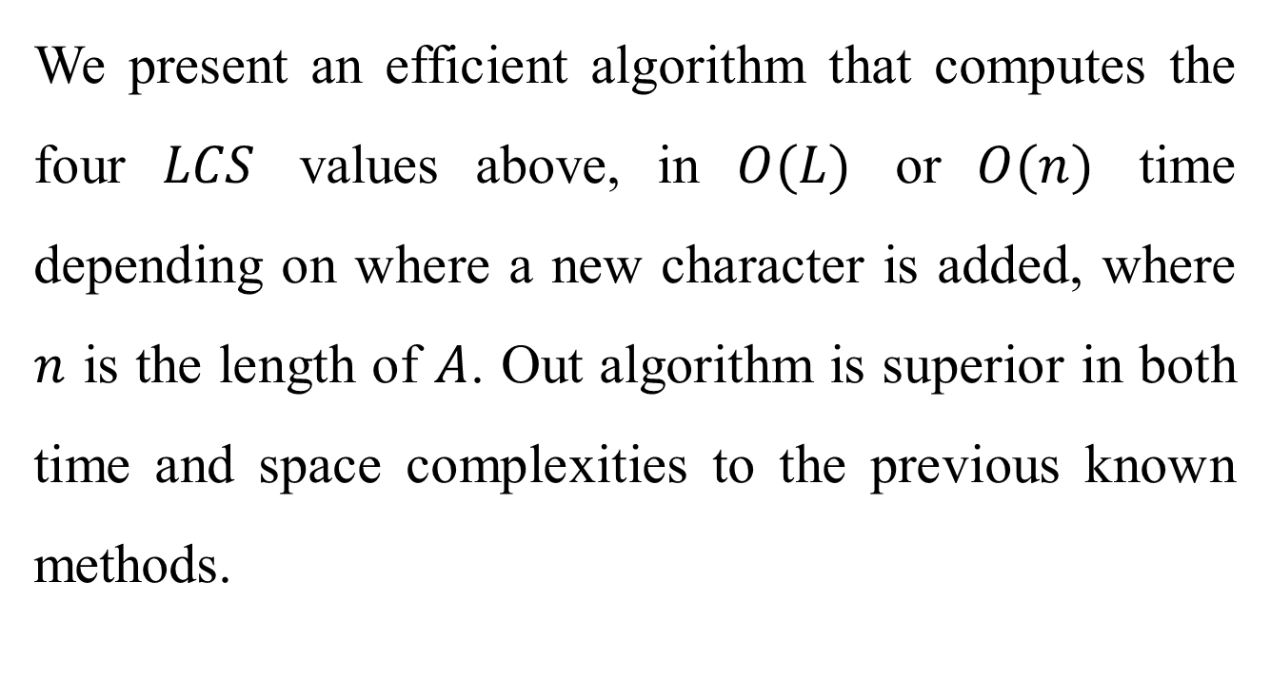
Abstract(3/3)
We present an efficient algorithm that computes the four $LCS$ values above, in $O(L)$ or $O(n)$ time depending on where a new character is added, where $n$ is the length of $A$. Out algorithm is superior in both time and space complexities to the previous known methods.

Slide 5
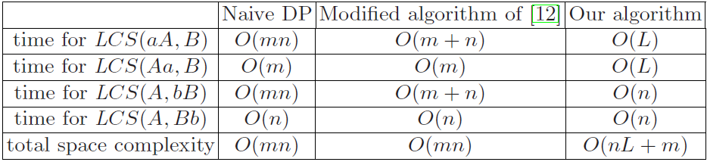
Comparison of the complexities
Kim, S.R., Park, K. A dynamic edit distance table (2000)

Slide 6
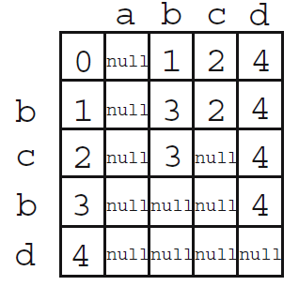

Preprocessing
String $B=bcbd$.
Fixed size alphabet, $O(m)$.

Slide 7
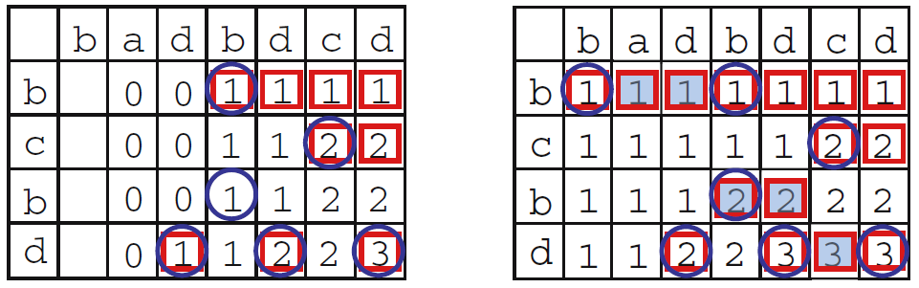
1. LCS(aA, B)
Landau G.M., Myers E., Ziv-Ukelson M. Two algorithms for LCS Consecutive Suffix Alignment(2004)
LCS(A, B) → LCS(aA, B)

Slide 8
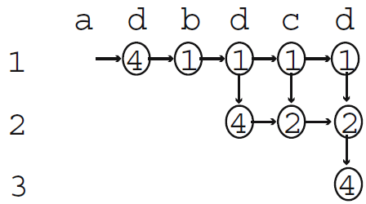
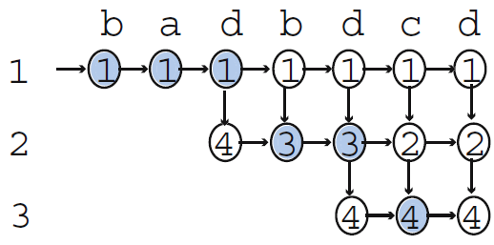

Amotized $O(L)$ time.

Slide 9
2. LCS(A, bB)
LCS(A, B) → LCS(A, bB)
 | b | a | d | b | d | c | d
d
b | 1 | 1 | 1 | 1 | 1 | 1 | 1
c | 1 | 1 | 1 | 1 | 1 | 2 | 2
b | 1 | 1 | 1 | 2 | 2 | 2 | 2
d | 1 | 1 | 2 | 2 | 3 | 3 | 3
 | b | a | d | b | d | c | d
d | 0 | 0 | 1 | 1 | 1 | 1 | 1
b | 1 | 1 | 1 | 2 | 2 | 2 | 2
c | 1 | 1 | 1 | 2 | 2 | 3 | 3
b | 1 | 1 | 1 | 2 | 2 | 3 | 3
d | 1 | 1 | 2 | 2 | 3 | 3 | 4

Slide 10
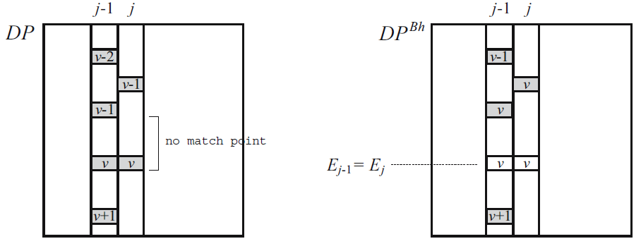
If no match point in the area, the eliminated point $E_{j}=E_{j−1}$.

Slide 11
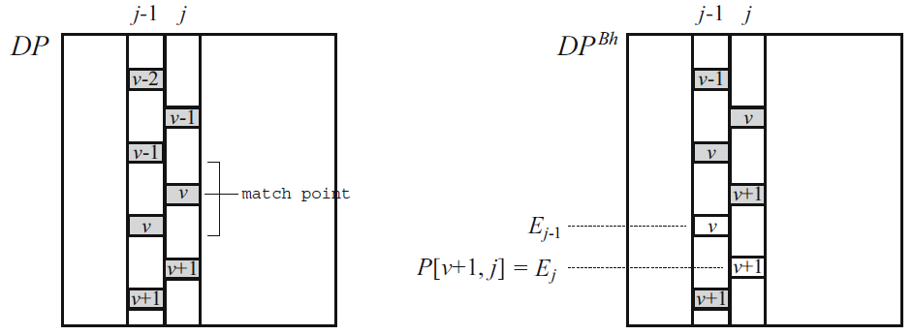

Otherwise, the eliminated point $E_{j}=P[v+1,j]$.

Slide 12
 | b | a | d | b | d | c | d
d | 0 | 0
b | 1 | 1 | 1 | 1 | 1 | 1 | 1
c | 1 | 1 | 1 | 1 | 1 | 2 | 2
b | 1 | 1 | 1 | 2 | 2 | 2 | 2
d | 1 | 1 | 2 | 2 | 3 | 3 | 3
 | b | a | d | b | d | c | d
d | 0 | 0 | 1
b | 1 | 1 | 1 | 1 | 1 | 1 | 1
c | 1 | 1 | 1 | 1 | 1 | 2 | 2
b | 1 | 1 | 1 | 2 | 2 | 2 | 2
d | 1 | 1 | 2 | 2 | 3 | 3 | 3

Slide 13
 | b | a | d | b | d | c | d
d | 0 | 0 | 1
b | 1 | 1 | 1 | 1 | 1 | 1 | 1
c | 1 | 1 | 1 | 1 | 1 | 2 | 2
b | 1 | 1 | 1 | 2 | 2 | 2 | 2
d | 1 | 1 | 2 | 2 | 3 | 3 | 3
 | b | a | d | b | d | c | d
d | 0 | 0 | 1 | 1
b | 1 | 1 | 1 | 2 | 1 | 1 | 1
c | 1 | 1 | 1 | 2 | 1 | 2 | 2
b | 1 | 1 | 1 | 2 | 2 | 2 | 2
d | 1 | 1 | 2 | 2 | 3 | 3 | 3

Slide 14
 | b | a | d | b | d | c | d
d | 0 | 0 | 1 | 1
b | 1 | 1 | 1 | 2 | 1 | 1 | 1
c | 1 | 1 | 1 | 1 | 1 | 2 | 2
b | 1 | 1 | 1 | 2 | 2 | 2 | 2
d | 1 | 1 | 2 | 2 | 3 | 3 | 3
 | b | a | d | b | d | c | d
d | 0 | 0 | 1 | 1 | 1
b | 1 | 1 | 1 | 2 | 2 | 1 | 1
c | 1 | 1 | 1 | 2 | 2 | 2 | 2
b | 1 | 1 | 1 | 2 | 2 | 2 | 2
d | 1 | 1 | 2 | 2 | 3 | 3 | 3

Slide 15
 | b | a | d | b | d | c | d
d | 0 | 0 | 1 | 1 | 1
b | 1 | 1 | 1 | 2 | 2 | 1 | 1
c | 1 | 1 | 1 | 1 | 2 | 2 | 2
b | 1 | 1 | 1 | 2 | 2 | 2 | 2
d | 1 | 1 | 2 | 2 | 3 | 3 | 3
 | b | a | d | b | d | c | d
d | 0 | 0 | 1 | 1 | 1 | 1
b | 1 | 1 | 1 | 2 | 2 | 2 | 1
c | 1 | 1 | 1 | 2 | 2 | 3 | 2
b | 1 | 1 | 1 | 2 | 2 | 3 | 2
d | 1 | 1 | 2 | 2 | 3 | 3 | 3

Slide 16
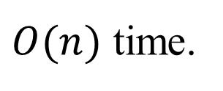
 | b | a | d | b | d | c | d
d | 0 | 0 | 1 | 1 | 1 | 1
b | 1 | 1 | 1 | 2 | 2 | 2 | 1
c | 1 | 1 | 1 | 1 | 2 | 3 | 2
b | 1 | 1 | 1 | 2 | 2 | 3 | 2
d | 1 | 1 | 2 | 2 | 3 | 3 | 3
 | b | a | d | b | d | c | d
d | 0 | 0 | 1 | 1 | 1 | 1 | 1
b | 1 | 1 | 1 | 2 | 2 | 1 | 2
c | 1 | 1 | 1 | 2 | 2 | 2 | 3
b | 1 | 1 | 1 | 2 | 2 | 2 | 3
d | 1 | 1 | 2 | 2 | 3 | 3 | 4
$O(n)$ time.

Slide 17
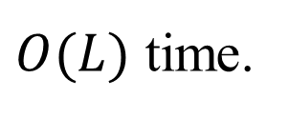
3. LCS(Aa, B)
 | b | a | d | b | d | c | d | b
b | 1 | 1 | 1 | 1 | 1 | 1 | 1
c | 1 | 1 | 1 | 1 | 1 | 2 | 2
b | 1 | 1 | 1 | 2 | 2 | 2 | 2
d | 1 | 1 | 2 | 2 | 3 | 3 | 3
LCS(A, B)
↓
LCS(Aa, B)
 | b | a | d | b | d | c | d | b
b | 1 | 1 | 1 | 1 | 1 | 1 | 1 | 1
c | 1 | 1 | 1 | 1 | 1 | 2 | 2 | 2
b | 1 | 1 | 1 | 2 | 2 | 2 | 2 | 3
d | 1 | 1 | 2 | 2 | 3 | 3 | 3 | 3
$O(L)$ time.

Slide 18
4. LCS(A, Bb)
 | b | a | d | b | d | c | d
b | 1 | 1 | 1 | 1 | 1 | 1 | 1
c | 1 | 1 | 1 | 1 | 1 | 2 | 2
b | 1 | 1 | 1 | 2 | 2 | 2 | 2
d | 1 | 1 | 2 | 2 | 3 | 3 | 3
c
 | b | a | d | b | d | c | d
b | 1 | 1 | 1 | 1 | 1 | 1 | 1
c | 1 | 1 | 1 | 1 | 1 | 2 | 2
b | 1 | 1 | 1 | 2 | 2 | 2 | 2
d | 1 | 1 | 2 | 2 | 3 | 3 | 3
c | 1 | 1 | 2 | 2 | 3 | 4 | 4
If score is greater than previous, do nothing. (X)
Else, if it is a match point, add a new point. (O)
Else, if previous score is greater, add a new point.(O)
$O(n)$ time.

Slide 19
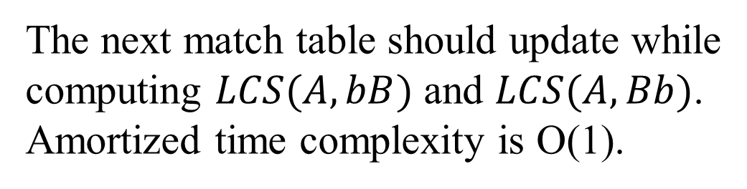
Comparison of the complexities
The next match table should update while
computing $LCS(A, bB)$ and $LCS(A, Bb)$.
Amortized time complexity is O(1).

