Slide 1
Using Persistent Data Structures for Adding Range Restrictions to Searching Problems
RAIRO Theoretical Informatics and Applications, Vol. 28, pp. 25-49, 1994
Hans-Peter Lenhof and Michiel Smid
Presenter: Chiou-Ting Tseng
Date: Dec. 8, 2009

Slide 2
Abstract
The problem of adding range restrictions to decomposable searching problem is considered. First, a general technique is given that makes an arbitrary dynamic data structure partially persistent. Then, a general technique is given that transforms a partially persistent data structure that solves a decomposable searching problem into a structure for the same problem with added range restrictions.

Slide 3
Abstract
Applying the general technique to specific searching problem gives efficient data structures, especially in case more than one range restriction, one of which has constant width, is added.

Slide 4
Searching Problems
Member searching: Given a set V of objects, answer whether q belongs to V.
(Orthogonal) range searching: Given a set of point V and a hyper-rectangle q, find all points located in q.
Nearest neighbor searching: Given a set V of points, find the one nearest to q.

Slide 5
Decomposable Searching Problem
PR(q, V)=(PR(q, A), PR(q, B)) for any V=A∪B, and any q, where can be calculated in constant time.
For member searching, = OR
For range searching, = ∪
For nearest neighbor searching, = min

Slide 6
Adding Range Restriction
For every element x in V, we have an additional parameter k_{x} and we only query objects in V that have k_{x} in the given range restriction.
Ex: V={1, 5, 2, 3}, we add a second dimension →V={(1, 4), (5, 2), (2, 3), (3, 6)} and the range restriction is [3, 5] then we only consider {(1, 4), (2, 3)}

Slide 7
Example
V=城市，k_{x}=人口，則我們可以找人口介於10萬到100萬的城市裡，最接近某一個點的。
n-dimensional range searching can be viewed as adding range restriction to (n-1)-dimensional range searching.

Slide 8
Previous Works
PR has query time of Q(n), data structure size of S(n) and building time T(n).
TPR can be solved by multiplying them by O(log n).
例: 2-D searching可以先找到x軸，再對每一個x對應的y作binary search。

Slide 9
Main Focus
This paper focuses on the constant width range restriction.
Extend to adding several range restrictions but one is with fixed width.
Q(n)/n, S(n)/n and P(n)/n are all non-decreasing.

Slide 10
Partially Persistent Data Structure
Can query the value of certain object at a certain time but modification can only be done to the current state.
Implemented using randomized van Emde Boas Tree.
Call it PPDS in the future.

Slide 11
Randomized van Emde Boas Tree
Implemented using dynamic perfect hashing, stratified tree and bucketing.
Predecessor O(log log n) worst case time, insertion maximal O(1) amortized time, search maximal O(1) worst case time, initialize O(1) worst case time, size O(m).

Slide 12
Transforming into Partially Persistent Data Structure
In this paper we use the RAM model which given an address, the value can be obtained in constant time.
For each memory location we maintain a randomized van Emde Boas Tree and take the time of updating as the key.

Slide 13
Update Algorithm
If we want to update memory position i at time t, we add a new element with key t to the vEB tree related to position i, O(1) time.
If this position is never been updated, we create a new vEB tree related to position i, O(1) time.

Slide 14
Query Algorithm
To query memory location i at time t, we query the vEB tree related to position i and find the predecessor of t for the value.

Slide 15
Complexity(1)
If the original data structure has query time Q(n), update time U(n) and space S(n) while changing C(n) memory locations during the updates.
One query: O(Q(n) log log n)
One update: O(U(n))
Total space: O(S(n) + n C(n))

Slide 16
Complexity(2)
If the original data structure is randomized vEB tree storing m integers in [1…n], Q(n) = O(loglog n), U(n) = O(loglog n), S(n)=O(m), C(n)=O(loglog n).
One query: O((log log n)²)
One update: O(log log n)
Total space: O(n log log n)

Slide 17
New van Emde Boas Tree
If only insertions are performed, there exists a partially persistent version of the vEB tree having size O(m) if it stores m integers in the range [1…n]. In this data structure, we can insert an element in the current version in O(log log n) amortized time. Moreover, we can solve a one-dimensional range query in an arbitrary version in O(log log n + k) time, if k is the size of the output.

Slide 18
New van Emde Boas Tree
A complete binary tree with bucketing.
S={1, 2, 5, 8}
1
2
3
4
5
6
7
8

Slide 19
Only Half-infinite Restriction
If we can solve TPR(q, [a : ∞), V) then if we store –k_{x} in the data structure, we can solve TPR(q, (-∞ : b], V).
Since we only deal with constant width restriction, we partition the k_{x}-axis into slices of constant width.
For each slice with element in it, we maintain a data structure.

Slide 20
Algorithm
k_{x}
a+c
a
x
x₁
x₂

Slide 21
Data Structure
For each non-empty slice, 一個DS回答[a : ∞)，一個DS回答(-∞ : b]
A balanced binary search tree indexing all non-empty slice pointing to the two DS.

Slide 22
Search
Search for [a, a+c], i=⎣a/c⎦
Search in the BST for i.
Query [a : ∞) in DS_{i}.
Query (-∞ : a+c] in DS_{i+1}
Use the merge operator in PR to get the final result.

Slide 23
Complexity
Because Q(n)/n, S(n)/n and P(n)/n are all non-decreasing.
Query time: O(Q(n) + log n)
Size: O(S(n))
Build time: O(P(n)+n log n)

Slide 24
TPR - Build Algorithm
Sort the objects according to k_{x}
Store the keys in this order into an array.
Insert the objects according to the order of k_{x} into an initially empty PPDS using k_{x} as the time.

Slide 25
TPR - Query Algorithm
To answer TPR(q, (-∞ : b], V)
Search in the array for b, let i be the position.
The set of elements V’ in slice i’ at time b is the set we want.
Solve PR(q,V’)

Slide 26
Time Complexity
Query time: O(Q(n) + log n)
Size: O(S(n))
Build time: O(n I(n) + n log n)

Slide 27
Fixed Height Range Searching
2-Dimension
Query time: O(log n + k)
Size: O(n)
Build time: O(n log n)

Slide 28
Fixed Height Range Searching
d-Dimension
Use technique of Bently for the first d-2 dimension.
Query time: O((log n)^{d-1} + k)
Size: O(n(log n)^{d-2})
Build time: O(n(log n)^{d-1})

Slide 29
Adding Several Range Restrictions
Each element has two additional parameter, k_{x} and l_{x}
TPR(q, [a₁ : b₁] × [a₂ : a₂ + c], V)=PR(q, {x∈V: a₁≤ k_{x} ≤ b₁, a₂ ≤ l_{x} ≤ a₂ + c])

Slide 30
Data Structure
Store all k_{x} in a binary search tree.
For each node w in the tree we store a pointer to an array containing all elements in the subtree rooted at w sorted according to l_{x}.
For every element of the array we also store two pointers pointing to the elements with the largest l_{x} ≤ l_{w} of the two sons (in their array).

Slide 31
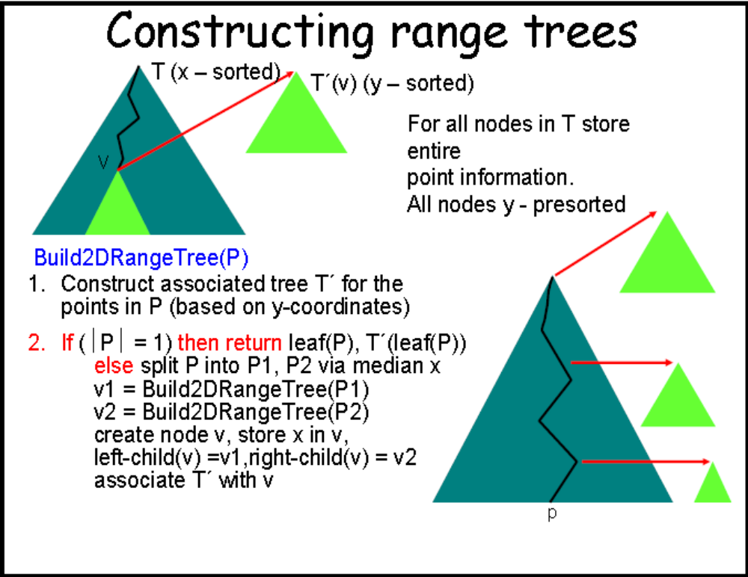

Slide 32
Fractional Cascading
一個把一些東西做合併的泛用方法。
Ex. We have k sorted lists, total size n, we want to do binary search on all of them,.
L₁=2.4, 6.4, 6.5, 8.0, 9.3
L₂=2.3, 2.5, 2.6
L₃=1.3, 4.4, 6.2, 6.6
L₄=1.1, 3.5, 4.6, 7.9, 8.1

Slide 33
Method 1
Search on all lists separately.
Query time: O(klog(n / k))
Space: O(n)

Slide 34
Method 2
Merge all n lists together into one list and record the position of the first “≥” element of every element in each list.
L = 1.1[0,0,0,0], 1.3[0,0,0,1], 2.3[0,0,1,1], 2.4[0,1,1,1], 2.5[1,1,1,1], 2.6[1,2,1,1], 3.5[1,3,1,1], 4.4[1,3,1,2], 4.6[1,3,2,2], 6.2[1,3,2,3], 6.4[1,3,3,3], 6.5[2,3,3,3], 6.6[3,3,3,3], 7.9[3,3,4,3], 8.0[3,3,4,4], 8.1[4,3,4,4], 9.3[4,3,4,5]

Slide 35
Method 2
Query Time: O(log n + k)
Space: O(kn)

Slide 36
Fractional Cascading
Space: O(n)
Query time: O(log n + k)
M_{k}=L_{k}
M_{i}=Merge( Every second element of M_{i+1}, L_{i}), record two numbers together with each element, [The position in L_{i}, the position in M_{i+1}]

Slide 37
Merge Example
L₄=1.1, 3.5, 4.6, 7.9, 8.1
M₄ = 1.1[0, 0], 3.5[1, 0], 4.6[2, 0], 7.9[3, 0], 8.1[4, 0]
L₃=1.3, 4.4, 6.2, 6.6
M₃ = 1.3[0, 1], 3.5[1, 1], 4.4[1, 2], 6.2[2, 3], 6.6[3, 3], 7.9[4, 3]

Slide 38
Merge Example
M₃ = 1.3[0, 1], 3.5[1, 1], 4.4[1, 2], 6.2[2, 3], 6.6[3, 3], 7.9[4, 3]
L₂=2.3, 2.5, 2.6
M₂ = 2.3[0, 1], 2.5[1, 1], 2.6[2, 1], 3.5[3, 1], 6.2[3, 3], 7.9[3, 5]

Slide 39
Merge Result
M₁ = 2.4[0, 1], 2.5[1, 1], 3.5[1, 3], 6.4[1, 5], 6.5[2, 5], 7.9[3, 5], 8[3, 6], 9.3[4, 6]
M₂ = 2.3[0, 1], 2.5[1, 1], 2.6[2, 1], 3.5[3, 1], 6.2[3, 3], 7.9[3, 5]
M₃ = 1.3[0, 1], 3.5[1, 1], 4.4[1, 2], 6.2[2, 3], 6.6[3, 3], 7.9[4, 3]
M₄ = 1.1[0, 0], 3.5[1, 0], 4.6[2, 0], 7.9[3, 0], 8.1[4, 0]

Slide 40
Search Example
q=5
6.4[1, 5]→在L₁的第1個位置，約在M₂的第5個位置
把5和6.2, 7.9比較得知確切是6.2[3, 3]→在L₂的第3個位置，約在M₃的第3個位置
把5和4.4, 6.2比較得知確切是6.2[2, 3]→在L₃的第2個位置，約在M₄的第3個位置
把5和4.6, 7.9比較得知確切是7.9[3, 0]→在L₄的第3個位置

Slide 41
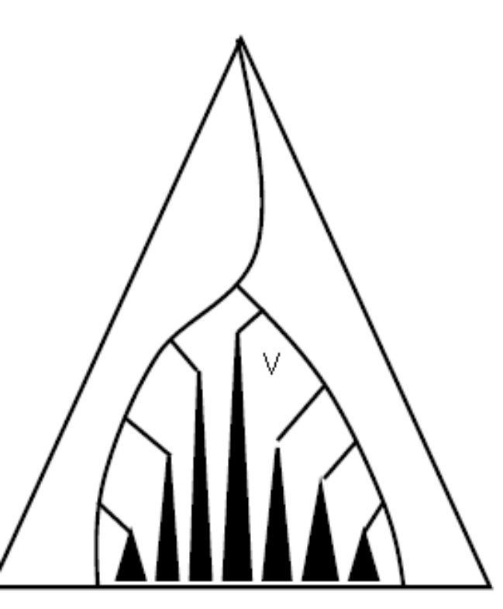
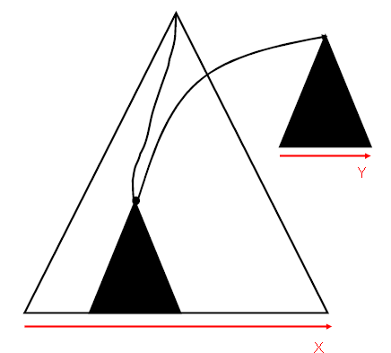
Back to Data Structure

Slide 42
Example
S={(1, 6), (2, 3), (3, 5), (5, 5), (7, 8), (8, 1), (9, 4)}原文說存在leaf
(5,2)
[4, 5, 6, 8]
(2,3)
[5, 6]
(8,1)
[4, 8]
(1,6)
[5]
(3,5)
[6]
(7,8)
[8]
(9,4)
[4]

Slide 43
Data Structure
We maintain the PPDS for the binary search tree which we insert the elements according to non-decreasing order of their l_{x}, that is, the time is l_{x}.

Slide 44
Query Algorithm
TPR(q, [a₁ : b₁] × (-∞ : b₂], V)
Find the O(log n) nodes partitioning [a₁:b₁] in the BST.
Search for b₂ in the array of the root then follow the pointer to the nodes found in the previous step.

Slide 45
Complexity
Query time: O(Q(n)log n)
  Search in the BST.
Space: O(S(n)log n)
  Each level has size O(S(n))
Build Time: O(nI(n)log n)
  Every object needs to be inserted O(log n) times

Slide 46
Adding d Range Restrictions
The last one is fixed width.
Use technique of Bently for the first d-2 dimension.
Query time: O(Q(n)(log n)^{d-1})
Size: O(S(n)(log n)^{d-1})
Build time: O(nI(n)(log n)^{d-1})

Slide 47
Fixed Height Range Searching
Use the PPDS for the first dimension, add d-1 range restrictions.
Use technique of Bently for the first d-2 dimension.
Query time: O(log n+(log n)^{d-2}log log n + k)
Size: O(n(log n)^{d-2})
Build time: O(nlog log n(log n)^{d-2} + nlog n)
Same as range searching for minimum (k=1)

Slide 48
Arbitrary Range Restriction
S={(1, 9), (2, 3), (3, 7), (5, 7), (7, 11), (8, 1), (9, 5)}, TPR(q, [2, 8], V)
(3,7)
(2,3)
[-∞, b],{7,9,11}
[a,∞],{1,3,5}
(1,9)
(8,1)
(9,5)
(5,7)
(7,11)
[a,∞],{1}
[-∞, b],{5}
[a,∞],{5}
[-∞, b],{11}

Slide 49
Query Algorithm
找出a在它左邊，b在它右邊的點x，x的left son是v，right son是w，對v做[a,∞]，對w做[-∞,b]之後merge。

Slide 50
Complexity
Same as fixed width range restriction.

