Slide 1
Disjoint pattern matching and implication in string
Leonid Libkin, Cristina Sirangelo,
Information Processong Letters 110 (2010) 142 - 147
Presenter : siao-ming jhou
Date : Dec. 29, 2009

Slide 2
ABSTRACT
We deal with the problem of deciding whether a given set of string patterns implies the presence of a fixed pattern. While checking whether a set of patterns occurs in a string is solvable in polynomial time, this implication problem is well known to be intractable. Here we consider a version of the problem when patterns in the set are required to be disjoint. We show that for such a version of the problem the situation is reversed: checking whether a set of patterns occurs in a string is NP-complete, but the implication problem is solvable in polynomial time.

Slide 3
符號介紹
L：a set of letters ex:{ a , c , d , f , g,…..}
_ ：is a special symbol (wildcard) not in L
s ╞π：s = a₀ . . .a_{n−1} and π =b₀ . . . b_{m−1}, then s ╞ π if there is a number j≤ n −m so that for each b_{i} that is not a wildcard, we have b_{i} =a_{i+j。}
ex:s=cdaafgcgad
π={daaf}
Π：{daaf,fgc,gad}

Slide 4
If s ╞ π whenever s ╞ Π,
then we can say Π ╞ π.
IMPL(π) :its input is a set Π of patterns,
and the question is whether Π ╞ π.
IMPL(π) is a co-NP-complete problem.

Slide 5
For the usual matching notion, checking whether s ╞ Π is polynomial, but Impl(π) could be coNP-hard, as we have just seen. For the disjoint versions of these problems, the situation is exactly the opposite: checking whether s ╞ _{d} Π is intractable, while Impl_{d}(π) is solvable in polynomial time for every π.

Slide 6
Theorem 1
The problem of checking, for a string s and a set of patterns Π, whether s ╞ _{d} Π is NP-complete. It remains NPcomplete even if the patterns do not use the wildcard.
For each pattern π, the problem Impl_{d}(π) is solvable in polynomial time.

Slide 7
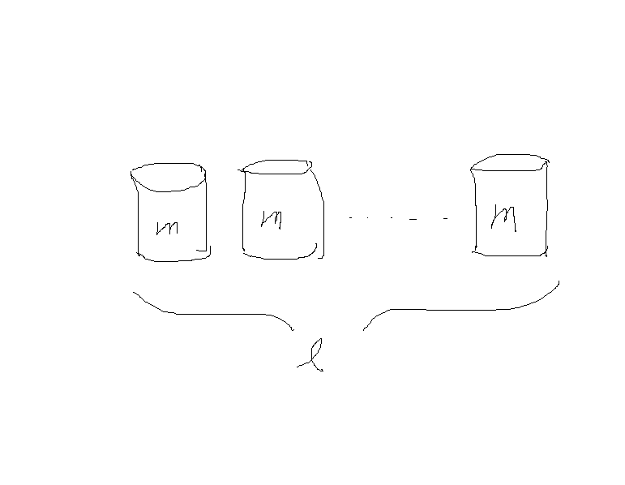
Proof:
令N={u_{o},u₁,…,u_{n-1}}= Π
L={0,1}
π _{i=}0^{ui} , s=(0^{m}1)^{l}

Slide 8
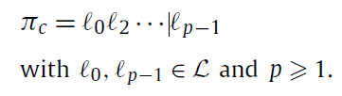
Proof 2:
Without loss of generality, let
π = (_)^{kpre}π_{c}(_)^{ksuf}
where k_{pre},k_{suf} ≧0 and π_{c} is either the empty string or

Slide 9
Claim 1. If O = {ρ₀, . . . ,ρ_{m−1}} is an ordered set of patterns (with ordering <_{O} ), then there exists a string s over L such that s |d (O,<_{O} ) and, if s ╞ π, there exists an index i ∈ [0, . . . ,m −1] so that the following hold:
• ρ_{i} ╞ π_{c} ;
• if i = 0 then ρ_{i} ╞ π_{c} with prefix at least kpre;
• if i =m −1 then ρ_{i} ╞ π_{c} with suffix at least ksuf .

Slide 10
Let B be the set of all patterns π_{k} ∈ Π such that π_{k} ╞ π_{c} (and |B| its cardinality). Let HB be the set of all possible matchings of π_{c} in patterns of B, i.e., HB is the set of all pairs (π_{k}, [i, j]) such that π_{k} ∈ B and π_{k} ╞ π_{c} from i to j.

Slide 11
Claim 2. For each string s such that s |d (Π,<_{B} ) and pattern π_{k} ∈ B, there exists a partition (S, S’) of Π \ B and integers P≧ ∑_{πi∈S} |π_{i} | and X ≧ ∑ _{πi∈S’} |π_{i} | such that the following holds:
if μ ∈ H_{B} is a matching in π_{k}, then s | π_{c} with prefix pre<_{B} (μ)+ P and suffix suf<_{B} (μ)+ X;

Slide 12
Claim 3. If |B|≧ kpre +ksuf +1, then Π ╞ _{d} π.
Claim 4. If there exists a matching μ ∈ H_{B} such that pre<_{B} (μ) ≧kpre and suf<_{B} (μ) ≧ksuf , then (Π,<B ) ╞ _{d} π.
Claim 5. If for all π_{i} ∈ B, either all matchings μ ∈ H_{B} into π_{i} have pre<_{B} (μ) < kpre or all matchings μ ∈ H_{B} into π_{i} have suf<_{B} (μ) <ksuf , then (Π,<B ) ╞ _{d} π.

Slide 13
Claim 6. If ∑_{π∈Π\B} |πi | ≧kpre +ksuf , then (Π,<B ) ╞ _{d} π.
Claim 7. If for each partition (S, S’) of Π \ B there exists a matching μ ∈ H_{B} into π_{r} such that pre<_{B} (μ) +∑_{πi∈S}|πi | ≧kpre and suf<_{B} (μ) +∑_{πi∈S} |πi |≧ksuf , then (Π,<B ) ╞ _{d} π.

Slide 14
The cost of this procedure is dominated by the cost of
the following computation:
• compute sets B and H_{B} ;
• check |B| kpre +ksuf +1;
• in the case |B| <kpre+ksuf +1, for each total order <_{B}on B
– compute pre<_{B} (μ) and suf<_{B} (μ) for all μ ∈ H_{B} ;
– check conditions of Claims 4, 5, 6 and 7.

