Slide 1
Tutorial - Rough sets theory
B. Walczak and D. L. Massart
ChemoAC, Pharmaceutical Institute, Vrije UnÍersiteit Brussel, Laarbeeklaan 103, B-1090 Brussels, Belgium
Chemometrics and Intelligent Laboratory Systems, Vol. 47 (1999), pp. 1–16
Presenter: Hung-Hsin Chen
Date: Jan. 11, 2011

Slide 2
Abstract
The basic concepts of the rough set theory are introduced and adequately illustrated. An example of the rough set theory application to the QSAR classification problem is presented. Numerous earlier applications of rough set theory to the various scientific domains suggest that it also can be a useful tool for the analysis of inexact, uncertain, or vague chemical data.

Slide 3
Related papers
FRSVMs: Fuzzy rough set based support vector machines [Chen10]:
使用fuzzy + rough set 做為SVM hyperlane判斷之條件可有效提升SVM預測之準確率。
A weighted rough set based method developed for class imbalance learning [Liu08]: 使用weighted rough set + SVM會比單獨使用SVM或SVM + unweighted rough set以及C4.5等方法有更高的準確率。
A rough margin based support vector machine [Zhan08]: 使用rough set +SVM 可比單獨使用SVM有更高的準確率，且已達到統計上之顯著性(p<0.05)。

Slide 4
Rough set theory (RST)
Z. Pawlak於1982年提出了RST，它主要是用來處理不精確、模糊及不確定性資訊值的一種數學工具。
RST可有效地進行
資料縮減
挖掘資料相關性
估計資料顯著性
資料概略分類
挖掘資料的相似或相異處
挖掘資料模型以及挖掘因果關係

Slide 5
Rough set theory (RST)
RST主要概念及優點如下：
不須服從任何的假設
無須考慮資料是否符合常態分配與變數選取問題
運算時間短
與Fuzzy set比較:
RST強調資料的indiscernibility、imprecision與ambiguity Fuzzy強調資料的vagueness degree
RST的重點在分類 Fuzzy的重點的同一類中不同instances之membership degree

Slide 6
Fuzzy set
Crisp set:
Ex: 0 <=age <10: infant, 10 <=age <30: young
30 <=age < 60: adult, 60 < age: old
fuzzy set: define a membership function:
Ex:
Age | 5 | 10 | 20 | 30 | 40 | 50 | 60 | 70 | 80
Infant | 0 | 0 | 0 | 0 | 0 | 0 | 0 | 0 | 0
Young | 1 | 1 | 0.8 | 0.5 | 0.2 | 0.1 | 0 | 0 | 0
Adult | 0 | 0 | 0.8 | 1 | 1 | 1 | 1 | 1 | 1
old | 0 | 0 | 0.1 | 0.2 | 0.4 | 0.6 | 0.8 | 1 | 1

Slide 7
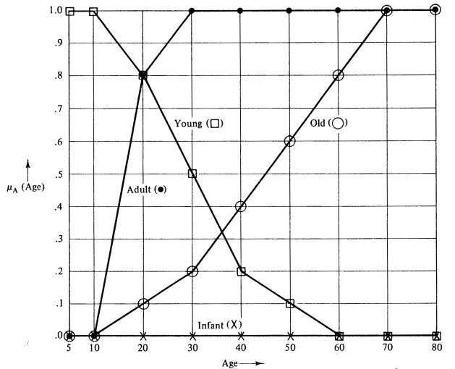

Slide 8
RST concept (1/2)
1
進行資料轉換
由於RST分析資料不拘泥形式，為了方便矩陣運算，則需將資料變數一律轉換成量化型式。
2
建立資訊系統 (Information System)
資訊系統是由所有欲分析的資料所組成的總表。
3
找出不可區分關係 (Indiscernibility Relation)
以屬性刪減及尋找核心屬性，找出所有可能最小的屬性集。

Slide 9
RST concept(2/2)
4
求取上下限近似集 (Lower and Upper Approximations)
在RST分析過程中發生分類不一致的情形時，即可藉由上下限近似集來處理、解決這類的問題。
5
進行屬性的刪減與核心 (Core and Reduct of Attributes)
找出可以解釋整體屬性集合之所有最小的屬性子集合，並挖掘不可或缺的屬性集合。
6
進行決策規則 (Decision Rules)
計算各項規則的強度，作為當條件屬性相同而分類結果不同的決策規則，應選擇何項決策規則進行預測或歸納的依據。

Slide 10
Information system (IS)
IS = (U, A)
U = {x₁, x₂,…, x_{m}} (instances)
A ={a₁, a₂,…,a_{n}} (attributes)
Va: range of attribute a
U | a₁ | a₂ | a₃
x₁ | 2 | 1 | 3
x₂ | 3 | 2 | 1
x₃ | 2 | 1 | 3
x₄ | 2 | 2 | 3
x₅ | 1 | 1 | 4
x₆ | 1 | 1 | 2
x₇ | 3 | 2 | 1
x₈ | 1 | 1 | 4
x₉ | 2 | 1 | 3
x₁₀ | 3 | 2 | 1
Example:
U = {x₁, x₂,…, x₁₀}
A ={a₁, a₂, a₃}
V₁= {1, 2, 3}
V₂={1, 2}
V₃={1, 2, 3, 4}

Slide 11
Indiscernibility relation
不同的instances卻有相同的attributes
B₁ = {a₁, a₂, a₃}
U | a₁ | a₂ | a₃
x₁ | 2 | 1 | 3
x₂ | 3 | 2 | 1
x₃ | 2 | 1 | 3
x₄ | 2 | 2 | 3
x₅ | 1 | 1 | 4
x₆ | 1 | 1 | 2
x₇ | 3 | 2 | 1
x₈ | 1 | 1 | 4
x₉ | 2 | 1 | 3
x₁₀ | 3 | 2 | 1
U/B₁ | a₁ | a₂ | a₃
{x₁,x₃,x₉} | 2 | 1 | 3
{x₂,x₇,x₁₀} | 3 | 2 | 1
{x₄} | 2 | 2 | 3
{x₅, x₈} | 1 | 1 | 4
{x₆} | 1 | 1 | 2
B₂ = {a₁, a₂}
U/B₂ | a₁ | a₂
{x₁,x₃,x₉} | 1 | 1
{x₂,x₇,x₁₀} | 3 | 2
{x₄} | 2 | 2
{x₅, x₆, x₈} | 1 | 1

Slide 12
Lower and upper approximation
U/B₁ | a₁ | a₂ | a₃
{x₁,x₃,x₉} | 2 | 1 | 3
{x₂,x₇,x₁₀} | 3 | 2 | 1
{x₄} | 2 | 2 | 3
{x₅, x₈} | 1 | 1 | 4
{x₆} | 1 | 1 | 2
Example:
B₁ = {a₁, a₂, a₃}
X={x₁, x₃, x₄, x₅, x₉}
∵{x₁, x₃, x₉}, {x₄} in table
∴BX ={x₁,x₃,x₄,x₉}
∵{x₁, x₃, x₉}, {x₄}, {x₅, x₈} in table
∴BX ={x₁,x₃,x₄, x₅, x₈, x₉}
∴ BNX = BX – BX = {x₅, x₈}
BX: lower approximation
BX: upper approximation
BNX: boundary of X in U

Slide 13
Lower approximation中之物件必定屬於集合X
Upper approximation中之物件也許屬於集合X

Slide 14
Accuracy of approximation
上一頁範例:
u_{B}(X) = 4/6 = 66.67%
Note:
0 ≦ u_{B}(X) ≦ 1
u_{B}(X) = 1, X is definable in U
u_{B}(X) = 0, X is undefinable in U

Slide 15
Independence of attributes
檢查移除某個attribute之後，使用剩下的attributes來分類instances個數時，set個數是否會增加
remove a₁ | a₂ | a₃
{x₁,x₃,x₉} | 1 | 3
{x₆} | 1 | 2
{x_{5,} x₈} | 1 | 4
{x₂, x₇, x₁₀} | 2 | 1
{x₄} | 2 | 3
remove a₂ | a₁ | a₃
{x₆} | 1 | 2
{x₅,x₈} | 1 | 4
{x₁, x₃,x₄, x₉} | 2 | 3
{x₂, x₇, x₁₀} | 3 | 1
remove a₃ | a₁ | a₂
{x₁,x₃,x₉} | 1 | 1
{x₂,x₇,x₁₀} | 3 | 2
{x₄} | 2 | 2
{x₅, x₆, x₈} | 1 | 1
 | Removed attribute
 | None | a1 | a2 | a3
# of elementary sets | 5 | 5 | 4 | 4
因刪除a₁之後，set個數不變，表示a₁不影響分類結果，所以a₁是多餘的屬性

Slide 16
Core and reduct of attributes
Core: 不可或缺屬性的集合
Reduct: discernibility matrix之屬性的最小子集合
 | U/B₁ | a₁ | a₂ | a₃
Set1 | {x₁,x₃,x₉} | 2 | 1 | 3
Set2 | {x₂,x₇,x₁₀} | 3 | 2 | 1
Set3 | {x₄} | 2 | 2 | 3
Set4 | {x₅, x₈} | 1 | 1 | 4
Set5 | {x₆} | 1 | 1 | 2
Discernibility matrix:
須使用何種attributes來區分不同的sets
 | Set1 | Set2 | Set3 | Set4 | Set5
Set1
Set2 | a₁, a₂,a₃
Set3 | a₂ | a₁, a₃
Set4 | a₁, a₃ | a₁, a₂, a₃ | a₁, a₂, a₃
Set5 | a₁, a₃ | a₁, a₂, a₃ | a₁, a₂, a₃ | a₃

Slide 17
所以要區分discernibility matrix中所有sets，必須滿足以下條件(+: or, *:and):
f(A) = (a₁+a₂+a₃)a₂(a₁+a₃)(a₁+a₃)(a₁+a₃)(a₁+a₂+a₃) *(a₁+a₂+a₃) (a₁+a₂+a₃) (a₁+a₂+a₃)a₃
Then we get: f(A) = a₂a₃
即只需a2,a3兩個attributes即可達成相同的分類結果
 | U/B₁ | a₁ | a₂ | a₃
Set1 | {x₁,x₃,x₉} | 2 | 1 | 3
Set2 | {x₂,x₇,x₁₀} | 3 | 2 | 1
Set3 | {x₄} | 2 | 2 | 3
Set4 | {x₅, x₈} | 1 | 1 | 4
Set5 | {x₆} | 1 | 1 | 2
 | U/B₁ | a₂ | a₃
Set1 | {x₁,x₃,x₉} | 1 | 3
Set2 | {x₂,x₇,x₁₀} | 2 | 1
Set3 | {x₄} | 2 | 3
Set4 | {x₅, x₈} | 1 | 4
Set5 | {x₆} | 1 | 2
Reduct R = {a₂, a₃}
In this case , core = R = {a₂, a₃}

Slide 18
Core and reduct of attribute values
Dropping certain values of attributes that are unnecessary for the system
 | U/B₁ | a₂ | a₃
Set1 | {x₁,x₃,x₉} | 1 | 3
Set2 | {x₂,x₇,x₁₀} | 2 | 1
Set3 | {x₄} | 2 | 3
Set4 | {x₅, x₈} | 1 | 4
Set5 | {x₆} | 1 | 2
Discernibility matrix:
須使用何種attributes來區分不同的sets
 | Set1 | Set2 | Set3 | Set4 | Set5
Set1 |  | a₂,a₃ | a₂ | a₃ | a₃
Set2 | a₂,a₃ |  | a₃ | a₂,a₃ | a₂,a₃
Set3 | a₂ | a₃ |  | a₂,a₃ | a₂,a₃
Set4 | a₃ | a₂, a₃ | a₂, a₃ |  | a₃
Set5 | a₃ | a₂, a₃ | a₂, a₃ | a₃

Slide 19
f₁(A)為分辨set1與set{2,3,4,5}至少需要那些attributes，以此類推
f₁(A) = (a₂+a₃)a₂a₃a₃ = a₂a₃
f₂(A) = (a₂+a₃)a₃(a₂+a₃)(a₂+a₃) = a₃
f₃(A)= a₂a₃(a₂+a₃)(a₂+a₃) = a₂a₃
f₄(A) = a₃(a₂+a₃)(a₂+a₃)a₃ = a₃
f₅(A) = a₃(a₂+a₃)(a₂+a₃)(a₂+a₃)a₃= a₃
 | U/B₁ | a₂ | a₃
Set1 | {x₁,x₃,x₉} | 1 | 3
Set2 | {x₂,x₇,x₁₀} | 2 | 1
Set3 | {x₄} | 2 | 3
Set4 | {x₅, x₈} | 1 | 4
Set5 | {x₆} | 1 | 2
 | U/B₁ | a₂ | a₃
Set1 | {x₁,x₃,x₉} | 1 | 3
Set2 | {x₂,x₇,x₁₀} | * | 1
Set3 | {x₄} | 2 | 3
Set4 | {x₅, x₈} | * | 4
Set5 | {x₆} | * | 2
*: denotes ‘don’t care’

Slide 20
Classification
U/B₁ | a₁ | a₂ | a₃
{x₁,x₃,x₉} | 2 | 1 | 3
{x₂,x₇,x₁₀} | 3 | 2 | 1
{x₄} | 2 | 2 | 3
{x₅, x₈} | 1 | 1 | 4
{x₆} | 1 | 1 | 2
We want to classify
X₁={x₁, x₃, x₉}, X₂={x₄, x₅, x₆}, X₃={x₂,x₇,x₈,x₁₀}
BX₁ = {x₁, x₃, x₉} , BX₁ = {x₁, x₃, x₉},
accuracy = 3/3 = 1.0
BX₂ = {x₄, x₆} , BX₂ = {x₄, x₅, x₆, x₈},
accuracy = 2/4 = 0.5
BX₃ = {x₂, x₇, x₁₀}, BX₃ = {x₂, x₅, x₇, x₈, x₁₀},
accuracy = 3/5 = 0.6
Accuracy of whole classification:
(3+2+3)/(3+4+5) = 0.67
Quality of whole classification:
(3+2+3)/(3+3+4) = 0.8
accuracy | Removed attribute
Class | None | a2 | a3
X₁ | 1 | NA | NA
X₂ | 0.5 | 0.14 | NA
X₃ | 0.6 | 0.60 | NA

Slide 21
Decision table
Any supervised classification problem can be considered as the decision table analysis
U | a₁ | a₂ | a₃ | d
x₁ | 2 | 1 | 3 | 1
x₂ | 3 | 2 | 1 | 2
x₃ | 2 | 1 | 3 | 1
x₄ | 2 | 2 | 3 | 2
x₅ | 1 | 1 | 4 | 3
x₆ | 1 | 1 | 2 | 3
x₇ | 3 | 2 | 1 | 2
x₈ | 1 | 1 | 4 | 3
x₉ | 2 | 1 | 3 | 1
x₁₀ | 3 | 2 | 1 | 2

Slide 22
Relative core and relative reducts of attributes
U | a₁ | a₂ | a₃ | d
x₁ | 2 | 1 | 3 | 1
x₂ | 3 | 2 | 1 | 2
x₃ | 2 | 1 | 3 | 1
x₄ | 2 | 2 | 3 | 2
x₅ | 1 | 1 | 4 | 3
x₆ | 1 | 1 | 2 | 3
x₇ | 3 | 2 | 1 | 2
x₈ | 1 | 1 | 4 | 3
x₉ | 2 | 1 | 3 | 1
x₁₀ | 3 | 2 | 1 | 2
All classes can be described by A={a₁,a₂,a₃}
Class | # of objects | Lower approx. | Upper approx. | Accuracy
1 | 3 | 3 | 3 | 1.0
2 | 4 | 4 | 4 | 1.0
3 | 3 | 3 | 3 | 1.0

Slide 23
Discernibility matrix:
須使用何種attributes來區分不同的sets
 | 1 | 2 | 3 | 4 | 5 | 6 | 7 | 8 | 9 | 10
1 | -
2 | a₁,a₂,a₃ | -
3 | - | a₁,a₂,a₃ | -
4 | a₂ | - | a₂ | -
5 | a₁,a₃ | a₁,a₂,a₃ | a₁,a₃ | a₁,a₂,a₃ | -
6 | a₁,a₃ | a₁,a₂,a₃ | a₁,a₃ | a₁,a₂,a₃ | - | -
7 | a₁,a₂,a₃ | - | a₁,a₂,a₃ | - | a₁,a₂,a₃ | a₁,a₂,a₃ | -
8 | a₁,a₃ | a₁,a₂,a₃ | a₁,a₃ | a₁,a₂,a₃ | - | - | a₁,a₂,a₃ | -
9 | - | a₁,a₂,a₃ | - | a₂ | a₁,a₃ | a₁,a₃ | a₁,a₂,a₃ | a₁,a₃ | -
10 | a₁,a₂,a₃ | - | a₁,a₂,a₃ | - | a₁,a₂,a₃ | a₁,a₂,a₃ | - | a₁,a₂,a₃ | a₁,a₂,a₃ | -

Slide 24
f_{A}(D)=(a₁+a₂+a₃)a₂(a₁+a₃) (a₁+a₃) (a₁+a₂+a₃) (a₁+a₃) (a₁+a₂+a₃) (a₁+a₂+a₃) (a₁+a₂+a₃) (a₁+a₂+a₃)a₂(a₁+a₃) (a₁+a₃) (a₁+a₂+a₃) (a₁+a₃) (a₁+a₂+a₃) (a₁+a₂+a₃) (a₁+a₂+a₃) (a₁+a₂+a₃) a₂(a₁+a₃) (a₁+a₂+a₃) (a₁+a₃) (a₁+a₂+a₃) (a₁+a₂+a₃) (a₁+a₃) (a₁+a₂+a₃) (a₁+a₂+a₃) (a₁+a₂+a₃) (a₁+a₃) (a₁+a₂+a₃) (a₁+a₂+a₃) = a₂(a₁+a₃) = a₁a₂ + a₂a₃
D-reducts = {a₁, a₂} and {a₂, a₃}
D-core = {a₂}
U | a₁ | a₂ | d
x₁ | 2 | 1 | 1
x₂ | 3 | 2 | 2
x₃ | 2 | 1 | 1
x₄ | 2 | 2 | 2
x₅ | 1 | 1 | 3
x₆ | 1 | 1 | 3
x₇ | 3 | 2 | 2
x₈ | 1 | 1 | 3
x₉ | 2 | 1 | 1
x₁₀ | 3 | 2 | 2
U | a₂ | a₃ | d
x₁ | 1 | 3 | 1
x₂ | 2 | 1 | 2
x₃ | 1 | 3 | 1
x₄ | 2 | 3 | 2
x₅ | 1 | 4 | 3
x₆ | 1 | 2 | 3
x₇ | 2 | 1 | 2
x₈ | 1 | 4 | 3
x₉ | 1 | 3 | 1
x₁₀ | 2 | 1 | 2

Slide 25
f₁(D) = (a₁+a₂)a₂a₁a₁(a₁+a₂)a₁(a₁+a₂) = a₁a₂
in the same way:
f₂(D) = a₁+ a₂
f₃(D) = a₁a₂
f₄(D) = a₂
f₅(D) = a₁
f₆(D) = a₁
f₇(D) = a₁+a₂
f₈(D) = a₁
f₉(D) = a₁a₂
f₁₀(D) = a₁ + a₂
U | a₁ | a₂ | d
x₁ | 2 | 1 | 1
x₂ | * | 2 | 2
x₃ | 2 | 1 | 1
x₄ | * | 2 | 2
x₅ | 1 | * | 3
x₆ | 1 | * | 3
x₇ | * | 2 | 2
x₈ | 1 | * | 3
x₉ | 2 | 1 | 1
x₁₀ | * | 2 | 2
Decision rule:
a₁ =2, a₂=1 => d=1
a₂ = 2 => d=2
a₁ =1 => d=3

Slide 26
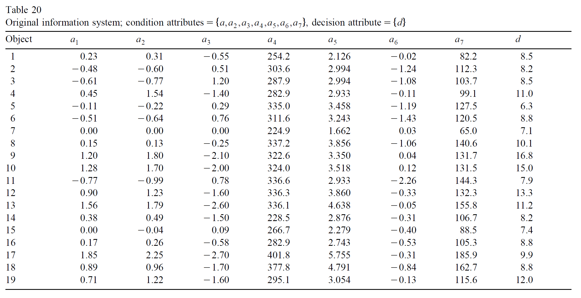
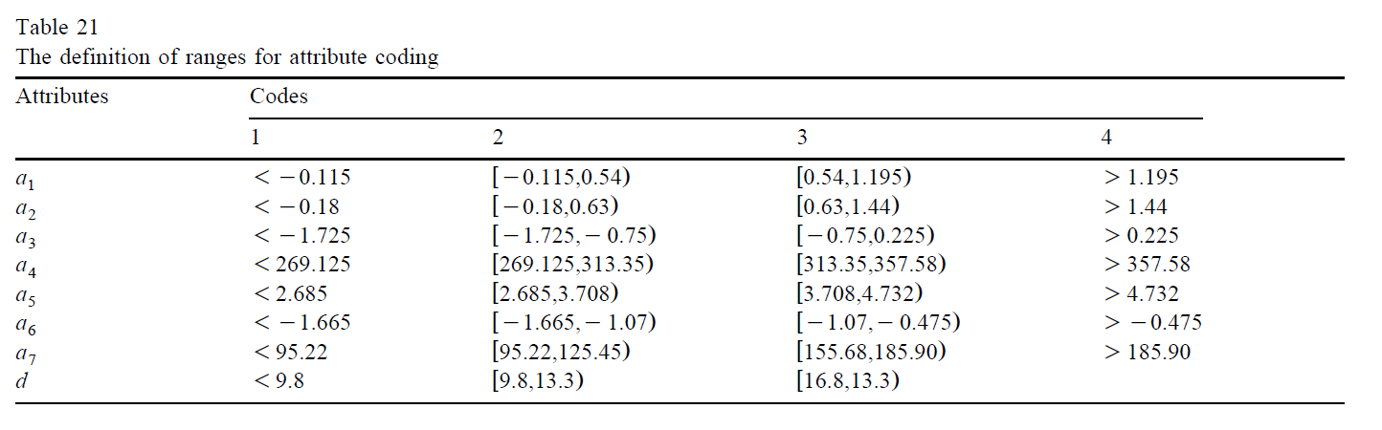
Example

Slide 27
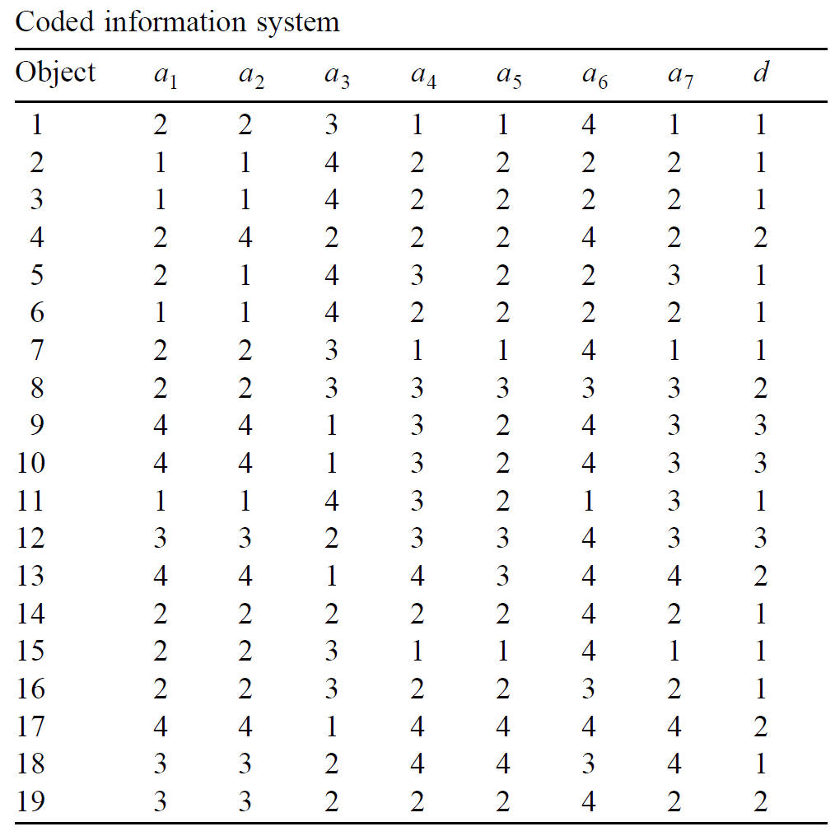

Slide 28
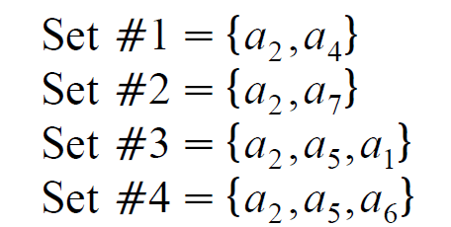
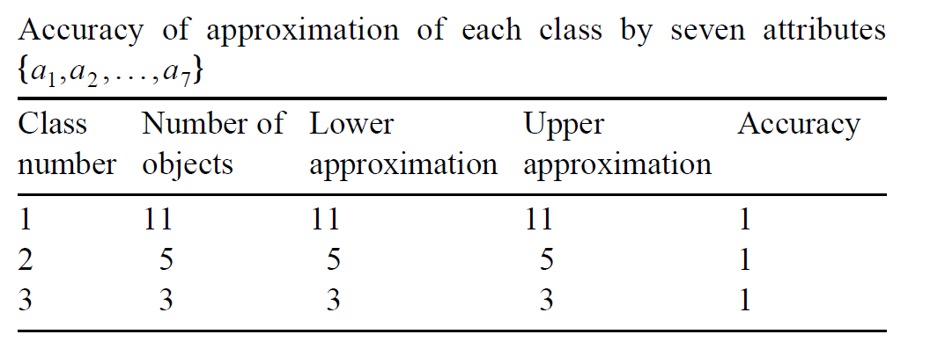
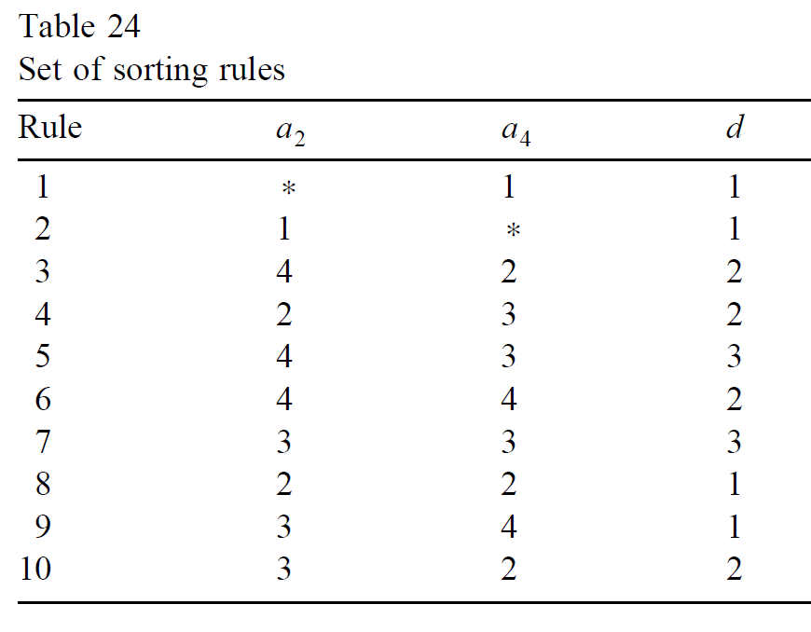

Slide 29
Discretization methods
Equal interval width
Equal frequency intervals
K-means clustering
Equal interval width, example:

Slide 30
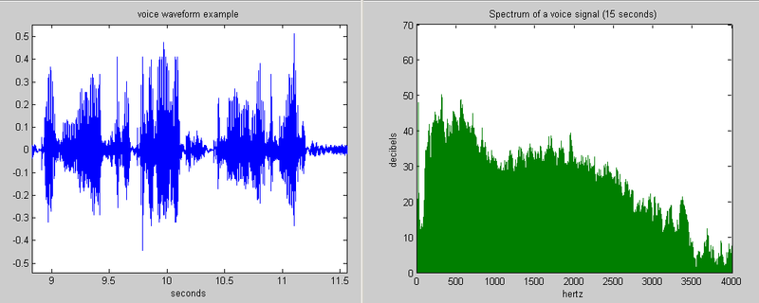
2.Equal frequency intervals, example:
3. K-means clustering, example:
http://cgm.cs.ntust.edu.tw/etrex/kMeansClustering/kMeansClustering2.html
決定K的個數(人為指定，且為固定值)
隨機產生K個中心
將n個點分類為離該點最近的中心
每一群將其所屬的點的座標平均，成為該群新的中心坐標
每一群所屬的點與新的中心座標距離平方加總，此即為新的k-means error
重複step3至停止條件為止

Slide 31
Original scores:
 | 國文 | 數學 | 英文
1 | 2.82 | 6.28 | 36.47
2 | 34.71 | 20.64 | 18.7
3 | 8.44 | 6.16 | 21.9
… | … | … | …
50 | 19.9 | 7.73 | 14.3
Discretization ranges (k=4)
Normalized scores | Correspond values
0~0.3 | 1
0.31~0.6 | 2
0.61~0.9 | 3
0.91~1.0 | 4
Normalized scores:
 | 國文 | 數學 | 英文
1 | 0.0812 | 0.43 | 1.0
2 | 1.0 | 1.0 | 0.6
3 | 0.25 | 0.42 | 0.7
… | … | … | …
50 | 0.8 | 0.5 | 0.5
 | 國文 | 數學 | 英文
1 | 1 | 2 | 4
2 | 4 | 4 | 2
3 | 1 | 2 | 3
… | … | … | …
50 | 3 | 2 | 2

Slide 32
Software
ROSE (rough set data explore): http://idss.cs.put.poznan.pl/site/rose.html
Rosetta:
http://www.lcb.uu.se/tools/rosetta/

Slide 33
Reference
[溫坤禮08]溫坤禮, 永井正武、張廷政、溫惠筑（2008）。粗糙集入門及應用。台北： 五南。
[chen10] D. Chen and Q. He, and X. Wang, “FRSVMs: Fuzzy rough set based support vector machines,” Fuzzy Sets and Systems, Vol. 161, Issue 4, pp. 596-607, 2010.
[Liu08] J. Liu, Q. Hu, and D. Yu, “A weighted rough set based method developed for class imbalance learning,” Information Sciences, Vol. 178, pp. 1235-1256, 2008.
[Zhan08] J.Zhang and Y. Wang,“A rough margin based support vector machine,”Information Sciences, Vol. 178, pp. 2204-2214, 2008.

Slide 34

Thanks for your listening!!!

