Slide 1
Portfolio value-at-risk forecasting with GA-based extreme value theory
Ping-Chen Lin(林萍珍), Po-Chang Ko(柯博昌)
Expert Systems with Applications 36 (2009) pp. 2503–2512
Presenter: Siao-ming Jhou
Date: Jan. 11, 2011

Slide 2
Abstract(1/2)
Value-at-risk (VaR) has become a popular risk measure since it was adopted by the Bank for International Settlements and US regulatory agencies in 1988. The VaR concept has also been further extended to the portfolio value-at-risk (PVaR) measure used for managing risks and returns under a multiple-asset portfolio. Precise prediction of PVaR provides better evaluation criteria in areas such as investment decision-making and risk management. The two issues concerned with portfolio risk are efficient set selection and volatility forecasting. Most of the statistical portfolio selection models are based on linear functions under specific assumptions.

Slide 3
Abstract(2/2)
Due to the fat-tailed distribution in most real ﬁnancial time-series data, extreme value theory (EVT) is powerful in determining the VaR of a portfolio by concentrating on estimating the shape of the fat-tailed probability distribution.
However, using EVT to evaluate the portfolio’s volatility is very diﬃcult, because each asset within the portfolio has its own distinct peak threshold value. This study introduces an evolutionary portfolio volatility forecasting model to optimize portfolios under their maximum expected returns subject to a risk constraint. We use a genetic algorithm (GA) to extract the best portfolio set and most suitable peak threshold in order to estimate the portfolio’s VaR by means of EVT.

Slide 4
Value-at-Risk(VaR)
風險值 (value at risk, VaR)的普及是由group of thirty (G30)的建議、國際清算銀行 (bank for international settlements, BIS)與JP Morgan公司的riskmetrics方法所推動。VaR是一種評估風險的方法，主要是可以估計風險的可能最大損失，而非只是抽象相對的波動程度。
計算VaR方法有很多種，例如:
  歷史模擬法
  蒙地卡羅法
  變異數－共變異數法
  極端值理論

Slide 5
Extreme Value Theory (EVT)
極端值理論的發展可追溯至 1950 年代，當時荷蘭由於海嘯造成潰堤，使國家遭受重大的生命財產損失，爾後荷蘭政府即利用極端值理論計算海堤建造所需之高度與強度，以預防極端事件發生時造成的傷害。如今，此項理論被運用在許多方面，財務風險的衡量亦為其中一項。
以風險值 (VaR) 衡量投資風險所關心的是下方風險 (downside risk) ，也就是投資組合報酬分配中的尾部分配；以極端值理論衡量風險值不需要對整個投資組合報酬分配作假設，只需估計投資組合的尾部分配，如此可以大幅降低模型風險 (model risk) ，亦可較為精確估計當極端事件發生時，可能遭受的損失金額。
極端值理論主要區分為兩種方法：一是block maxima model (BMM)；另一是peaks over threshold method (POT)，皆是利用極端樣本資料來配適尾部分配。

Slide 6
Peaks Over Threshold method (POT)
此方法為設定一個門檻值，取出所有超過該門檻值的樣本，進而據此估計其尾部分配。利用POT法估計尾部分配參數的方法又可分為兩種，分別以Pareto分配以及Hill estimator 進行。

Slide 7
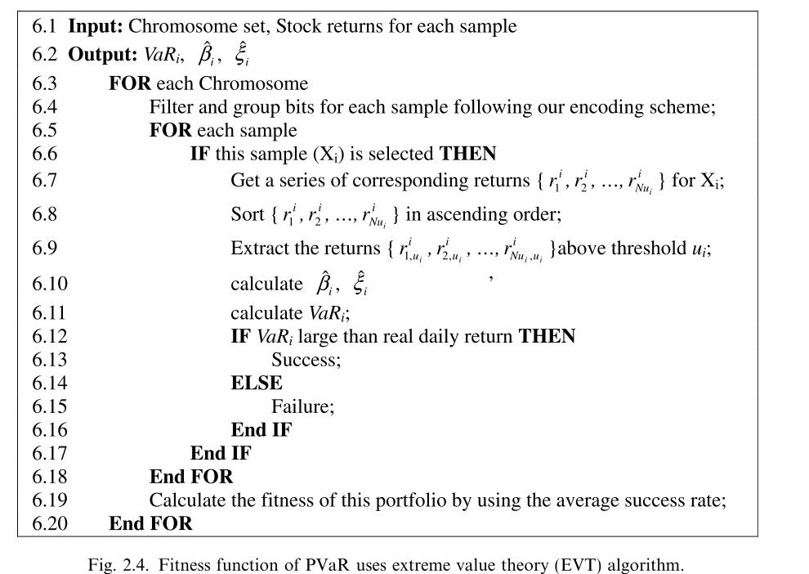

Slide 8
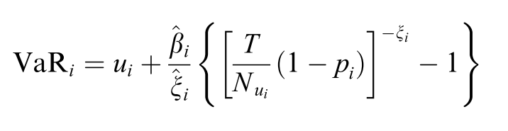
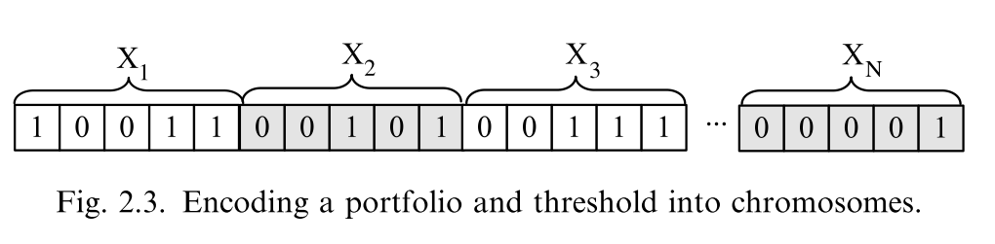

Slide 9
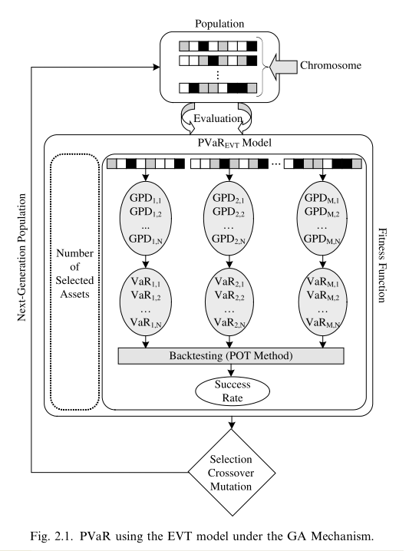
Method

Slide 10
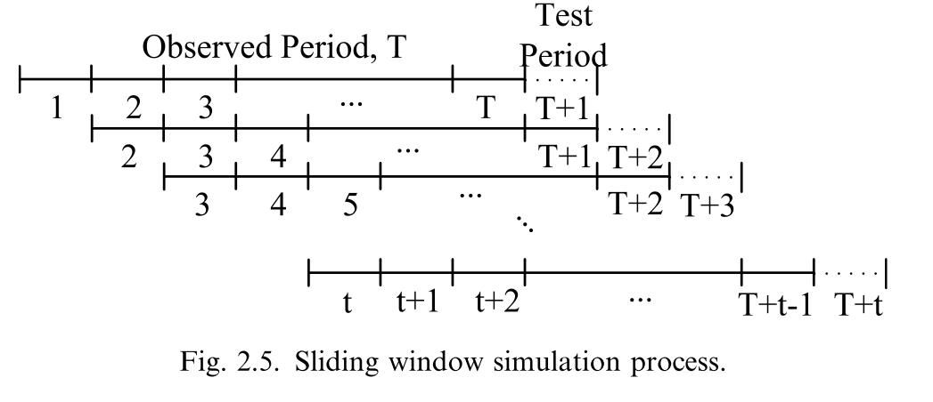


Slide 11
GA參數設定
Population = 500
Chromosome length = 390 (78*5)
代數 = 1000
Crossover rate =0.6
Mutation rate = 0.001

Slide 12
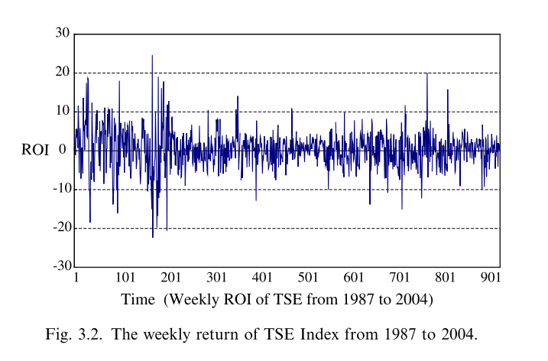
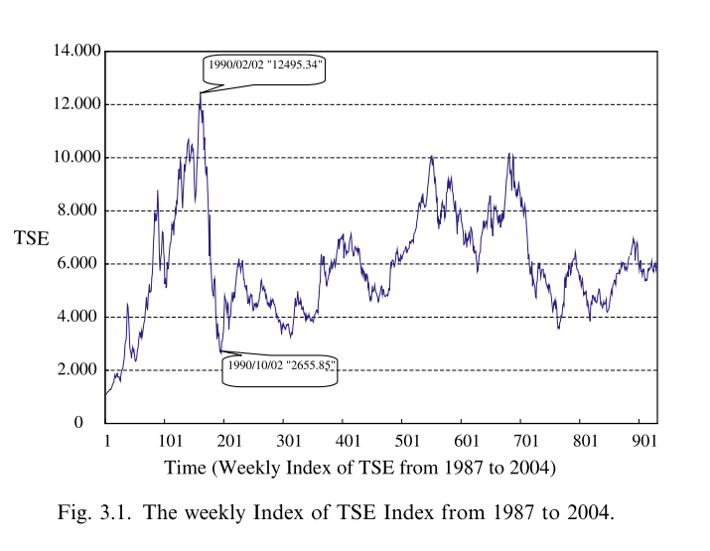
Data set
There are more than 700 companies currently listed in Taiwan stock exchange (TSE). We remove companies which are listed less than 20 years in Taiwan economic journal (TEJ) data bank. The results analyses are 20 industries of 78 companies shown in Appendix. We use weekly stock return data because 7% daily price upward/downward limited in TSE. There are 932 observations in data set of each company from January 1987 to December 2004.

Slide 13
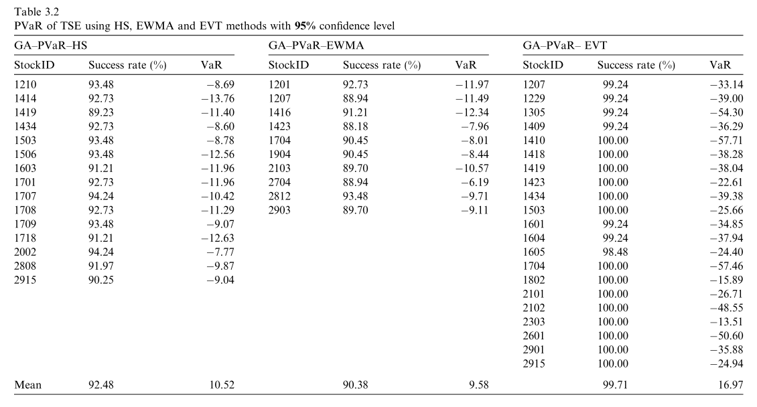
Result (1/3)

Slide 14
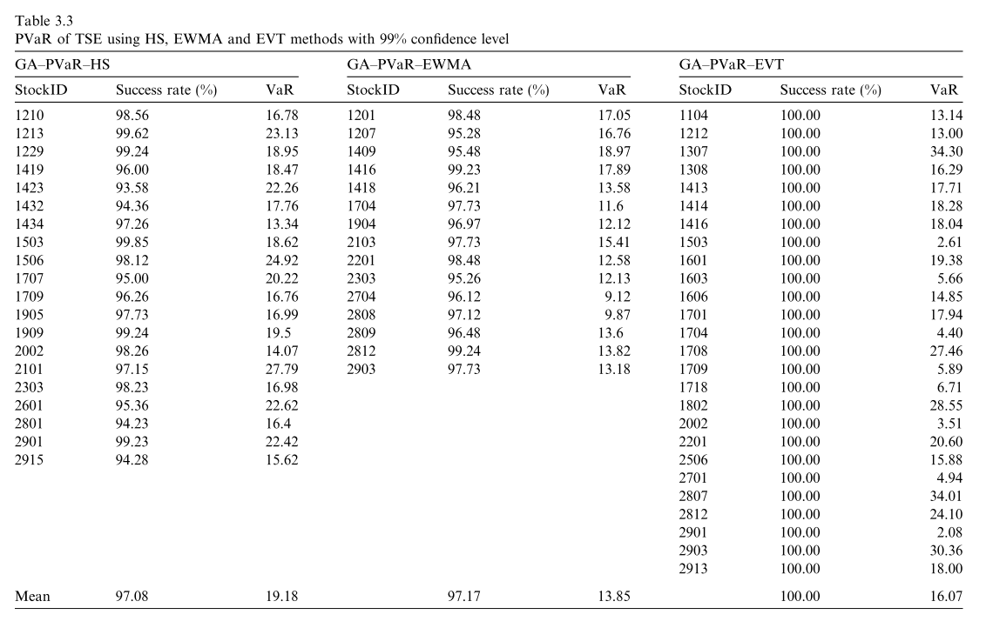
Result (2/3)

Slide 15
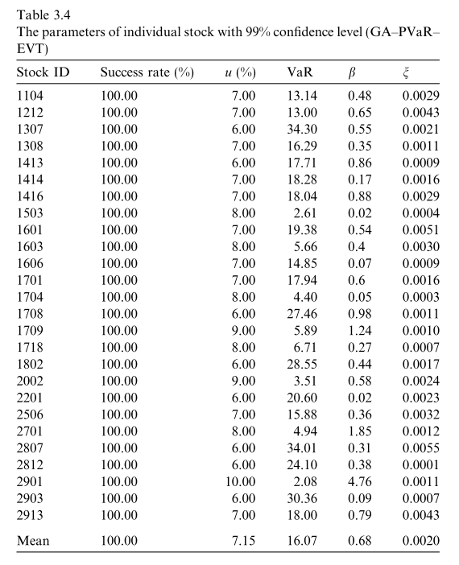
Result (3/3)

Slide 16
End

