Slide 1
Analysis of protein contacts into Protein Units
Guilhem Faure, Aurelie Bornot,
Alexandre G. de Brevern
Biochimie, Vol. 91, pp. 876–887, 2009
Presenter: Dong-Jian Lin
Date: Jan. 11, 2011

Slide 2
Abstract
Three-dimensional structures of proteins are the support of
their biological functions. Their folds are maintained by
inter-residue interactions which are one of the main
focuses to understand the mechanisms of protein folding
and stability. Furthermore, protein structures can be
composed of single or multiple functional domains that can
fold and function independently. Hence, dividing a protein
into domains is useful for obtaining an accurate structure
and function determination.

Slide 3
In previous studies, we enlightened protein contact
properties according to different definitions and developed
a novel methodology named Protein Peeling. Within
protein structures, Protein Peeling characterizes
small successive compact units along the sequence called
protein units (PUs). The cutting done by Protein Peeling
maximizes the number of contacts within the PUs and
minimizes the number of contacts between them. This
method is so a relevant tool in the context of the protein
folding research and particularly regarding the hierarchical
model proposed by George Rose.

Slide 4
Here, we accurately analyze the PUs at different levels of
cutting, using a non-redundant protein data-bank.
Distribution of PU sizes, number of PUs or their
accessibility are screened to determine their common and
different features. Moreover, we highlight the preferential
amino acid interactions inside and between PUs. Our
results show that PUs are clearly an intermediate level
between secondary structures and protein structural
domains.

Slide 5
Protein Unit(PU)
An intermediate level of organization, between
secondary structures elements and domains.
A PU is a compact subregion of the 3D
structure corresponding to one sequence fragment.
Each PU must have a high number of intra-PU
contacts, and, a low number of inter-PU contacts.

Slide 6
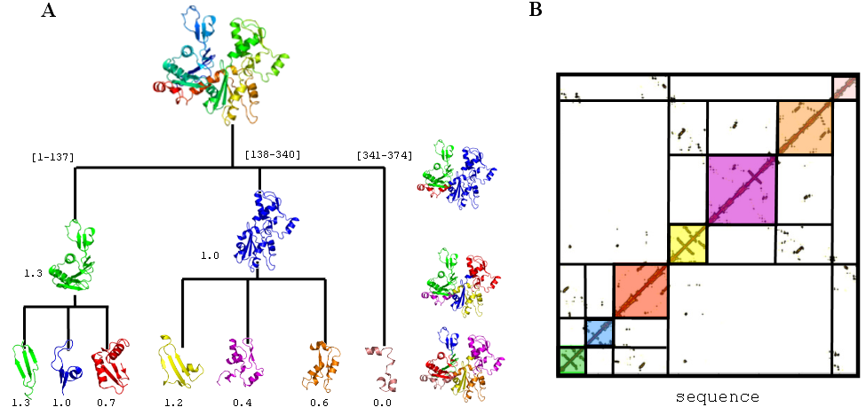

Slide 7
Contact Definition
Two residues are in contact if they are at a lower distance than a distance 8 Å from one another.
Three residues surrounding the studied one will not be taken into account.

Slide 8
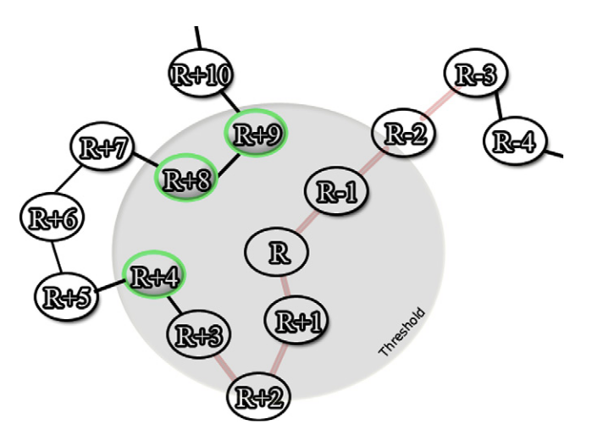

Slide 9
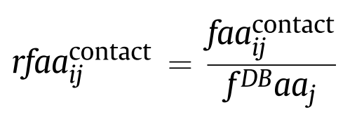

Relative Contact Frequency
The relative contact frequency (noted rf in the text)
of the amino acid of type i found in contact with the
amino acid of type j:

Slide 10
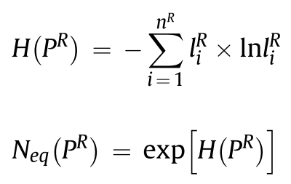
Equivalent Number(N_{eq})
To estimate the equilibrium between the lengths of
the different Pus generated for each protein P and
at each value of R(R₀).
N_{eq} : 1~n^{R}
Normalized by n^{R} : 0~1

Slide 11
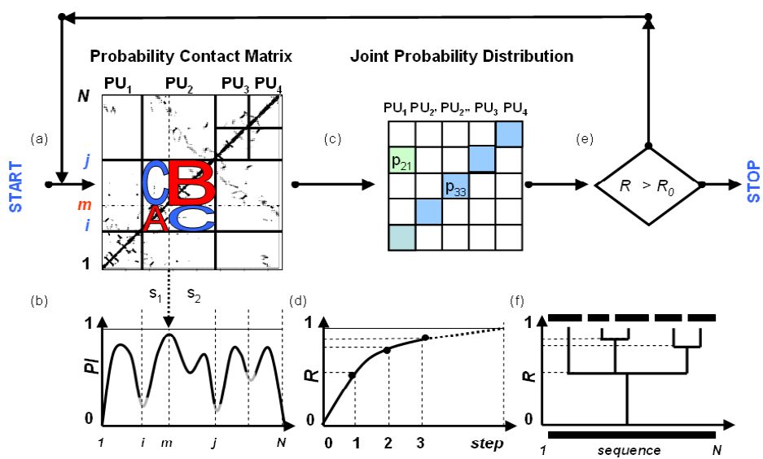
Protein Peeling

Slide 12
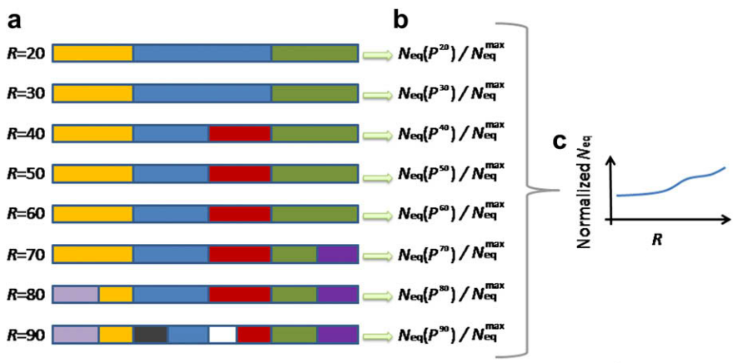

Slide 13
Databank
A non-redundant protein databank has been initially built using
PDB-REPRDB. It was composed of 1736 protein chains taken
from the PDB. The set contained proteins with no more than
10% pairwise sequence identity. We selected chains with a
resolution better than 2.5 Å and a R-factor less than 0.2.
pairwise root mean square deviation (rmsd) values between all
chains were more than 10 Å. Only proteins with more than 99%
of complete classical amino acids were conserved. Moreover,
proteins that cannot be used by software used during analysis
process have also been excluded. Thus, we retained 1230
protein chains corresponding to 377,232 residues.

Slide 14
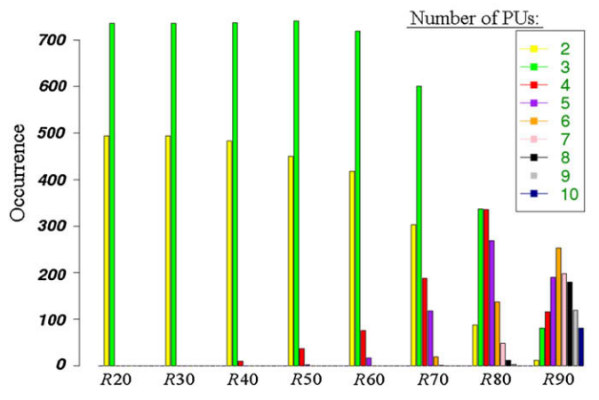
Result(1/3)

Slide 15
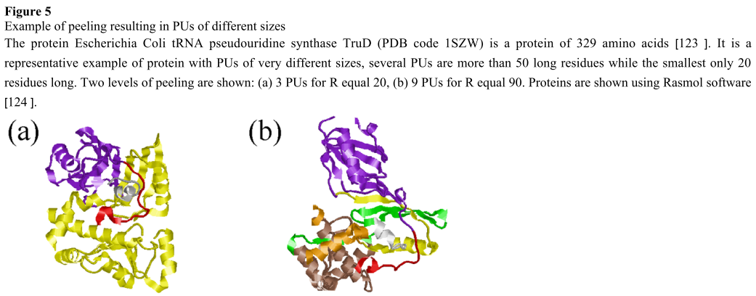

Slide 16
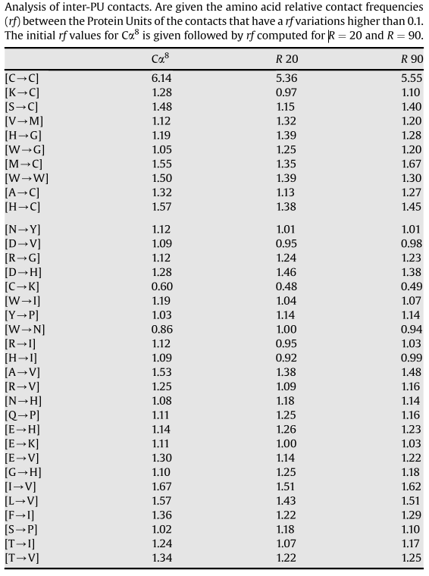
Result2
Result(2/3)

Slide 17
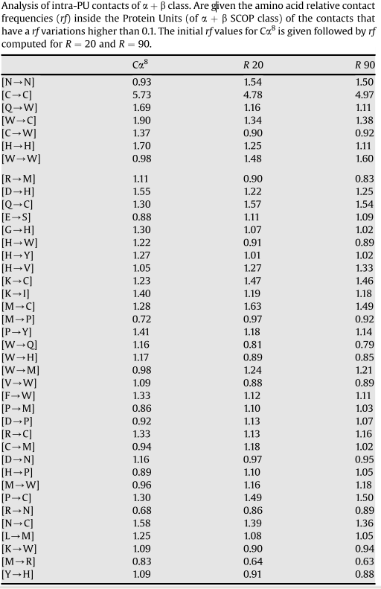
Result(3/3)

Slide 18
Thanks for your listening!

