Slide 1
Prediction of protein subcellular locations by support vector machines using compositions of amino acids and amino acid pairs
Keun-Joon Park and Minoru Kanehisa
Bioinformatics Vol. 19 no. 13 2003, pages 1656–1663
Presenter: Kai-Yu Chen
Date: Jan. 25, 2011

Slide 2
ABSTRACT
Motivation: The subcellular location of a protein is closely correlated to its function. Thus, computational prediction of subcellular locations from the amino acid sequence information would help annotation and functional prediction of protein coding genes in complete genomes. We have developed a method based on support vector machines (SVMs).

Slide 3
ABSTRACT
Results: We considered 12 subcellular locations in eukaryotic cells: chloroplast, cytoplasm, cytoskeleton, endoplasmic reticulum, extracellular medium, Golgi apparatus, lysosome, mitochondrion, nucleus, peroxisome, plasma membrane, and vacuole. We constructed a data set of proteins with known locations from the SWISS-PROT database. A set of SVMs was trained to predict the subcellular location of a given protein based on its amino acid, amino acid pair, and gapped amino acid pair compositions. The predictors based on these different compositions were then combined using a voting scheme. Results obtained through 5-fold cross-validation tests showed an improvement in prediction accuracy over the algorithm based on the amino acid composition only. This prediction method is available via the Internet.

Slide 4
INTRODUCTION
蛋白質在生命體中的位置(subcellular location)與其生理功能有著密切的關係，如果知道某蛋白質的subcellular location，就能幫助分析該蛋白質的功能。
12 subcellular locations in eukaryotic cells(真核細胞) :
  Chloroplast(葉綠體)
  Cytoplasm(細胞質)
  Cytoskeleton(細胞骨架)
  Endoplasmic reticulum(內質網)
  extracellular medium(外介質)
  Golgi apparatus(高爾基體)
  Lysosome(溶酶體)
  Mitochondrion(線粒體)
  Nucleus(細胞核)
  Peroxisome(過氧化物酶體)
  plasma membrane(細胞膜)
  Vacuole(液泡)

Slide 5
DATA SET
Collected from the SWISS-PROT.
We identified eukaryotic proteins with specific subcellular locations.
We grouped all proteins by ALIGN with full length matches of 80% similarity.
The total number of proteins in the final data set was 7589 for the 12 subcellular locations.

Slide 6
SVM
Feature:
  Amino acid composition(20 features)
  Amino acid pair(400 features)
  One gapped amino acid pair(400 features)
  Two gapped amino acid pair(400 features)
  Three gapped amino acid pair(400 features)
5-fold cross-validation test

Slide 7
Voting scheme
For each of the five different compositions, a query protein is tested against 12 SVM classifiers and assigned to the subcellular location that corresponds to the highest output value. After repeating this step for the five different compositions, the results are combined by a voting scheme.

Slide 8
Voting sheme
SVM₁
SVM₂
SVM₃
SVM₄
SVM₅
SVM₆
SVM₇
SVM₈
SVM₉
SVM₁₀
SVM₁₁
SVM₁₂
SVM₁₋₁
SVM₁₋₂
SVM₁₋₃
SVM₁₋₄
SVM₁₋₅
voting
Subcellular location
Input sequence
Feature: amino acid composition
amino acid pair
one gapped amino acid pair
two gapped amino acid pair
three gapped amino acid pair
Feature: amino acid composition

Slide 9
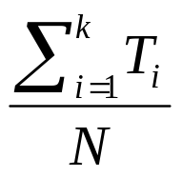
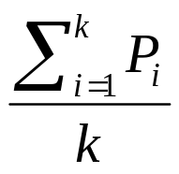
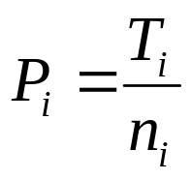
RESULTS
Total accuracy:
Location accuracy:
N is total number of proteins (N=7589).
k is the number of subcellular locations (k=12).
n_{i} is the number of proteins in each location i.
T_{i} is the number of correctly predicted proteins (true positives) in each location i.

Slide 10
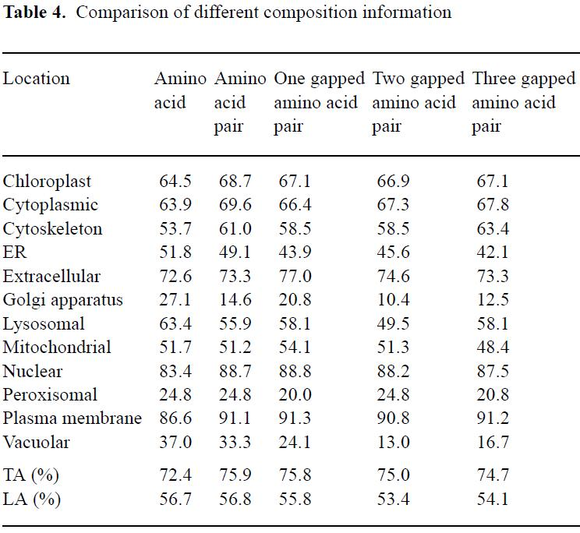
RESULTS

Slide 11
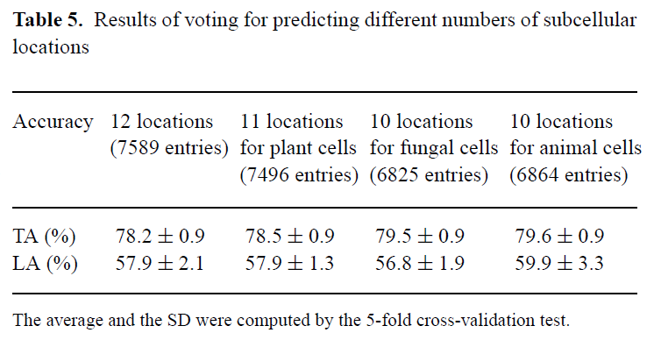
RESULTS

Slide 12
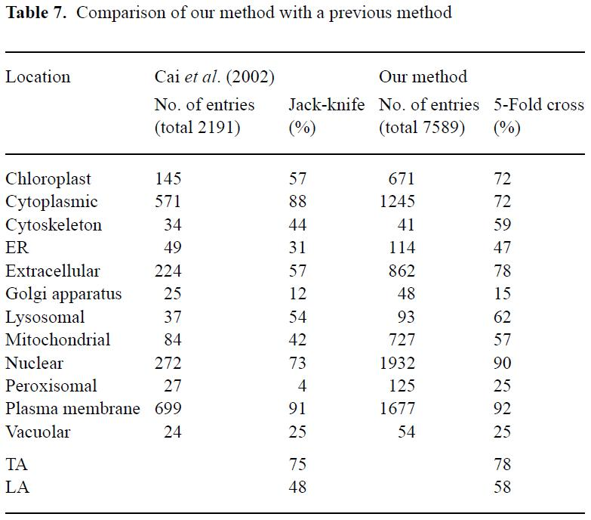
RESULTS

Slide 13
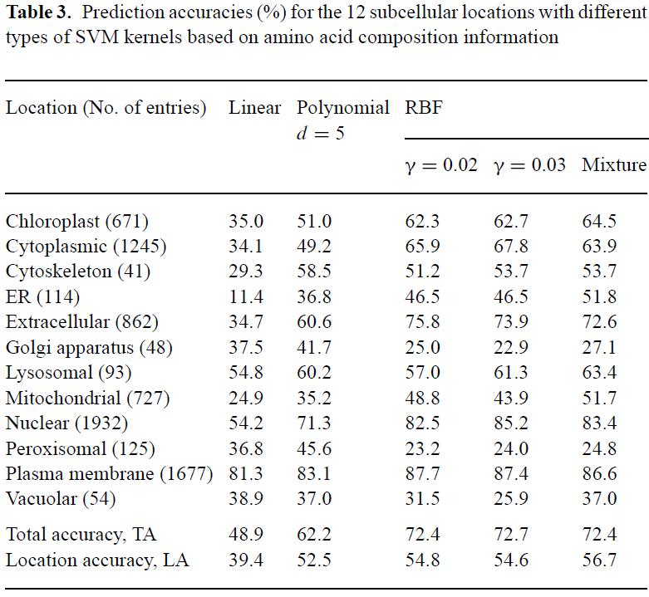
RESULTS

