Slide 1
Computing Longest Previous Factor in linear time and applications
Maxime Crochemore and Lucian Ilie
Information Processing Letters, Vol. 106, pp. 75-80, 2008
Presenter: Hsin-Fang Wu
Date: Jan 25, 2011

Slide 2
Abstract
We give two optimal linear-time algorithms for computing the Longest Previous Factor (LPF) array corresponding to a string w. For any position i in w, LPF[i] gives the length of the longest factor of w starting at position i that occurs previously in w. Several properties and applications of LPF are investigated. They include computing the Lempel-Ziv factorization of a string and detecting all repetitions (runs) in a string in linear time independently of the integer alphabet size.

Slide 3
The Longest Previous Factor (LPF)
LPF[i] = max({ l | T[i..i+l–1] is a substring of T[0..i+l–2]}, 0)
For i=7, we can find l=4
0 | 1 | 2 | 3 | 4 | 5 | 6 | 7 | 8 | 9 | 10
2 | 3 | 5 | 1 | 4 | 2 | 3 | 3 | 5 | 1 | 4

Slide 4
Suffix Array
i | 1 | 2 | 3 | 4 | 5 | 6 | 7 | 8 | 9 | 10 | 11 | 12
A[i] | a | b | r | a | c | a | d | a | b | r | a | $
SuffixArray={12,11,8,1,4,6,9,2,5,7,10,3}
a b r a c a d a b r a $ | S(1)
b r a c a d a b r a $ | S(2)
r a c a d a b r a $ | S(3)
a c a d a b r a $ | S(4)
c a d a b r a $ | S(5)
a d a b r a $ | S(6)
d a b r a $ | S(7)
a b r a $ | S(8)
b r a $ | S(9)
r a $ | S(10)
a $ | S(11)
$ | S(12)
index | Sorted suffix | lcp
12 | a b r a c a d a b r a $ | 0
11 | b r a c a d a b r a $ | 0
8 | r a c a d a b r a $ | 1
1 | a c a d a b r a $ | 4
4 | c a d a b r a $ | 1
6 | a d a b r a $ | 1
9 | d a b r a $ | 0
2 | a b r a $ | 3
5 | b r a $ | 0
7 | r a $ | 0
10 | a $ | 0
3 | $ | 2

Slide 5
Longest Common Prefix (LCP)
每個字串都有出現的prefix之中最長的那一個，可能為空。
S1: a a b b c c c
S2: a a b b b c c c
S3: a a b a c c c
=> LCP: a a b

Slide 6
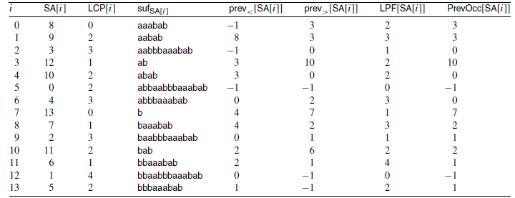
Computing LPF
LPF[11]: max(LCP(2,11), LCP(6, 11))= max(min(2), min(1)) = 2

Slide 7
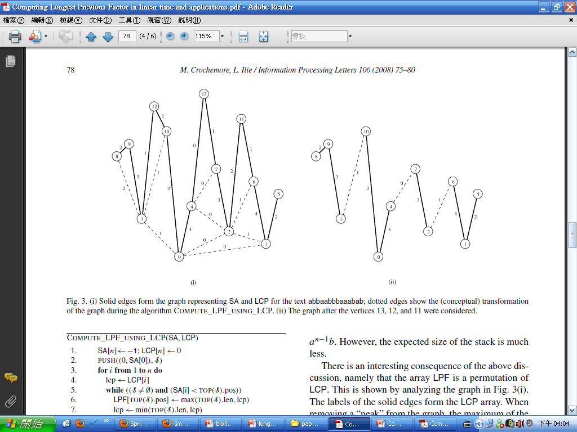
Conceptual Graph (Ι)

Slide 8
Conceptual Graph (Ι Ι)
After vertices 13,12,11 were considered.

Slide 9

Application
Application 1: Computing the Lempel-Ziv factorization.
Theorem: The Lempel–Ziv factorization of a string of length n over an integer alphabet can be computed in O(n) time.
a b b a a b b b a a a b a b
Length: 1 3 2
Start : 0 1 2 3 4 7 10 12

Slide 10
Application
Application 2: Computing runs in linear time.
A general repetition has the form w^{e}, for any rational exponent e ≥ 2 such that e|w| is an integer.
(aabab) ^{7/5} = aababaa.
Given a string T of length n, the runs of T can be obtained in O(n) time with the LPF array of T.

