Slide 1
A Tutorial on Convex Optimization
Haitham Hindi
Palo Alto Research Center (PARC), Palo Alto, California
Proceedings of the American Control Conference, 2004, Boston, MA, USA, June 30 -July 2, 2004.
Presenter: Hung-Hsin Chen (陳紘昕)
Date: Oct. 3, 2011

Slide 2
Abstract
In recent years, convex optimization has become a computational tool of central importance in engineering, thanks to it’s ability to solve very large, practical engineering problems reliably and efficiently. The goal of this tutorial is to give an overview of the basic concepts of convex sets, functions and convex optimization problems, so that the reader can more readily recognize and formulate engineering problems using modern convex optimization. This tutorial coincides with the publication of the new book on convex optimization, by Boyd and Vandenberghe [7], who have made available a large amount of free course material and links to freely available code. These can be downloaded and used immediately by the audience both for self-study and to solve real problems.

Slide 3
Outline
Convex set
Convex function
Convex problem
Python CVXOPT package

Slide 4
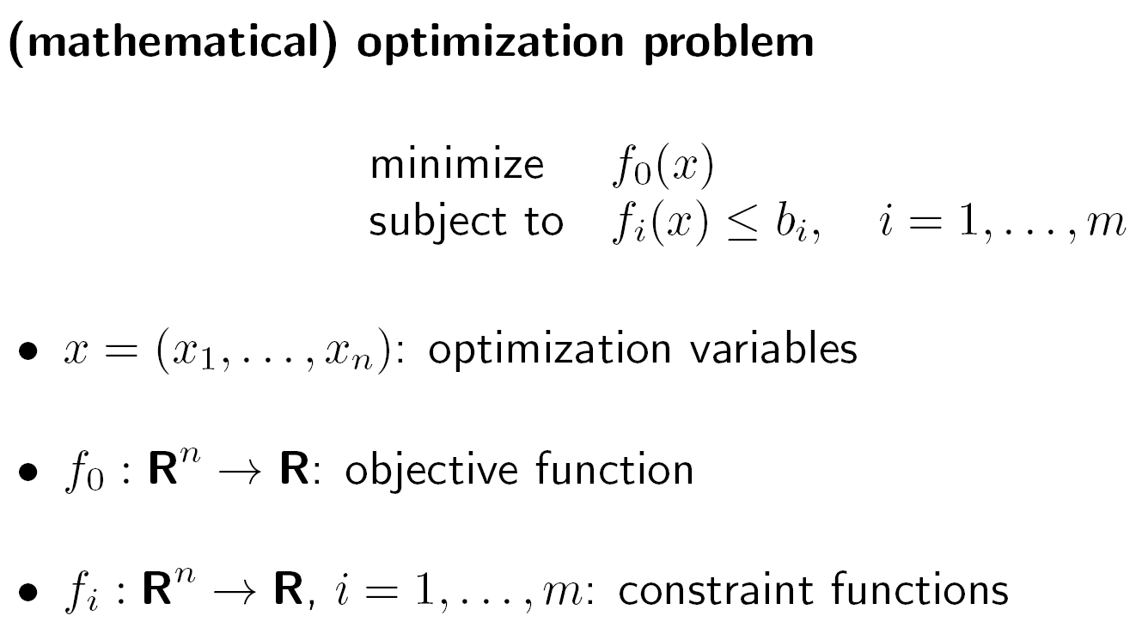
Optimization problem

Slide 5
Example: 0/1 knapsack problem
n objects , weight W₁, W₂, …,W_{n}
profit P₁, P₂, …,P_{n}
capacity M
maximize
subject to
x_{i} = 0 or 1, 1≤i≤n
e. g.

Slide 6
Convex set

Slide 7
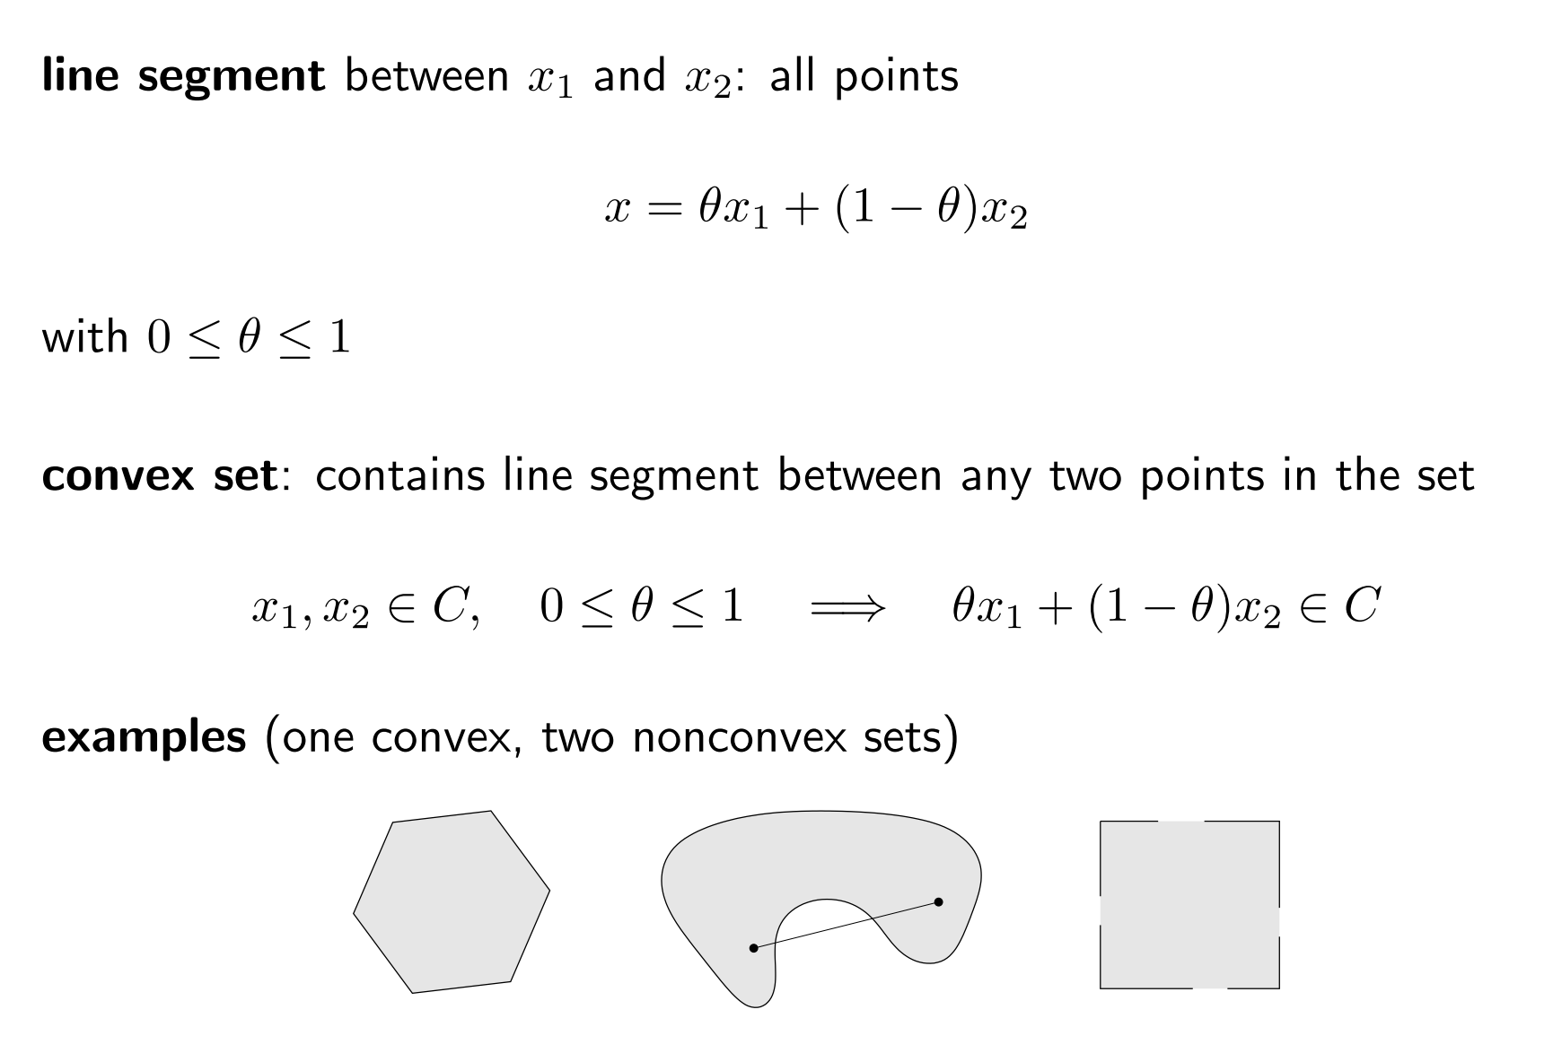
Convex set

Slide 8
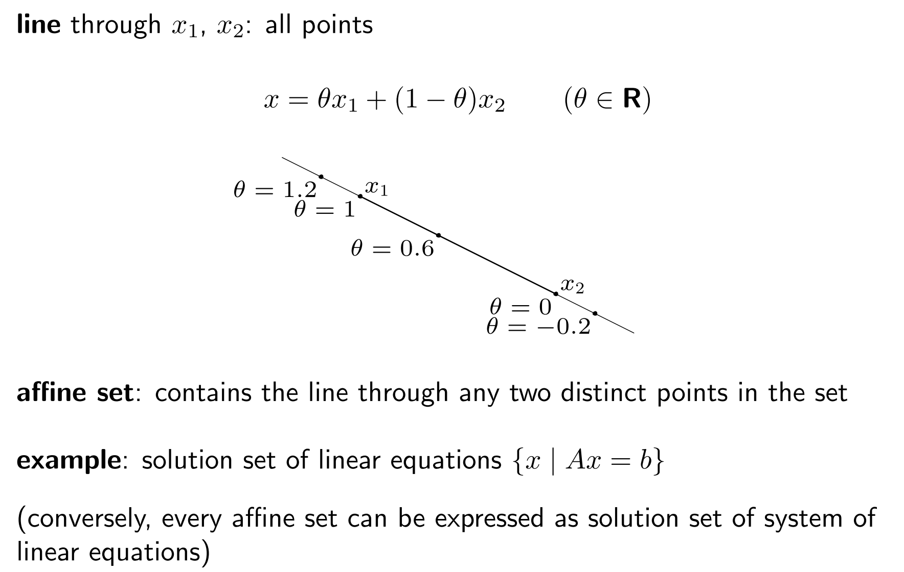
Affine set
(No boundary)

Slide 9
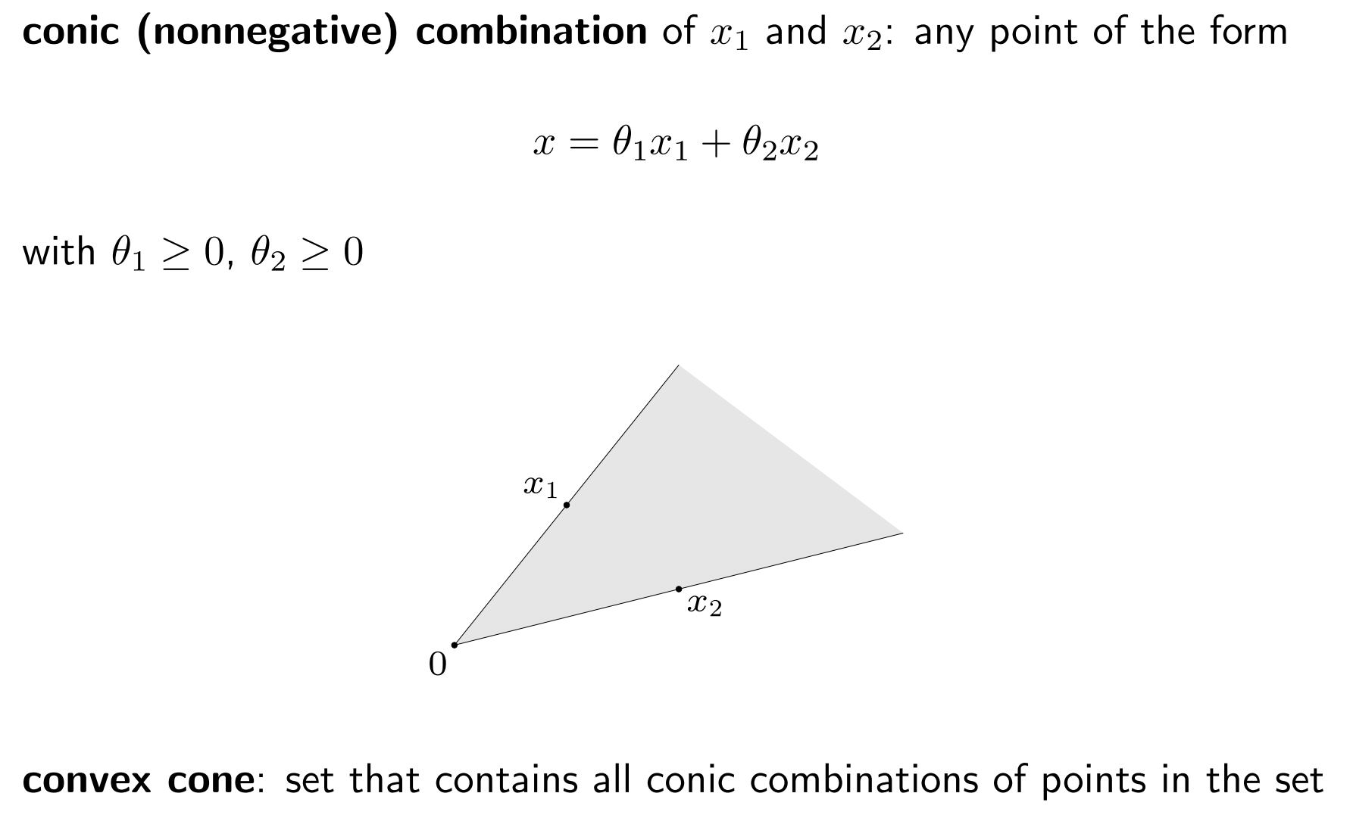
Convex cone

Slide 10
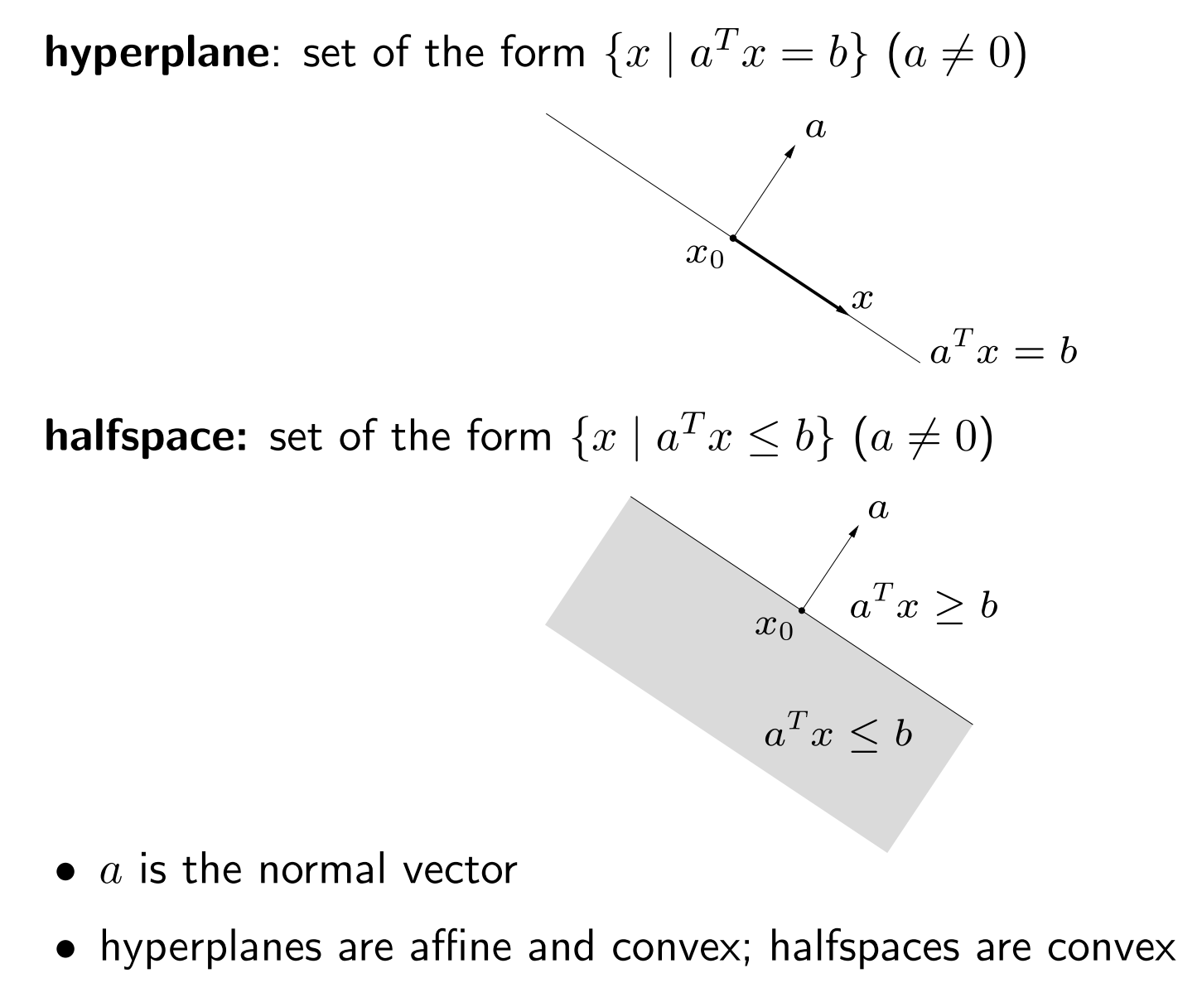
Hyperplane & Halfspace

Slide 11
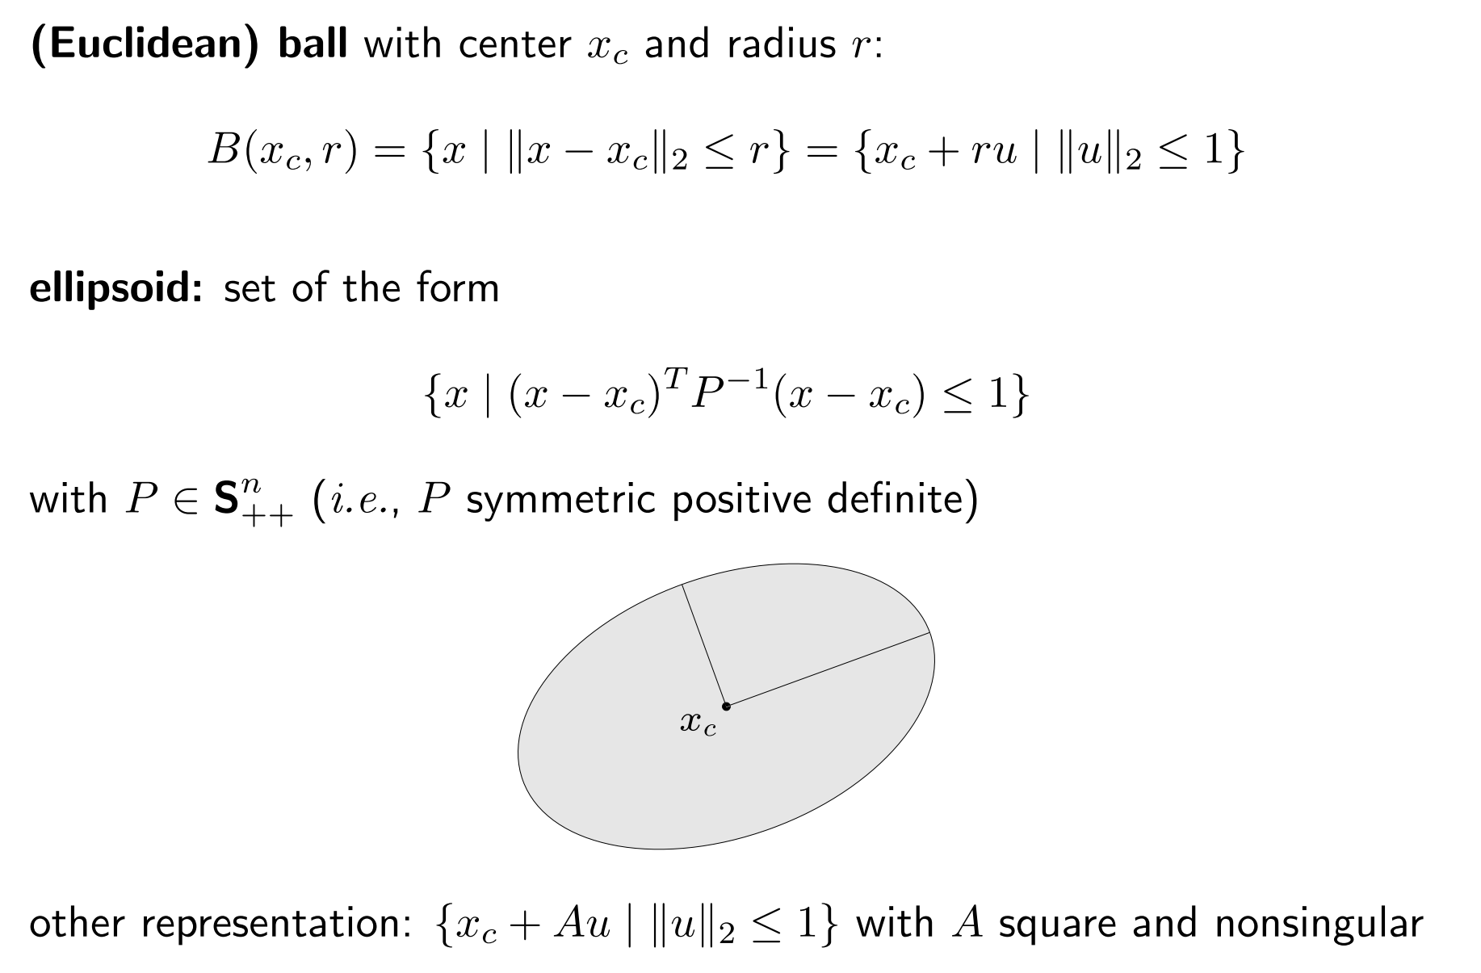
Euclidean balls & ellipsoids

Slide 12
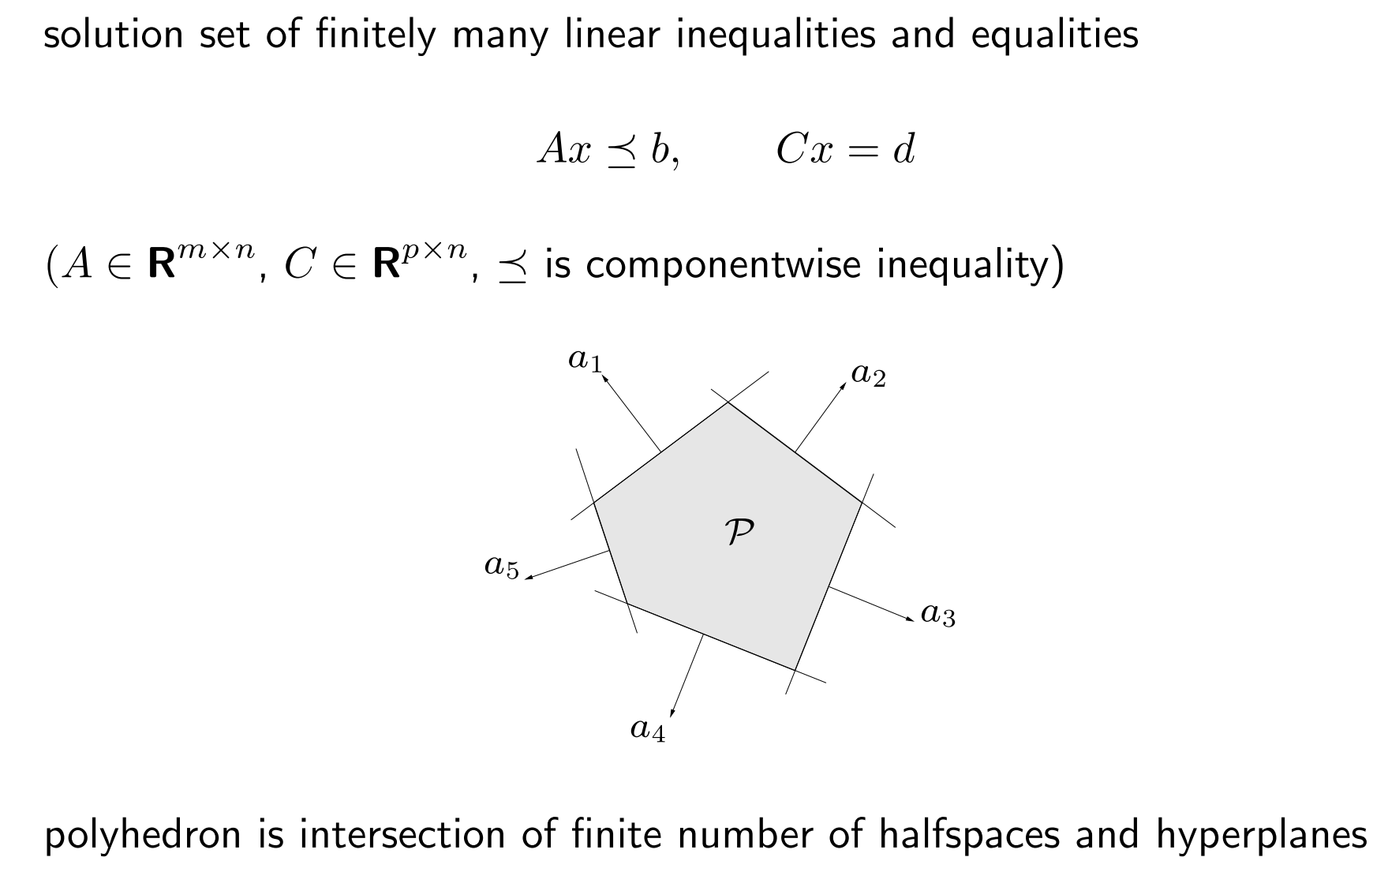
Polyhedra

Slide 13
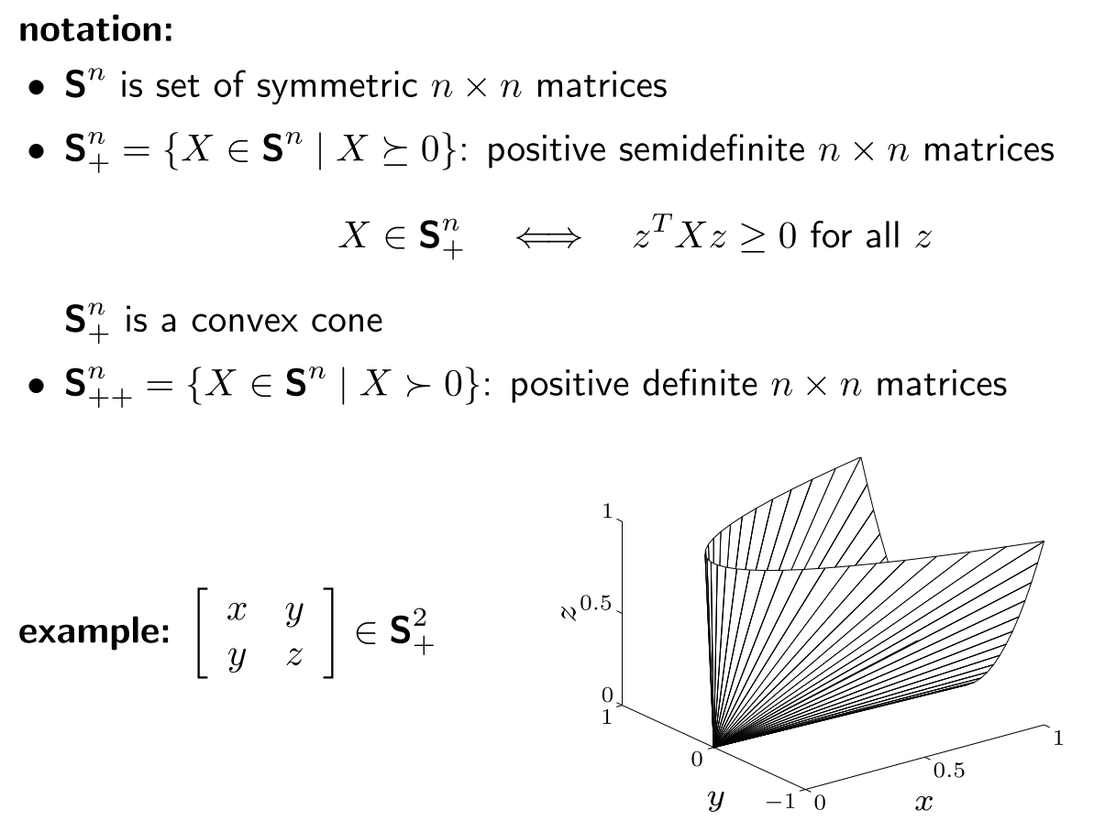
Positive semidefinite cone

Slide 14
Operations that preserve convexity
Intersection
Affine functions
Perspective function
Linear-fractional functions

Slide 15
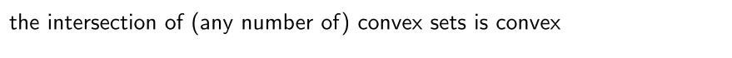
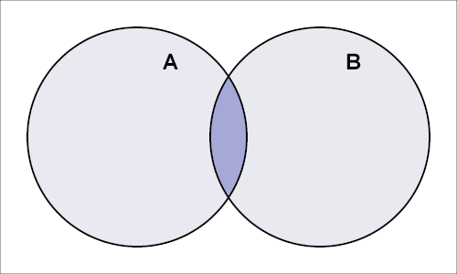
Intersection

Slide 16
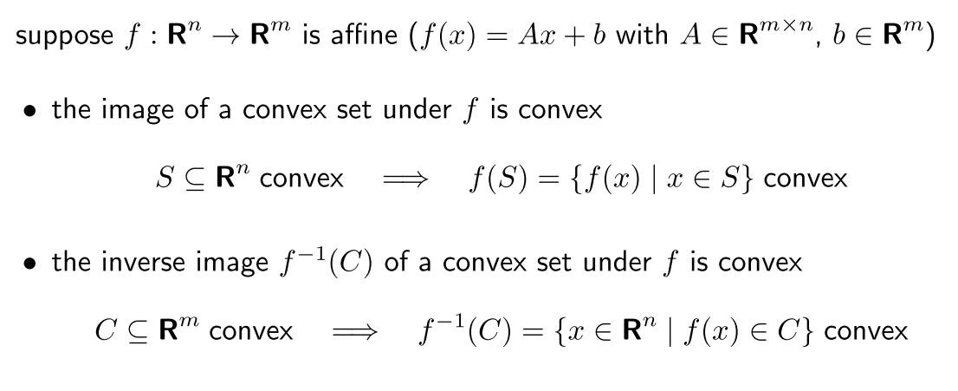
Affine function

Slide 17
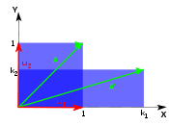

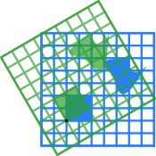

Scaling:
Rotation:
Counter clockwise

Slide 18
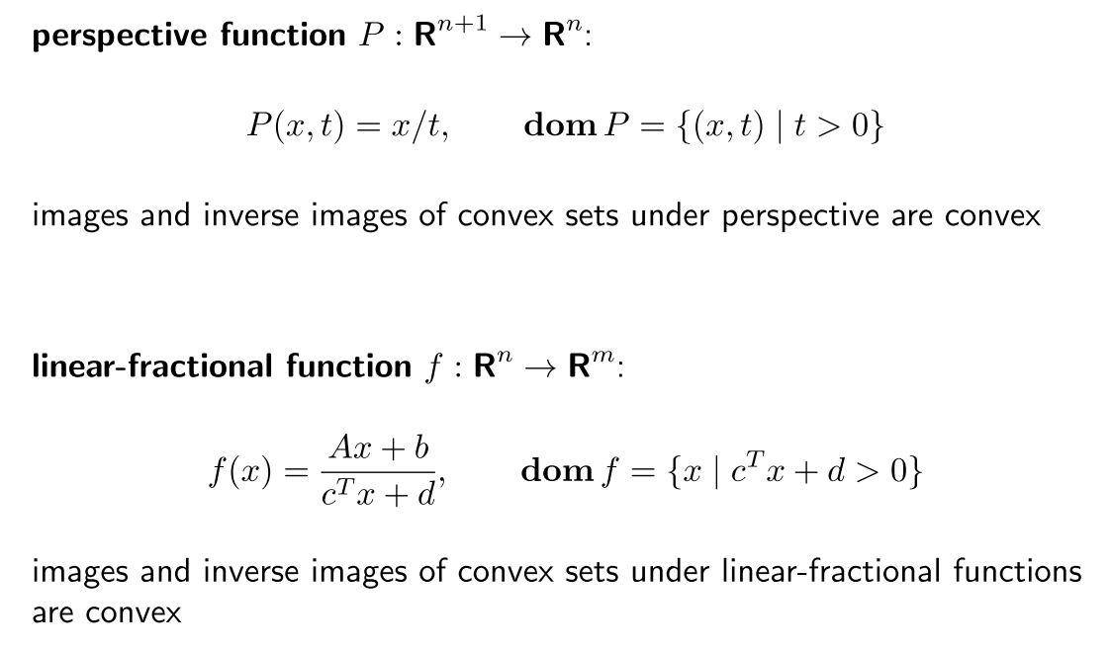
Perspective and linear-fractional function

Slide 19
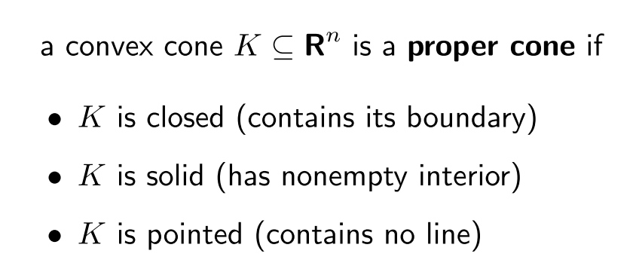
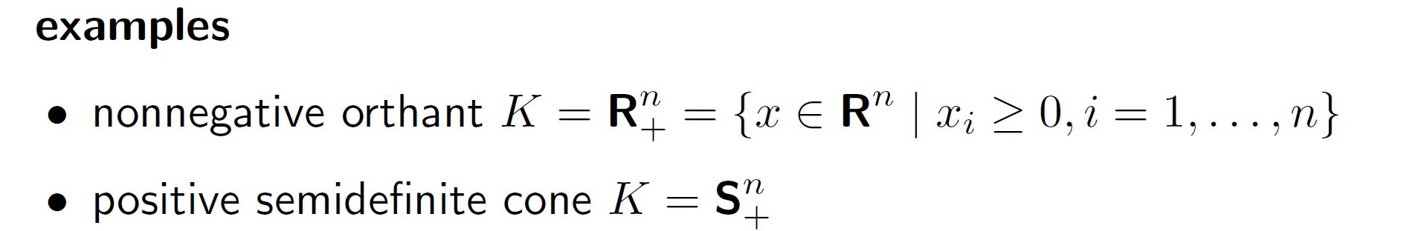
Generalized inequalities

Slide 20
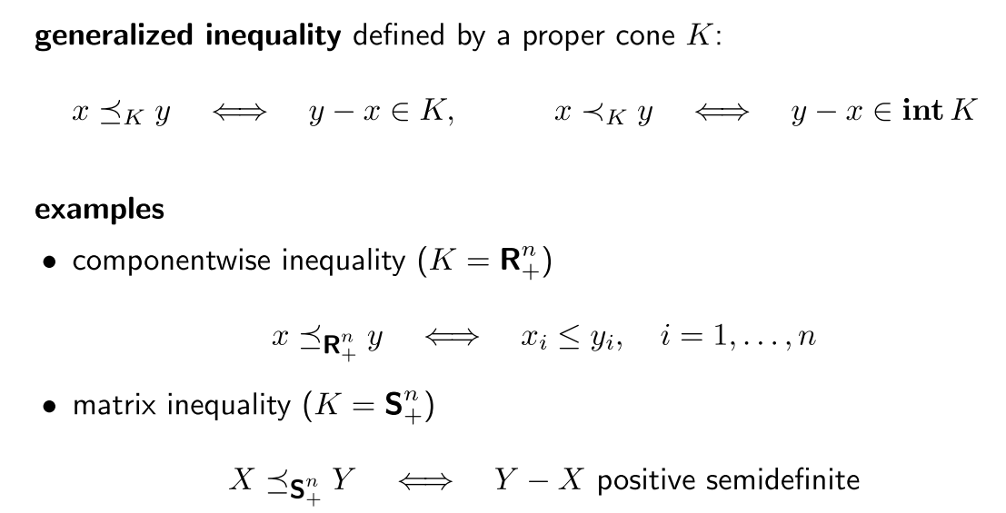
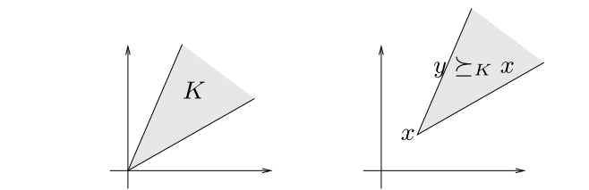

Slide 21
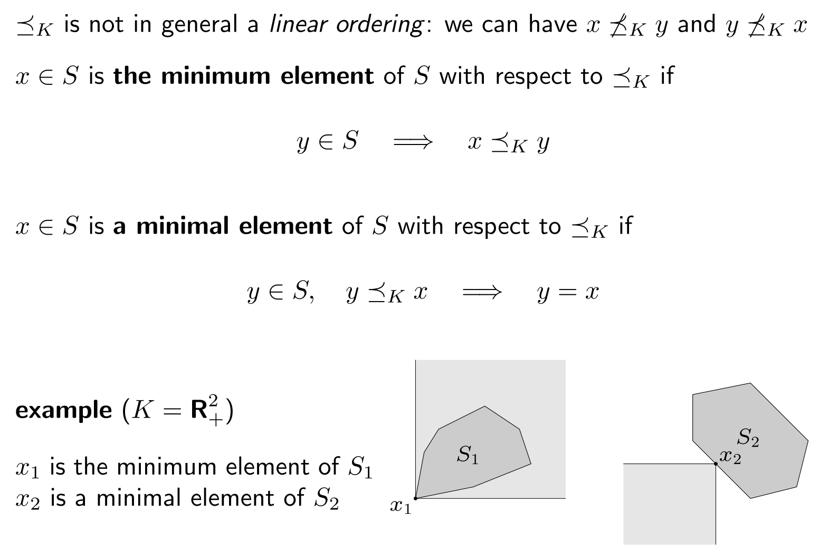
Minimum & minimal elements
S中不存在不能與x比較大小的元素
S中存在不能與x比較大小的元素

Slide 22
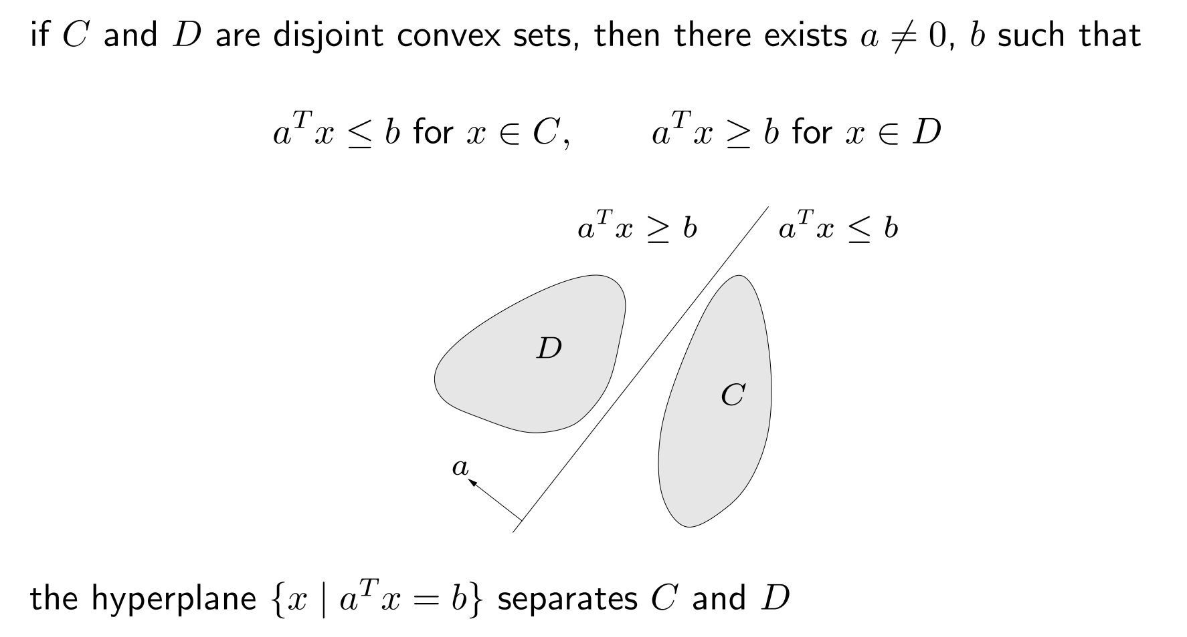
Separating hyperplane theorem
兩個沒有交集的凸集合，必存在一條可將兩個集合分開的直線。

Slide 23
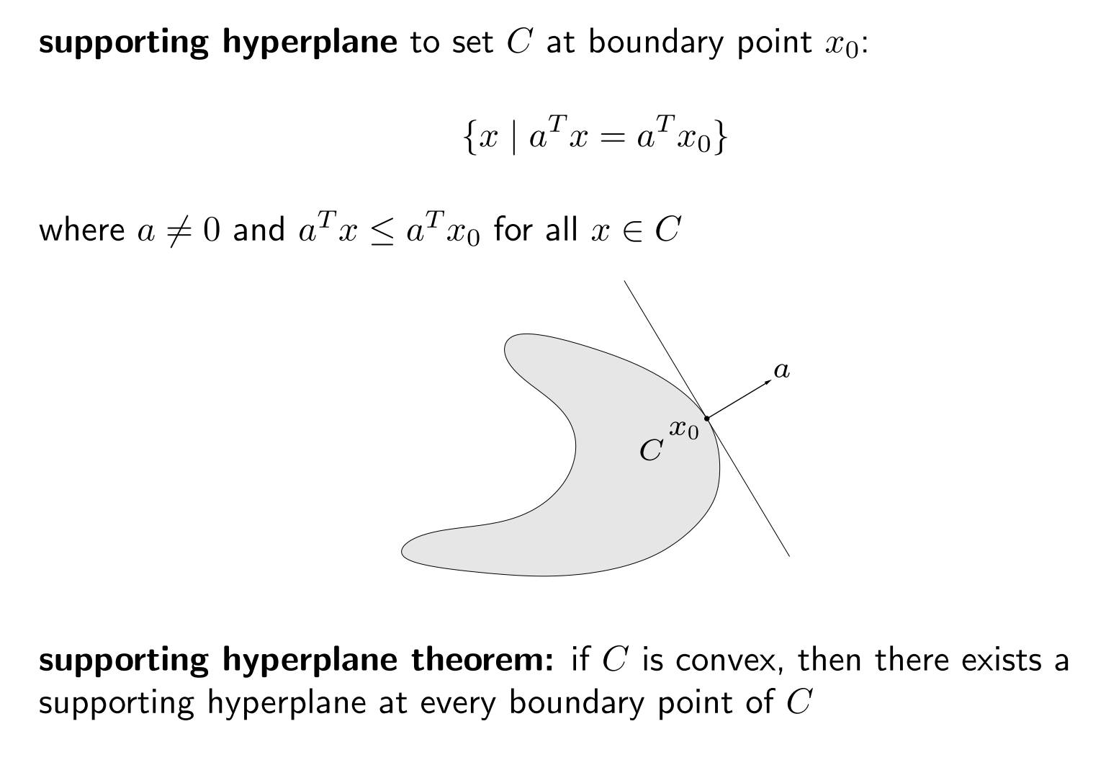
Supporting hyperplane theorem
凸集合邊界上每一點的必定有切線存在。

Slide 24
Convex function

Slide 25
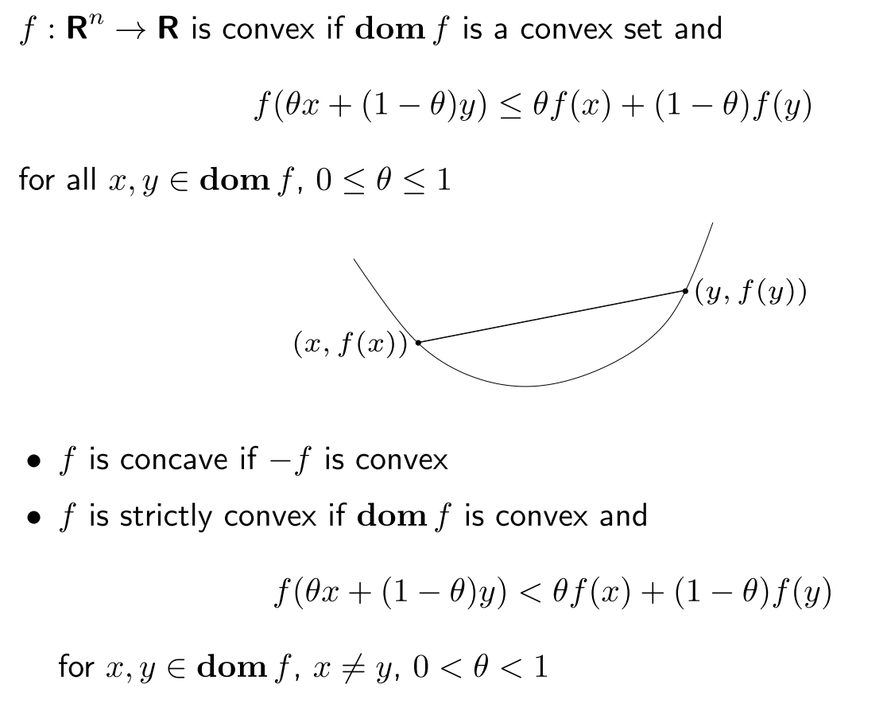
Definition

Slide 26
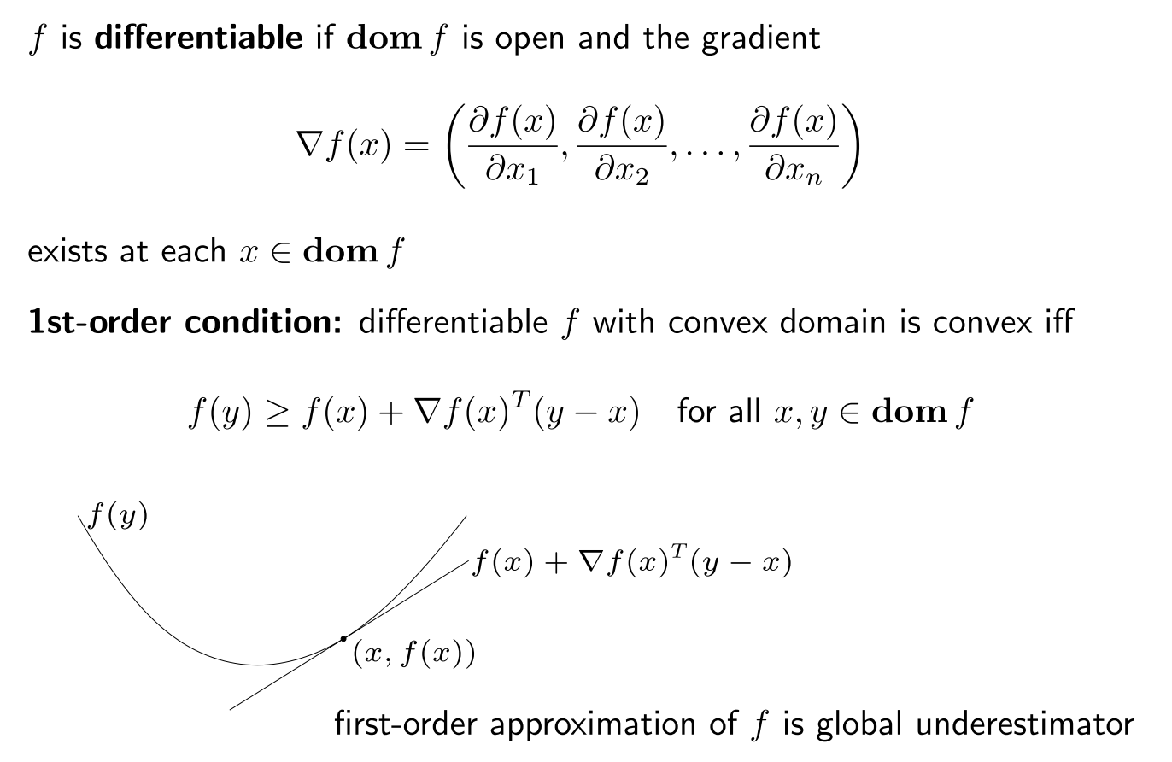
First-order condition

Slide 27
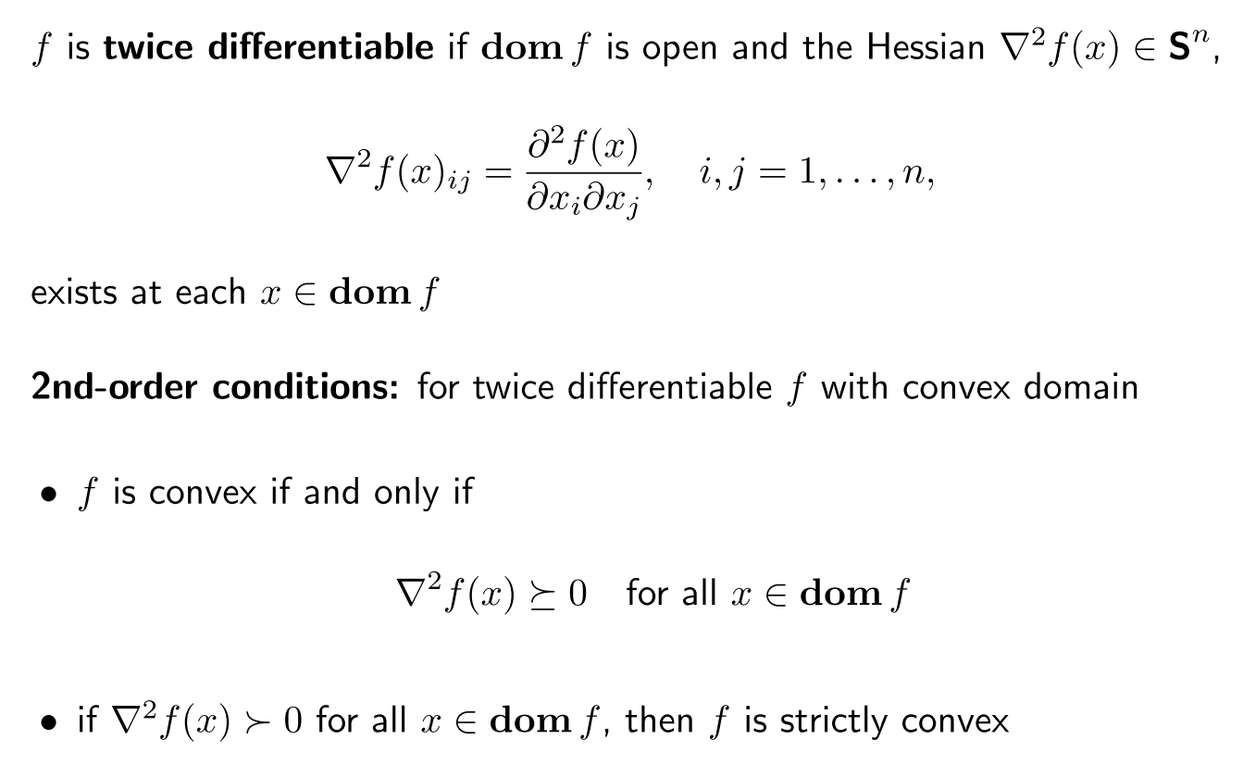
Second-order conditions

Slide 28
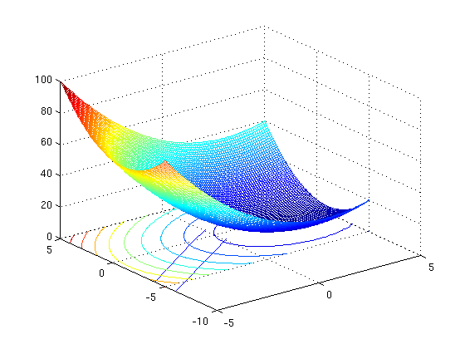

Slide 29
Def : positive definite matrix A
Properties of Hessian matrix of function f
H(x) is positive definite (正定) matrix → x is local minimum
H(x) is positive semidefinite (正半定) matrix → x is global minimum
H(x) is negative definite (負定) matrix → x is local maximum
H(x) is negative semidefinite (負半定) matrix → x is global maximum
H(x)不為上述四種狀況，indefinite → x is saddle point
Properties of definite matrix
A is P.D. matrix <-> all eigenvalues of A > 0
A is P.S.D matrix <-> all eigenvalues of A >=0
A is N.D matrix <-> all eigenvalues of A < 0
A is N.S.D matrix <-> all eigenvalues of A <=0

Slide 30
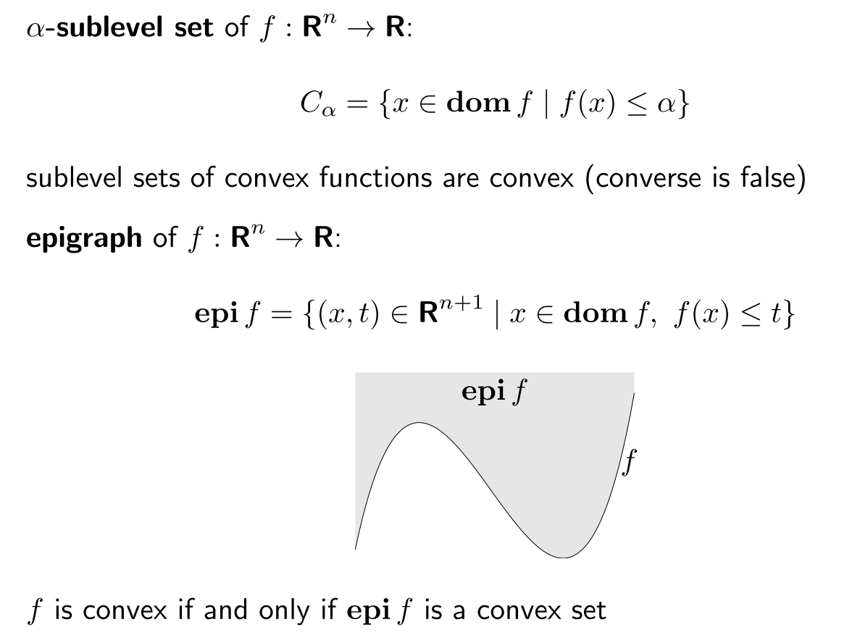
Epigraph and sublevel set

Slide 31
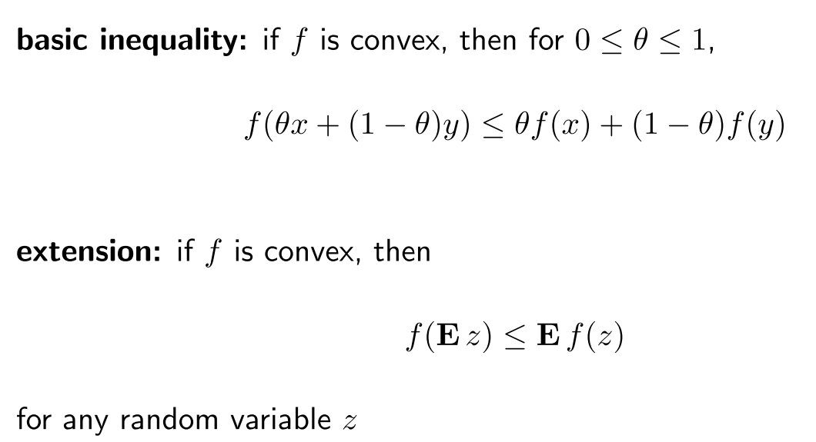
Jensen’s inequality

Slide 32
Operations that preserve convexity
Nonnegative weighted sum
Composition with affine function
Pointwise maximum and supremum
Composition
Minimization
Perspective

Slide 33
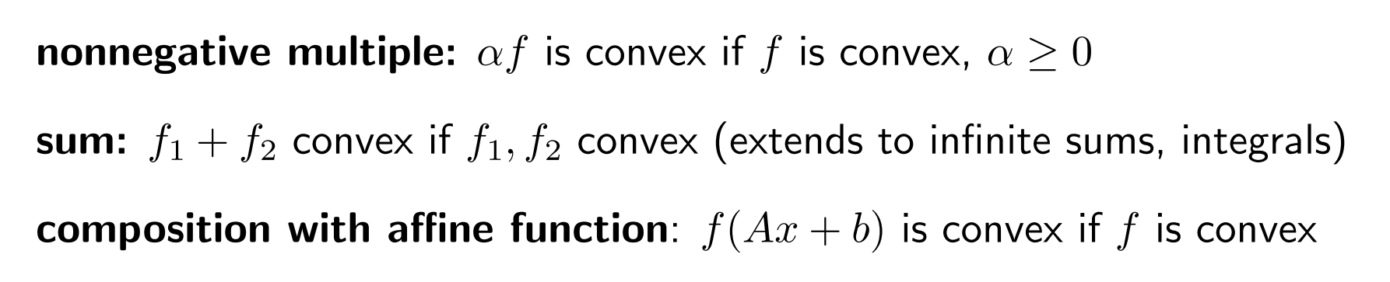
Nonnegative weighted sum & Composition with affine function

Slide 34
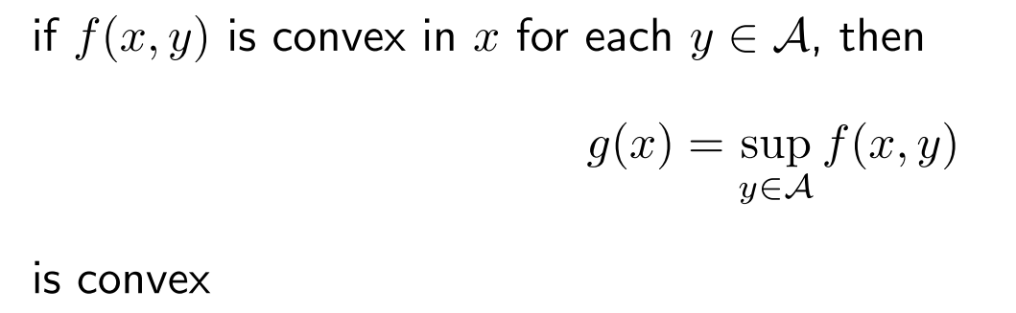
Pointwise maximum and supremum

Slide 35
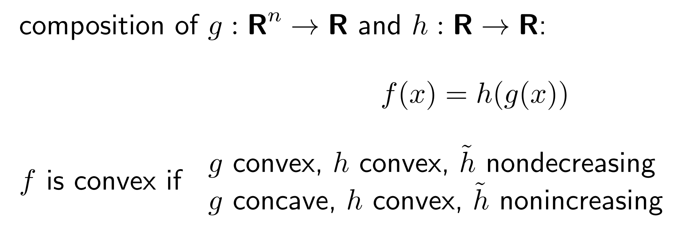
Composition

Slide 36
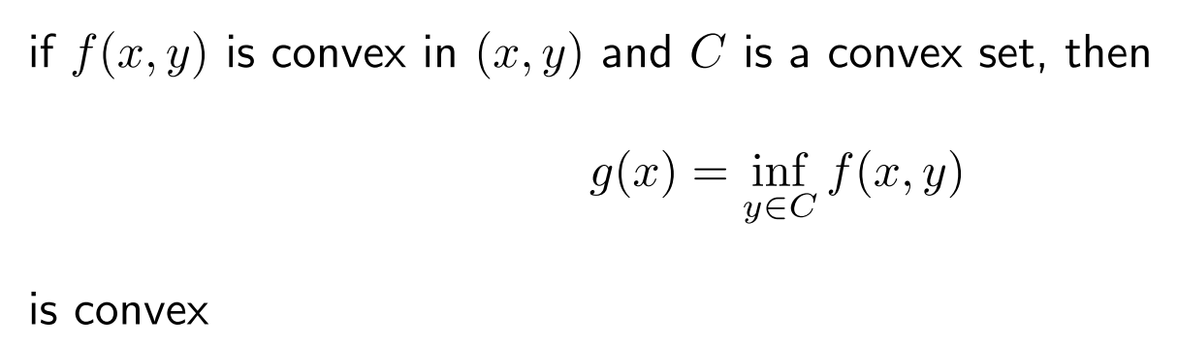
Minimization

Slide 37
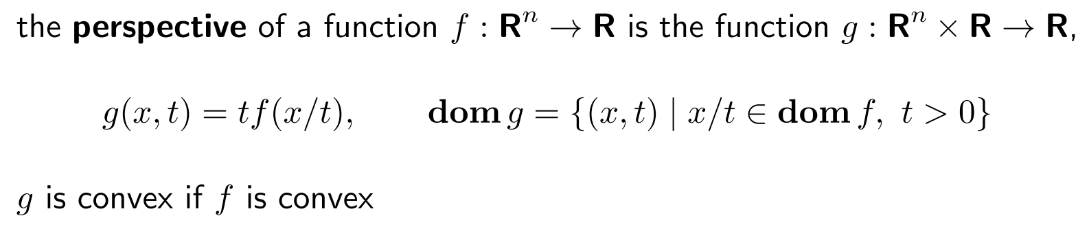
Perspective

Slide 38
Convex optimization function

Slide 39
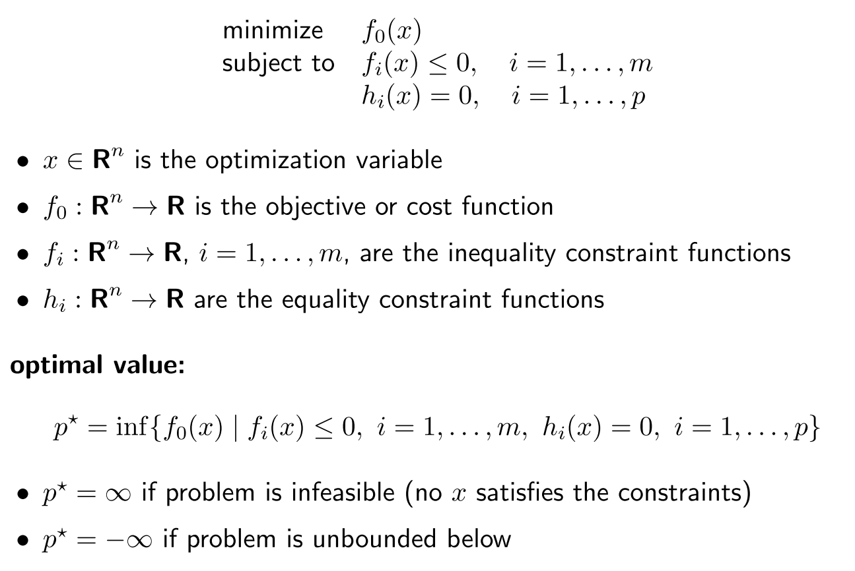
Optimization problem in standard form

Slide 40
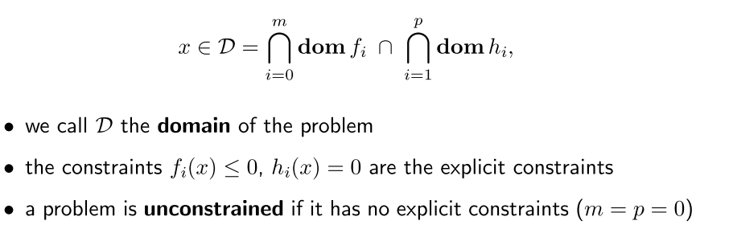
(Feasible set)

Slide 41
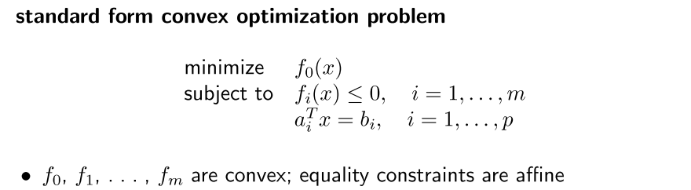
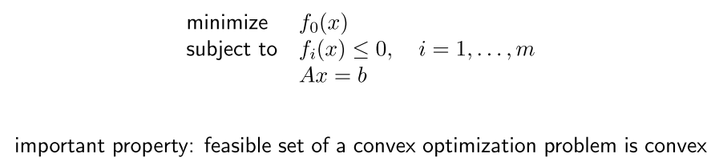
Convex optimization problem
polyhedra

Slide 42
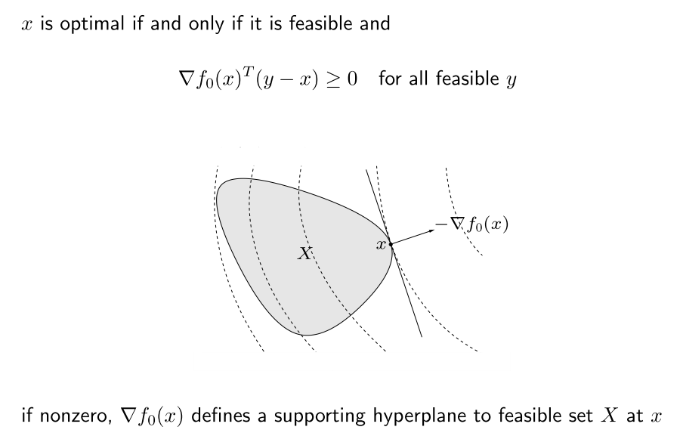
Optimality criterion for f₀

Slide 43
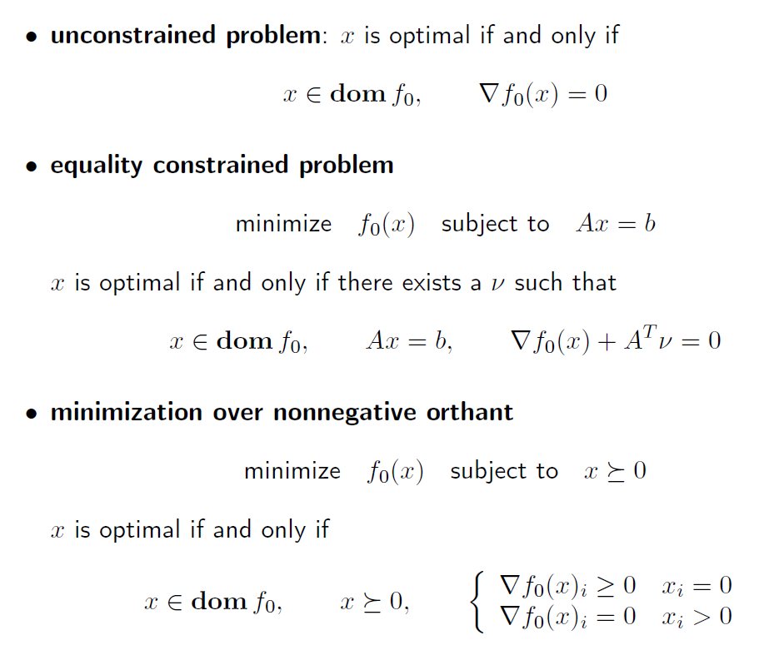

Slide 44
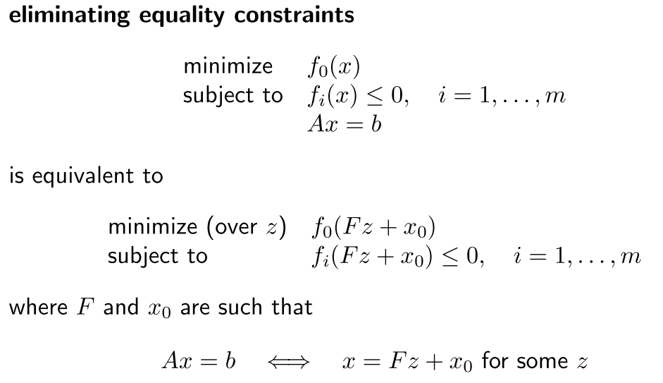
Equivalent convex problem
先出求線性方程式的通解，代入問題中變換變數

Slide 45
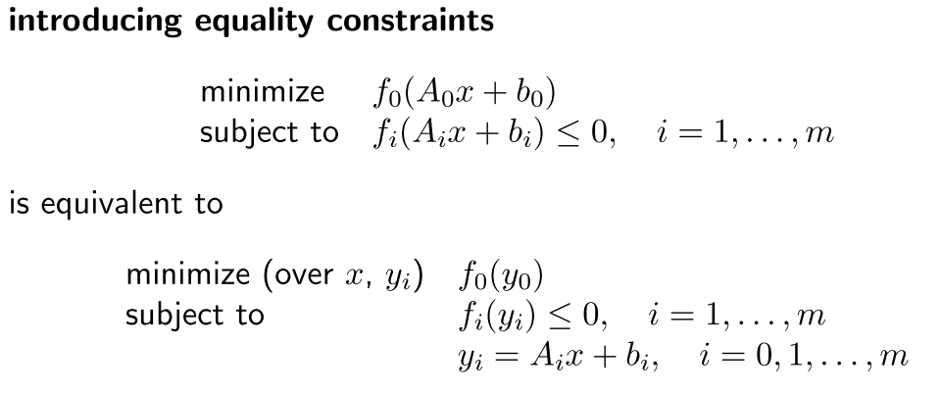
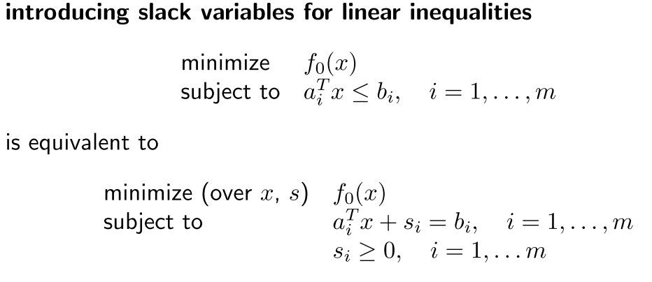
變換變數 y_{i}=A_{i}x+b_{i}

Slide 46
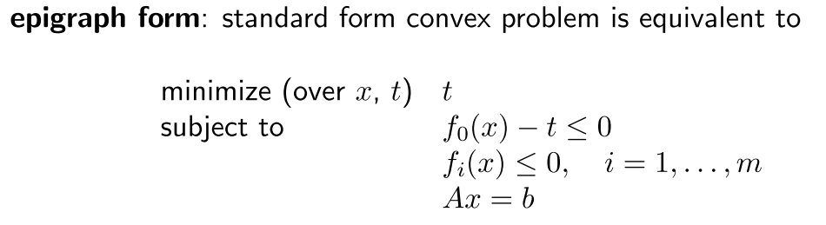
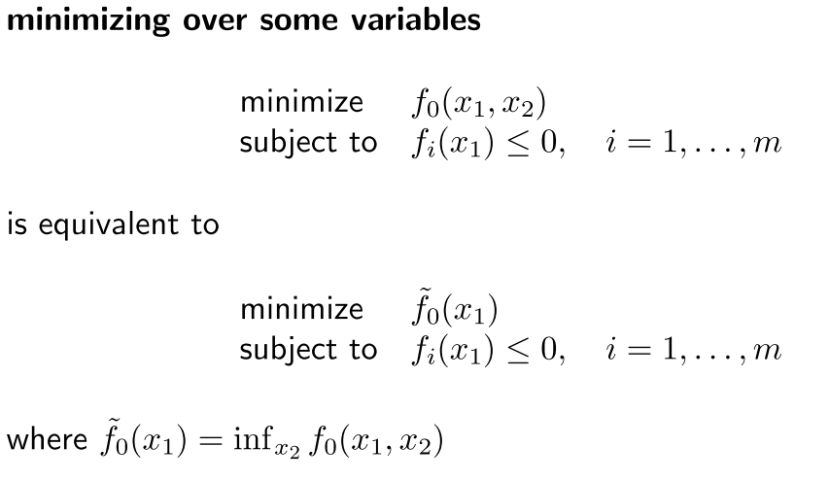
t
f₀(x)

Slide 47
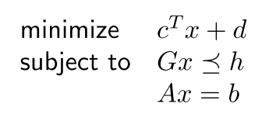
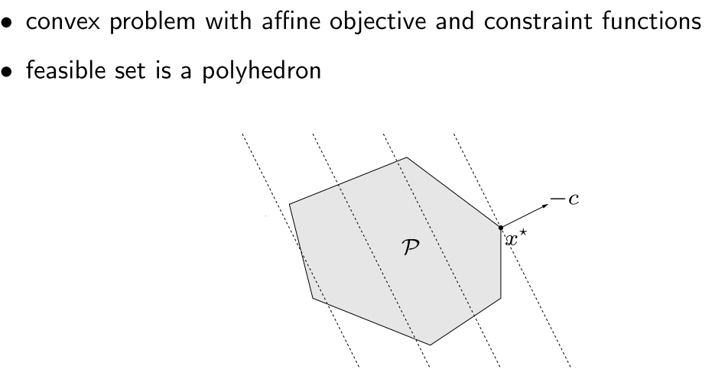
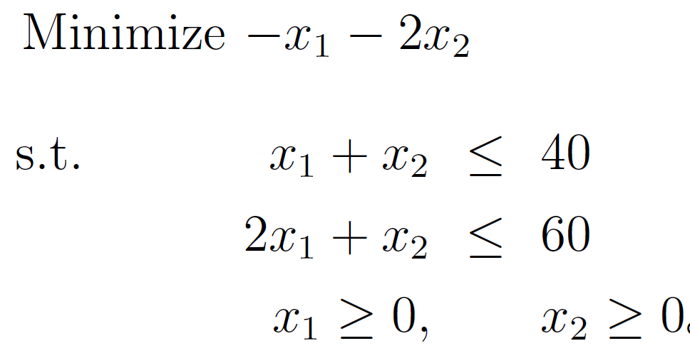
Linear program (LP)

Slide 48
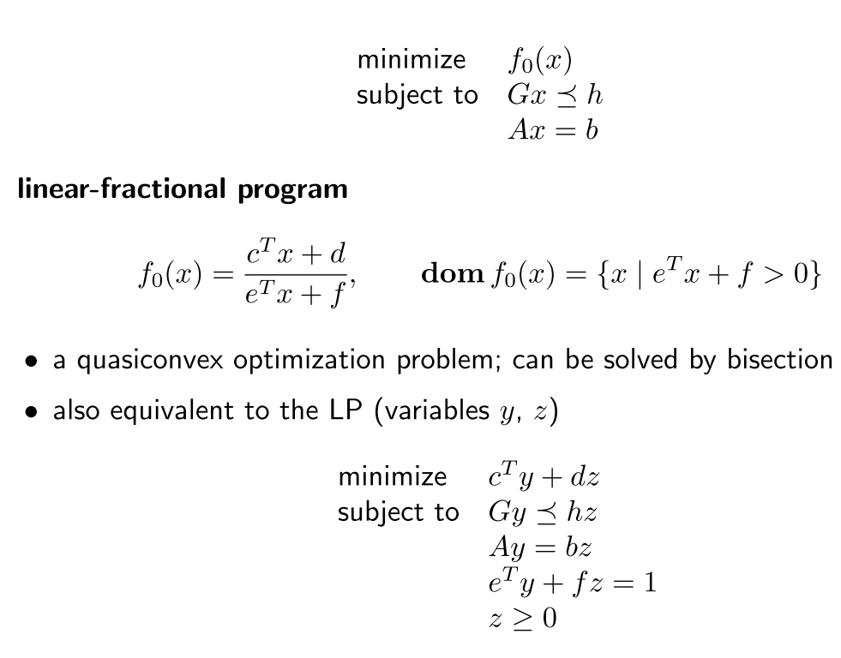
Linear-fractional program

Slide 49
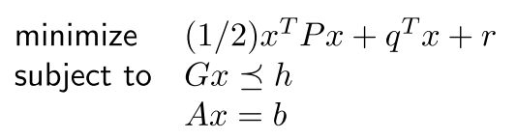
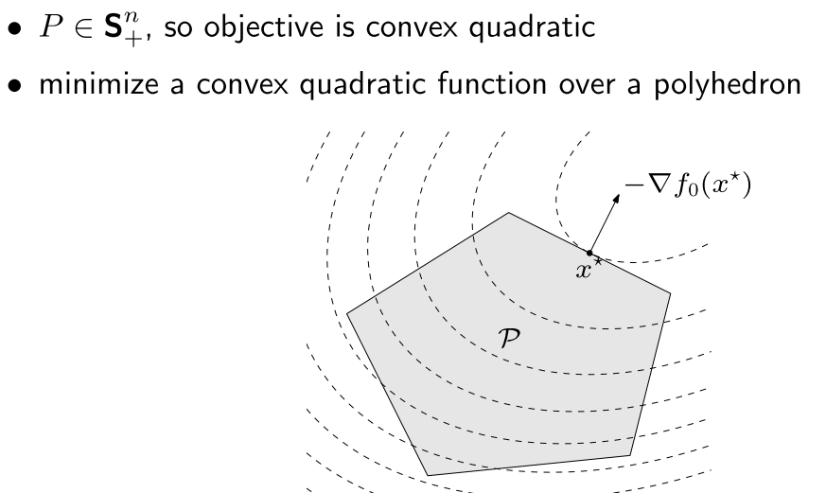
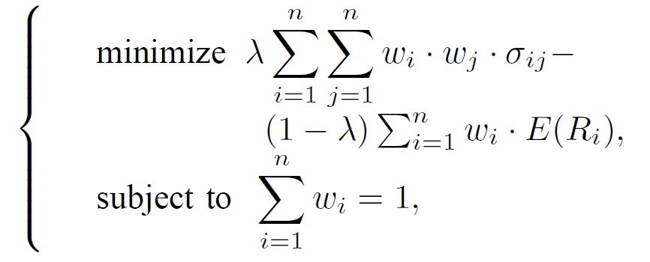
Quadratic program (QP)
Mean variance model:

Slide 50

Quadratically constrained quadratic program (QCQP)

Slide 51


Second-order cone programming

Slide 52


Slide 53
Python cvxopt package
http://abel.ee.ucla.edu/cvxopt/

Slide 54


Linear programming
from cvxopt import matrix, solvers
c = matrix([-4., -5.])
G = matrix([[2., 1., -1., 0.], [1., 2., 0., -1.]])
h = matrix([3., 3., 0., 0.])
sol = solvers.lp(c, G, h)
print sol['x']
#ans--------
[ 1.00e+00]
[ 1.00e+00]

Slide 55


Quadratic programming

Slide 56
from math import sqrt
from cvxopt import matrix
from cvxopt.blas import dot
from cvxopt.solvers import qp
import pylab
n = 4
S = matrix([[ 4e-2, 6e-3, -4e-3, 0.0 ],
[ 6e-3, 1e-2, 0.0, 0.0 ],
[-4e-3, 0.0, 2.5e-3, 0.0 ],
[ 0.0, 0.0, 0.0, 0.0 ]])
pbar = matrix([.12, .10, .07, .03])
G = matrix(0.0, (n,n))
G[::n+1] = -1.0
h = matrix(0.0, (n,1))
A = matrix(1.0, (1,n))
b = matrix(1.0) #
Compute trade-off.
N = 100
mus = [ 10**(5.0*t/N-1.0) for t in xrange(N) ]
portfolios = [ qp(mu*S, -pbar, G, h, A, b)['x'] for mu in mus ]
returns = [ dot(pbar,x) for x in portfolios ]
risks = [ sqrt(dot(x, S*x)) for x in portfolios

Slide 57


Second-order cone programming

Slide 58
from cvxopt import matrix, solvers
c = matrix([-2., 1., 5.])
G = [ matrix( [[12., 13., 12.], [6., -3., -12.], [-5., -5., 6.]] ) ]
G += [ matrix( [[3., 3., -1., 1.], [-6., -6., -9., 19.], [10., -2., -2., -3.]] ) ]
h = [ matrix( [-12., -3., -2.] ), matrix( [27., 0., 3., -42.] ) ]
sol = solvers.socp(c, Gq = G, hq = h)
sol['status'] optimal
print sol['x'] #[-5.02e+00] [-5.77e+00] [-8.52e+00]
print sol['zq'] #[0] [ 1.34e+00] [-7.63e-02] [-1.34e+00]
print sol['zq'] #[1] [ 1.02e+00] [ 4.02e-01] [ 7.80e-01] [-5.17e-01]

Slide 59


Semidefinite programming

Slide 60
from cvxopt import matrix, solvers
c = matrix([1.,-1.,1.])
G = [ matrix([[-7., -11., -11., 3.], [ 7., -18., -18., 8.], [-2., -8., -8., 1.]]) ]
G += [ matrix([[-21., -11., 0., -11., 10., 8., 0., 8., 5.], [ 0., 10., 16., 10., -10., -10., 16., -10., 3.], [ -5., 2., -17., 2., -6., 8., -17., -7., 6.]]) ]
h = [ matrix([[33., -9.], [-9., 26.]]) ]
h += [ matrix([[14., 9., 40.], [9., 91., 10.], [40., 10., 15.]]) ]
sol = solvers.sdp(c, Gs=G, hs=h)
print sol['x'] #[-3.68e-01] [ 1.90e+00] [-8.88e-01]
print sol['zs'][0] #[ 3.96e-03 -4.34e-03] [-4.34e-03 4.75e-03]
print sol['zs'][1] #[ 5.58e-02 -2.41e-03 2.42e-02] [-2.41e-03 1.04e-04 -1.05e-03] [ 2.42e-02 -1.05e-03 1.05e-02]

Slide 61
Resource
Stephen P. Boyd, Stanford University:
EE364A: Convex Optimization I
EE364B: Convex Optimization II
http://www.stanford.edu/~boyd/cvxbook/
Software:
CVX (Matlab)
CVXOPT (Python)
CVXMOD (Python)

Slide 62

Thank you!!

