Slide 1
Robust Support Vector Regression Networks for Function Approximation With Outliers
IEEE TRANSACTIONS ON NEURAL NETWORKS, VOL. 13, NO. 6, NOVEMBER 2002
Chen-Chia Chuang, Shun-Feng Su, Member, IEEE, Jin-Tsong Jeng, Member, IEEE, and Chih-Ching Hsiao
Presenter: Yung-Shiun Chen
Date: Oct. 03, 2011

Slide 2
Abstract
Support vector regression (SVR) employs the support vector machine (SVM) to tackle problems of function approximation and regression estimation. SVR has been shown to have good robust properties against noise. When the parameters used in SVR are improperly selected, overfitting phenomena may still occur. However, the selection of various parameters is not straightforward. Besides, in SVR, outliers may also possibly be taken as support vectors. Such an inclusion of outliers in support vectors may lead to seriously overfitting phenomena. In this paper, a novel regression approach, termed as the robust support vector regression (RSVR) network, is proposed to enhance the robust capability of SVR. In the approach, traditional robust learning approaches are employed to improve the learning performance for any selected parameters. From the simulation results, our RSVR can always improve the performance of the learned systems for all cases. Besides, it can be found that even the training lasted for a long period, the testing errors would not go up. In other words, the overfitting phenomenon is indeed suppressed.

Slide 3
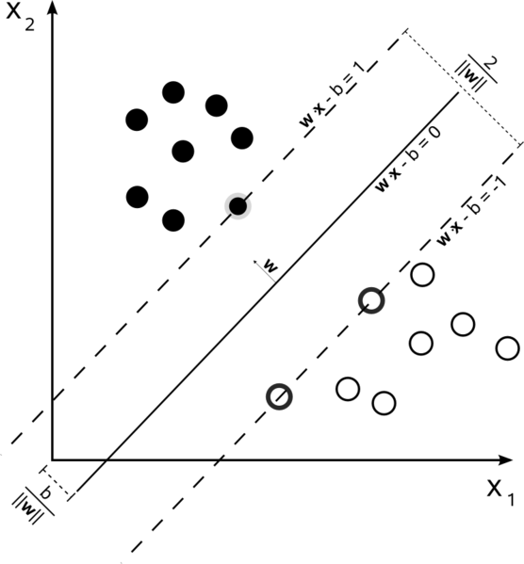
Support Vector Machine (SVM)
Notes:
Robust 用在很多地方 如PCA intervl regression等等方法中以用來解果outliers問題
第一個問題是要怎麼決定誰是outlier 目前他提到的方法都有問題

Slide 4
Support Vector Machine (SVM)
find a hyper plan to classify the data
H1: w^{T}x+b+δ ,H2: w^{T}x+b−δ
=> H1: w^{T}x+b=1 ,H2: w^{T}x-b=-1
=> y_{i}((w^{T}x_{i})+b)≧1
maximize margin
maximize distance between H1, H2: 2/|W|²
=> minimize |W|²/2

Slide 5
Support Vector Machine (SVM)
Quadratic Programming
Kernel Function
Linear:
Polynomail:
Radial basis function(RBF):
Gaussian:
Notes:
上面式子的可以用Quadratic Programming解
但是如果Xi的維度很高 這時候就要借助kernel function
不懂SVM的相關推導沒關係
只要記得kernel Function是SVM為了往高維度尋找答案的東西
不同的kernel Function可以有不同的找法
這邊要注意的是 lab常說要調整SVM的參數 gammar就是即是調整RBF和Gaussian中的gammar

Slide 6
Support Vector Machine (SVM)
Kernel Function
The choice of a kernel depends on the problem at hand because it depends on what we are trying to model. A polynomial kernel, for example, allows us to model feature conjunctions up to the order of the polynomial. Radial basis functions allows to pick out circles (or hyperspheres) - in constrast with the linear kernel, which allows only to pick out lines (or hyperplanes).

Slide 7
Support Vector Regression(SVR)
SVR和SVM一樣，都是要找一個最適平面(hyperplane)，不過SVR尋找的平面為可以準確預測所有資料點之平面
minimize |W|²/2
subject to |y_{i}−(w·x_{i}−b)|≤ε

Slide 8
Traditional SVR
cost function (objective function):
loss function

Slide 9
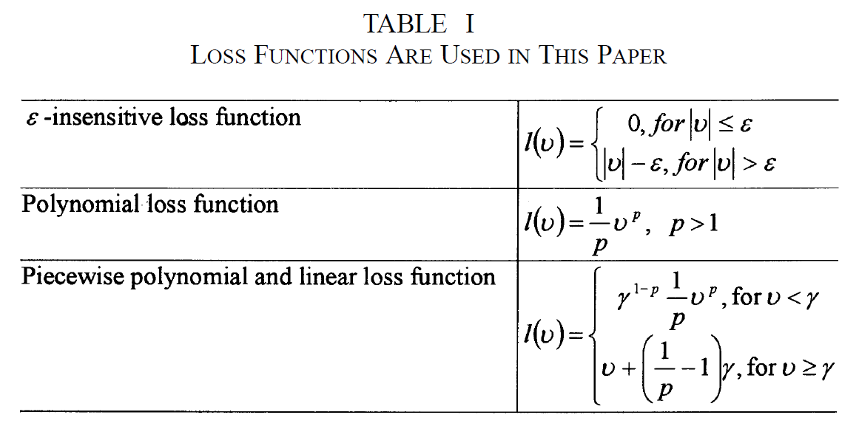
Traditional SVR

Slide 10
Traditional SVR
f can be written as:
kernel function :
Gaussian kernel:

Slide 11
Robust SVR
The robust learning concept and the SVR theory are combined to form the RSVR networks.
The learning of the proposed RSVR network is divided into two phases, the initial phase and the robust learning phase.

Slide 12
Robust SVR
The initial phase is to determine the network structure and the corresponding initial network weights through the SVR theory.
Choose the cost function and the kernel functions.
an initial RSVR network is obtained as:
Notes:
Β = [B1…..Bp] is the weight vector of the network.
P us the number of kernel functions.

Slide 13
Robust SVR
Step 1) Initialize the RSVR structure with the given kernel functions, the loss function, and the constant .
Step 2) For each training pattern, compute the estimated result and its error.
Step 3) Update the weight vector incrementally. When it is in the first epoch, the robust cost function is the quadratic form by selecting and large enough to count in all points.
Step 4) Determine the cutoff points and by the CUTOFF algorithm.
Step 5) Compute the robust cost function.
Step 6) If the termination conditions are not satisfied, then go to Step 2; otherwise, terminate the learning process.

Slide 14
Robust SVR
In the learning algorithm, a robust cost function E_{R}(t) is defined as:

Slide 15
Robust SVR
In the RSVR learning algorithms, the gradienet descent method is employed and β can be updated as
η is a learning constant
is the influence function

Slide 16
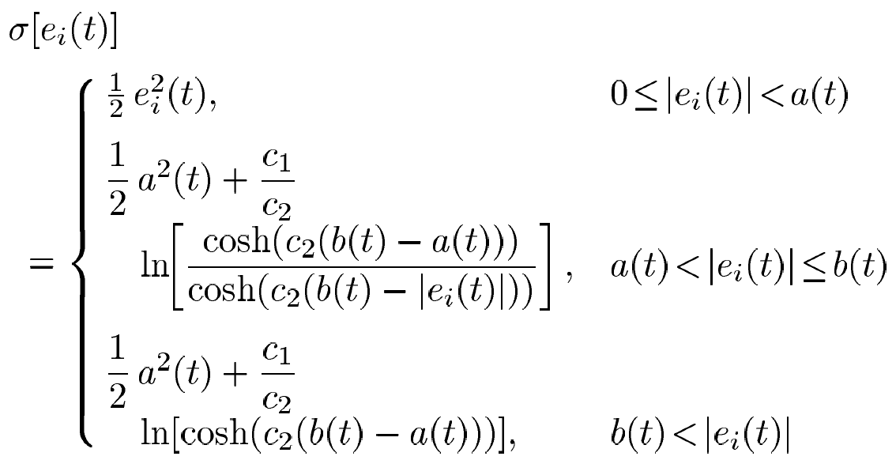
Robust SVR
The tanh-estimator is used as the robust cost function:
Notes:
a(t)和b(t) 為時間涵式 他們也是cutpoint

Slide 17
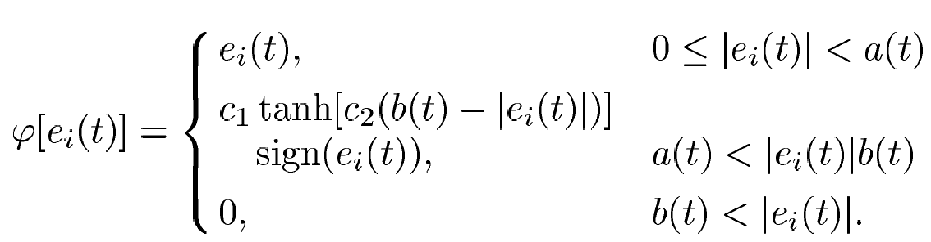
Robust SVR
The influence function:

Slide 18
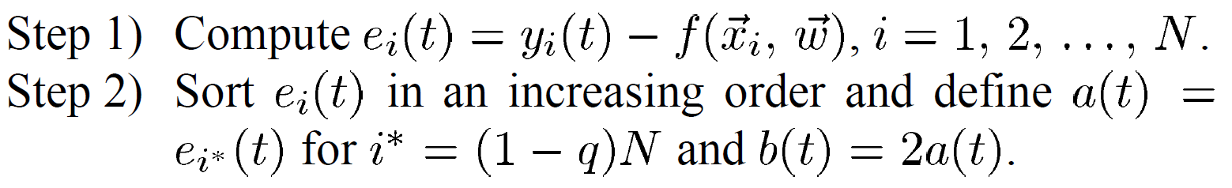
Robust SVR
CUTOFF algorithm
Let q be an upper bound of the percentage of outliers in the training data set, and thus a(t) and b(t) can be defined as follows.

Slide 19
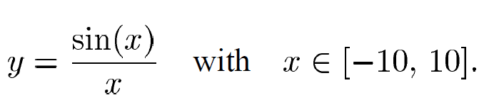
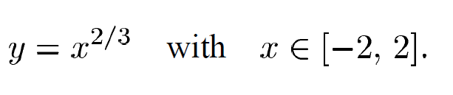
Experiment
Regression Function 1:
Regression Function 2:

Slide 20
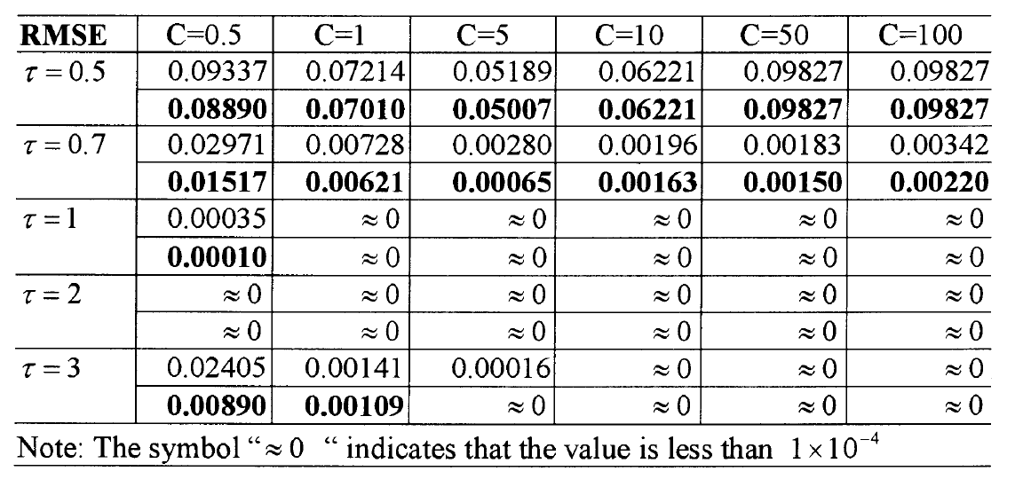
Experimental Result with ε-insensitive function ε=0
Notes:
上面是SVR 下面的粗體是RSVR

Slide 21
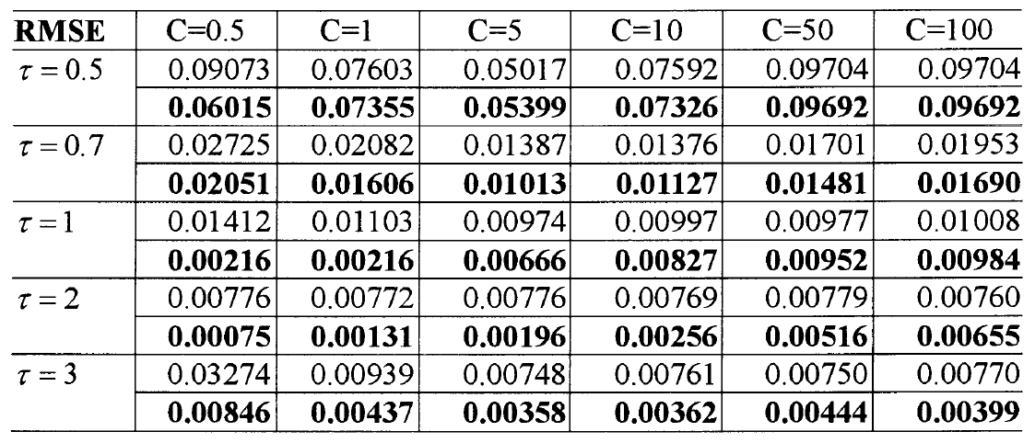
Experimental Result with ε-insensitive function ε=0.1

Slide 22
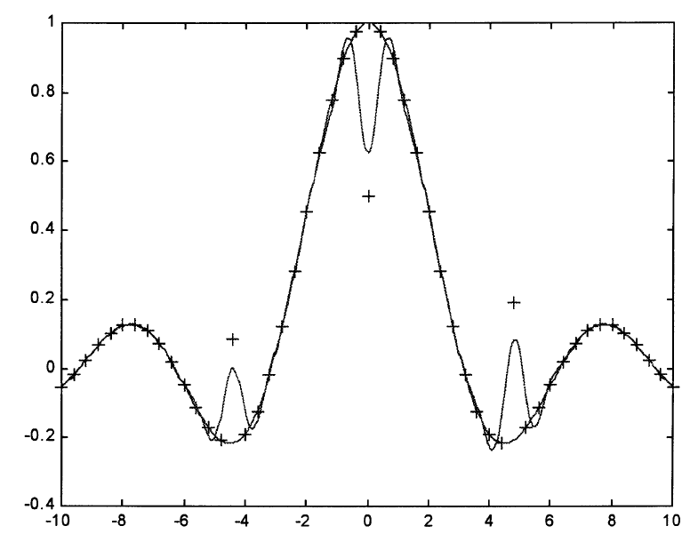
Sin function regression with SVR

Slide 23
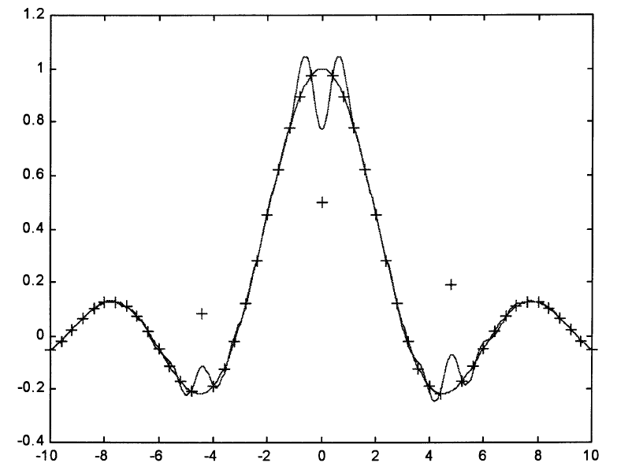
Sin function regression with RSVR

Slide 24
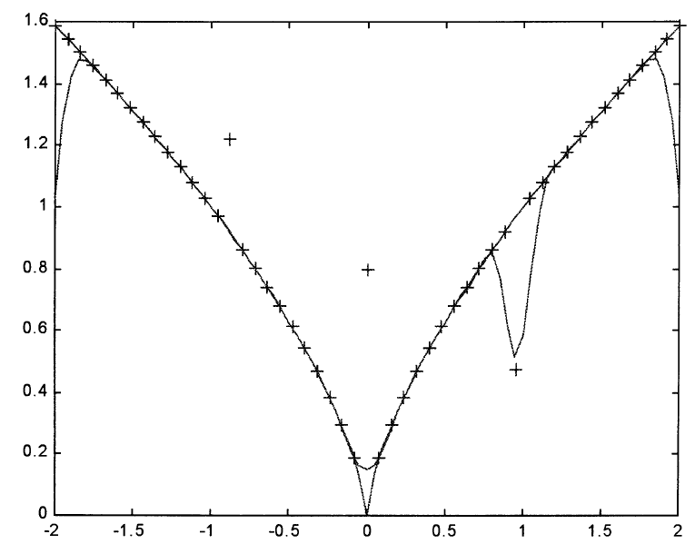
y=x^(2/3) regression with SVR

Slide 25
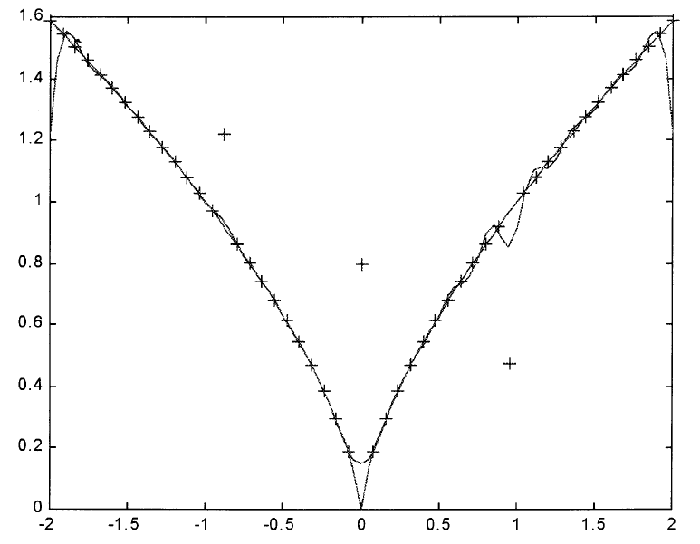
y=x^(2/3) regression with RSVR

Slide 26
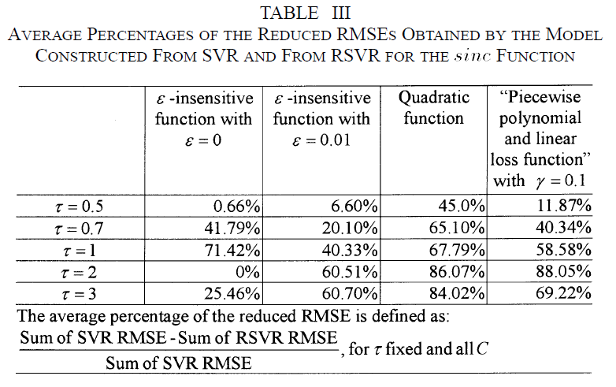

Slide 27
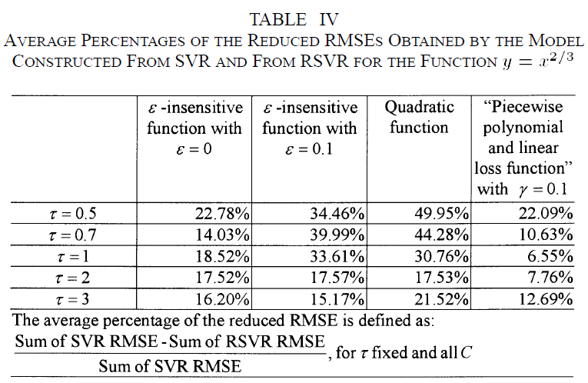

Slide 28
Thank you!

Slide 29
Reference
SVM
http://www.cmlab.csie.ntu.edu.tw/~cyy/learning/tutorials/SVM3.pdf
http://en.wikipedia.org/wiki/Support_vector_machine
http://crsouza.blogspot.com/2010/03/kernel-functions-for-machine-learning.html
SVR
http://www.cmlab.csie.ntu.edu.tw/~cyy/learning/tutorials/SVR.pdf

