Slide 1
Novel Computational Analysis of Protein Binding Array Data
BMC Bioinformatics 2011 Open Access Article
Jonathon T Hill, Keith R Anderson,
Teresa L Mastracci, Klaus H Kaestner and
Lori Sussel.
October 14th 2011
Presenter: Bamfa Ceesay

Slide 2
Overview
Abstract
Transcription Factor Binding Sites
ChIP_Seq Method
PBM Mapping

Slide 3
Abstract
Transcription Factor Binding Sites
ChIP_Seq Method
PBM Mapping

Slide 4
Abstract
Background: The creation of a complete genome-map of transcription factor binding site is essential for understanding gene regulatory networks. However, current prediction methods generally rely on statistical models that imperfectly model transcription factor binding. Generation of new prediction methods that are based on protein binding data, but not relying on these models may improve prediction sensitivity and specificity.

Slide 5
Abstract
Result: A method was proposed for predicting transcription factor binding sites in the genome by directly mapping data generated from protein binding microarrays(PBM) to the genome and calculating a moving average of several overlapping octamers. Using this unique algorithm, we predicted binding sites for essential pancreatic islet transcription factor NKX2.2.

Slide 6
Abstract
Transcription Factor Binding Sites
ChIP-Seq Method
PBM Mapping

Slide 7
Transcription Factor(TF) Binding Sites
A transcription factor is a protein that binds to specific DNA sequences, thereby controlling the flow of genetic information from DNA to mRNA.
Transcription can be achieved with a single transcription factor or with other proteins in a complex.
The DNA binding domain(DBDs) attach to specific sequence of DNA adjacent to the genes that they regulate(site for binding).

Slide 8
Transcription Factor(TF) Binding Sites
TF active site binds with DNA
Several binding mechanism exist
-Helix-Turn-Helix
-Leucine Zipper
-Zinc finger
TF know the binding site by finding the sequence pattern.

Slide 9
Abstract
Transcription Factor Binding Sites
ChIP-Seq Method
TRANSFAC Based PWM
PBM Mapping

Slide 10
ChIP-Seq
ChIP-Seq is a method that is used primarily to determine how transcription factors and other chromatin associated proteins influence phenotype expression.

Slide 11
Chromatin Immunoprecipitation(ChIP)
Chromatin Immunoprecipitation(ChIP) used the process wherein specific cross linked DNA protein complexes are enriched using antibodies.
Goal: determine whether specific proteins are associated with specific genome regions such as TRANSFAC or DNA binding sites

Slide 12
Sequencing(Seq)
Sequencing uses the result from ChIP and sequence the DNA fragments simultaneously using genome sequencer.
Achievable after size selection.

Slide 13
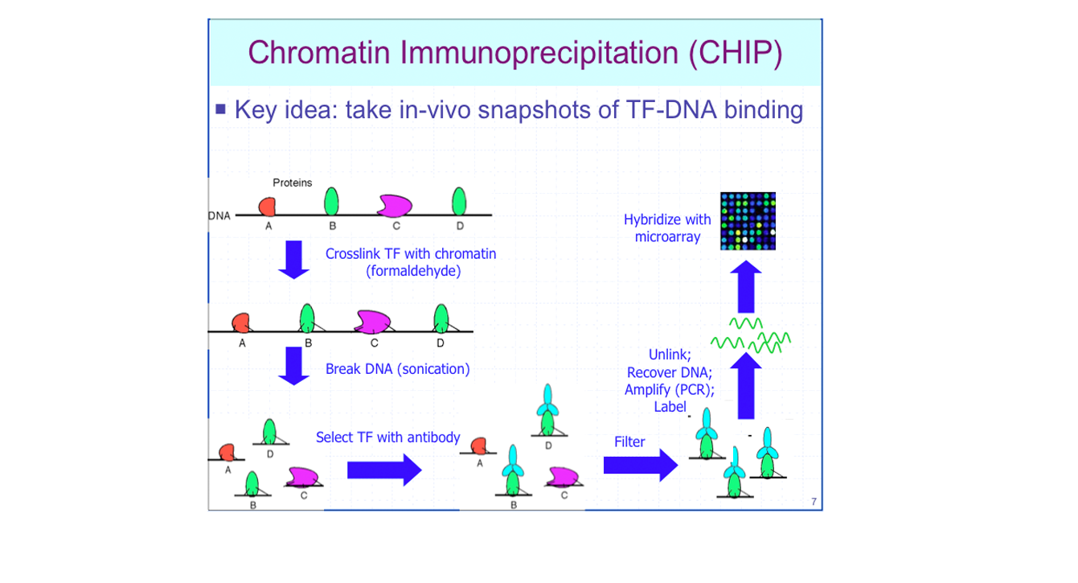
Chromatin Immunoprecipitation(ChIP)

Slide 14
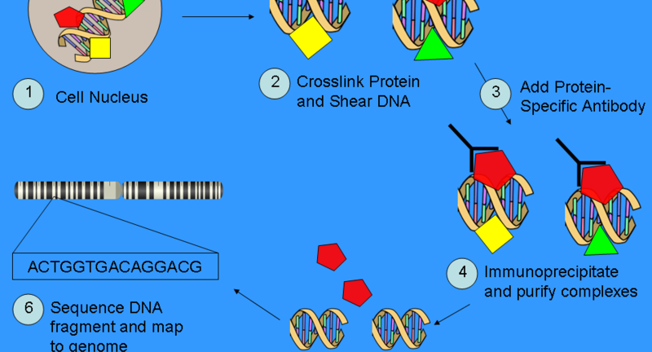

Slide 15
ChIP-Seq Method
Draw backs:
-can’t identify the precise binding site.
-technically difficult to implement
-are limited by lack of high quality antibodies for many transcription factors.

Slide 16
Abstract
Transcription Factor Binding Sites
ChIP-Seq Method
PBM Mapping

Slide 17
Position Weight Matrix(PWM)
Use to represent patterns of sequences
Based on assumptions that :
-individual bases at binding sites are independent
-bases are additive at binding site
-binding energy of the bases are proportional to the frequency.

Slide 18
Finding PWM Pattern(motifs)
Brute force search:
.Consider all the sequences(k-mers), compute PWM M for each subset of k-mers.
.Find M which maximiizes the expected relative entropy
Recast the problem:
.Estimate the parameters M(PWM), P(position) and b (background probability) that best explain the sample sequence S.
.Maximize the log likelihood l(M, p, b |S)
Strategy: iterate the following two steps
.Estimate p from (M, b) and S
.Estimate (M, b) from p and S
This yield a family of solutions, depending on the estimation technique

Slide 19
Position Weight Matrix(PWM)
Disadvantages:
-There are in existence transcription factors with resulting binding affinity that are both interdependent and non-additive.
-predictive power is low.
-poor scores

Slide 20
Protein Binding Microarray(PBM)
PBM use mathematically constructed set of proteins(oligos) to quantitatively measure protein- DNA binding for all possible octamers.
It can be used to create composite TFBS maps across the entire genome.

Slide 21
