Slide 1
DIGITAL LIGHT FIELD PHOTOGRAPHY
A dissertation submitted to the department of computer science and the committee on graduate studies of Stanford university,
Ren Ng, July 2006
Presenter: Cheng-Han Lee
November.14 2011

Slide 2
Introduction
This dissertation introduces a new approach to everyday photography, which solves the longstanding problems related to focusing images accurately. The root of these problems is missing information. It turns out that conventional photographs tell us rather little about the light passing through the lens. In particular, they do not record the amount of light traveling along individual rays that contribute to the image.

Slide 3
Introduction
They tell us only the sum total of light rays striking each point in the image. To make an analogy with a music-recording studio, taking a conventional photograph is like recording all the musicians playing together, rather than recording each instrument on a separate audio track.

Slide 4
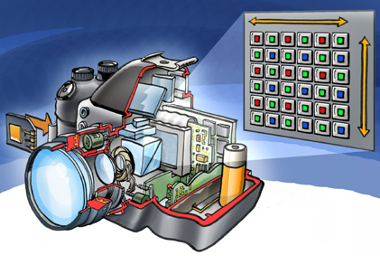
CCD / CMOSE
感光元件，類似底片

Slide 5
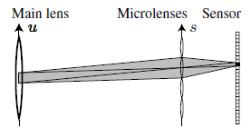
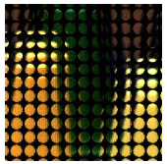
microlens
放置於感光元件的前方，用來增加光的吸收度。

Slide 6


main idea
紀錄光的入射角與強度，事後再透過軟體運算出新的影像。

Slide 7
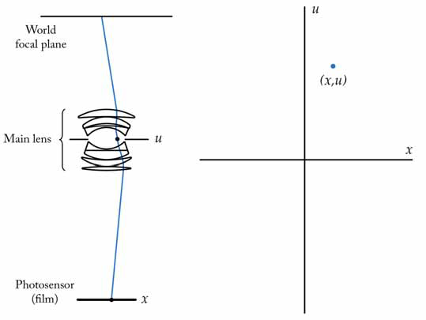

Slide 8
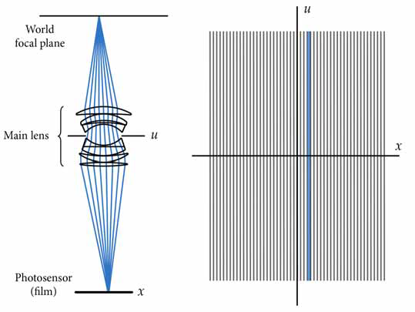

Slide 9
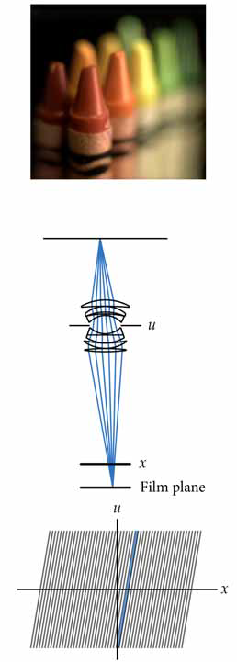
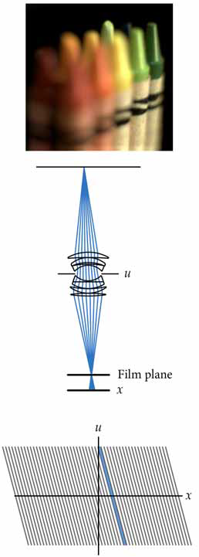

Slide 10
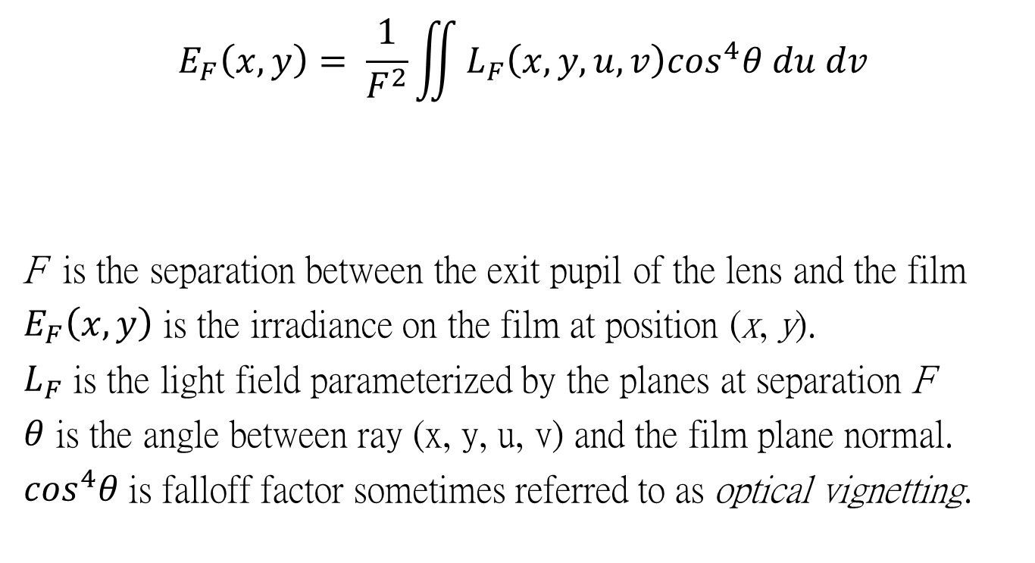
Imaging Equations
$$E_{F}\left(x,y\right)= \frac{1}{F^{2}}\iint{L_{F}\left(x,y,u,v\right)\cos^{4}θ du dv}$$
F is the separation between the exit pupil of the lens and the film
$E_{F}\left(x,y\right)$ is the irradiance on the film at position (x, y).
$L_{F}$ is the light field parameterized by the planes at separation F
$θ$ is the angle between ray (x, y, u, v) and the film plane normal.
$\cos^{4}θ$is falloff factor sometimes referred to as optical vignetting.

Slide 11
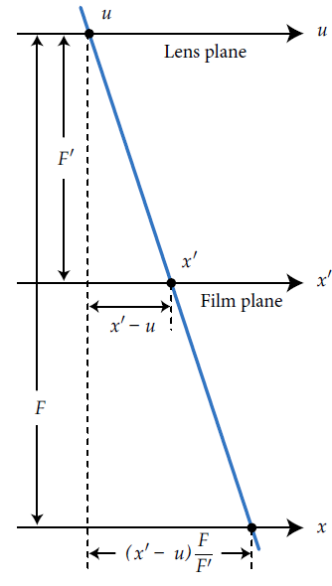


$$α=\frac{F^{′}}{F}$$

Slide 12
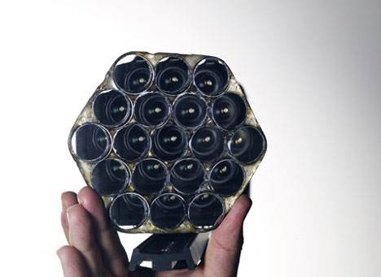
如何記錄角度資訊
Adobe : 像昆蟲的複眼一樣，有多個鏡頭。

Slide 13
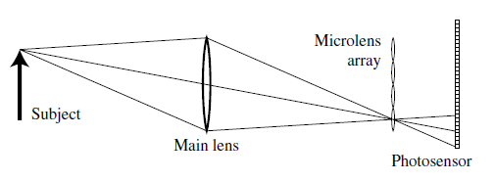
如何記錄光線角度資訊
Lytro : 利用microlens。(即本篇作者的方法)

Slide 14
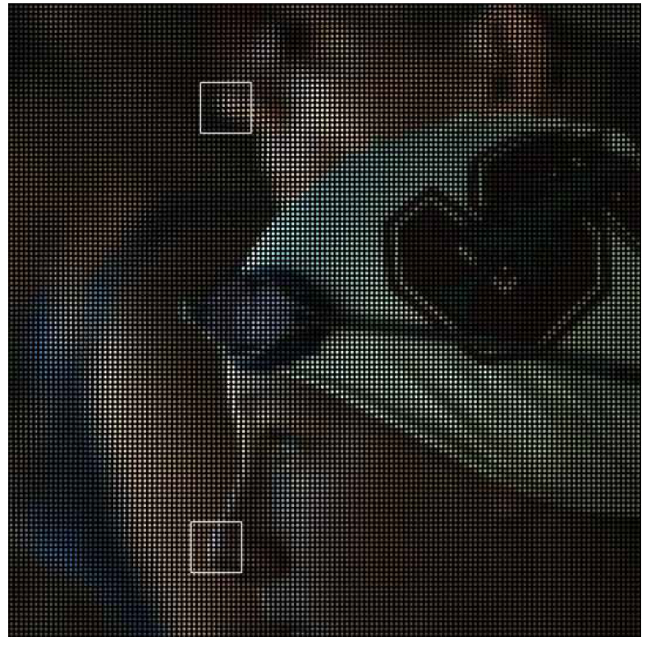


Slide 15
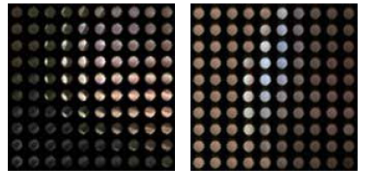
左圖是失焦的部分，可看出光線來自不同方向。 (一般相機只算出每點的均值色彩，喪失許多資訊)
右圖有對焦，每個點的色彩都很平均。

Slide 16
LINK
Lytro官網：https://www.lytro.com/

