Slide 1
RosettaBackrub—a web server for flexible backbone protein structure modeling and design
Florian Lauck, Colin A. Smith, Gregory F. Friedland, Elisabeth L. Humphris and Tanja Kortemme
Nucleic Acids Research, Vol. 38, pp.569-575, 2010
Presenter: Hsin-Fang Wu
Date: Nov. 14, 2011

Slide 2
Abstract (1/2)
The RosettaBackrub server (http://kortemmelab.ucsf.edu/backrub) implements the Backrub
method, derived from observations of alternative conformations in high-resolution protein crystal structures, for flexible backbone protein modeling. Backrub modeling is applied to three related applications using the Rosetta program for structure prediction and design: (I) modeling of structures of point mutations, (II) generating protein conformational ensembles and designing sequences consistent with these conformations and (III) predicting tolerated sequences at protein–protein interfaces.

Slide 3
Abstract (2/2)
The three protocols have been validated on experimental data. Starting from a user-provided single input protein structure in PDB format, the server generates near-native conformational ensembles. The predicted conformations and sequences can be used for different applications, such as to guide mutagenesis experiments, for ensemble-docking approaches or to generate sequence libraries for protein design.

Slide 4
Introduction
Ensembles of conformations are often a better representation
of protein native states than a single static structure.
(Proteins are a dynamic ensemble of conformation.)
Ensemble representations have been found useful for improving applications of molecular modeling such as protein-small molecule and protein–protein docking as well as in
protein design.
We make three common modeling and design applications using Backrub—
(I) modeling of structures of point mutations.
(II) generation of protein ensembles and computational
sequence design on these conformational ensembles.
(III) interface sequence plasticity prediction.

Slide 5
Server applications (1/7)
A common task in biological research is the mutagenesis of a protein.
Application I: Modeling of Point Mutations aims to predict the structural effects of one or more point mutations to guide experimental analyses.
*定點突變:
由於蛋白質的結構決定其功能，因此我們對某已知基因的特定堿基進行定點改變、缺失或者插入，可以改變對應的氨基酸序列和蛋白質結構，對突變基因的表達產物進行研究有助于我們了解蛋白質結構和功能的關系，探討蛋白質的結構/結構域。

Slide 6
Server applications (2/7)
Our application builds on the method for computational alanine (丙氨酸) scanning we developed several years. This method has provided ~9000 predictions since 2004.
It has been used for example in applications to receptor recognition in immunology and for evaluating docked models of
antibody–antigen interactions.
Our method differs from others in that it is based on structural modeling of protein conformations instead of using machine learning approaches.
*alanine scanning is a technique used to determine the contribution of a specific residue to the stability or function of given protein. This technique can also be used to determine whether the side chain of a specific residue plays a significant role in bioactivity.

Slide 7
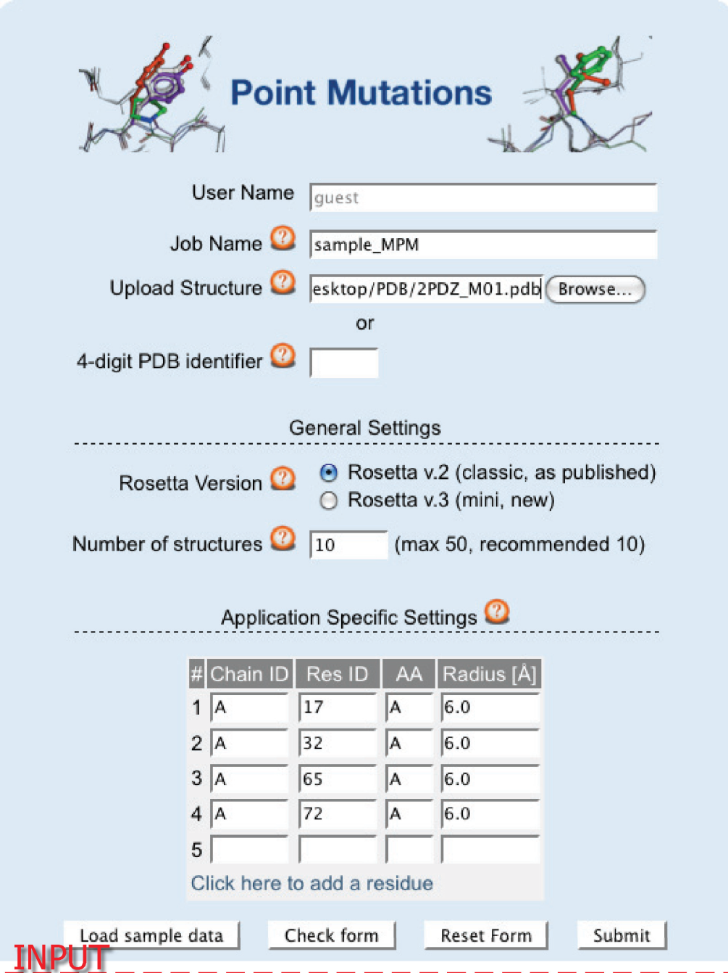
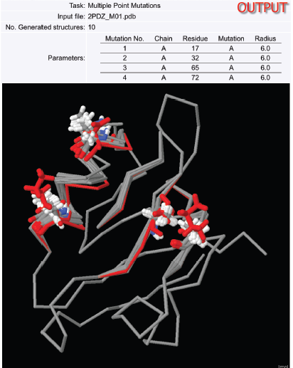
Server applications (3/7)

Slide 8
Server applications (4/7)
Application II: Generation of Protein Ensembles/ Ensemble Design produces conformational ensembles based on a single crystal structure that are intended to represent aspects of the native state dynamics of a protein in solution.
The application can also be used to generate conformations that may be adopted by other closely related members of the protein’s family.
The RosettaDesign method has been experimentally validated through the design of protein structures, protein–protein interfaces, protein–DNA interfaces and enzymes.

Slide 9
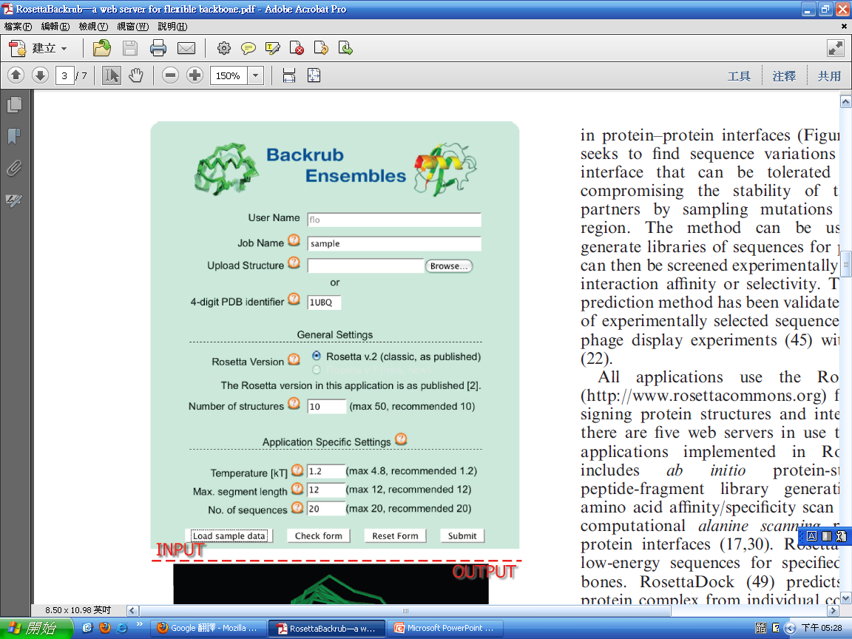
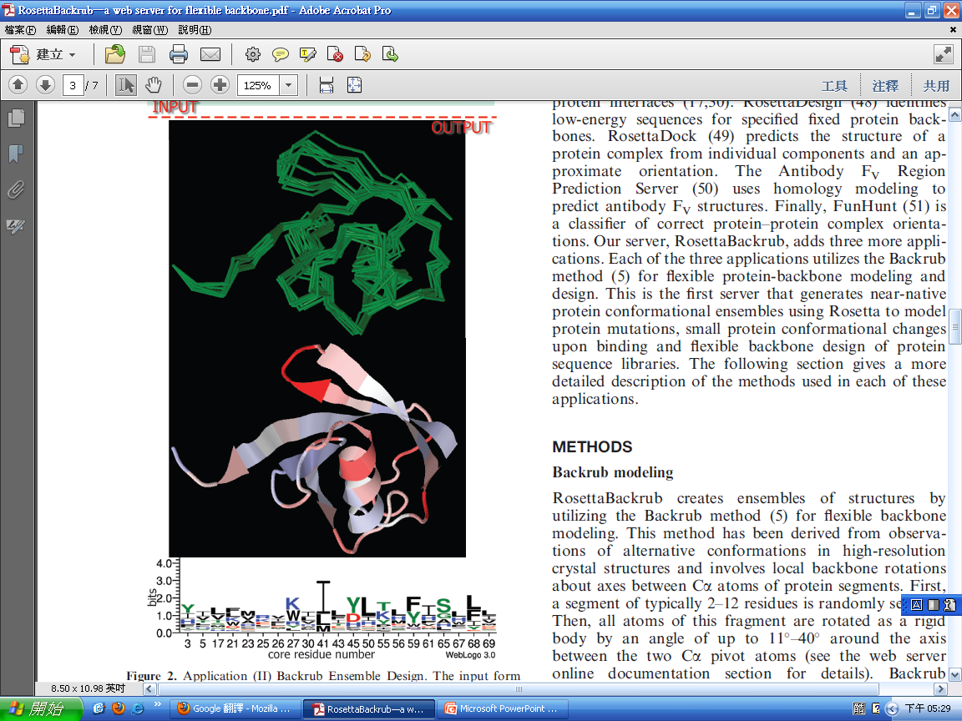
Server applications (5/7)

Slide 10
Server applications (6/7)
Application III: Protein Interface Sequence Plasticity Prediction predicts the sequence diversity (‘plasticity’) in protein–protein interfaces.
The method can be used to automatically generate libraries of sequences for protein interfaces that can then be screened experimentally for changes in protein interaction affinity or selectivity.
The sequence plasticity prediction method has been validated through comparison of experimentally selected sequences from comprehensive phage display experiments with modeled sequences.

Slide 11
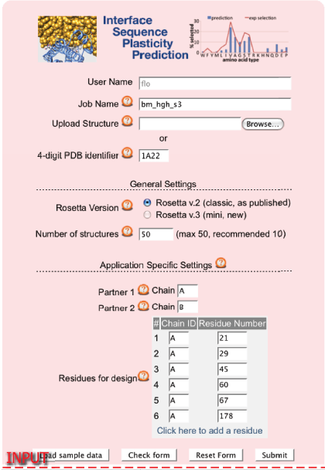
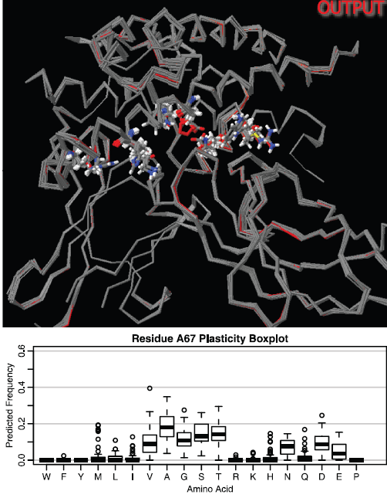
Server applications (7/7)

Slide 12
Backrub modeling
First, a segment of typically 2–12 residues is randomly selected.
Then, all atoms of this fragment are rotated as a rigid body by an angle of up to 11–40 around the axis between the two Cα pivot atoms.
Backrub moves, interleaved with rearrangements of the surrounding side chains, are sampled by a Monte Carlo algorithm using the Rosetta all-atom force field.
Backrub and side chains moves are made 10 000 times, with each new conformation being scored with the Rosetta scoring
function. The resulting score is used to determine whether the new conformation is accepted or not according to the Metropolis criterion.
* Metropolis criterion (默察波利斯標準): P=exp(-dE／kT)

Slide 13
Input structure files
The structure file must be provided in PDB format. There may be gaps in the structure, but each residue must have a complete set of backbone atoms (N, Cα, C and O); side chain atoms may be missing. Rosetta automatically picks the first conformation if
multiple conformations for a single residue are found in
the PDB file.
If the file contains coordinates for hydrogen atoms, those are ignored and automatically rebuilt according to the Rosetta force
field. Water and other heteroatoms are not considered in the simulations in the present version. Non-standard amino acids are currently removed and a gap is introduced.

Slide 14
Application I: Modeling of Point Mutations
This application computationally mutates one or more
amino acid residues at position(s) defined by the user.
The web server implements two flavors of the protocol: single
point mutation allows only for one mutation at a time and
uses a fixed radius of 6Å.
For single point mutations, the accuracy was found to be somewhat dependent on the sampling radius.
The application multiple point mutations allows the user to define more than one point mutation in a given structure. Furthermore, the Backrub radius for each mutation can be set independently. The number of mutations per simulation is limited to 30. The prediction of multiple mutations has not been validated extensively with experimental data.

Slide 15
Application II: Generation of Protein Ensembles and
Ensemble Design
Backrub conformational ensembles are created by applying the
Backrub method repeatedly to the entire uploaded structure
without any spatial restrictions.
The second protocol, Ensemble Design, creates a Backrub ensemble first, for which it requires a simulation temperature in kT and the maximum size of the Backrub segment from the
user. Then, this ensemble is used to predict low-energy
sequences consistent with the ensemble structures, using
a Monte Carlo simulated annealing protocol.

Slide 16
Application II: Generation of Protein Ensembles and
Ensemble Design
Backrub conformational ensembles are created by applying the
Backrub method repeatedly to the entire uploaded structure
without any spatial restrictions.
The second protocol, Ensemble Design, creates a Backrub ensemble first, for which it requires a simulation temperature in kT and the maximum size of the Backrub segment from the
user. Then, this ensemble is used to predict low-energy
sequences consistent with the ensemble structures, using
a Monte Carlo simulated annealing protocol.
* 模擬退火法是常用於解決最佳化問題中的其中一種近似解法，主要是根據統計熱力學的原理，模擬材料在進行退火的過程中，能自行達到最低溫狀態的現象，所發展出的一種全域最佳化的方法，這個方法由於搜尋簡單，且具有跳離區域最小值的能力，因此已成功的解決了許多最佳化設計的問題

Slide 17
Application III: Interface Sequence Plasticity Prediction
This application models the tolerated sequence space for interface positions in a protein complex.
First, Backrub is applied to the two interaction partners in a
protein–protein complex to create a conformational ensemble.
Each of the resulting complex structures is then subject to the
sequence plasticity protocol. This protocol uses a genetic
algorithm to sample amino acid changes at interface positions
specified by the user. Modeled residues are scored according to their contributions to the stability of the protein partners as well as to the stability of the protein–protein interface.
Interface sequences are recorded and kept if their score is within a threshold from the interface and complex scores of the sequence in the input file.

Slide 18
Thanks for your listening !!

