Slide 1
Scaled and permuted string matching
Ayelet Butman, Revital Eres, Gad M. Landau
Information Processing Letters
Vol. 92, pp. 293-297, 2004
Speaker: Kai-Yuan Cheng
Date: Nov. 28, 2011

Slide 2
Abstract
The goal of scaled permuted string matching is to find all occurrences of a pattern in a text, in all possible scales and permutations. Given a text of length n and a pattern of length m we present an O(n) algorithm.

Slide 3
Run-length compress
P = aabbbaccaab
P’= a²b³a¹c²a²b¹

Slide 4
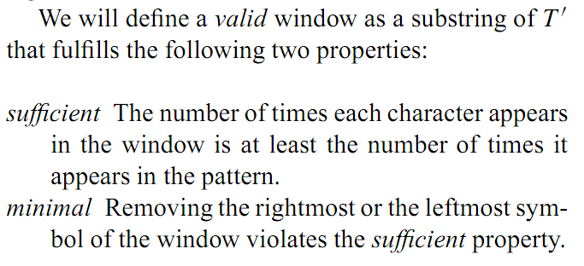
Permuted string matching

Slide 5
Example. Let P= a²b³c²d² and T=c³a²c²a³d²b³c¹
c³ | a² | c² | a³ | d² | b³ | c¹
L |  |  |  |  | R
c³ | a² | c² | a³ | d² | b³ | c¹
 |  | L |  |  | R

Slide 6
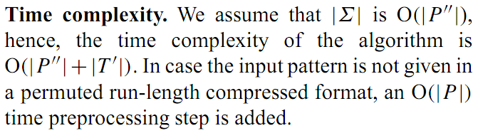
Time complexity

Slide 7
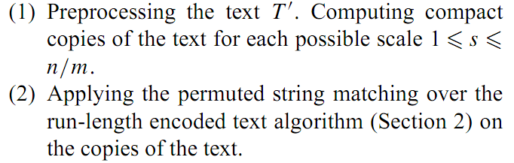
Scaled permuted string matching

Slide 8
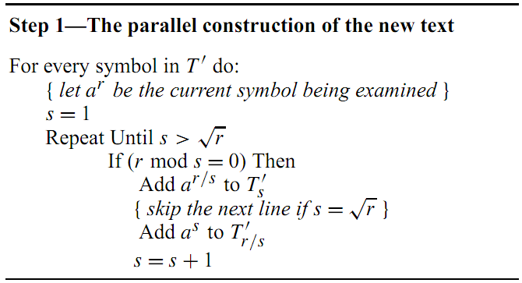

Slide 9
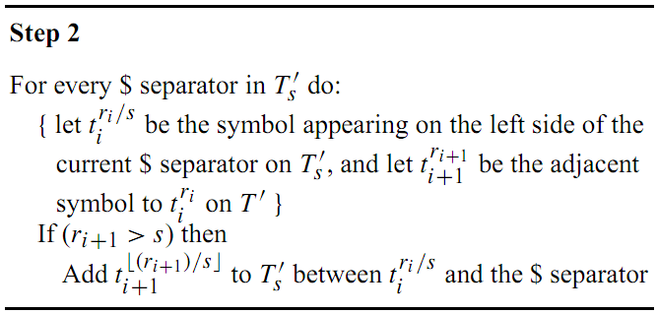

Slide 10
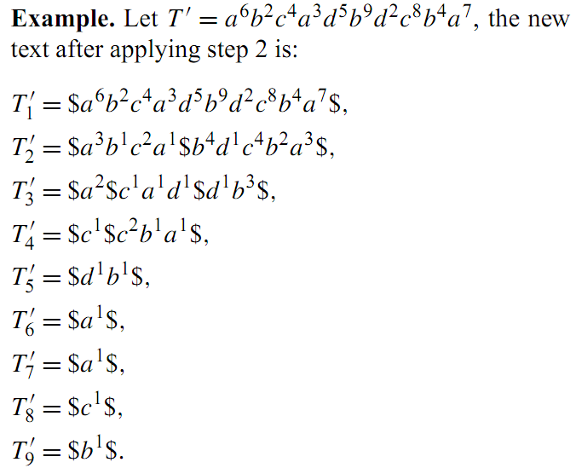

Slide 11

Time complexity
The total length of all the new texts T’s (1≦s ≦n/m) is O(n).
the number of new symbols that we produce from T_{i} is bounded by 2√ r_{i} .
2*
r_{i}

Slide 12
Thank you!!!

