Slide 1
Two-dimensional homing sort
Bo-Yi Wang(王柏易), Hsueh-I Lu(呂學一)
Information Processing Letters, Vol. 111, pp. 1067–1071, 2011
Presenter: Chiou-Ting Tseng
Date: Nov. 28, 2011

Slide 2
Abstract
Homing sort, i.e., sorting by placement and shift, is a natural way to do hand-sorting. Elizalde and Winkler showed that (1) any n-element permutation can be sorted by n−1 or less one-dimensional homing operations; (2) no n-element permutation admits a sequence of 2^{n−1} or more homing operations; and (3) the number of n-element permutations that admit a sequence of 2^{n−1} − 1 homing operations is super-exponential in n. In the present paper, we study sorting via two-dimensional homing operations and obtain the following observations: (1) Any m×n permutation can be sorted by at most mn−1 two-dimensional homing operations.

Slide 3
Abstract
(2) If both vertical-first and horizontal-first homing operations are allowed, for any integers m ≥ 2 and n ≥ 2, there is an m ×n permutation that admits an infinite sequence of two-dimensional homing operations. (3) If only vertical-first homing operations are allowed, for any integers m ≥ 3 and n ≥ 2, there is an m × n permutation that admits an infinite sequence of two-dimensional homing operations. (4) The number of 2 × n permutations that admit sequences of Ω(2^{n}) vertical-first two-dimensional homing operations is super-exponential in n. (5) No 2×n permutation admits a sequence of (2n)! or more vertical-first two-dimensional homing operations.

Slide 4
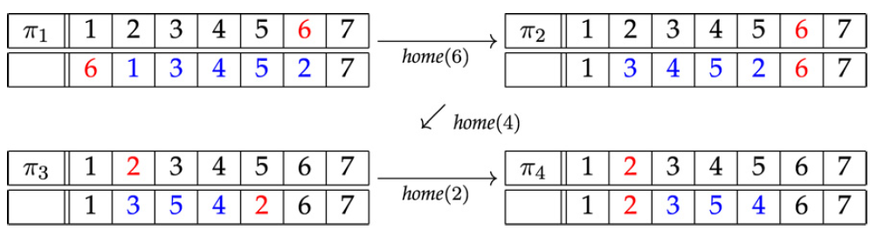
Homing Sort
home(i) places element i at the i-th position of π and shifts accordingly the elements of π between positions i andπ(i)

Slide 5
Previous Result 1
Any n-element permutation can be sorted by at most n − 1 homing operations.
永遠把位置錯誤的數字中選最小或是最大的做homing
6134527→1634527→1263457→1236457→1234657→1234567

Slide 6
Previous Result 2
Homing always terminates in at most 2^{n-1} - 1 steps.
If one begins with the permutation 2, 3, …, n-1, n, 1 and always places the left-most not-at-home entry, the result is 2^{n-1} - 1 steps before the identity permutation is reached (via the familiar “tower of Hanoi” pattern).

Slide 7
Previous Result 3
The number of n-element permutations that admit a sequence of 2^{n−1} − 1 homing operations is super-exponential in n.
2^{n-2}≤ M_{n}≤(n-1)!
2341→3241→2431→4231→2314→3214→2134→1234

Slide 8
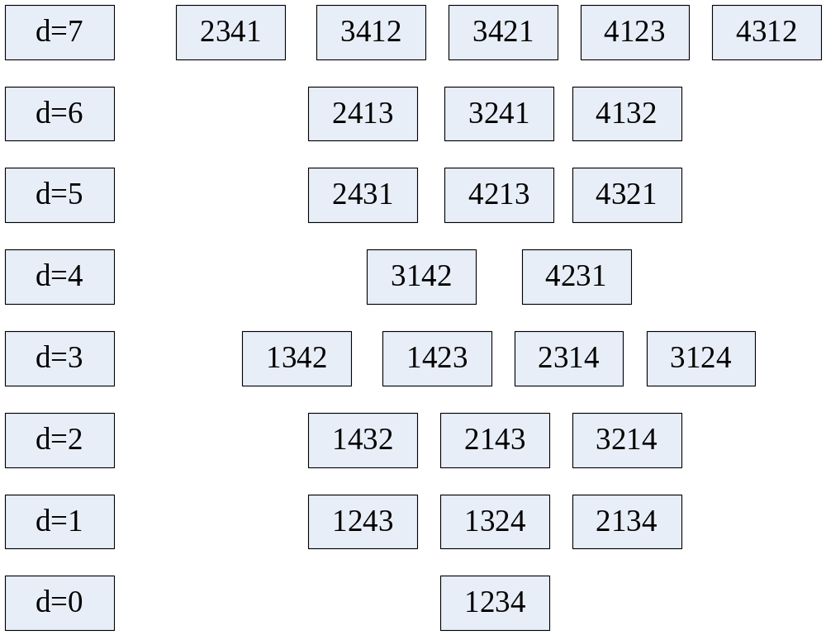
跨層關係省略

Slide 9
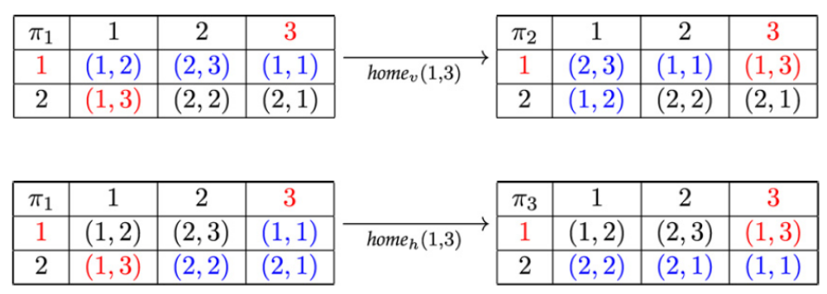
2D Homing Sort

Slide 10
Result 1
Any m ×n permutation can be sorted by at most mn −1 two-dimensional homing operations.
For each L = 1, 2, . . . ,mn, if π(i, j) ≠ [i, j] holds for the numbers i and j with L= i + ( j − 1) · m, then we replace π byπ ◦ home_{v} (i, j).
用(1,1)→(2,1)→…(m,1)→(1,2)→(2,2)→…
→(m,2)→…→(m,n)的順序作home_{v}，因為作(i, j)的時候，前j - 1 column都已經排好，目前的位置也不會是在前j - 1 column。

Slide 11
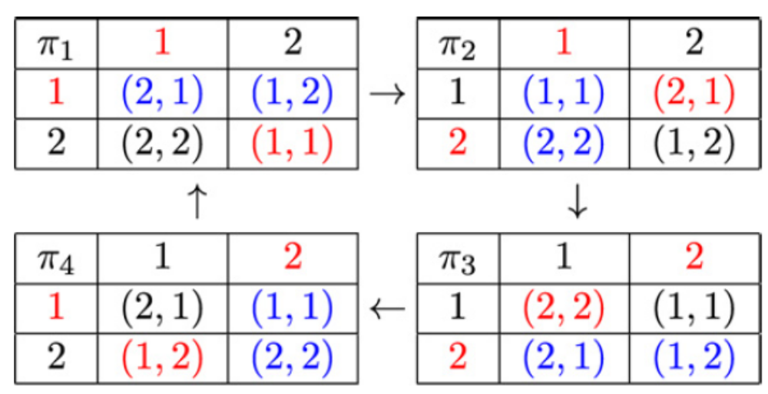
Result 2
If both vertical-first and horizontal-first homing operations are allowed, for any integers m ≥ 2 and n ≥ 2, there is an m × n permutation that admits an infinite sequence of two-dimensional homing operations.
v
h
h
v

Slide 12
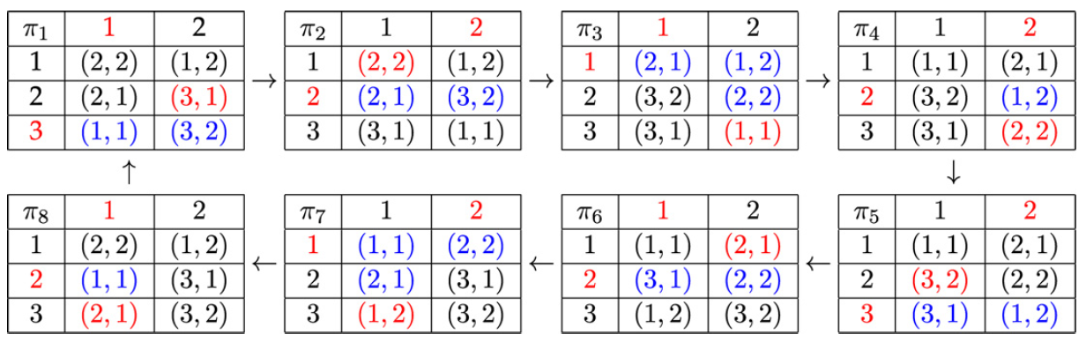
Result 3
If only vertical-first homing operations are allowed, for any integers m ≥ 3 and n ≥ 2, there is an m ×n permutation that admits an infinite sequence of two-dimensional homing operations.

Slide 13
Result 4
The number of 2 × n permutations that admit a sequence of Ω(2^{n}) vertical-first two-dimensional homing operations is superexponential in n.
Consider those 2 ×n permutations π such that row(π(i, j)) = i holds for each i = 1, 2 and j = 1, 2, . . . ,n.
讓兩行變成獨立，所以各自可以排2^{n-1}-1次的有超過2^{n-2}種。

Slide 14
Result 5
No 2×n permutation admits a sequence of (2n)! or more vertical-first two-dimensional homing operations.

Slide 15
我的目標
找出loop case的規則，分成
  可以vertical first與horizontal first
  只能vertical first

Slide 16
目前發現
對於3*2，若是只能vertical first，從每個情形出發，一但偵測到loop就不再繼續找，則只有兩種loop，長度都是8，如下頁。
對於3*2，若是可以vertical first與horizontal first，從每個情形出發，一但偵測到loop就不再繼續找，則有四種loop，長度都是4，如下下頁。

Slide 17
(1,1) | (2,2)
(1,2) | (3,2)
(3,1) | (2,1)
(1,1) | (3,2)
(1,2) | (2,2)
(3,1) | (2,1)
(3,2) | (1,2)
(1,1) | (2,2)
(3,1) | (2,1)
(3,2) | (1,2)
(2,1) | (1,1)
(3,1) | (2,2)
(1,1) | (3,1)
(1,2) | (2,2)
(2,1) | (3,2)
(1,1) | (3,1)
(2,1) | (1,2)
(2,2) | (3,2)
(3,1) | (1,2)
(2,1) | (1,1)
(2,2) | (3,2)
(2,1) | (1,2)
(3,1) | (1,1)
(2,2) | (3,2)

Slide 18
(1,1) | (1,2)
(2,1) | (3,1)
(3,2) | (2,2)
(1,1) | (1,2)
(3,2) | (2,1)
(3,1) | (2,2)
(1,1) | (1,2)
(2,1) | (3,2)
(2,2) | (3,1)
(1,1) | (1,2)
(3,2) | (2,2)
(2,1) | (3,1)
(1,1) | (1,2)
(3,1) | (2,2)
(3,2) | (2,1)
(1,1) | (1,2)
(3,1) | (2,1)
(2,2) | (3,2)
(1,1) | (1,2)
(2,2) | (3,2)
(3,1) | (2,1)
(1,1) | (1,2)
(2,2) | (3,1)
(2,1) | (3,2)
(1,1) | (2,2)
(1,2) | (2,1)
(3,1) | (3,2)
(2,2) | (1,2)
(1,1) | (2,1)
(3,1) | (3,2)
(1,1) | (2,1)
(2,2) | (1,2)
(3,1) | (3,2)
(2,2) | (1,1)
(2,1) | (1,2)
(3,1) | (3,2)
(1,2) | (2,2)
(2,1) | (1,1)
(3,1) | (3,2)
(1,2) | (2,1)
(1,1) | (2,2)
(3,1) | (3,2)
(2,1) | (1,2)
(2,2) | (1,1)
(3,1) | (3,2)
(2,1) | (1,1)
(1,2) | (2,2)
(3,1) | (3,2)

