Slide 1
Evolving Accurate and Compact Classification Rules With Gene Expression Programming
IEEE TRANSACTIONS ON EVOLUTIONARY COMPUTATION, VOL. 7, NO. 6, DECEMBER 2003
Presenter: Chen Yun-Shiuan
Data: 2011/12/5

Slide 2
Abstract
Classification is one of the fundamental tasks of data mining. Most rule induction and decision tree algorithms perform local, greedy search to generate classification rules that are often more complex than necessary. Evolutionary algorithms for pattern classification have recently received increased attention because they can perform global searches. In this paper, we propose a new approach for discovering classification rules by using gene expression programming (GEP), a new technique of genetic programming (GP) with linear representation. The antecedent of discovered rules may involve many different combinations of attributes. To guide the search process, we suggest a fitness function considering both the rule consistency gain and completeness. A multiclass classification problem is formulated as multiple two-class problems by using the one-against-all learning method. The covering strategy is applied to learn multiple rules if applicable for each class. Compact rule sets are subsequently evolved using a two-phase pruning method based on the minimum description length (MDL) principle and the integration theory. Our approach is also noise tolerant and able to deal with both numeric and nominal attributes. Experiments with several benchmark data sets have shown up to 20% improvement in validation accuracy, compared with C4.5 algorithms. Furthermore, the proposed GEP approach is more efficient and tends to generate shorter solutions compared with canonical tree-based GP classifiers.

Slide 3
Gene Programming (GP)
As a robust, domain-independent mechanism for numeric and symbolic optimization, GAs have been applied to evolve a set of production rules for more than two decades, which forms a machine learning paradigm called learning classifier systems (LCS).

Slide 4
Gene Programming (GP)
GA-based classifier systems usually fall into two basic classes: the Michigan approach and the Pittsburgh approach.
The main difference between these two stems from the chromosome encoding schemes in the population of individuals.
Michigan approach
each individual with fixed length encodes a single production rule.
more flexible to handle incremental-mode learning, in which training examples arrive over time and dynamically changing domains
Pittsburgh approach
each individual is represented by a variable-length string and encodes a complete set of rules
better suited for static domains and batch-mode learning, in which all training examples are available before the learning process starts.

Slide 5
Gene Expression Programming (GEP)
Like GP, five general components:
function set
terminal set
fitness function
control parameters
stop criteria

Slide 6
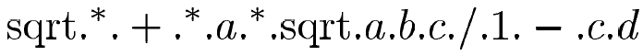
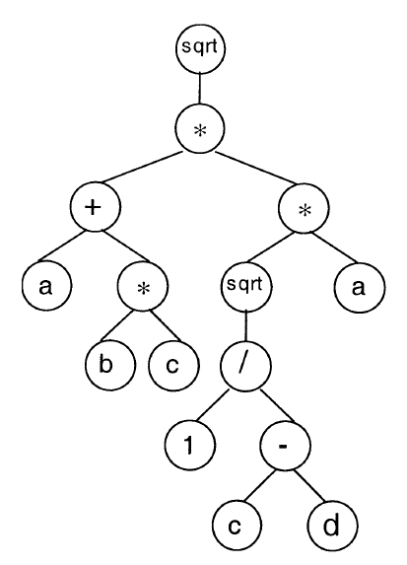
Gene Expression Programming(GEP)
Chromosomes:
Expression Trees:

Slide 7
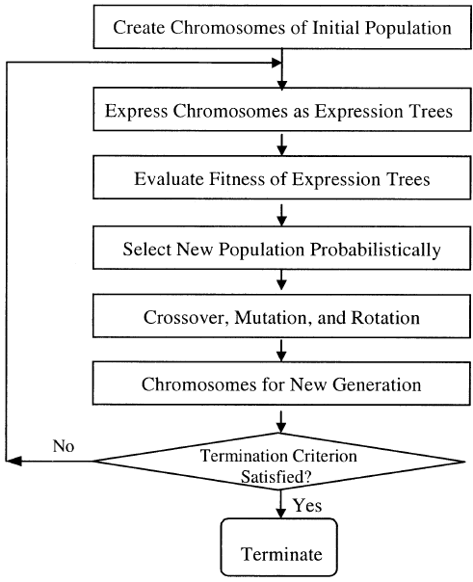
Flowchart of GEP

Slide 8
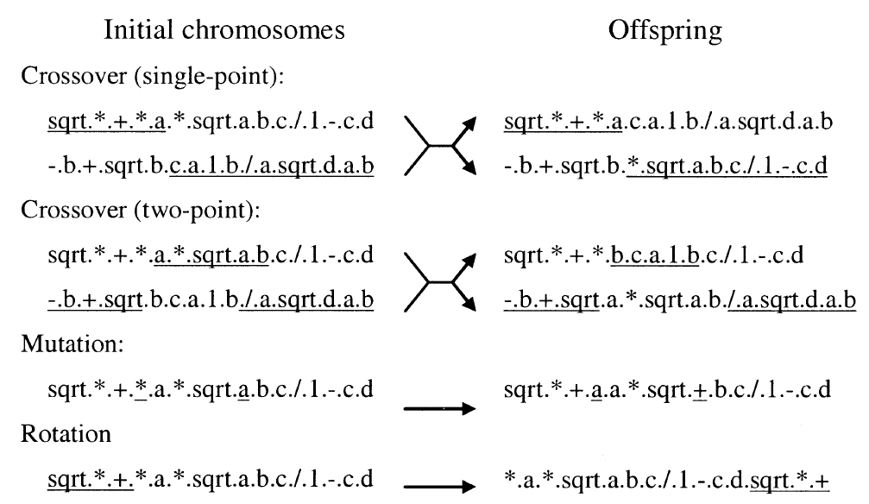
GEP operators

Slide 9
One-Against All Learning
Also called “binary decomposition”
One-against-all learning method transform the n-class problem into n 2-class problems.
In this paper, we apply the covering strategy to learn multiple rules for each binary classification problem.
For each class in the given training set, we learn a rule that covers as many positive examples as possible and as few negative examples as possible. Then, we remove all positive examples that have been covered from the training set and repeat the procedure to learn another rule. These steps are repeated until no positive examples remain in the training set.

Slide 10
One-Against All Learning
There are two additional issues to be considered in developing an efficient classifier.
One is the problem of over fitting noisy data. In our approach, the MDL principle is applied to avoid overly specific rules that try to fit noisy examples.
Another issue arises when the generated GEP rules are applied to new cases. It is possible for more than one GEP expression to return a positive value, which results in a “classification conflict.” In the worst case, all rules may not be satisfied. So there is the need for a strategy to solve classification conflict and rejection.

Slide 11
Numerization of Nominal Attributes
There are two ways to perform numerization of nominal attributes.
One method is to map the values of a nominal attribute to integers, so that the attribute can be considered as numeric inside the GEP.\
For example, if an attribute can take three possible values, then these nominal values are mapped into a set of integers, i.e., {0, 1, 2}. The disadvantage of this approach, however, lies in the fact that it imposes an order that does not exist in the original data.
Another method is to divide a nominal attribute into binary attributes, which is called “binarization,” if there are possible values (here, ), with 0/1 representing the absence/presence of each value. This method overcomes the shortcomings of the first-integer approach, but will generate a large set of derived attributes if is large. In this paper, we use the binarization approach.

Slide 12
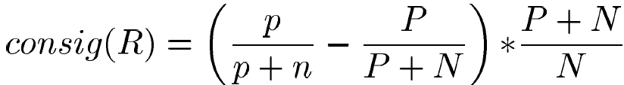
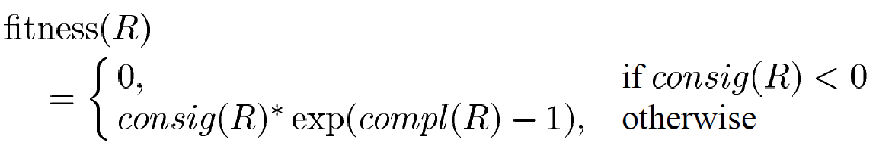
Fitness Function
Use consistency gain
This measure takes into account the distribution of positive and negative examples in the training set.
consistency gain of rule R is defined as:
The fitness function has the form
where compl(R)=p/P is the rule completeness

Slide 13
Two-phase rule pruning
In order to evolve an accurate, noise-tolerant and compact rule set, we apply two phases of rule pruning: prepruning and postpruning.
If the training data are not noise free, it tends to generate some specific rules that fit the noisy data very well, but do not generalize the concept to be learned well, thus resulting in overfitting.
One common approach to deal with this problem is early stopping. In the prepruning process, we employ a stop criterion based on the MDL principle to determine when to stop learning more rules for that class. The MDL principle tries to avoid learning complicated rules that cover only a small number of examples, which may result from noisy data.

Slide 14
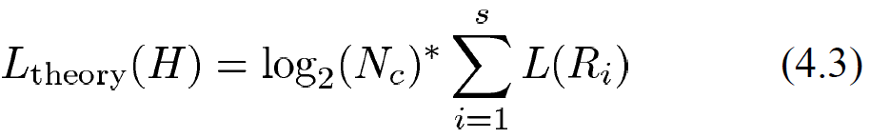
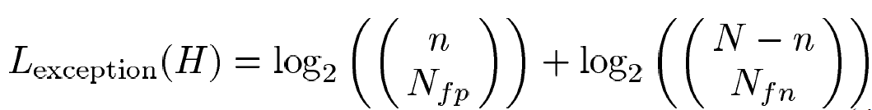
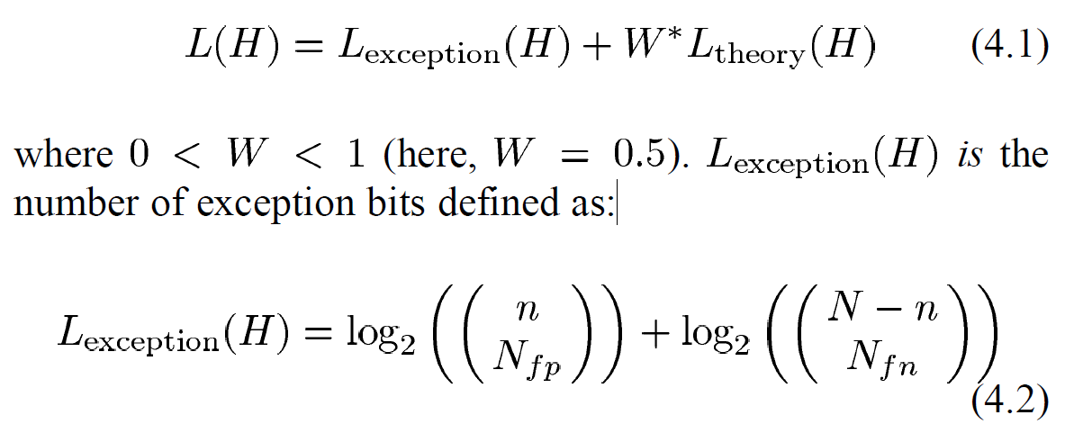
Two-phase rule pruning - prepuning
Following the Occam’s razor principle, the MDL principle states that the best theory is the one that minimizes the total description length. In our approach, we follow the method used in C4.5 and define the description length of a rule set as:

Slide 15
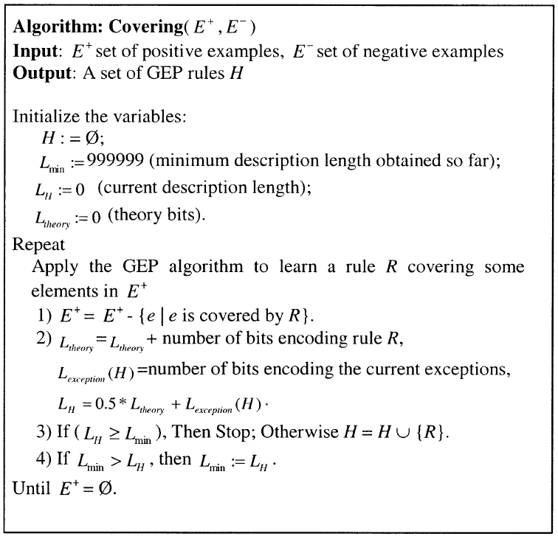
Two-phase rule pruning - prepruning

Slide 16
Two-phase rule pruning - postpruning
1. Order all generated rules according to their fitness values.
2. Select the rule with the highest fitness value, and add it to the ordered rule set.
3. Remove all positive and negative examples covered by the selected rule.
4. Recompute the fitness values of the remaining rules on the remaining examples.
5. Repeat steps 1–4 until there is no example left, or until none of the remaining rules yields a positive fitness value.
6. A default class is selected in casethat all rules reject a new example.

Slide 17
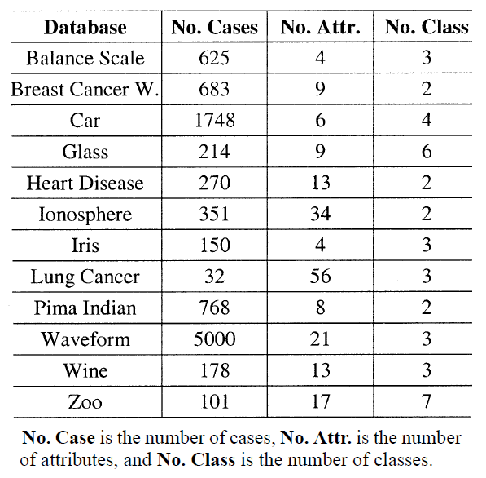
Other experiments

Slide 18
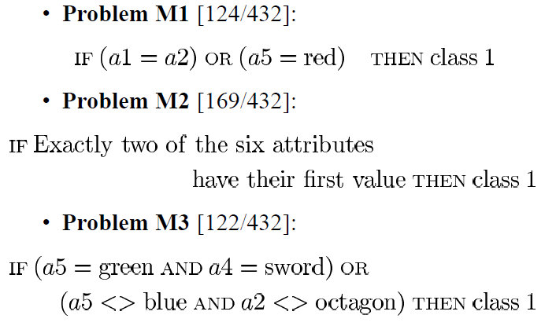
Experiment – Monk’s Problem
A data set with 6 attributes and 2 classes
head_shape: {round, square, octagon}
body_shape: {round, square, octagon}
is_smiling: {yes, no}
holding: {sword, balloon, flag}
jacket_color: {red, yellow, green, blue}
has_tie: {yes, no}
Problem M3 has 5% noise in training set.

Slide 19
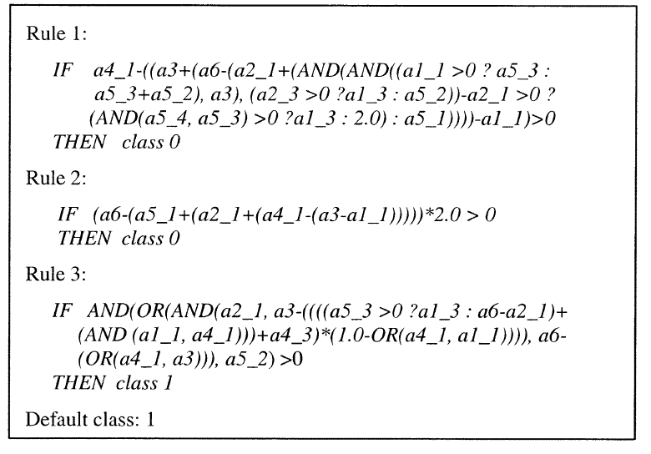
Result – Monk’s Problem
GEP rules for Monk’s problem 2.

Slide 20
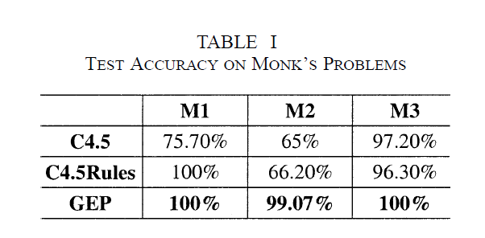
Result – Monk’s Problem

Slide 21
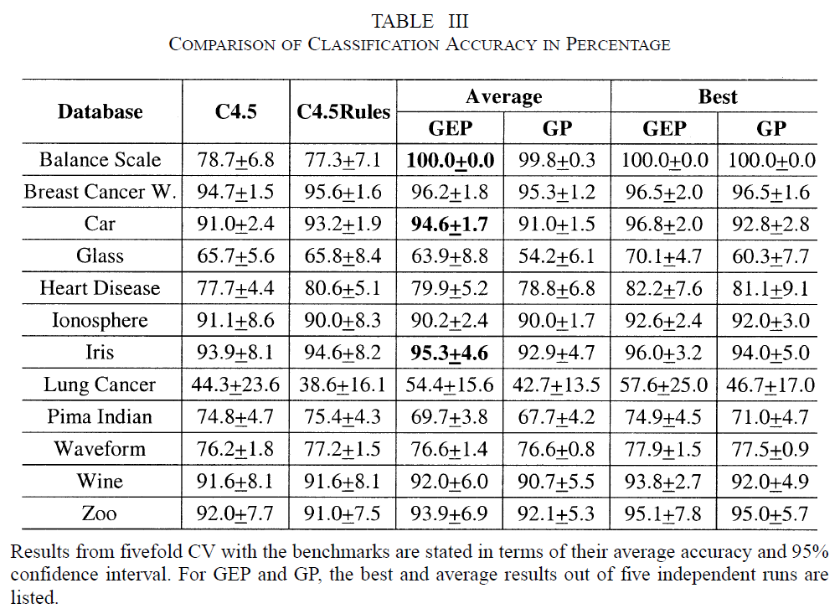
Experimental results

Slide 22
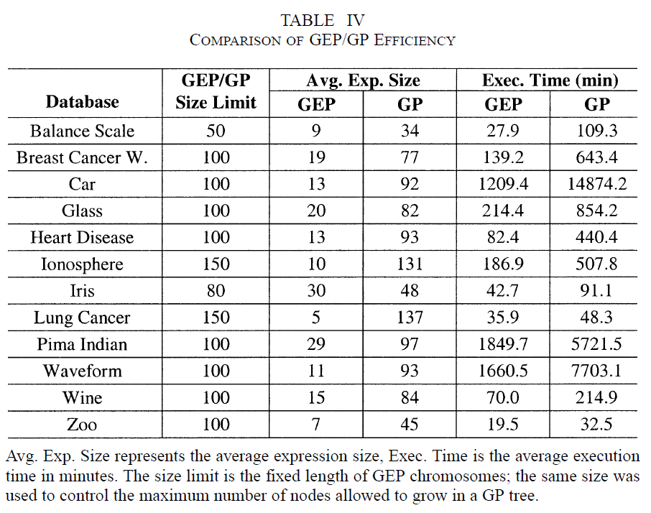
Experimental results

Slide 23
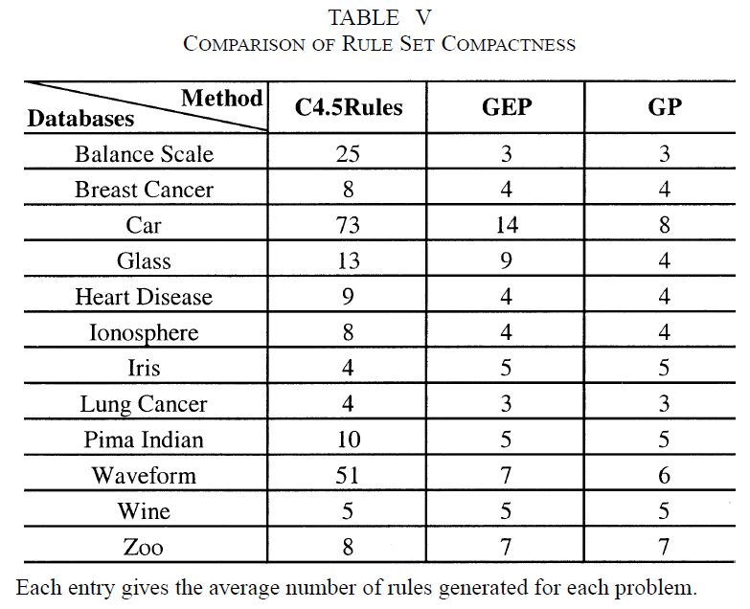
Experimental results

Slide 24
Thank you!!

