Slide 1
Mastermind is NP-Complete
Jeff Stuckman, Guo-Qiang Zhang
INFOCOMP Journal of Computer Science, [S..],
Vol 5, No 2, pp. 25-28, June 2006
Presenter : Bo-Xian Chen
Date : 2017/1/3
Notes:
http://infocomp.dcc.ufla.br/index.php/INFOCOMP/about http://infocomp.dcc.ufla.br/index.php/INFOCOMP/issue/view/14

Slide 2
Abstract(1/2)
In this paper we show that the Mastermind Satisfiability Problem (MSP) is NP-complete. Mastermind is a popular game which can be turned into a logical puzzle called the Mastermind Satisfiability Problem in a similar spirit to the Minesweeper puzzle [5]. By proving that MSP is NP-complete, we reveal its intrinsic computational property that makes it challenging and interesting.

Slide 3
Abstract(2/2)
This serves as an addition to our knowledge about
a host of other puzzles, such as Minesweeper [5], Mah-Jongg [1], and the 15-puzzle [6].

Slide 4
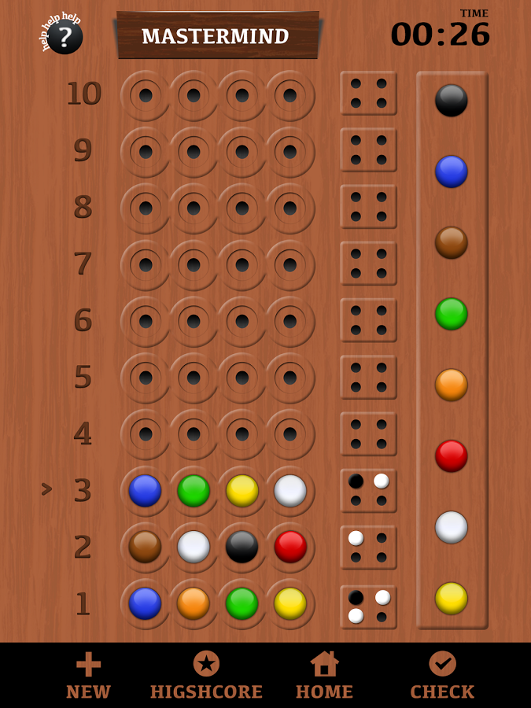
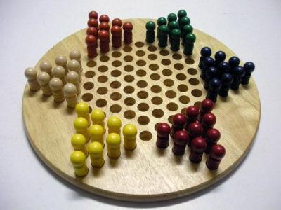
The Mastermind Game
Goal :
Let the player determine the colors of each peg in a sequence of concealed locations(solution).

Slide 5

The Mastermind Game(Con’t)
Two parameters (k, l) determine a specific Mastermind game
$N_{k}$ $≔$ [1, 2, …, k] represent the colors
$N_{k}^{l}$ $≔$ represent l-tuple guesses
e.g. (7, 4)
…
…
Notes:
List_of_mathematical_symbols
https://en.wikipedia.org/wiki/List_of_mathematical_symbols 色彩表RGB
http://www.ebaomonthly.com/window/photo/lesson/colorList.htm

Slide 6
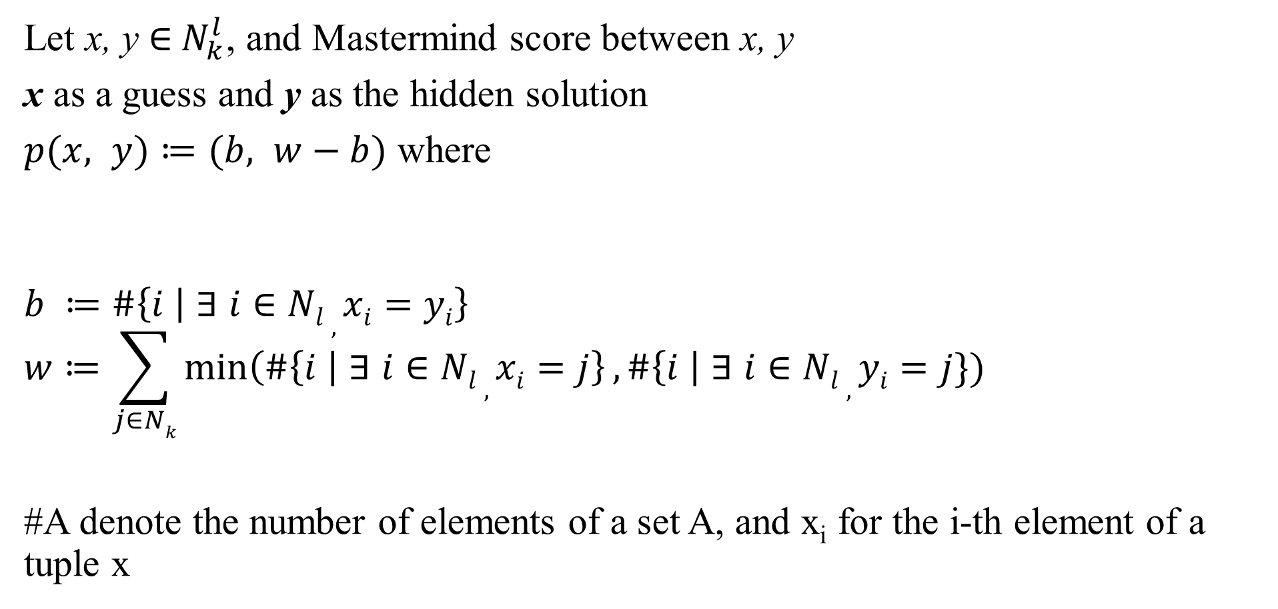
The Mastermind Game(Con’t)
Let x, y ∈${ N}_{k}^{l}$, and Mastermind score between x, y
x as a guess and y as the hidden solution
$p(x, y)≔(b, w−b)$ where
$$b ≔\left.\#\left\{i \right| \text{∃} i∈Nl , xi=yi\right\}$$
$$w≔\sum_{j∈Nk}{\min\left(\#\left\{i \right| \text{∃} i∈Nl , xi=j\right\}, \#\left\{i \right| \text{∃} i∈Nl , yi=j\})}$$
#A denote the number of elements of a set A, and x_{i} for the i-th element of a tuple x
_{x}
_{y}

Slide 7
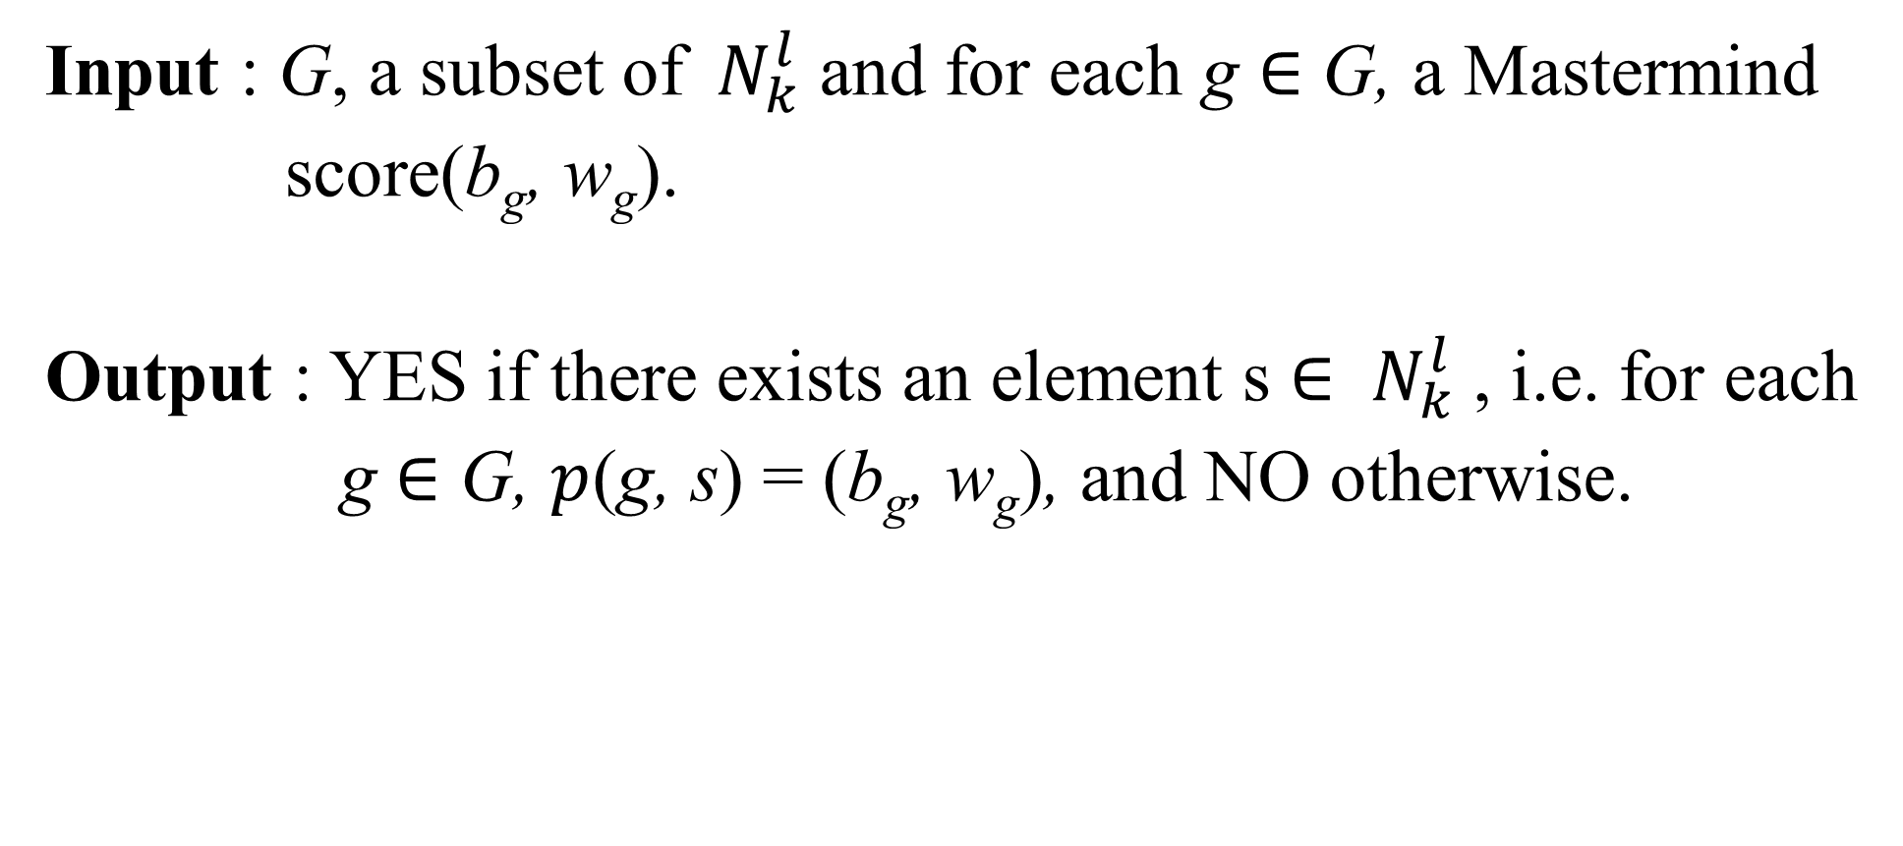
Mastermind Satisfiability Problem(MSP)
Input : G, a subset of${ N}_{k}^{l}$ and for each g $∈$ G, a Mastermind
score(b_{g}, w_{g}).
Output : YES if there exists an element s $∈$ ${ N}_{k}^{l}$ , i.e. for each
g $∈$ G, $p$(g, s) = (b_{g}, w_{g}), and NO otherwise.

Slide 8
MSP(Con’t)
How to proof ?
MSP is an NP problem (obviously)
Vertex-Cover Problem reduces to MSP
Vertex-Cover Problem (node cover problem)
Given a graph G=(V, E),
S is the node cover if S⊆V and for every edge (u, v) ∈ E, either u ∈ S or v ∈ S.

Slide 9
MSP(Con’t)
Let G=(V, E) be a graph and n>1, and for its corresponding MSP instance, set
k = #V + #E + 2
(encodes each edge and vertex as a distinct color, plus two control colors)
K = {v₁, v₂, v₃, …v_{#V}, e₁, e₂, e₃, …e_{#E}, Y, N}
l = 3 + 2#V + #E
(first three positions for encoding edges, #V for vertex selection, #E for edge selection

Slide 10
MSP(Con’t)
the set of guesses can be given as follows:
(N, N, …, N) with score (0, 0) → prevent N from appearing in the solution.
(Y, Y, Y, N, …, N) with score(3, 0) →force the first three are Y.
For the i-th edge (a, b) in E, (e_{ij}, a, b, N, N, …, N) with score (0, 2)
(Y, Y, Y, v₁, v₂, v₃, …, v_{#V}, N, N, …, N) with score(3, n)

Slide 11
MSP(Con’t)
Show Vertex-Cover Problem(G, n) has a solution iff the instance of MSP above has a solution.
(⇐)
color N doesn’t appear in the solution - ①.
n vertices w₁, w₂, …, w_{n} from V appear as part of solution - ②④
Verify that for each edge in E, at least one vertex in W is adjacent to it.
each edge has a corresponding guess, i.e. at least one vertex among a and b must be in W to receive a score (0, 2) - ③
Thus, W is a size-n vertex-cover for G.

Slide 12
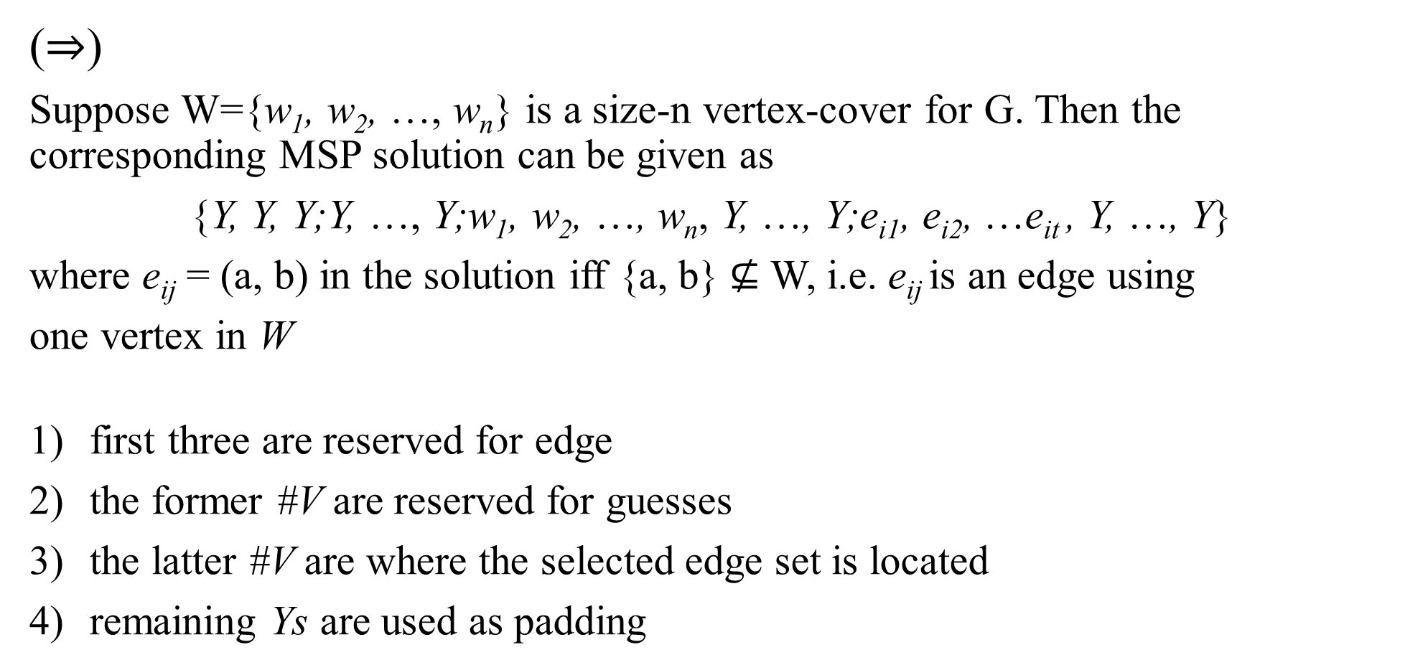
MSP(Con’t)
(⇒)
Suppose W={w₁, w₂, …, w_{n}} is a size-n vertex-cover for G. Then the corresponding MSP solution can be given as
{Y, Y, Y;Y, …, Y;w₁, w₂, …, w_{n}, Y, …, Y;e_{i1}, e_{i2}, …e_{it} , Y, …, Y}
where e_{ij} = (a, b) in the solution iff {a, b} $⊈$ W, i.e. e_{ij} is an edge using
one vertex in W
first three are reserved for edge
the former #V are reserved for guesses
the latter #V are where the selected edge set is located
remaining Ys are used as padding

Slide 15
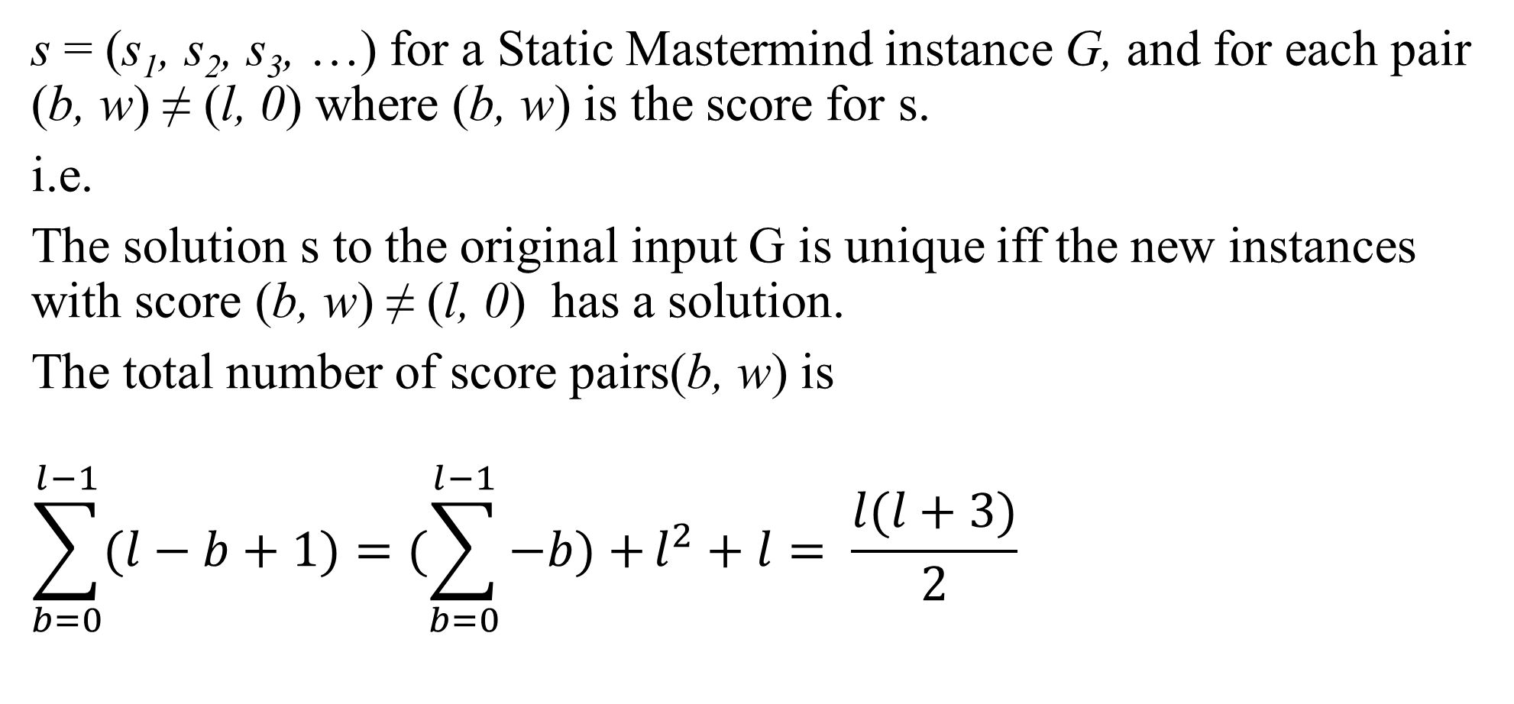
Uniqueness of Solution
s = (s₁, s₂, s₃, …) for a Static Mastermind instance G, and for each pair (b, w) ≠ (l, 0) where (b, w) is the score for s.
i.e.
The solution s to the original input G is unique iff the new instances with score (b, w) ≠ (l, 0) has a solution.
The total number of score pairs(b, w) is
$$\sum_{b=0}^{l−1}{(l−b+1)}=(\sum_{b=0}^{l−1}{−b)+}l^{2}+l= \frac{l(l+3)}{2}$$

