Slide 1
Derivative Dynamic Time Warping
Eamonn J. Keogh
Michael J. Pazzani
First SIAM International Conference on Data Mining (SDM 2001), Chicago, IL, USA, April 5-7, 2001.
Speaker: Hsiu-Chieh Hung
Date: 2017/1/3

Slide 2
Abstract(1/3)
A common task with time series data is comparing one sequence with another. In some domains a very simple distance measure, such as Euclidean distance will suffice. However, it is often the case that two sequences have the approximately the same overall component shapes, but these shapes do not line up in X-axis. In order to find the similarity between such sequences, or as a preprocessing step before averaging them, we must "warp" the time axis of one (or both) sequences to achieve a better alignment. Dynamic time warping (DTW), is a technique for efficiently achieving this warping.

Slide 3
Abstract(2/3)
Although DTW has been successfully used in many domains, it can produce pathological results. The crucial observation is that the algorithm may try to explain variability in the Y-axis by warping the X-axis. This can lead to unintuitive alignments where a single point on one time series maps onto a large subsection of another time series. We call examples of this undesirable behavior "singularities".
An additional problem with DTW is that the algorithm may fail to find obvious, natural alignments in two sequences simply because a feature (i.e peak, valley, inflection point, plateau etc.) in one sequence is slightly higher or lower than its corresponding feature in the other sequence.

Slide 4
Abstract(3/3)
In this paper we address both these problems by introducing a modification of DTW. The crucial difference is in the features we consider when attempting to find the correct warping. Then we introduce and demonstrate our extension, which we call Derivative Dynamic Time Warping (DDTW).

Slide 5
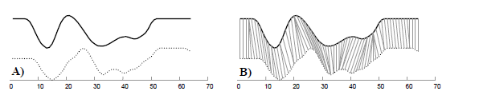
Dynamic Time Warping (DTW)

Slide 6
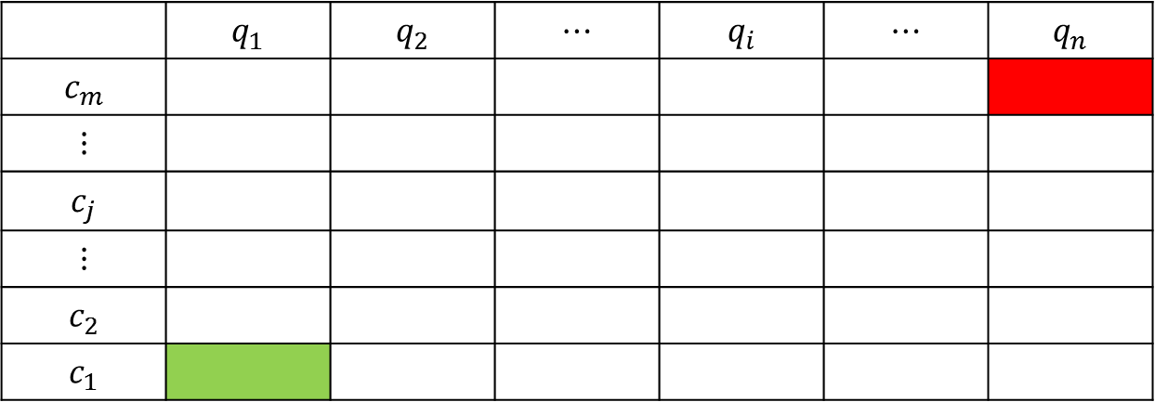
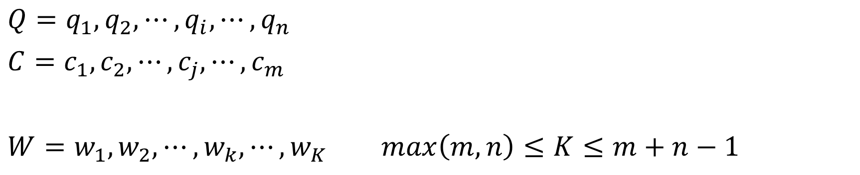

Dynamic Time Warping (DTW)
$Q=q_{1}, q_{2}, ⋯, q_{i}, ⋯, q_{n}$
$C=c_{1}, c_{2}, ⋯, c_{j}, ⋯, c_{m}$
$W=w_{1}, w_{2}, ⋯, w_{k}, ⋯, w_{K}$ $max\left(m,n\right)≤K≤m+n−1$
 | $$q_{1}$$ | $$q_{2}$$ | $$⋯$$ | $$q_{i}$$ | $$⋯$$ | $$q_{n}$$
$$c_{m}$$
$$⋮$$
$$c_{j}$$
$$⋮$$
$$c_{2}$$
$$c_{1}$$
$$d\left(q_{i},c_{j}\right)$$

Slide 7
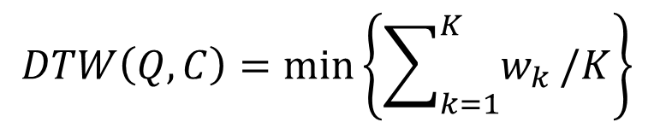
Dynamic Time Warping (DTW)
$$DTW\left(Q,C\right)=min⁡\left\{\sum_{k=1}^{K}{w_{k}}/K\right\}$$
 | 啊 | 你 | 好 | 啊
好 | 1 | 1 |  | 1
好 | 1 | 1 |  | 1
你 | 1 |  | 1 | 1
你 | 1 |  | 1 | 1
啊 |  | 1 | 1
啊 |  | 1 | 1
啊 |  | 1 | 1

Slide 8
Dynamic Time Warping (DTW)
$$γ\left(i,j\right)=d\left(q_{i},c_{j}\right)+min⁡\{ γ\left(i−1,j−1\right) ,γ\left(i−1,j\right) ,γ\left(i,j−1\right) \}$$
 | 啊 | 你 | 好 | 啊
好 | 4 | 2 |  | 1
好 | 3 | 1 |  | 1
你 | 2 |  | 1 | 2
你 | 1 |  | 1 | 2
啊 |  | 1 | 2
啊 |  | 1 | 2
啊 |  | 1 | 2

Slide 9
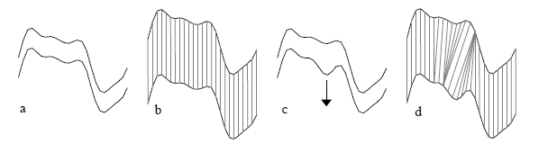
Derivative Dynamic Time Warping (DDTW)

Slide 10

Derivative Dynamic Time Warping (DDTW)
First element : use the estimate of second element
Last element : use the estimate of penultimate element

Slide 11
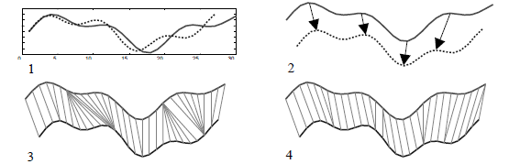
Derivative Dynamic Time Warping (DDTW)
Complexity
O(mn)

Slide 12
Experiment
1. Spurious warping
2. Finding the correct warping

Slide 13
Experiment
Dataset:
1. Space Shuttle:
A set of 9 sequences from sensors that measured acceleration in
a particular direction during the first eight hours of Shuttle
Mission STS-57.
2. Exchange rate:
A set of 5 sequences containing the exchange rate between the
Deutsche Mark and five other European currencies over a six
month period.
3.EEG:
A set of 9 Electroencephalograghy measurements that were a subset
of sensors from 21-lead reading. Each sequence contains 514
datapoints.

Slide 14
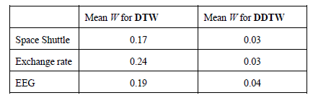

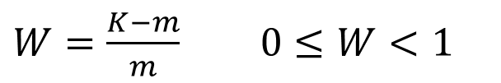

Spurious warping
All the sequences within a dataset have the same length : $m=n$
$$max\left(m,n\right)≤K≤m+n−1$$
$$m≤K<2m−1$$
$W=\frac{K−m}{m}$ $0≤W<1$

Slide 15
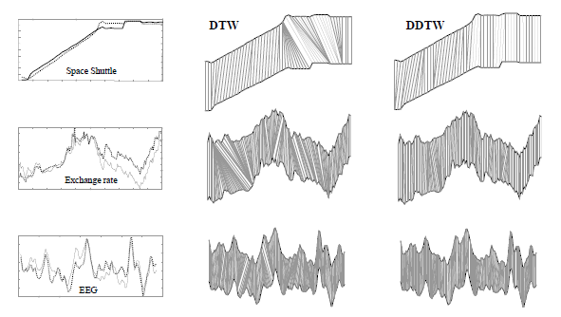
Spurious warping

Slide 16
Finding the correct warping
Copy a sequence Q to make Q’
Randomly choose an anchor point in Q’
Distort the Y-axis by adding or subtracting 0.0 , 0.1 and 0.2
Randomly shifted the anchor point 15 time-units left or right (inverse distance interpolation)

Slide 17

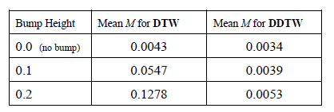
Finding the correct warping

Slide 18
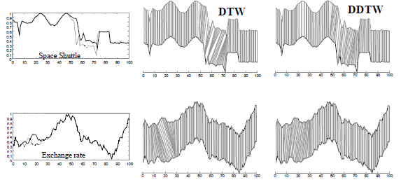
Finding the correct warping

