Slide 1
A Genetic Algorithm for the Longest Common Subsequence Problem
Brenda Hinkemeyer and Bryant A. Julstrom
GECCO '06 Proceedings of the 8th annual conference on Genetic and evolutionary computation
Pages 609-610, Seattle, Washington, USA
Presenter : Shie-Yan Lee
2017/1/3

Slide 2
Abstract
A genetic algorithm for the longest common subsequence problem encodes candidate sequences as binary strings that indicate subsequences of the shortest or first string. Its fitness function penalizes sequences not found in all the strings. In tests on 84 sets of three strings, a dynamic programming algorithm returns optimum solutions quickly on smaller instances and increasingly slowly on larger instances. Repeated trials of the GA always identify optimum subsequences, and it runs in reasonable times even on the largest instances.

Slide 3
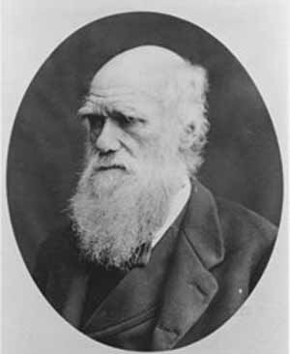
Genetic Algorithm
Chromosome
Chromosome
Chromosome
Chromosome
Chromosome
Chromosome
Chromosome
Chromosome

Slide 4
Genetic Algorithm
Use a fitness function to evaluate the solutions
Chromosome
7
Chromosome
12
Chromosome
200
Chromosome
35
Chromosome
-50
Chromosome
1
Chromosome
12
Chromosome
350

Slide 5
Genetic Algorithm
Choose the best chromosomes to be parents
Chromosome
7
Chromosome
12
Chromosome
200
200
Chromosome
35
Chromosome
-50
Chromosome
1
Chromosome
12
Chromosome
350
350

Slide 6
Genetic Algorithm
Choose the best chromosomes to be parents
7
12
200
35
-50
1
12
350

Slide 7
Genetic Algorithm
Crossover to generate new chromosomes
200
350
7
-50
35
12
1
12
Crossover
Chromosome
Chromosome

Slide 8
Genetic Algorithm
Mutation
Chromosome
Chromosome
Chromosome
Chromosome
Chromosome
Chromosome
Chromosome
Chromosome
Chromosome
Chromosome

Slide 9
Genetic Algorithm
Repeat this generational process until a termination condition has been reached.
Chromosome
Chromosome
Chromosome
Chromosome
Chromosome
Chromosome
Chromosome
Chromosome
Chromosome

Slide 10
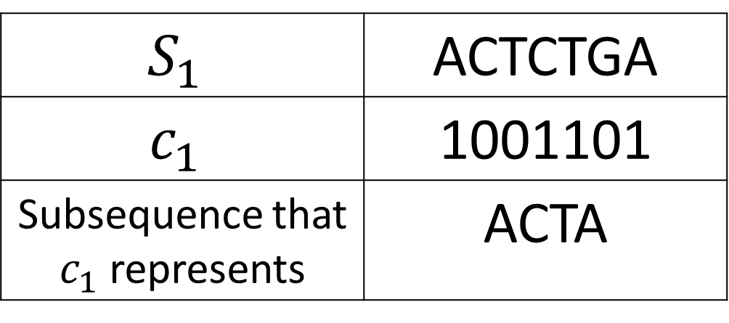

Genetic Algorithm for LCS
Find the LCS of given $k$ strings : $S_{1},S_{2},S_{3}… S_{k}$
Each chromosome $c_{i}$ is a bit string as long as $S_{1}$
$$S_{1}$$ | ACTCTGA
$$c_{1}$$ | 1001101
Subsequence that $c_{1}$ represents | ACTA

Slide 11


Genetic Algorithm for LCS
Fitness function $f(c_{i}$)
$l$: length of the subsequence $c_{i}$ represents
(the number of 1 in $c_{i}$)
$m$ : number of strings that the subsequence matches
$v←l+30∗m$
$$if l=\left|S_{1}\right|$$
$v←v+50$
$$if m=K$$
$v←3000∗v$
$$else$$
$v←−1000∗v∗(K−m)$
$f(c_{i}$)$←v$

Slide 12




Genetic Algorithm for LCS
K-point crossover
Parents
$$c_{1}$$
$$c_{2}$$
Children
$$c_{3}$$
$$c_{4}$$

Slide 13


Genetic Algorithm for LCS
Mutation with probability : $\frac{1}{n}$
$$c_{1}$$
0 1 0 1 0 1 1 0 1 0 1 1 0 1
0
$$c_{1}$$
0 1 0 1 0 1 1 0 1 0 1 1 0 1
1

Slide 14
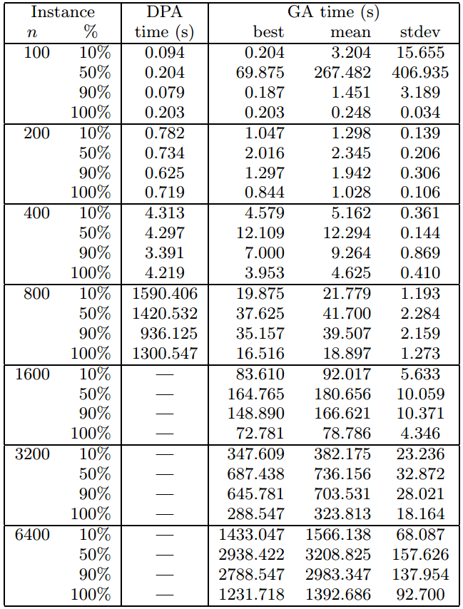
Tests
Size of alphabet = 4

Slide 15
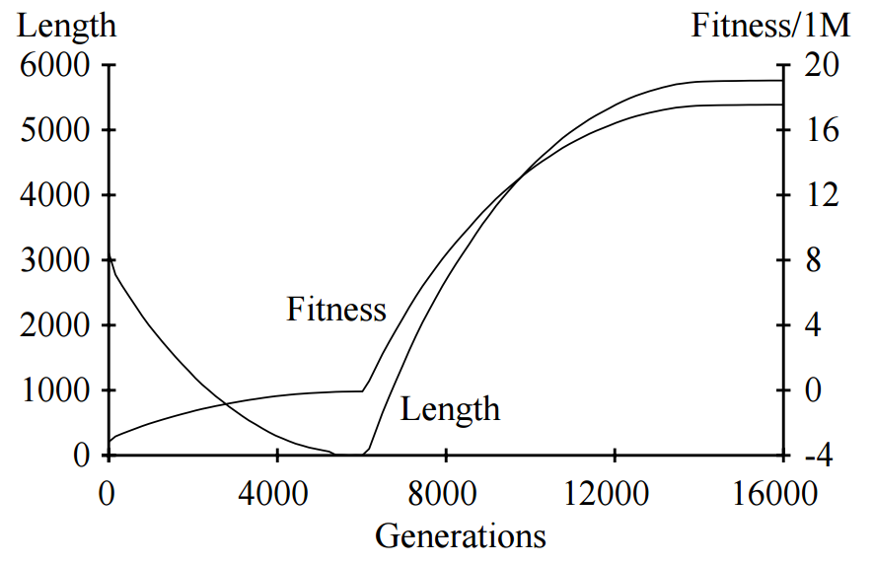
Tests

