Slide 1
A Short Note on the Approximability of the Maximum Leaves Spanning Tree Problem
G. Galbiati, F. Maffioli and A. Morzenti
Information Processing Letters, Vol. 52, pp. 45-49 (1994)
Presenter: Shiou-Zong Chiou
Date: 2017/01/24

Slide 2
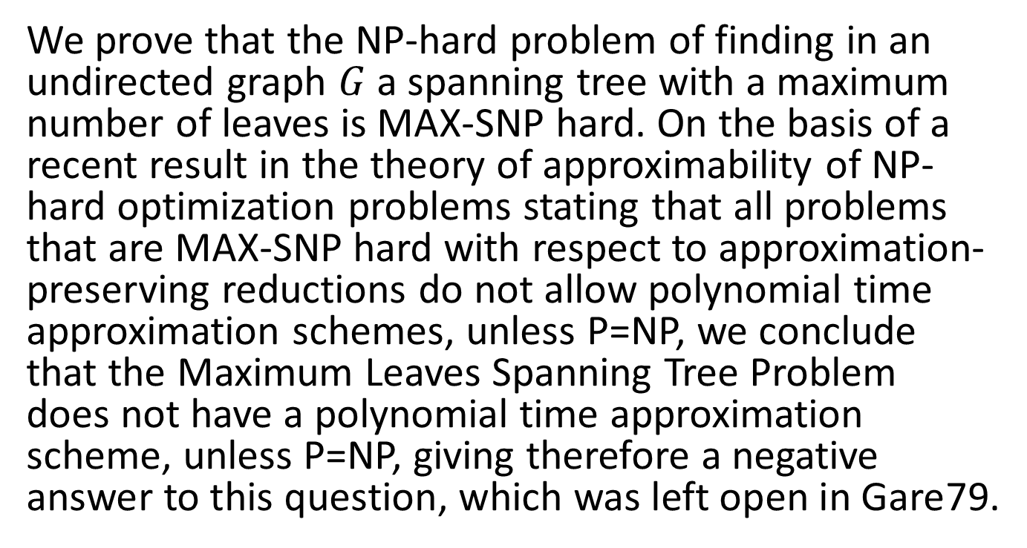
Abstract
We prove that the NP-hard problem of finding in an undirected graph $G$ a spanning tree with a maximum number of leaves is MAX-SNP hard. On the basis of a recent result in the theory of approximability of NP-hard optimization problems stating that all problems that are MAX-SNP hard with respect to approximation-preserving reductions do not allow polynomial time approximation schemes, unless P=NP, we conclude that the Maximum Leaves Spanning Tree Problem does not have a polynomial time approximation scheme, unless P=NP, giving therefore a negative answer to this question, which was left open in Gare79.

Slide 3
MLSTP

Slide 4









MIN DOM SET-B $∝$ MLSTP
$$α_{1}$$
3
4
$$α_{0}$$
$$1_{1}$$
$$1_{7}$$
2
5
$$2_{1}$$
$$2_{7}$$
1
6
7
$$3_{1}$$
$$3_{7}$$

Slide 5














Spanning tree with same leaves
$$α_{0}$$
$$α_{0}$$
$$1_{1}$$
$$1_{7}$$
$$1_{1}$$
$$1_{7}$$
$$2_{1}$$
$$2_{7}$$
$$2_{1}$$
$$2_{7}$$
$$3_{1}$$
$$3_{7}$$
$$3_{1}$$
$$3_{7}$$

Slide 6


MIN DOM SET-B $∝$ MLSTP
$$α_{1}$$
3
4
$$α_{0}$$
$$1_{1}$$
$$1_{7}$$
2
5
$$2_{1}$$
$$2_{7}$$
1
6
7
$$3_{1}$$
$$3_{7}$$
$$3$$
$$7+\left(7−3\right)+1$$

Slide 7
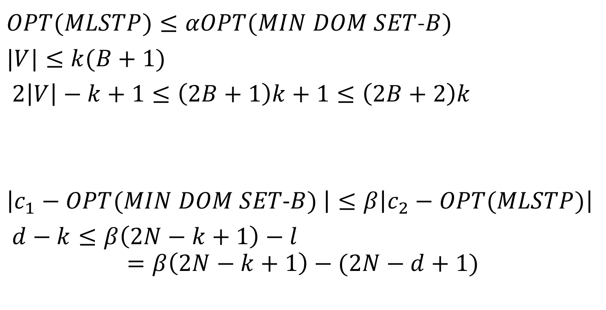
L-reduction
$OPT(MLSTP)≤αOPT(MIN DOM SET$-$B)$
$|V|≤k(B+1)$
$2\left|V\right|−k+1≤\left(2B+1\right)k+1≤\left(2B+2\right)k$
$\left|c_{1}−OPT(MIN DOM SET\text{−}B) \right|≤β\left|c_{2}−OPT(MLSTP)\right|$
$d−k≤β\left(2N−k+1\right)−l$
$$=β\left(2N−k+1\right)−(2N−d+1)$$

