Slide 1
An Algorithm and Applications to Sequence Alignment with Weighted Constraints
Yung-Hsing Peng, Chang-Biau Yang, Kuo-Tsung Tseng
and Kuo-Si Huang
International Journal of Foundations of Computer Science
Vol. 21, No. 1 (2010) 51-59
Presenter：Siang-Huai Hung
Date：2017/01/24

Slide 2
Abstract(1/2)
Given two sequences S₁, S₂, and a constrained sequence C, a longest common subsequence of S₁, S₂ with restriction to C is called a constrained longest common subsequence of S₁ and S₂ with C. At the same time, an optimal alignment of S₁, S₂ with restriction to C is called a constrained pairwise sequence alignment of S₁ and S₂ with C. Previous algorithms have shown that the constrained longest common subsequence problem is a special case of the constrained pairwise sequence alignment problem, and that both of them can be solved in O(rnm) time, where r, n, and m represent the lengths of C, S₁, and S₂, respectively. In this paper, we extend the definition of constrained pairwise sequence alignment to a more flexible version, called weighted constrained pairwise sequence alignment, in which some constraints might be ignored.

Slide 3
Abstract(2/2)
We first give an O(rnm)-time algorithm for solving the weighted constrained pairwise sequence alignment problem, then show that our extension can be adopted to solve some constraint-related problems that cannot be solved by previous algorithms for the constrained longest common subsequence problem or the constrained pairwise sequence alignment problem. Therefore, in contrast to previous results, our extension is a new and suitable model for sequence analysis.

Slide 4
Constrained LCS
A = cccccggaga
B = aggaaccccc
C = ag
LCS = ccccc
CLCS = aga

Slide 5
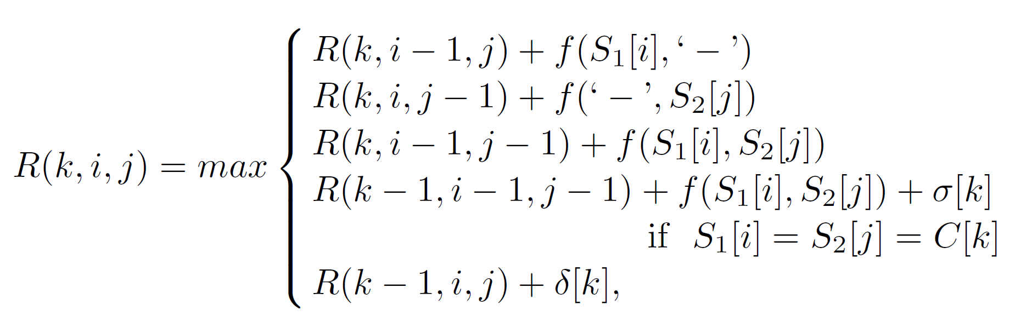
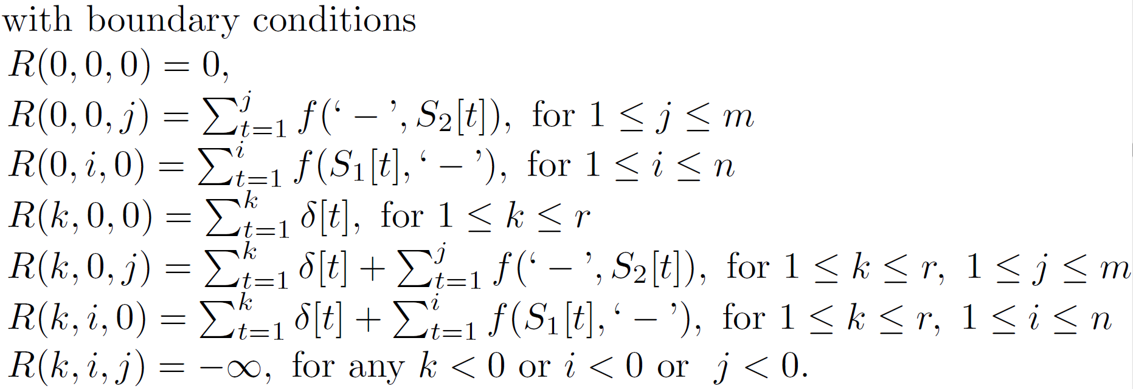
Sequence Alignment with Weighted Constraints

Slide 6
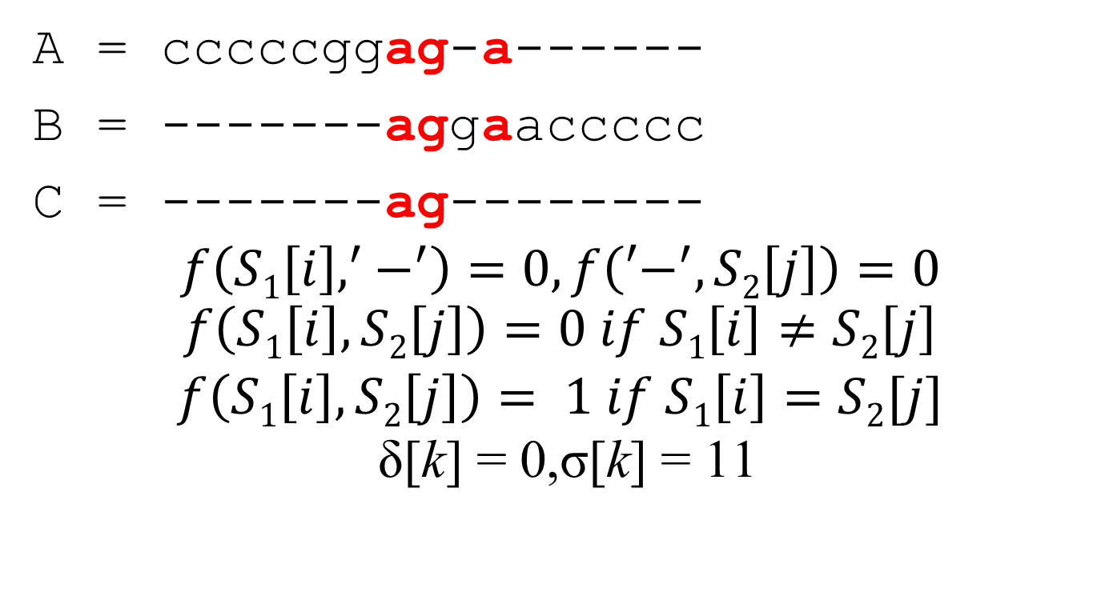
A = cccccggag-a------
B = -------aggaaccccc
C = -------ag--------
$$f\left(S1\left[i\right],^{′}−^{′}\right)=0, f\left(′−^{′},S2\left[j\right]\right)=0$$
$$f\left(S1\left[i\right],S2\left[j\right]\right)=0 if S1\left[i\right]≠S2\left[j\right]$$
$$f\left(S1\left[i\right],S2\left[j\right]\right)= 1 if S1\left[i\right]=S2[j]$$
$$\text{δ}\text{[}\text{k}\text{] = 0}\text{,}\text{σ}\text{[}\text{k}\text{] = }\text{11}$$

Slide 7
A = cccccggag-a------
B = -------aggaaccccc
C = -------ag--------
k = 0 k = 1
 |  | a | g | g | a | a | c | c | c | c | c
 | 0 | 0 | 0 | 0 | 0 | 0 | 0 | 0 | 0 | 0 | 0
c | 0 | 0 | 0 | 0 | 0 | 0 | 1 | 1 | 1 | 1 | 1
c | 0 | 0 | 0 | 0 | 0 | 0 | 1 | 2 | 2 | 2 | 2
c | 0 | 0 | 0 | 0 | 0 | 0 | 1 | 2 | 3 | 3 | 3
c | 0 | 0 | 0 | 0 | 0 | 0 | 1 | 2 | 3 | 4 | 4
c | 0 | 0 | 0 | 0 | 0 | 0 | 1 | 2 | 3 | 4 | 5
g | 0 | 0 | 1 | 1 | 1 | 1 | 1 | 2 | 3 | 4 | 5
g | 0 | 0 | 1 | 2 | 2 | 2 | 2 | 2 | 3 | 4 | 5
a | 0 | 1 | 1 | 2 | 3 | 3 | 3 | 3 | 3 | 4 | 5
g | 0 | 1 | 2 | 2 | 3 | 3 | 3 | 3 | 3 | 4 | 5
a | 0 | 1 | 2 | 2 | 3 | 4 | 4 | 4 | 4 | 4 | 5
 |  | a | g | g | a | a | c | c | c | c | c
 | 0 | 0 | 0 | 0 | 0 | 0 | 0 | 0 | 0 | 0 | 0
c | 0 | 0 | 0 | 0 | 0 | 0 | 1 | 1 | 1 | 1 | 1
c | 0 | 0 | 0 | 0 | 0 | 0 | 1 | 2 | 2 | 2 | 2
c | 0 | 0 | 0 | 0 | 0 | 0 | 1 | 2 | 3 | 3 | 3
c | 0 | 0 | 0 | 0 | 0 | 0 | 1 | 2 | 3 | 4 | 4
c | 0 | 0 | 0 | 0 | 0 | 0 | 1 | 2 | 3 | 4 | 5
g | 0 | 0 | 1 | 1 | 1 | 1 | 1 | 2 | 3 | 4 | 5
g | 0 | 0 | 1 | 2 | 2 | 2 | 2 | 2 | 3 | 4 | 5
a | 0 | 12 | 12 | 12 | 14 | 14 | 14 | 14 | 14 | 14 | 14
g | 0 | 12 | 13 | 13 | 14 | 14 | 14 | 14 | 14 | 14 | 14
a | 0 | 12 | 13 | 13 | 14 | 15 | 15 | 15 | 15 | 15 | 15

Slide 8
A = cccccggag-a------
B = -------aggaaccccc
C = -------ag--------
k = 2
 |  | a | g | g | a | a | c | c | c | c | c
 | 0 | 0 | 0 | 0 | 0 | 0 | 0 | 0 | 0 | 0 | 0
c | 0 | 0 | 0 | 0 | 0 | 0 | 1 | 1 | 1 | 1 | 1
c | 0 | 0 | 0 | 0 | 0 | 0 | 1 | 2 | 2 | 2 | 2
c | 0 | 0 | 0 | 0 | 0 | 0 | 1 | 2 | 3 | 3 | 3
c | 0 | 0 | 0 | 0 | 0 | 0 | 1 | 2 | 3 | 4 | 4
c | 0 | 0 | 0 | 0 | 0 | 0 | 1 | 2 | 3 | 4 | 5
g | 0 | 0 | 12 | 12 | 12 | 12 | 12 | 12 | 12 | 12 | 12
g | 0 | 0 | 12 | 13 | 13 | 13 | 13 | 13 | 13 | 13 | 13
a | 0 | 1 | 12 | 13 | 14 | 14 | 14 | 14 | 14 | 14 | 14
g | 0 | 1 | 24 | 24 | 24 | 24 | 24 | 24 | 24 | 24 | 24
a | 0 | 1 | 24 | 24 | 25 | 25 | 25 | 25 | 25 | 25 | 25

Slide 9
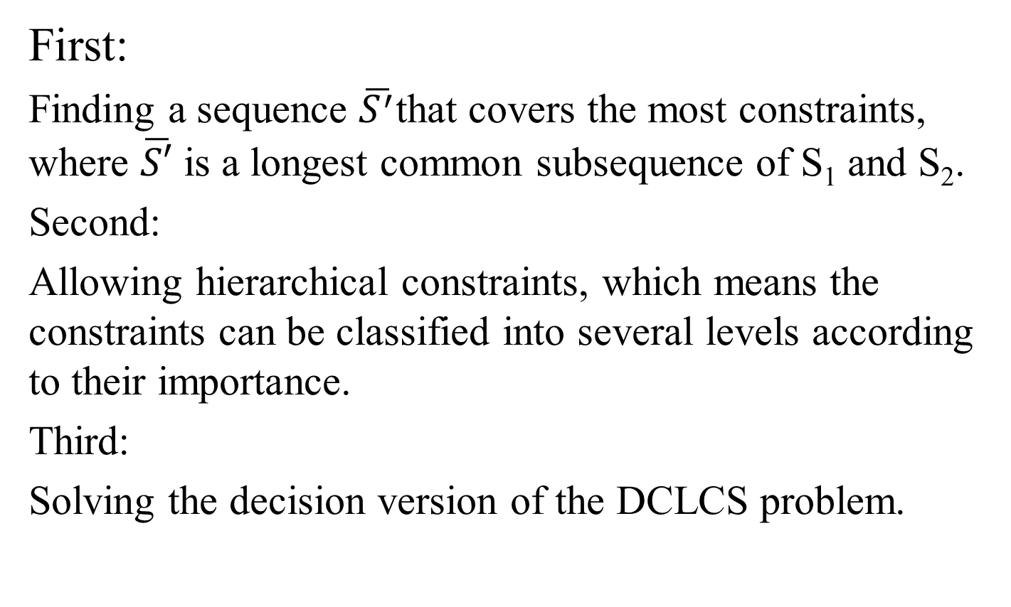
Applications
First:
Finding a sequence $\overline{S^{′}}$that covers the most constraints, where $\overline{S′}$ is a longest common subsequence of S₁ and S₂.
Second:
Allowing hierarchical constraints, which means the constraints can be classified into several levels according to their importance.
Third:
Solving the decision version of the DCLCS problem.

Slide 10
Thanks for listening

