Slide 1
Haibo He and Edwardo A. Garcia IEEE Transactions on Knowledge and Data Engineering, 21(9):1263-1284, 2009
Learning from Imbalanced Data
Presenter：Jyun-Hao Lai
Date：2017 / 01 / 24
Notes:
1

Slide 2
Abstract(1/2)
With the continuous expansion of data availability in many large-scale, complex, and networked systems, such as surveillance, security, Internet, and finance, it becomes critical to advance the fundamental understanding of knowledge discovery and analysis from raw data to support decision-making processes. Although existing knowledge discovery and data engineering techniques have shown great success in many real-world applications, the problem of learning from imbalanced data is a relatively new challenge that has attracted growing attention from both academia and industry. The imbalanced learning problem is concerned with the performance of learning algorithms in the presence of underrepresented data and severe class distribution skews.

Slide 3
Abstract(2/2)
Due to the inherent complex characteristics of imbalanced data sets, learning from such data requires new understandings, principles, algorithms, and tools to transform vast amounts of raw data efficiently into information and knowledge representation. In this paper, we provide a comprehensive review of the development of research in learning from imbalanced data. Our focus is to provide a critical review of the nature of the problem, the state-of-the-art technologies, and the current assessment metrics used to evaluate learning performance under the imbalanced learning scenario. Furthermore, in order to stimulate future research in this field, we also highlight the major opportunities and challenges, as well as potential important research directions for learning from imbalanced data.

Slide 4
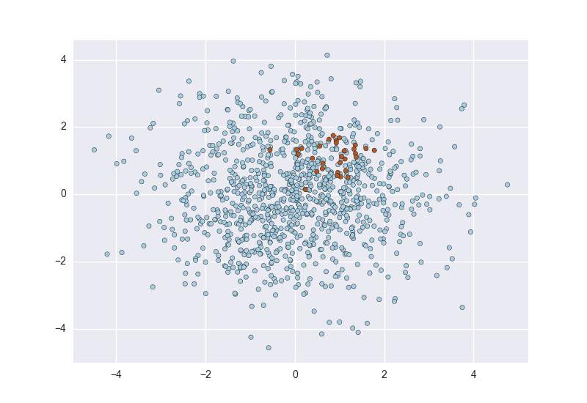
Class-Imbalance
分類學習方法都有一個共同的假設，即不同的類別之間樣本數目相同或者彼此差異不大，但若差別很大，則會對學習的過程造成困擾。
例如，對於一個二元分類，有998個反例(False)，但正例(True)只有一個，那麼分類器(classifier)只需要返回一個永遠都是負例的預測，就能達到99.8%預測，然而這樣的學習器往往沒有價值，因為他無法預測正例。

Slide 5
Symbol
首先資料是不平衡的，因此佔多數的資料我們稱作majority，少數的資料稱作minority。
整個training set 另為S， majority簡稱$S_{maj}，$minority簡稱$S_{min}$ 。
$S_{maj}$的數量表示為$\left|S_{maj}\right|$，$S_{min}$的數量表示為$\left|S_{min}\right|$ 。

Slide 6
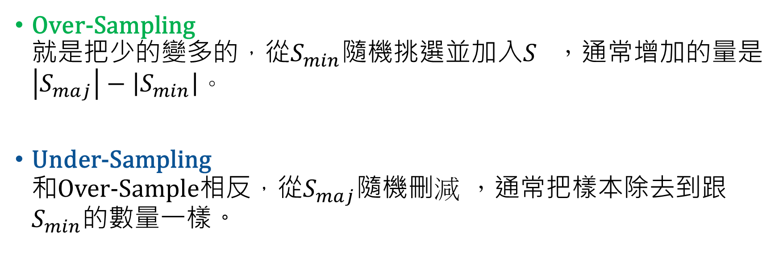
Over-Sampling 就是把少的變多的，從$S_{min}$隨機挑選並加入$S_{}$，通常增加的量是$\left|S_{maj}\right|−\left|S_{min}\right|$。
Under-Sampling 和Over-Sample相反，從$S_{maj}$隨機刪$減$ ，通常把樣本除去到跟$S_{min}$的數量一樣。
Over-Sample由於會重覆採樣，因此可能會有over-fitting的問題，
Under-Sample則是可能會刪掉一些重要的樣本。

Slide 7
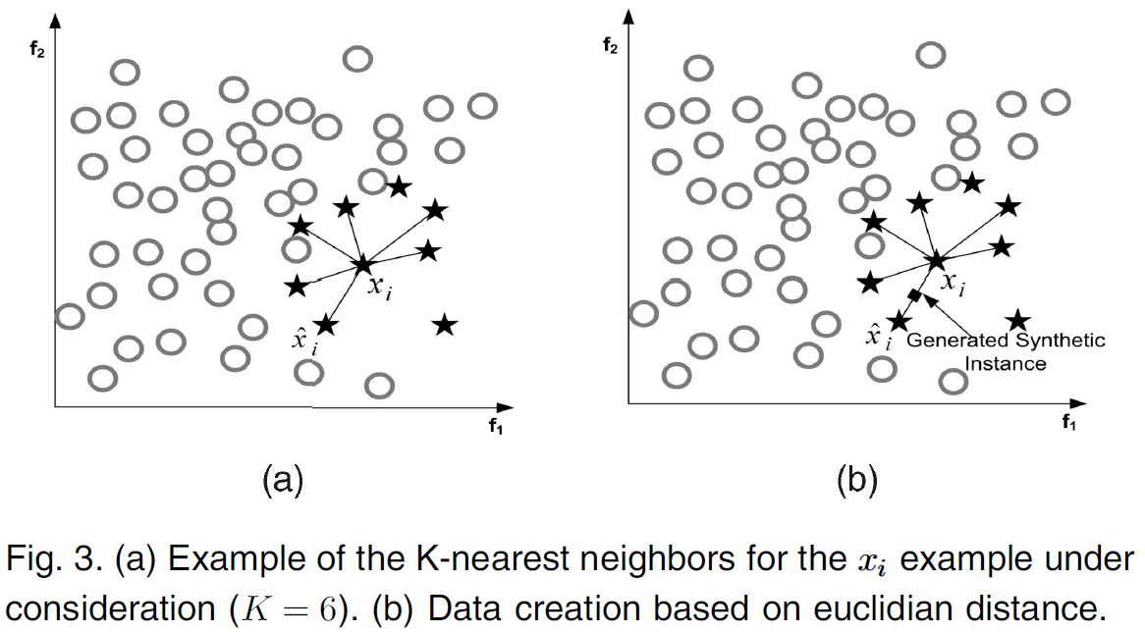
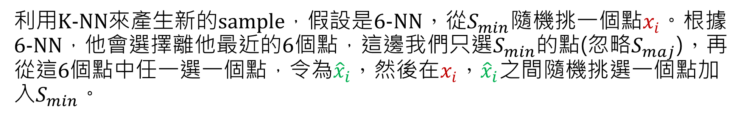


SMOTE
利用K-NN來產生新的sample，假設是6-NN，從$S_{min}$隨機挑一個點$x_{i}。$根據6-NN，他會選擇離他最近的6個點，這邊我們只選$S_{min}$的點(忽略$S_{maj}$)，再從這6個點中任一選一個點，令為${\hat{x}}_{i}$，然後在$x_{i}$，${\hat{x}}_{i}$之間隨機挑選一個點加入$S_{min}$。
$$x_{new}=x_{i}+({\hat{x}}_{i}−x_{i})×α$$
$α是[0, 1]之間的$實數值

Slide 8
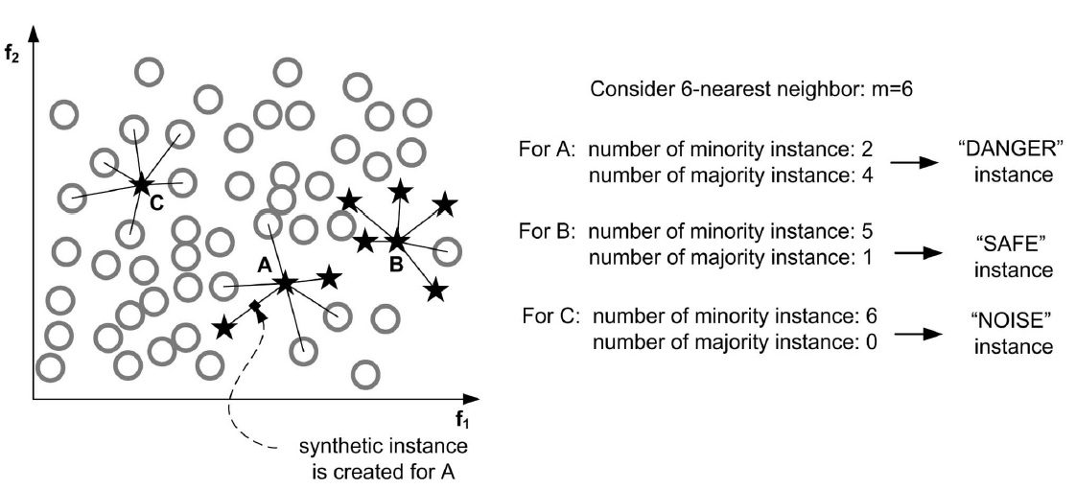
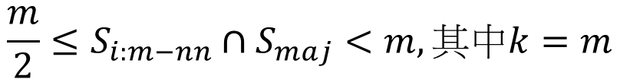
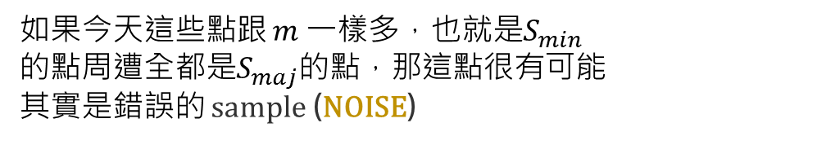
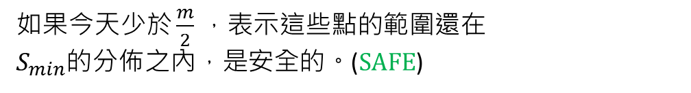
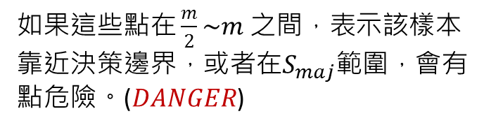
Borderline-SMOTE
一樣用K-NN找$S_{min}$週邊的Sample，但是這次不忽略$S_{maj}$，找到後代入公式：
$$\frac{m}{2}≤S_{i:m−nn}∩S_{maj}<m,其中k=m$$
如果這些點在 $\frac{m}{2}\sim m 之間，表示該樣本$
靠近決策邊界，或者在$S_{maj}$範圍，會有
點危險。($DANGER$)
如果今天少於 $\frac{m}{2}$ ，表示這些點的範圍還在
$S_{min}$的分佈之內，是安全的。(SAFE)
如果今天這些點跟 $m$ 一樣多，也就是$S_{min}$
的點周遭全都是$S_{maj}$的點，那這點很有可能
其實是錯誤的 sample (NOISE)

Slide 9
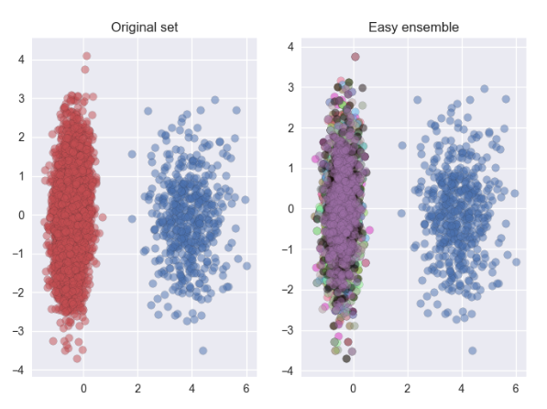
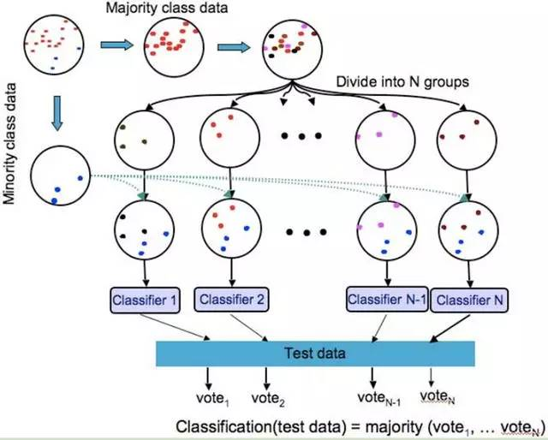
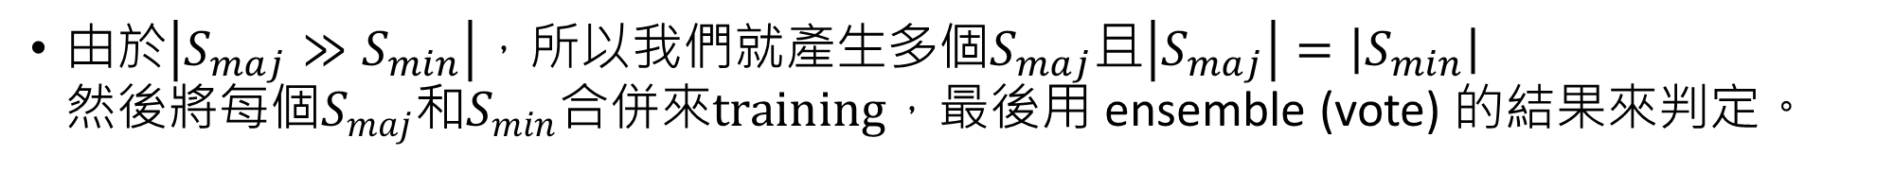
Easy-Ensemble
由於$\left|S_{maj}≫S_{min}\right|$，所以我們就產生多個$S_{maj}$且$\left|S_{maj}\right|=\left|S_{min}\right|$ 然後將每$個S_{maj}和S_{min}合併來training，$最後用 ensemble (vote) 的結果來判定。
Example:
假設$\left|S_{maj}\right| :\left|S_{min}\right|=10 :1，那麼就將S_{maj}$切成不同的10份$S_{maj}$，然後建立10個classifier來訓練$S_{maj}∪S_{min}。$

Slide 10
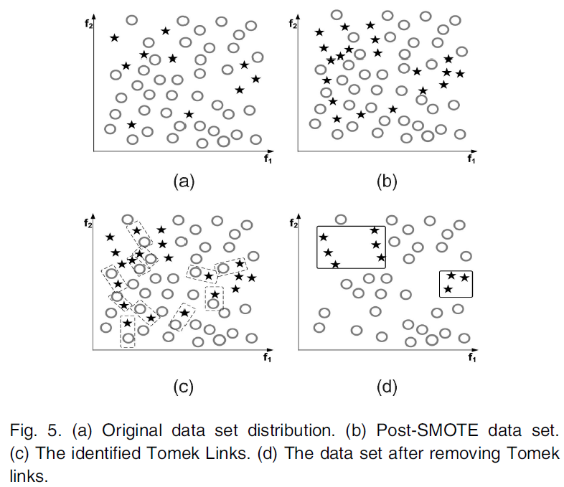

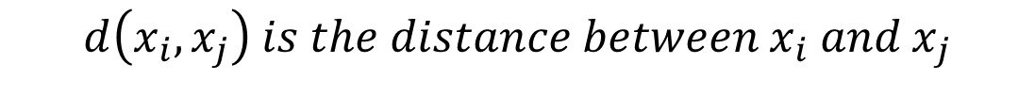
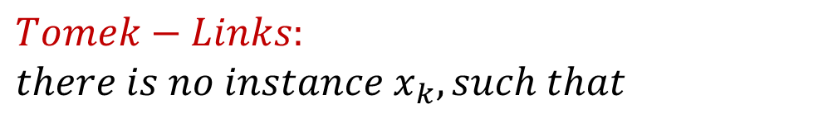


Tomek-Links
$$Pair:$$
$$\left(x_{i}, x_{j}\right), where x_{i}∈S_{min},x_{j}∈S_{maj}$$
$$Define :$$
$$d\left(x_{i}, x_{j}\right) is the distance between{ x}_{i} and x_{j}$$
$$Tomek−Links: \\ there is no instance x_{k}, such that$$
$$d\left(x_{i}, x_{k}\right)<d\left(x_{i}, x_{j}\right) or d\left(x_{j}, x_{k}\right)<d\left(x_{i}, x_{j}\right)$$

Slide 11
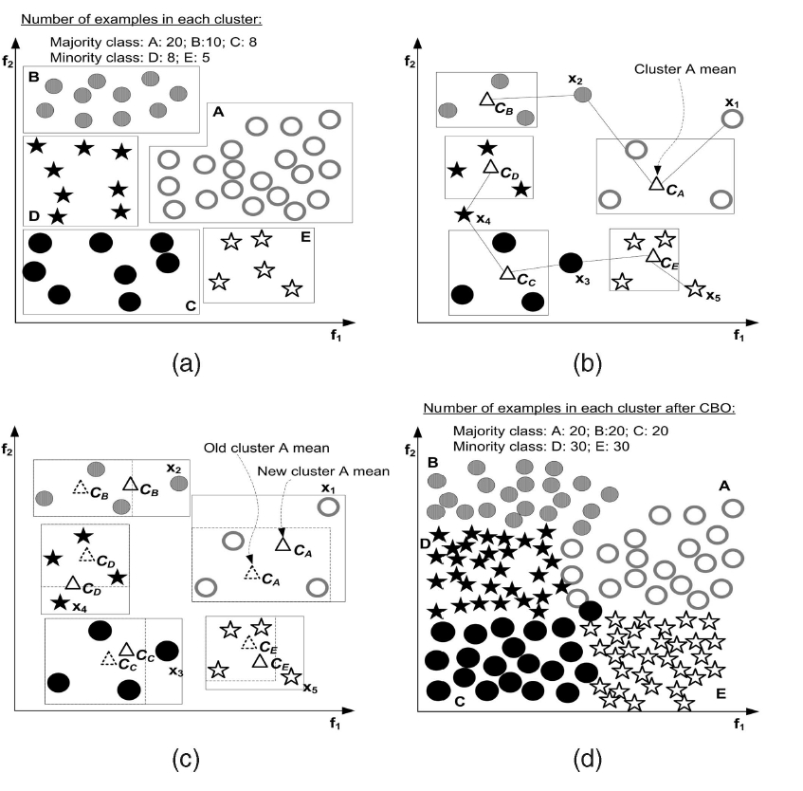
Cluster-Based Sampling Method (CBO)
首先，先做K-means ，先從各個類別挑出 K 個samples然後根據各個類別挑出來的K個samples，算出各個類別的中心點 (mean)然後開始把沒挑過得 sample 加進來，一加一個，接著調整中心點。
漸漸地開始會有些類別的sample不夠，我們就開始做 over-sampling(SMOTE)。

Slide 12
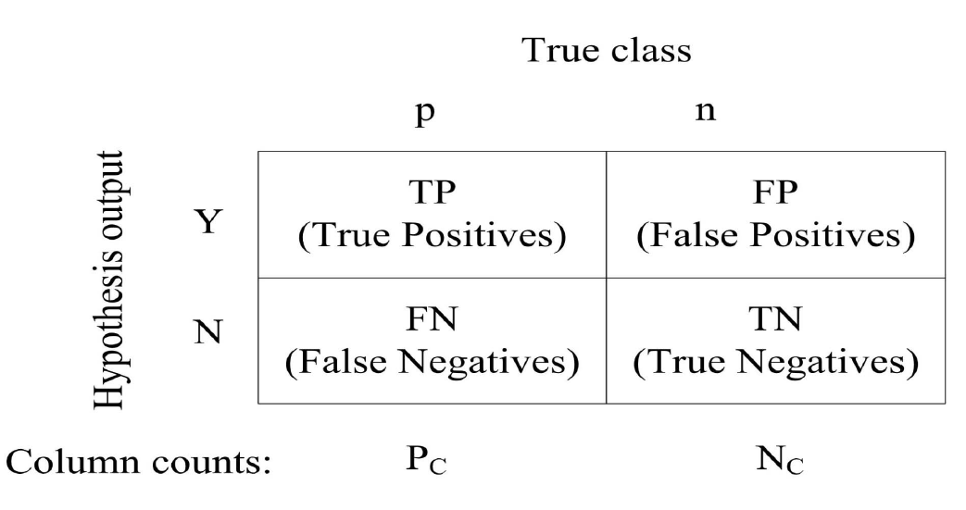
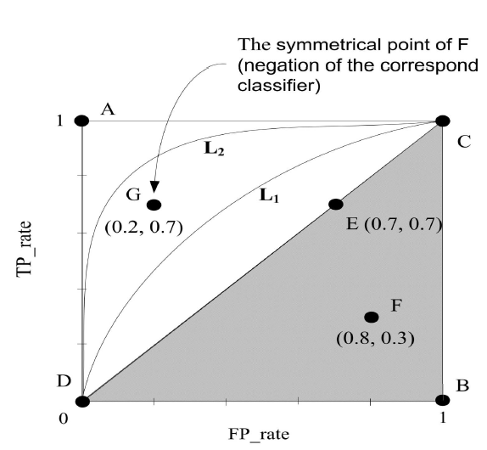
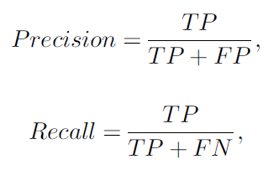

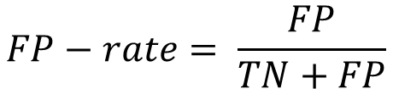
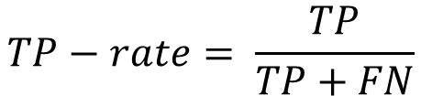
$$\left(FP−rate,TP−rate\right)$$
$$TP−rate= \frac{TP}{TP+FN}$$
$$FP−rate= \frac{FP}{TN+FP}$$
越靠近A點表現越好

