Slide 1
Electronic Imaging Conference on SPIE, Burlingame, California, USA, 2013 Costantino Grana, Daniele Borghesani, Rita Cucchiara
A Fast Approach for Integrating ORB
Descriptors in the Bag of Words Model
Presenter：Wei-Hao Fu
Date：2017/ 02/ 07
Notes:
1

Slide 2
Abstract
In this paper we propose to integrate the recently introduces ORB descriptors in the currently favored approach for image classification, that is the Bag of Words model. In particular the problem to be solved is to provide a clustering method able to deal with the binary string nature of the ORB descriptors. We suggest to use a k-means like approach, called k-majority, substituting Euclidean distance with Hamming distance and majority selected vector as the new cluster center. Results combining this new approach with other features are provided over the ImageCLEF 2011 dataset.

Slide 3
Algorithm
Lightweight features
ORB descriptor
Centrist descriptor
Color histogram descriptor
A bag of words model for binary descriptors

Slide 4
ORB descriptor(1/4)
介紹：利用FAST來尋找特徵點，並且利用BRIEF來編碼。
優點：
具有尺度不變性及旋轉不變性
抗噪能力佳
節省空間且運算快速

Slide 5
ORB descriptor(2/4)

Slide 6
ORB descriptor(3/4)

Slide 7
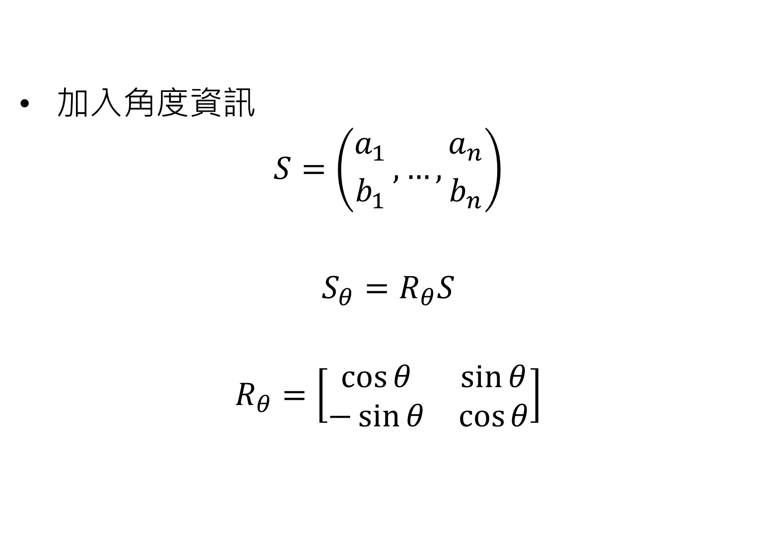
ORB descriptor(4/4)
加入角度資訊
$$S=\left({a_{1} \atop b_{1}}, …, {a_{n} \atop b_{n}}\right)$$
$$S_{θ}=R_{θ}S$$
$$R_{θ}=\left[\begin{matrix}\cos{θ} & \sin{θ} \\ −\sin{θ} & \cos{θ}\end{matrix}\right]$$

Slide 8
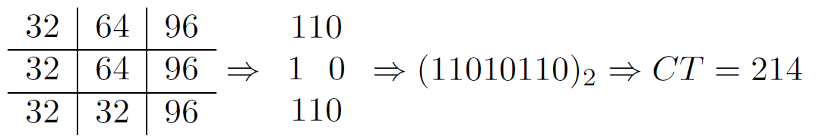
Centrist descriptor
與LBP基本上是一樣的，只是排的順序不同。
做成CENTRIST (CENsus TRansform hISTogram)
Centrist: A visual descriptor for scene categorization

Slide 9
Color histogram descriptor
方法：Median Cut Algorithm的變形，在色彩空間中每次都找出最佳的切割，切出最具有代表性的box以及較無代表性的box，在將這兩個box放回list中，反覆進行到共有N個box為止。
Notes:
Median Cut Algorithm:
參考資料:http://acm.nudt.edu.cn/~twcourse/ColorQuantization.html

Slide 10
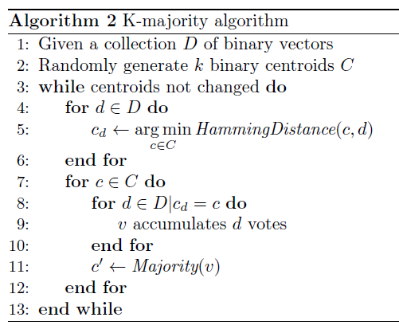
Bag of words model

Slide 11
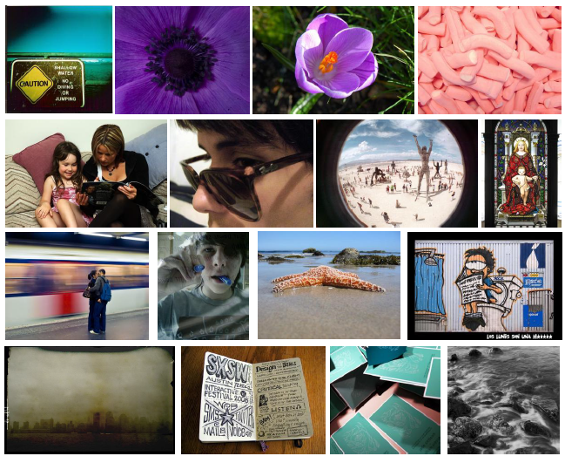
Experiments(1/2)
ImageCLEF 2011
Notes:
MiAP (Mean interpolated Average Precision)

Slide 12
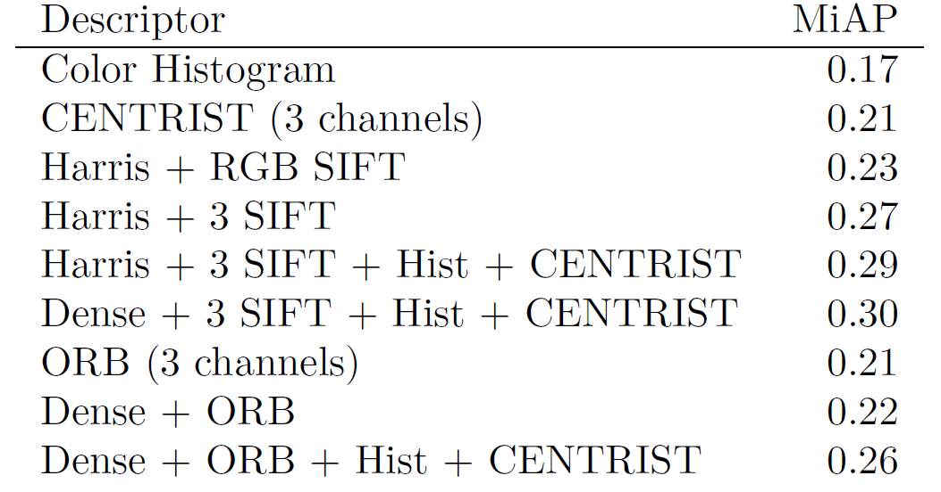
Experiments(2/2)
Notes:
MiAP (Mean interpolated Average Precision)

