Slide 1
The trading on the mutual funds by gene expression programming with Sortino ratio
Hung-Hsin Chenª, Chang-Biau Yangª , Yung-Hsing Peng^{b}
ªDepartment of Computer Science and Engineering, National Sun Yat-sen University, Kaohsiung, Taiwan
^{b}Innovative DigiTech-Enabled Applications & Services Institute, Institute for Information Industry, Kaohsiung, Taiwan
Applied Soft Computing 15 (2014), pp. 219–230
Presenter：Shih-jhan Huang
Date：2017/2/7

Slide 2
Abstract
The aim of this paper is to combine several techniques together to provide one systematic method for guiding the investment in mutual funds. Many researches focus on the prediction of a single asset time series, or focus on portfolio management to diversify the investment risk, but they do not generate explicit trading rules. Only a few researches combine these two concepts together, but they adjust trading rules manually. Our method combines the techniques for generating observable and profitable trading rules, managing portfolio and allocating capital. First, the buying timing and selling timing are decided by the trading rules generated by gene expression programming. The trading rules are suitable for the constantly changing market. Second, the funds with higher Sortino ratios are selected into the portfolio. Third, there are two models for capital allocation, one allocates the capital equally (EQ) and the other allocates the capital with the mean variance (MV) model.

Slide 3
Abstract
Also, we perform superior predictive ability test to ensure that our method can earn positive returns without data snooping. To evaluate the return performance of our method, we simulate the investment on mutual funds from January 1999 to September 2012. The training duration is from 1999/1/1 to 2003/12/31, while the testing duration is from 2004/1/1 to 2012/9/11. The best annualized return of our method with EQ and MV capital allocation models are12.08% and 12.85%, respectively. The latter also lowers the investment risk. To compare with the method proposed by Tsai et al., we also perform testing from January 2004 to December 2008. The experimental results show that our method can earn annualized return 9.07% and 11.27%, which are better than the annualized return 6.89% of Tsai et al.

Slide 4
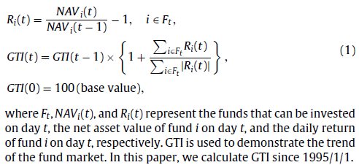
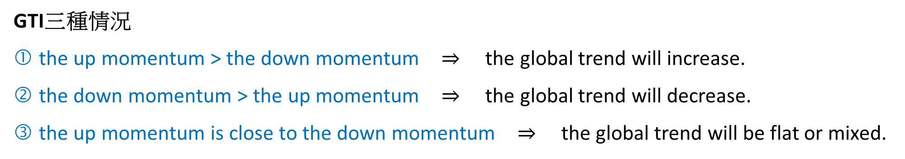
Global Trend Indicator (GTI)
GTI三種情況
the up momentum > the down momentum the global trend will increase.
the down momentum > the up momentum the global trend will decrease.
the up momentum is close to the down momentum the global trend will be flat or mixed.

Slide 5
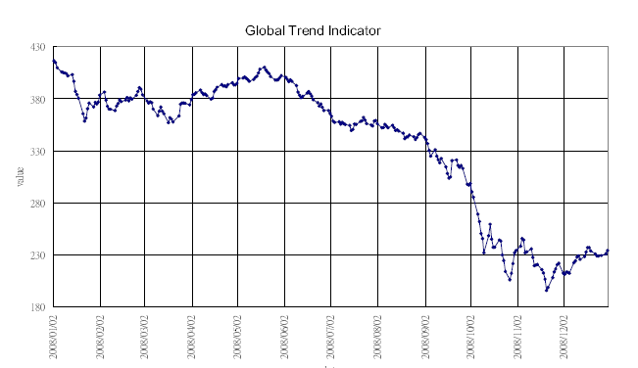

Slide 6
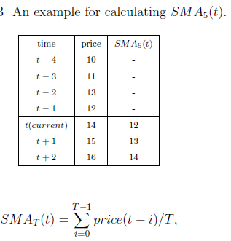
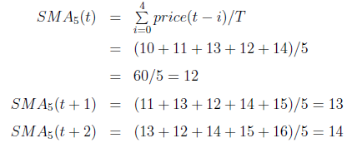
Simple Moving Average (SMA)

Slide 7
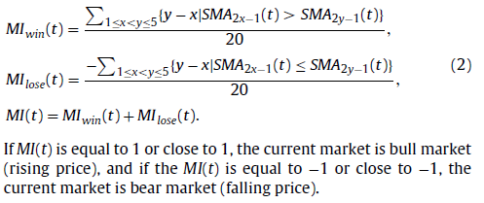
Monitoring Indicator (MI)
Derived from GTI and its five simple moving average indicators,
to measure whether the fund market is in the bull or bear state.
The intervals of the five moving averages are 1, 3, 5, 7 and 9, denoted as SMA₁(t), SMA₃(t), SMA₅(t), SMA₇(t) and SMA₉(t).

Slide 8
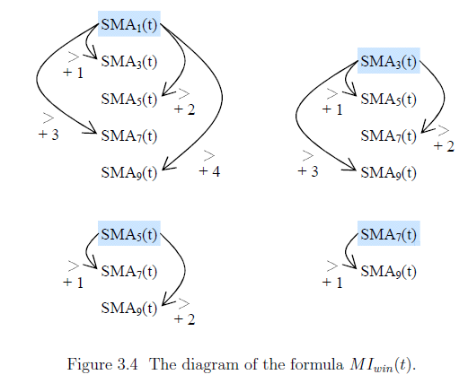
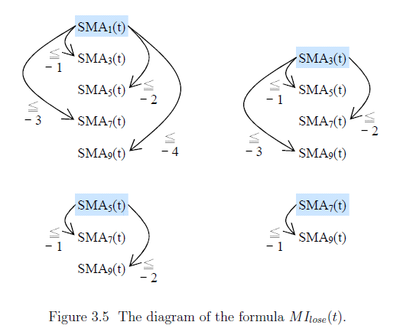

Slide 9
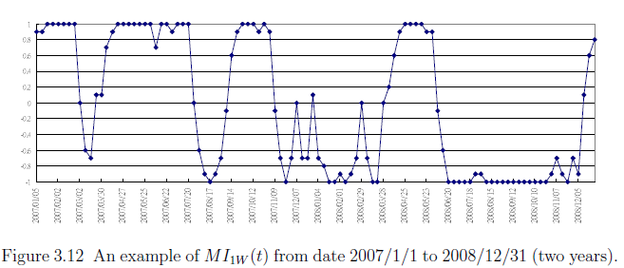
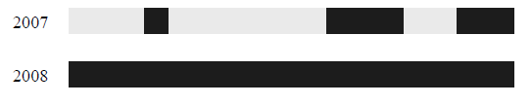

Slide 10
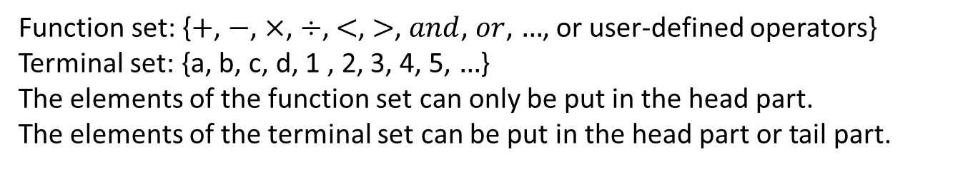
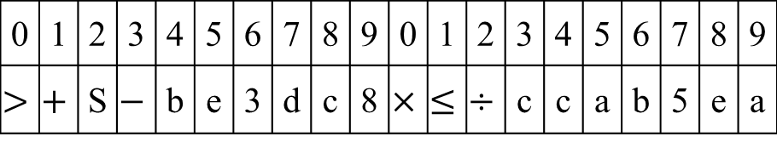
Chromosome
gene 1
gene 2
Index
0 | 1 | 2 | 3 | 4 | 5 | 6 | 7 | 8 | 9 | 0 | 1 | 2 | 3 | 4 | 5 | 6 | 7 | 8 | 9
$$>$$ | $$+$$ | S | $$−$$ | b | e | 3 | d | c | 8 | $$×$$ | $$≤$$ | $$÷$$ | c | c | a | b | 5 | e | a
Symbol
allele
head
tail
Function set: {$+$, $−$, $×$, $÷$, $<$, $>$, $and$, $or$, $…$, or user-defined operators}
Terminal set: {a, b, c, d, 1 , 2, 3, 4, 5, $…$}
The elements of the function set can only be put in the head part.
The elements of the terminal set can be put in the head part or tail part.

Slide 11



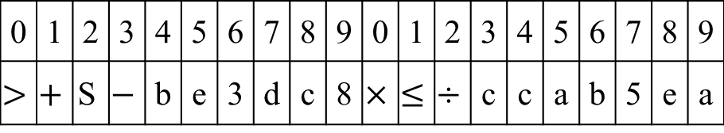




Two Structures of a Gene
Genotype (string)
gene 1
gene 2
Index
0 | 1 | 2 | 3 | 4 | 5 | 6 | 7 | 8 | 9 | 0 | 1 | 2 | 3 | 4 | 5 | 6 | 7 | 8 | 9
$$>$$ | $$+$$ | $$\text{S}$$ | $$−$$ | b | e | 3 | d | c | 8 | $$×$$ | $$≤$$ | $$÷$$ | c | c | a | b | 5 | e | a
Symbol
allele
head
tail
By level order
Phenotype (tree)
gene 1
gene 2
$$>$$
$$×$$
$$+$$
$$\text{S}$$
$$≤$$
$$÷$$
$$−$$
b
e
c
c
a
b
3
d
c
8
5
e
a

Slide 12


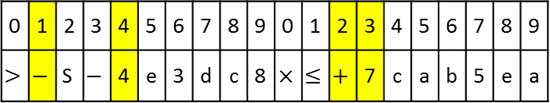


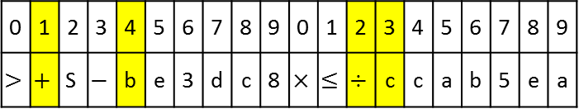





gene 1
gene 2
0 | 1 | 2 | 3 | 4 | 5 | 6 | 7 | 8 | 9 | 0 | 1 | 2 | 3 | 4 | 5 | 6 | 7 | 8 | 9
$$>$$ | $$+$$ | $$\text{S}$$ | $$−$$ | b | e | 3 | d | c | 8 | $$×$$ | $$≤$$ | $$÷$$ | c | c | a | b | 5 | e | a
Mutation
head
tail
0 | 1 | 2 | 3 | 4 | 5 | 6 | 7 | 8 | 9 | 0 | 1 | 2 | 3 | 4 | 5 | 6 | 7 | 8 | 9
$$>$$ | $$−$$ | $$\text{S}$$ | $$−$$ | 4 | e | 3 | d | c | 8 | $$×$$ | $$≤$$ | $$+$$ | 7 | c | a | b | 5 | e | a
gene 1
gene 2
$$>$$
$$×$$
$$+$$
S
$$≤$$
$$÷$$
$$−$$
b
e
c
c
a
b
3
d
gene 1
gene 2
$$>$$
$$×$$
$$−$$
S
$$≤$$
$$+$$
$$−$$
4
e
7
c
a
b
3
d

Slide 13



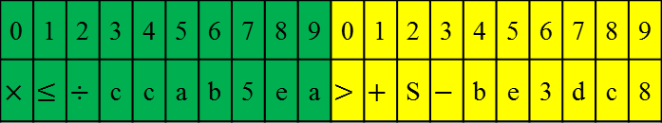





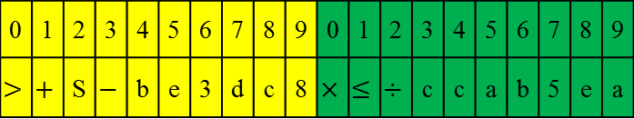





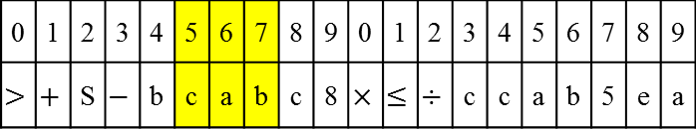



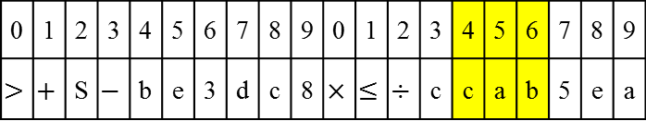


Copy a part of gene to another in a chromosome
Swap two genes in a chromosome
gene 1
gene 2
gene 1
gene 2
0 | 1 | 2 | 3 | 4 | 5 | 6 | 7 | 8 | 9 | 0 | 1 | 2 | 3 | 4 | 5 | 6 | 7 | 8 | 9
$$>$$ | $$+$$ | S | $$−$$ | b | e | 3 | d | c | 8 | $$×$$ | $$≤$$ | $$÷$$ | c | c | a | b | 5 | e | a
0 | 1 | 2 | 3 | 4 | 5 | 6 | 7 | 8 | 9 | 0 | 1 | 2 | 3 | 4 | 5 | 6 | 7 | 8 | 9
$$>$$ | $$+$$ | S | $$−$$ | b | e | 3 | d | c | 8 | $$×$$ | $$≤$$ | $$÷$$ | c | c | a | b | 5 | e | a
Transposition of insertion
Gene transposition
head
tail
head
tail
0 | 1 | 2 | 3 | 4 | 5 | 6 | 7 | 8 | 9 | 0 | 1 | 2 | 3 | 4 | 5 | 6 | 7 | 8 | 9
$$>$$ | $$+$$ | S | $$−$$ | b | c | a | b | c | 8 | $$×$$ | $$≤$$ | $$÷$$ | c | c | a | b | 5 | e | a
0 | 1 | 2 | 3 | 4 | 5 | 6 | 7 | 8 | 9 | 0 | 1 | 2 | 3 | 4 | 5 | 6 | 7 | 8 | 9
$$×$$ | $$≤$$ | $$÷$$ | c | c | a | b | 5 | e | a | $$>$$ | $$+$$ | S | $$−$$ | b | e | 3 | d | c | 8
gene 1
gene 2
gene 1
gene 2
$$>$$
$$×$$
$$>$$
$$×$$
$$+$$
S
$$≤$$
$$÷$$
$$+$$
S
$$≤$$
$$÷$$
$$−$$
b
e
c
c
a
b
$$−$$
b
e
c
c
a
b
3
d
3
d
gene 2
gene 1
gene 2
gene 1
$$>$$
$$×$$
$$×$$
$$>$$
$$+$$
S
$$≤$$
$$÷$$
$$≤$$
$$÷$$
$$+$$
S
$$−$$
b
c
c
c
a
b
c
c
a
b
$$−$$
b
e
a
b
3
d

Slide 14


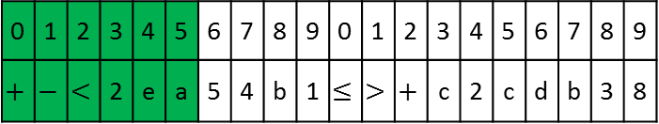



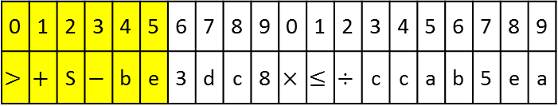





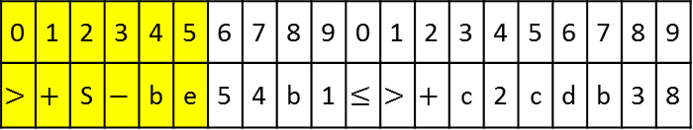





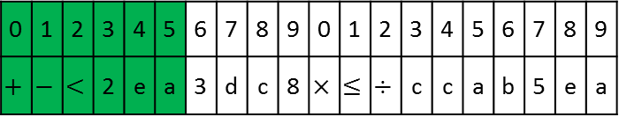



Recombination (crossover)
(one-point)
Chromosome 1
Chromosome 1
0 | 1 | 2 | 3 | 4 | 5 | 6 | 7 | 8 | 9 | 0 | 1 | 2 | 3 | 4 | 5 | 6 | 7 | 8 | 9
$$>$$ | $$+$$ | S | $$−$$ | b | e | 3 | d | c | 8 | $$×$$ | $$≤$$ | $$÷$$ | c | c | a | b | 5 | e | a
0 | 1 | 2 | 3 | 4 | 5 | 6 | 7 | 8 | 9 | 0 | 1 | 2 | 3 | 4 | 5 | 6 | 7 | 8 | 9
$$+$$ | $$−$$ | $$<$$ | 2 | e | a | 3 | d | c | 8 | $$×$$ | $$≤$$ | $$÷$$ | c | c | a | b | 5 | e | a
0 | 1 | 2 | 3 | 4 | 5 | 6 | 7 | 8 | 9 | 0 | 1 | 2 | 3 | 4 | 5 | 6 | 7 | 8 | 9
$$+$$ | $$−$$ | $$<$$ | 2 | e | a | 5 | 4 | b | 1 | $$≤$$ | $$>$$ | $$+$$ | c | 2 | c | d | b | 3 | 8
0 | 1 | 2 | 3 | 4 | 5 | 6 | 7 | 8 | 9 | 0 | 1 | 2 | 3 | 4 | 5 | 6 | 7 | 8 | 9
$$>$$ | $$+$$ | S | $$−$$ | b | e | 5 | 4 | b | 1 | $$≤$$ | $$>$$ | $$+$$ | c | 2 | c | d | b | 3 | 8
Chromosome 2
Chromosome 2
$$>$$
$$+$$
S
$$+$$
$$−$$
$$<$$
$$−$$
b
e
2
e
a
3
3
d
Chromosome 1
$$×$$
Chromosome 1
$$×$$
$$≤$$
$$÷$$
$$≤$$
$$÷$$
c
c
a
b
c
c
a
b
$$>$$
$$+$$
$$+$$
S
$$−$$
$$<$$
$$−$$
b
e
2
e
a
5
$$≤$$
Chromosome 2
5
4
$$≤$$
Chromosome 2
$$>$$
$$+$$
$$>$$
$$+$$
c
2
a
b
c
2
a
b

Slide 15



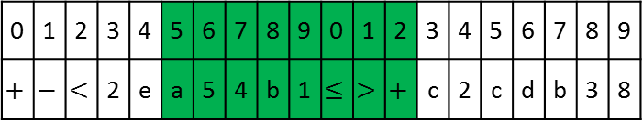




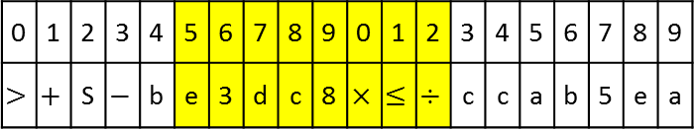






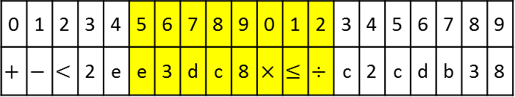






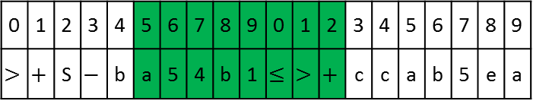




Recombination (crossover)
(two-point)
Chromosome 1
Chromosome 1
0 | 1 | 2 | 3 | 4 | 5 | 6 | 7 | 8 | 9 | 0 | 1 | 2 | 3 | 4 | 5 | 6 | 7 | 8 | 9
$$>$$ | $$+$$ | S | $$−$$ | b | e | 3 | d | c | 8 | $$×$$ | $$≤$$ | $$÷$$ | c | c | a | b | 5 | e | a
0 | 1 | 2 | 3 | 4 | 5 | 6 | 7 | 8 | 9 | 0 | 1 | 2 | 3 | 4 | 5 | 6 | 7 | 8 | 9
$$>$$ | $$+$$ | S | $$−$$ | b | a | 5 | 4 | b | 1 | $$≤$$ | $$>$$ | $$+$$ | c | c | a | b | 5 | e | a
0 | 1 | 2 | 3 | 4 | 5 | 6 | 7 | 8 | 9 | 0 | 1 | 2 | 3 | 4 | 5 | 6 | 7 | 8 | 9
$$+$$ | $$−$$ | $$<$$ | 2 | e | a | 5 | 4 | b | 1 | $$≤$$ | $$>$$ | $$+$$ | c | 2 | c | d | b | 3 | 8
0 | 1 | 2 | 3 | 4 | 5 | 6 | 7 | 8 | 9 | 0 | 1 | 2 | 3 | 4 | 5 | 6 | 7 | 8 | 9
$$+$$ | $$−$$ | $$<$$ | 2 | e | e | 3 | d | c | 8 | $$×$$ | $$≤$$ | $$÷$$ | c | 2 | c | d | b | 3 | 8
Chromosome 2
Chromosome 2
$$>$$
$$>$$
$$+$$
S
+
S
$$−$$
b
e
$$−$$
b
a
5
3
d
Chromosome 1
4
b
Chromosome 1
$$×$$
$$≤$$
$$≤$$
$$÷$$
$$>$$
$$+$$
c
c
a
b
c
c
a
b
$$+$$
$$+$$
$$−$$
$$<$$
$$−$$
$$<$$
2
e
a
5
2
e
3
d
$$≤$$
Chromosome 2
$$×$$
Chromosome 2
$$>$$
$$+$$
$$≤$$
$$÷$$
c
2
a
b
c
2
a
b

Slide 16
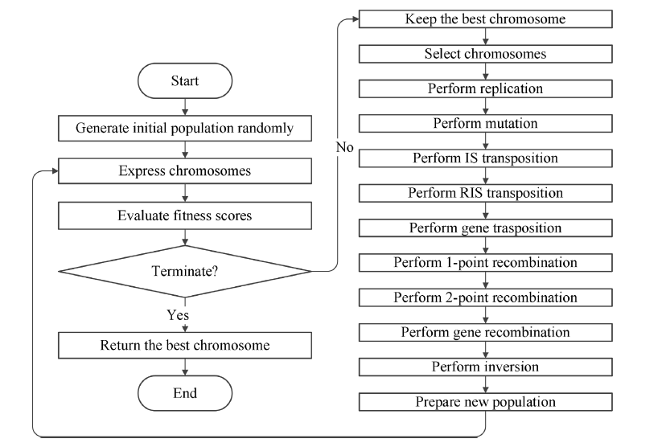
GEP

Slide 17
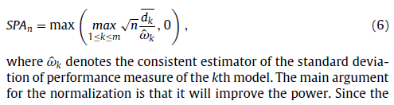
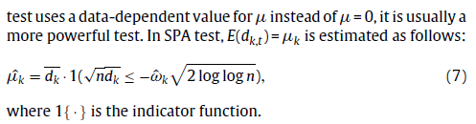
SPA

Slide 18
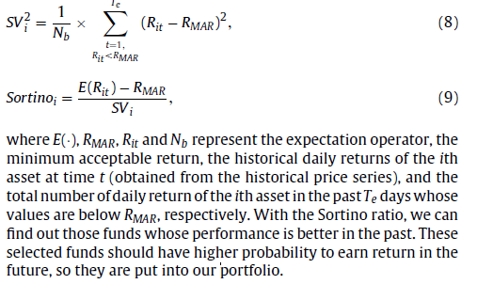
Sortino ratio

Slide 19
The paper’s method
The trading signals generated by the GEP .
The funds which can be invested are ranked with the Sortino ratio.
Allocation capital：EQ model、MV model

Slide 20
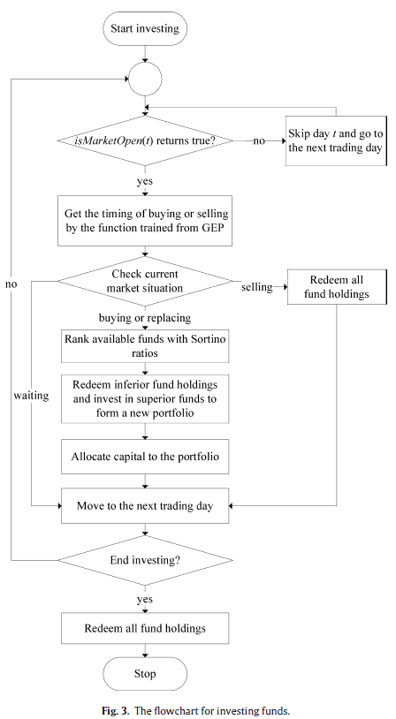
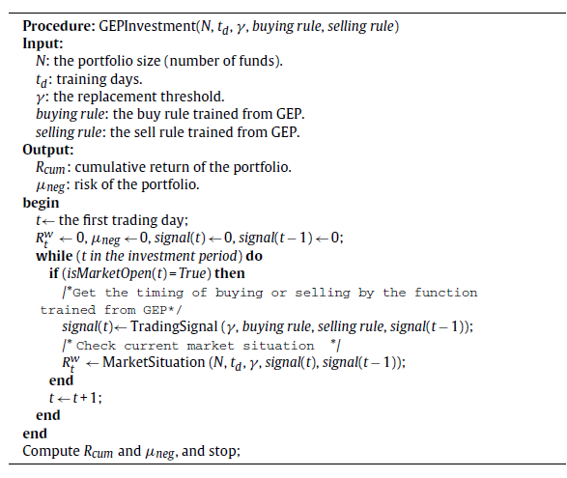
isMarketOpen(t)：
如果市場第t天的可交易基金數量 > 第t天之前發行的所有基金的10%

Slide 21
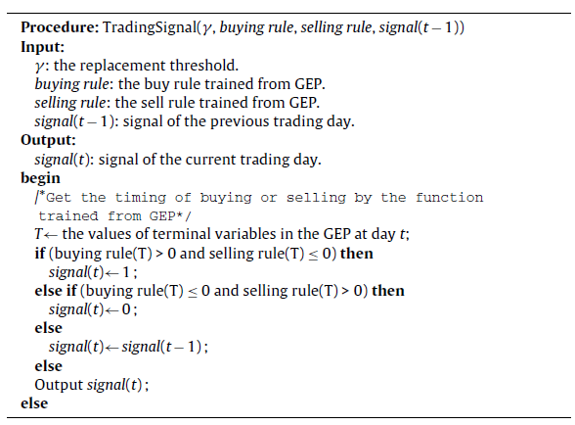
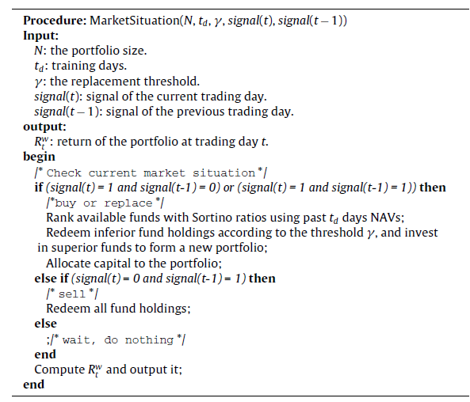

Slide 22
Determining the timing with GEP
To simplify the procedure of determining the trading timing, we assume that we can buy and sell GTI. The fitness function of GEP is to maximize the return of GTI in the training period.
Our trading interval is one week, thus we put the weekly monitor indicator (MI^{w}) in the terminal set of GEP, which can be viewed as the feature of market situation.

Slide 23
Portfolio management
Buying signal：We pick out superior funds according to the Sortino ratios from current available funds as our investment objects, and put them into the portfolio with size N.
Selling signal ： Redeem all held funds.
Replacing signal：Some inferior funds in the current portfolio are replaced by superior ones with the replacement method proposed by Tsai et al. [35].
replacement threshold ：γ
（Ex : suppose there are 120 available funds and γ = 60%. Once the Sortino rank of a certain fund falls outside top 72 (= 120 × 60%), this fund will be replaced by a one with higher Sortino rank. ）

Slide 24
Experimental results
Training : 1999/1/1 ~ 2003/12/31
Testing : 2004/1/1 ~ 2012/9/11
the portfolio size N
the replacement threshold γ
the training days t_{d} for ranking the Sortino ratio and for the MV model.

Slide 25
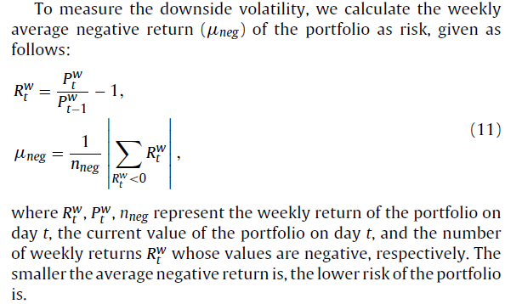
The weekly average negative return

Slide 26
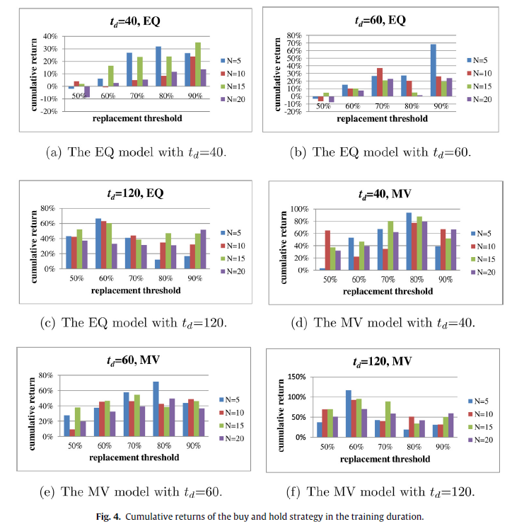
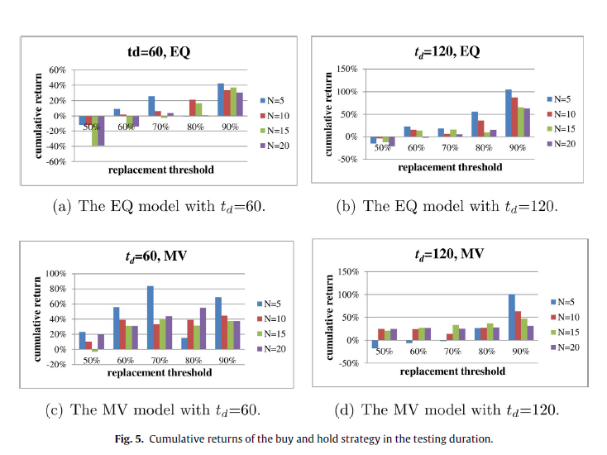
Buy-and-hold strategy
Optimal :
t_{d} = 120, γ = 60%

Slide 27
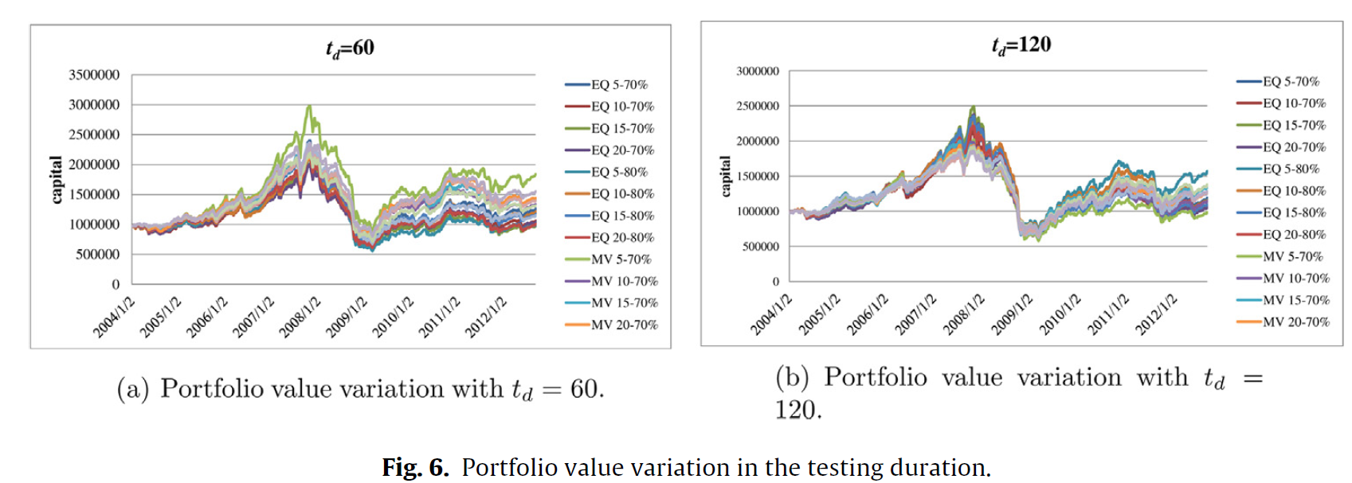

Slide 28
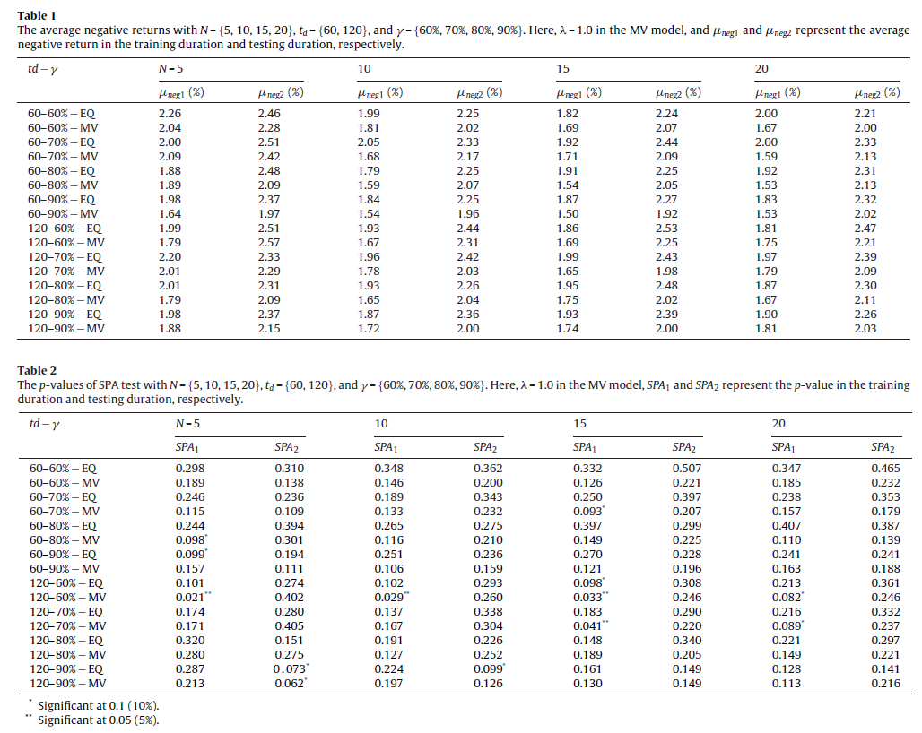

Slide 29
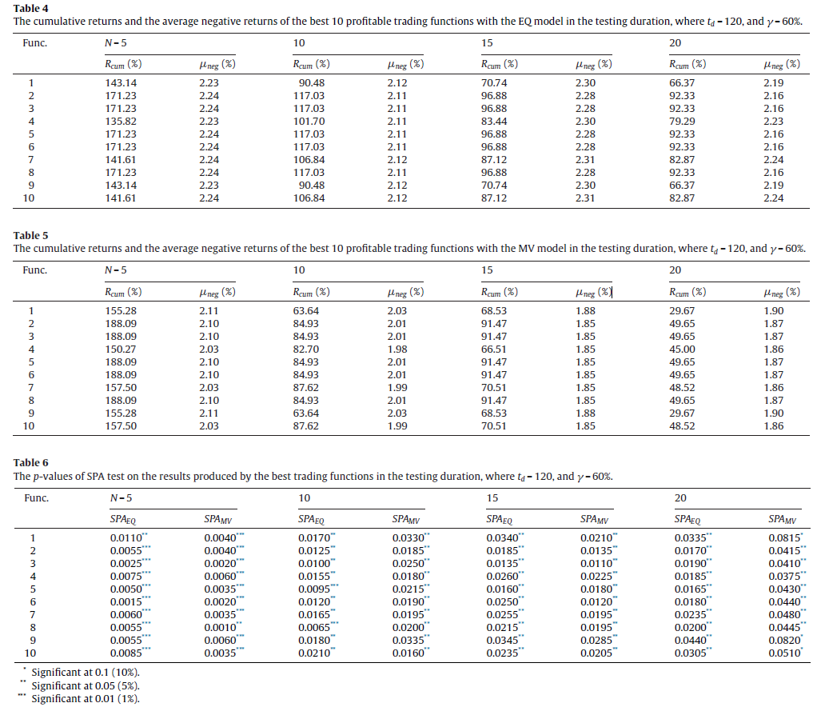
GEP

Slide 30
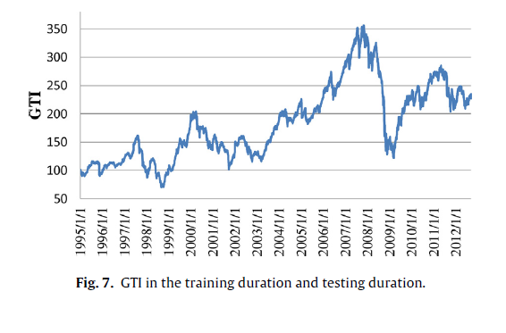
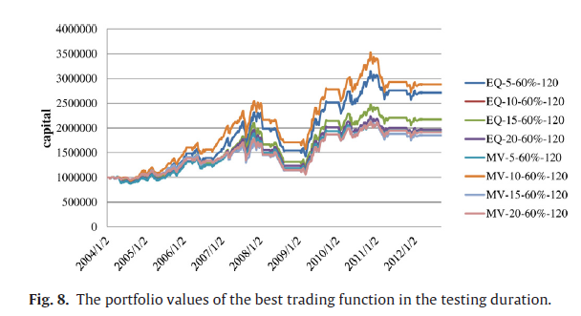

Slide 31
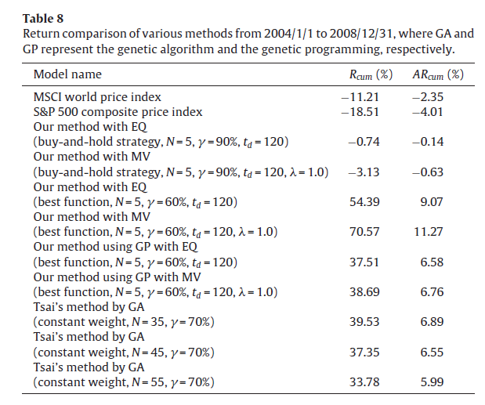
Comparison

