Slide 1
Constrained Longest Common Subsequence Computing Algorithms in Practice
Sebastian Deorowicz, Joanna Obstoj
Computing and Informatics, Vol. 29, 2010, 427–445
Presenter: Shou-Fu Lo
Date:2017/02/07

Slide 2
Abstract
The problem of ﬁnding a constrained longest common subsequence (CLCS) for the sequences A and B with respect to sequence P was introduced recently. Its goal is to ﬁnd a longest subsequence C of A and B such that P is a subsequence of C. There are several algorithms solving the CLCS problem, but there is no real experimental comparison of them. The paper has two aims. Firstly, we propose an improvement to the algorithms by Chin et al. and Deorowicz based on an entry-exit points technique by He and Arslan. Secondly, we compare experimentally the existing algorithms for solving the CLCS problem.

Slide 3
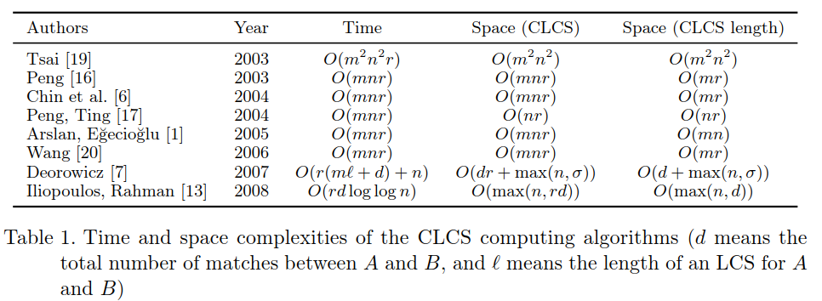
DP
Peng and Arslan–Egecioglu algorithms use a very similar recurrence to the one by Chin et al.
Peng and Ting algorithm is a divide and conquer method and the application of this techniques is not easy.
Wang algorithm employs a similar idea.
Deorowicz algorithm use a sparsity of the dynamic programming matrix.
Iliopoulos–Rahman algorithm use the data structure employs van Emde Boas trees [8] to achieve such complexities.

Slide 4
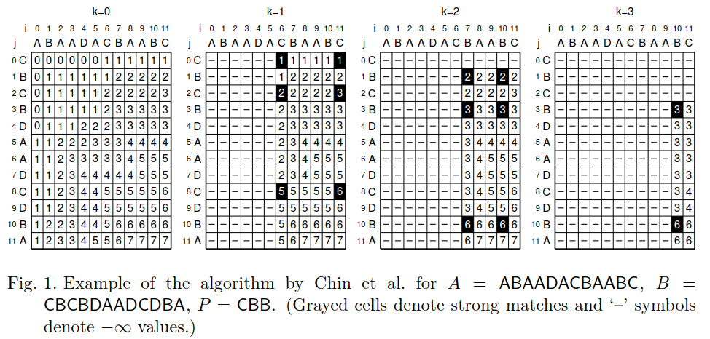
Chin algorithm

Slide 5
Improvement algorithm
Use the entry-exit points (EEP) to reduce the number of computations.
He, D.—Arslan, A. N.: A Space-Eﬃcient Algorithm for the Constrained Pairwise Sequence Alignment Problem. Genome Informatics, Vol. 16, 2005, No. 2, pp. 237–246,2005.

Slide 6
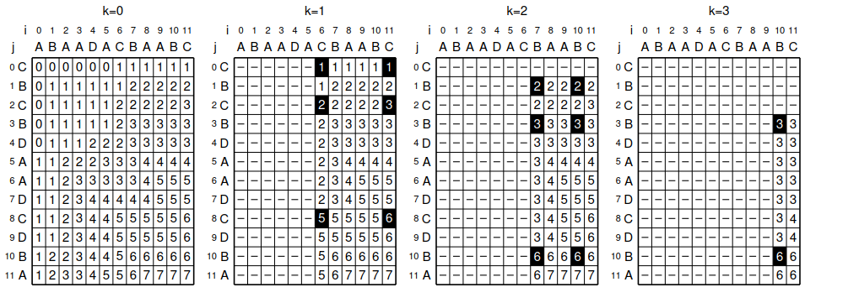
Improvement algorithm
1. Compute the boundary for each layer:
For each k, find every pair of first and last possible positions that match P[k] in each sequence, S1, S2, then find pair of start point and end point
(S1_{begin}[k], S1_{end}[k]),(S2_{begin}[k]), S2_{end}[k]) as the boundary for layer k

Slide 7
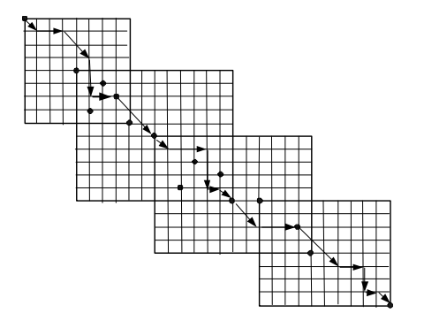
Improvement algorithm
2. Compute the entry and exit vertices on each layer:
For layer k, 1 ≤ k ≤ r, find all the candidate entry vertices (t1, t2, k) such that
S1[t1] = S2[t2] = P[k], in the overlapping region of layer k − 1 and k
For layer k, 0 ≤ k ≤ r − 1, find all the candidate exit vertices (m1, m2, k) such
that S1[m1] = S2[m2] = P[k + 1], in the overlapping region of layer k and k +1

Slide 8
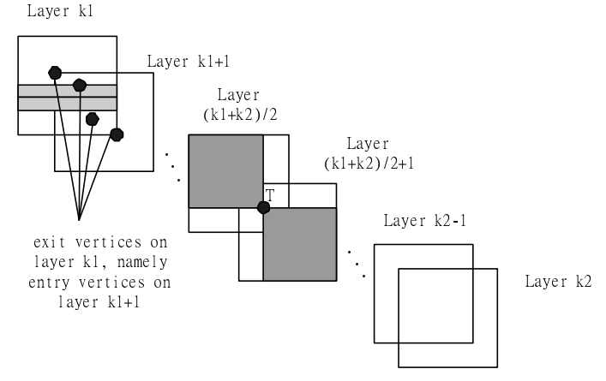
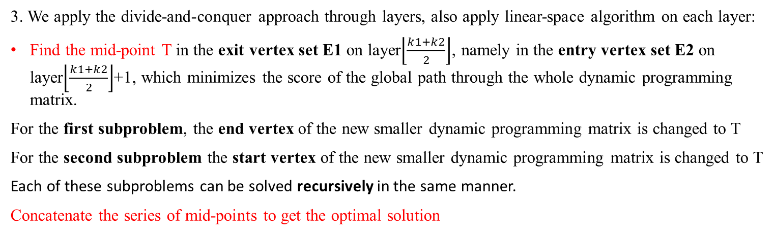
Improvement algorithm
3. We apply the divide-and-conquer approach through layers, also apply linear-space algorithm on each layer:
Find the mid-point T in the exit vertex set E1 on layer$\left\lfloor \frac{k1+k2}{2}\right\rfloor$, namely in the entry vertex set E2 on layer$\left\lfloor \frac{k1+k2}{2}\right\rfloor$+1, which minimizes the score of the global path through the whole dynamic programming matrix.
For the first subproblem, the end vertex of the new smaller dynamic programming matrix is changed to T
For the second subproblem the start vertex of the new smaller dynamic programming matrix is changed to T
Each of these subproblems can be solved recursively in the same manner.
Concatenate the series of mid-points to get the optimal solution

Slide 9
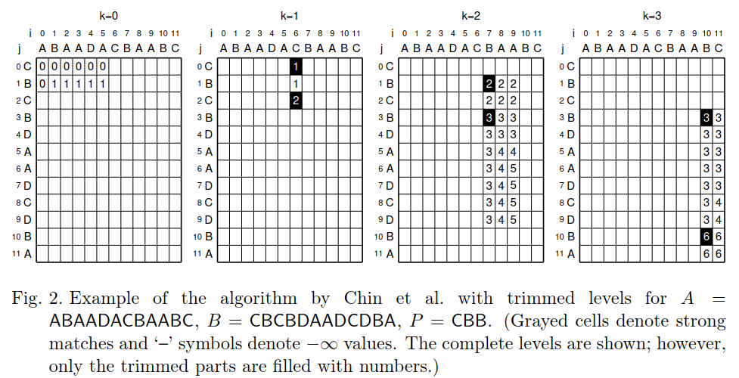
Improvement algorithm

Slide 10
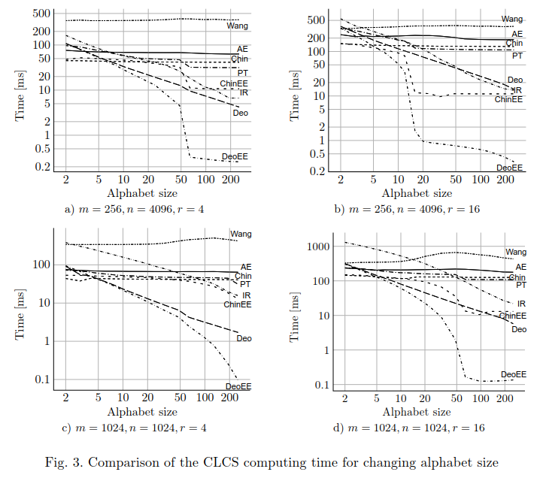
Experimental result

Slide 11
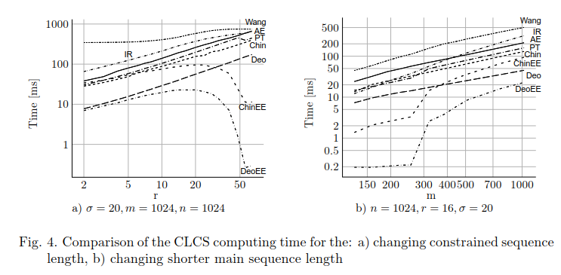
Experimental result

Slide 12
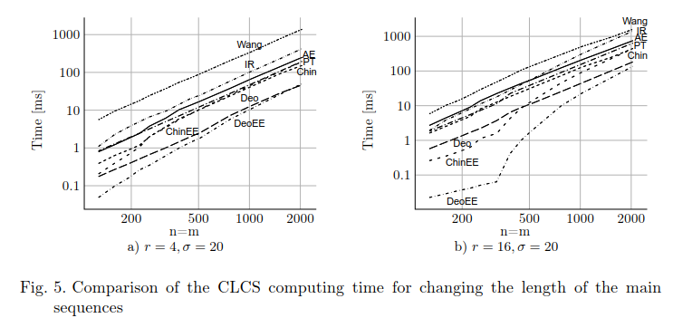
Experimental result

