Slide 1
Remarks on the Analytic Hierarchy Process
Management Science Volume 36 Issue 3 pp. 249-258
March 1990
James S. Dyer
Department of Management Science and Information Systems, The University of Texas
Presenter : Bo-Xian Chen
Date : 2017/2/14
Notes:
http://pubsonline.informs.org/doi/abs/10.1287/mnsc.36.3.249

Slide 2
Abstract (1/2)
The analytic hierarchy process (AHP) is flawed as a procedure for ranking alternatives in that the rankings produced by this procedure are arbitrary. This paper provides a brief review of several areas of operational difficulty with the AHP, and then focuses on the arbitrary rankings that occur when the principle of hierarchic composition is assumed.

Slide 3
Abstract (2/2)
This principle requires that the weights on the higher levels of a hierarchy can be determined independently of the weights on the lower levels. Virtually all of the published examples of the use of the AHP to evaluate alternatives relative to a set of criteria have assumed this principle. The key to correcting this flaw is the synthesis of the AHP with the concepts of multiattribute utility theory.

Slide 4
The Flaw of AHP - Rank Reversal
AHP所產生的排序是可變動的
 | C₁ | C₂ | C₃ | C₄
A₁ | 1 | 9 | 1 | 3
A₂ | 9 | 1 | 9 | 1
A₃ | 8 | 1 | 4 | 5
 | C₁ | C₂ | C₃ | C₄ | Score | Rank
A₁ | 1/18 | 9/11 | 1/14 | 3/9 | 0.320 | 3
A₂ | 9/18 | 1/11 | 9/14 | 1/9 | 0.336 | 2
A₃ | 8/18 | 1/11 | 4/14 | 5/9 | 0.344 | 1
 | C₁ | C₂ | C₃ | C₄
A₁ | 1 | 9 | 1 | 3
A₂ | 9 | 1 | 9 | 1
A₃ | 8 | 1 | 4 | 5
A₄ | 4 | 1 | 8 | 5
 | C₁ | C₂ | C₃ | C₄ | Score | Rank
A₁ | 1/22 | 9/12 | 1/22 | 3/14 | 0.264 | 1
A₂ | 9/22 | 1/12 | 9/22 | 1/14 | 0.243 | 4
A₃ | 8/22 | 1/12 | 4/22 | 5/14 | 0.246 | 2
A₄ | 4/22 | 1/12 | 8/22 | 5/14 | 0.246 | 2

Slide 5
The Resolution to Rank Reversal
Absolute Measurement
E.g. 一間公司評量員工的四個準則 Dependability、Education、experience 與 Quality
Dependability | Outstanding | Above Average | Average | Below Average | Unsatisfactory | Priorities
Outstanding | 1.0 | 2.0 | 3.0 | 4.0 | 5.0 | 0.419
Above Average | 1/2 | 1.0 | 2.0 | 3.0 | 4.0 | 0.263
Average | 1/3 | 1/3 | 1.0 | 2.0 | 3.0 | 0.160
Below Average | 1/4 | 1/3 | 1/2 | 1.0 | 2.0 | 0.097
Unsatisfactory | 1/5 | 1/4 | 1/3 | 1/2 | 1.0 | 0.062

Slide 6
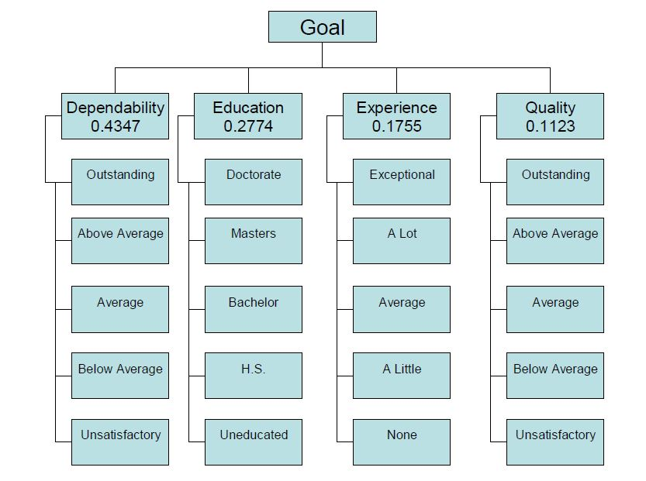
The Resolution to Rank Reversal

Slide 7
The Resolution to Rank Reversal
Dependability之 絕對測度 | Priorities | m(x) = max_{i}{x_{i}} | 正規化之 Priorities | 乘上Dependability 的權重 0.4347
Outstanding | 0.419 | 0.419 | 1.000 | 0.4347
Above Average | 0.263 |  | 0.626 | 0.2721
Average | 0.160 |  | 0.385 | 0.1674
Below Average | 0.097 |  | 0.231 | 0.1004
Unsatisfactory | 0.062 |  | 0.148 | 0.0643

Slide 8
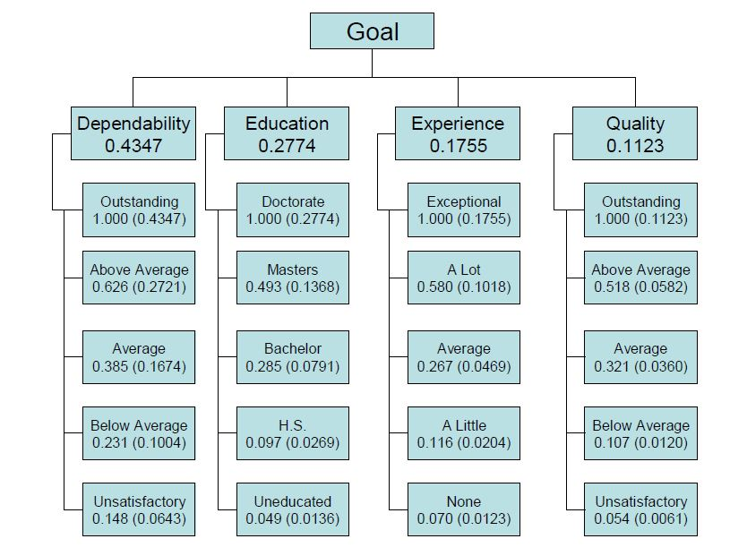
The Resolution to Rank Reversal

Slide 9
The Resolution to Rank Reversal
Goal | Dependability | Education | Experience | Quality
Adams, V | Outstanding | Bachelor | A Little | Outstanding
Becker, L | Average | Bachelor | A Little | Outstanding
Hayat, F | Average | Masters | A lot | Below Average
Kesselman, S | Above Average | H.S. | None | Above Average
Goal | Dependability 0.4347 | Education 0.2774 | Experience 0.1755 | Quality 0.1123 | 權重 | 排序
Adams, V | 0.4347 | 0.0791 | 0.0204 | 0.1123 | 0.6465 | 1
Becker, L | 0.1674 | 0.0791 | 0.0204 | 0.1123 | 0.3792 | 3
Hayat, F | 0.1674 | 0.1368 | 0.0120 | 0.418 | 0.418 | 2
Kesselman, S | 0.2721 | 0.0269 | 0.0582 | 0.3695 | 0.3695 | 4

Slide 10
The Resolution to Rank Reversal
Goal | Dependability | Education | Experience | Quality
O’Shea, K | Average | Doctorate | A Lot | Above
Peters, T | Average | Doctorate | A Lot | Average
Goal | Dependability 0.4347 | Education 0.2774 | Experience 0.1755 | Quality 0.1123 | 權重 | 排序
Adams, V | 0.4347 | 0.0791 | 0.0204 | 0.1123 | 0.6465 | 1
Becker, L | 0.1674 | 0.0791 | 0.0204 | 0.1123 | 0.3792 | 5
Hayat, F | 0.1674 | 0.1368 | 0.0120 | 0.418 | 0.418 | 4
Kesselman, S | 0.2721 | 0.0269 | 0.0582 | 0.3695 | 0.3695 | 6
O’Shea, K | 0.1674 | 0.2774 | 0.1018 | 0.0582 | 0.6048 | 2
Peters, T | 0.1674 | 0.2774 | 0.1018 | 0.0360 | 0.5826 | 3

Slide 12
AHP
建立層次結構模型
成對比較矩陣
計算權重並做一致性檢驗

