Slide 1
Decision making with the analytic
hierarchy process
Thomas L. Saaty
International Journal of Services Sciences, Vol. 1, No. 1, 2008
Presenter: Hsiu-Chieh Hung
Date: 2017/2/14

Slide 2
Abstract
Decisions involve many intangibles that need to be traded off. To do that, they have to be measured along side tangibles whose measurements must also be evaluated as to, how well, they serve the objectives of the decision maker. The Analytic Hierarchy Process (AHP) is a theory of measurement through pairwise comparisons and relies on the judgements of experts to derive priority scales. It is these scales that measure intangibles in relative terms. The comparisons are made using a scale of absolute judgements that represents, how much more, one element dominates another with respect to a given attribute. The judgements may be inconsistent, and how to measure inconsistency and improve the judgements, when possible to obtain better consistency is a concern of the AHP. The derived priority scales are synthesised by multiplying them by the priority of their parent nodes and adding for all such nodes. An illustration is included.

Slide 3
第一層
最終目標
第二層
評估項目1
評估項目2
評估項目3
評估項目4
.
.
.
.
.
.
第n層
方案1
方案2
方案3
方案4

Slide 4
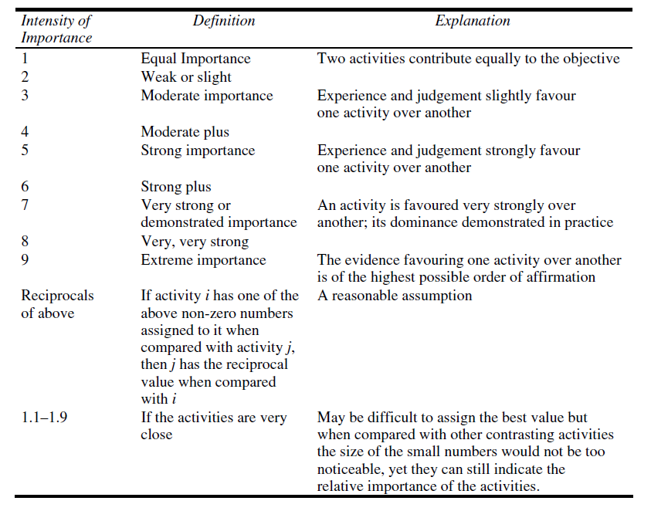

Slide 5
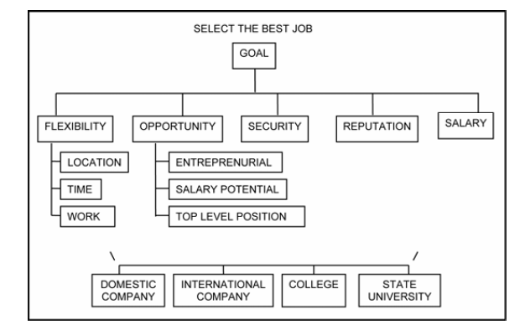

Slide 6
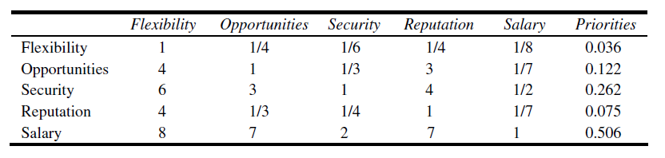
對GOAL來說
23 11.58 3.75 15.25 1.91
 | Flexibility | Opportunities | Security | Reputation | Salary
Flexibility | 0.043 | 0.022 | 0.044 | 0.016 | 0.065
Opportunities | 0.174 | 0.086 | 0.089 | 0.197 | 0.075
Security | 0.261 | 0.259 | 0.267 | 0.262 | 0.261
Reputation | 0.174 | 0.029 | 0.067 | 0.066 | 0.075
Salary | 0.348 | 0.604 | 0.533 | 0.459 | 0.524
0.038
0.124
0.262
0.082
0.493

Slide 8
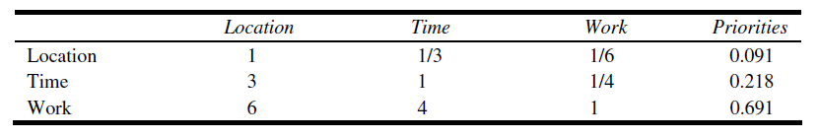
對Flexibility來說
10 5.33 1.42
 | Location | Time | Work
Location | 0.1 | 0.063 | 0.117
Time | 0.3 | 0.188 | 0.176
Work | 0.6 | 0.75 | 0.704
0.093
0.221
0.685

Slide 10
對Salary Potential來說
 | Domestic company | International company | College | State University | Priorities
Domestic company
Int’l company
College
State University

Slide 11
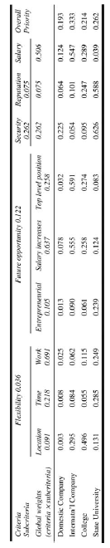

Slide 12
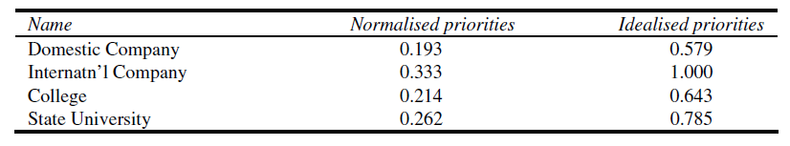

Slide 13
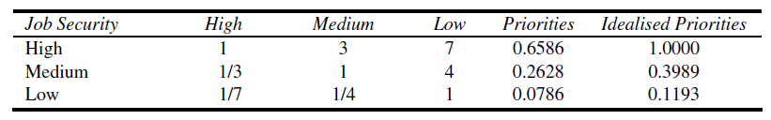
The ratings mode

Slide 14
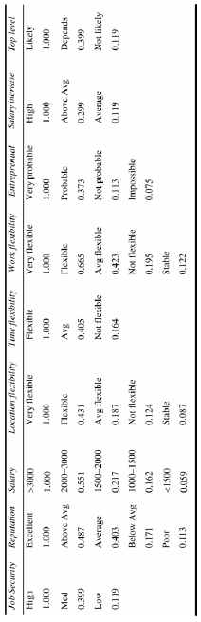

Slide 15
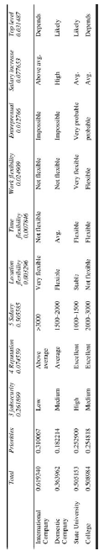
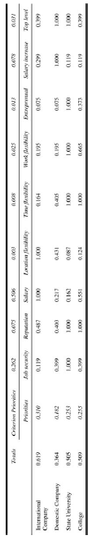
1.997

Slide 16
