Slide 1
How to make a decision: The Analytic Hierarchy Process
Thomas L. Saaty
European Journal of Operational Research
Volume 48, Issue 1, 5 September 1990, Pages 9–26
Presenter : Shie-Yan Lee
2017/2/14

Slide 2
Abstract
This paper serves as an introduction to the Analytic Hierarchy Process – A multicriteria decision making approach in which factors are arranged in a hierarchic structure. The principles and the philosophy of the theory are summarized giving general background information of the type of measurement utilized, its properties and applications.

Slide 3



Analytic Hierarchy Process
Overall Goal
$$level 0$$
Criteria
Criteria
Criteria
Criteria
Criteria
$$level 1$$
Choice
Choice
Choice
$$level 2$$

Slide 4
Relative Measurement
Satisfaction with house
Size of house
Transportation
Neighborhood
Age of house
Yard space
Modern facilities
General Condition
Financing
House A
House B
House C

Slide 5
Relative Measurement
Satisfaction with house
Size of house
Transportation
Age of house
Financing
House A
House B
House C

Slide 6
Paired Comparison
Importance | Definition
1 | Equal importance
3 | Moderate importance of one over another
5 | Essential or strong importance
7 | Very strong importance
9 | Extreme importance
2,4,6,8 | Intermediate values between the two adjacent judgments

Slide 7
Relative Measurement
Satisfaction with house
1
2
3
4
Size of house
Transportation
Age of house
Financing
House A
House B
House C

Slide 8
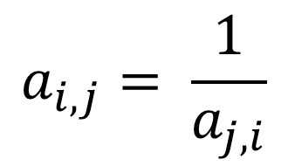
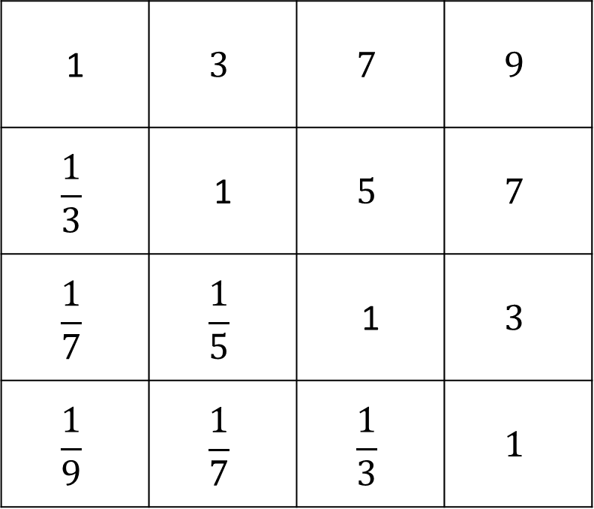
Comparison Matrix for criteria
1
2
3
4
$$a_{i,j}= \frac{1}{a_{j,i}}$$
1 | $$3$$ | $$7$$ | $$9$$
$$\frac{1}{3}$$ | 1 | $$5$$ | $$7$$
$$\frac{1}{7}$$ | $$\frac{1}{5}$$ | 1 | $$3$$
$$\frac{1}{9}$$ | $$\frac{1}{7}$$ | $$\frac{1}{3}$$ | $$1$$
1
2
3
4

Slide 9
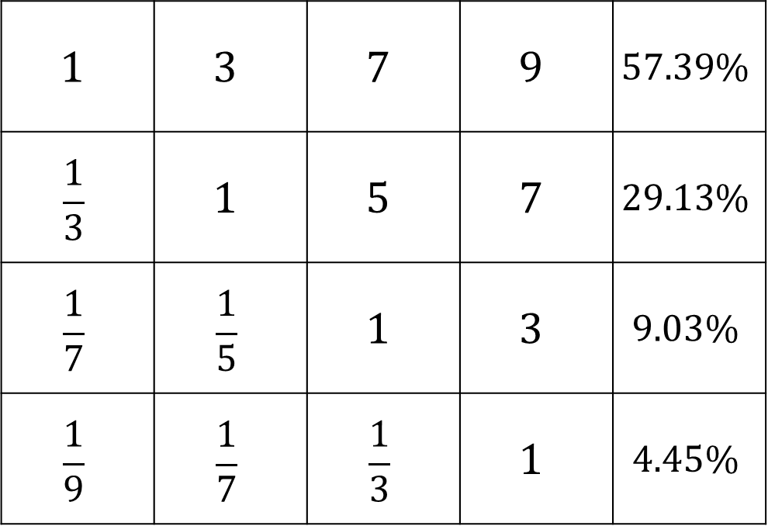
Comparison Matrix for criteria
1
2
3
4
Priority
Vector
$$1$$ | $$3$$ | $$7$$ | $$9$$ | $$57.39\%$$
$$\frac{1}{3}$$ | $$1$$ | $$5$$ | $$7$$ | $$29.13\%$$
$$\frac{1}{7}$$ | $$\frac{1}{5}$$ | $$1$$ | $$3$$ | $$9.03\%$$
$$\frac{1}{9}$$ | $$\frac{1}{7}$$ | $$\frac{1}{3}$$ | $$1$$ | $$4.45\%$$
1
2
3
4

Slide 10
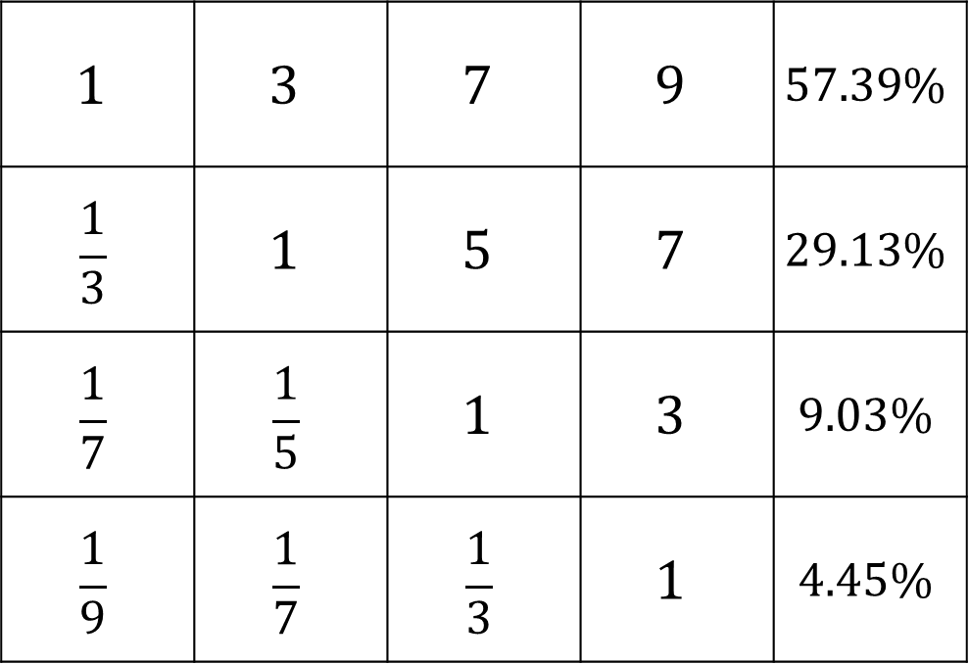
1
2
3
4
Priority
Vector
$$1$$ | $$3$$ | $$7$$ | $$9$$ | $$57.39\%$$
$$\frac{1}{3}$$ | $$1$$ | $$5$$ | $$7$$ | $$29.13\%$$
$$\frac{1}{7}$$ | $$\frac{1}{5}$$ | $$1$$ | $$3$$ | $$9.03\%$$
$$\frac{1}{9}$$ | $$\frac{1}{7}$$ | $$\frac{1}{3}$$ | $$1$$ | $$4.45\%$$
1
2
3
4

Slide 11
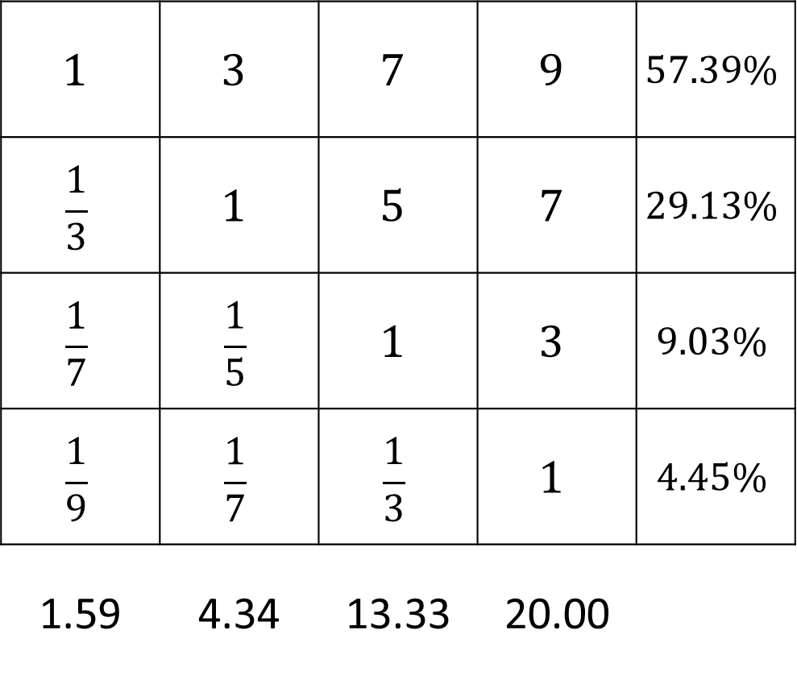
1
2
3
4
Priority
Vector
$$1$$ | $$3$$ | $$7$$ | $$9$$ | $$57.39\%$$
$$\frac{1}{3}$$ | $$1$$ | $$5$$ | $$7$$ | $$29.13\%$$
$$\frac{1}{7}$$ | $$\frac{1}{5}$$ | $$1$$ | $$3$$ | $$9.03\%$$
$$\frac{1}{9}$$ | $$\frac{1}{7}$$ | $$\frac{1}{3}$$ | $$1$$ | $$4.45\%$$
1.59 | 4.34 | 13.33 | 20.00
1
2
3
4
sum
$$λ_{max}=0.5739∗1.59+0.2913∗4.34+0.1333∗9.03+0.0445∗20=4.2692$$

Slide 12
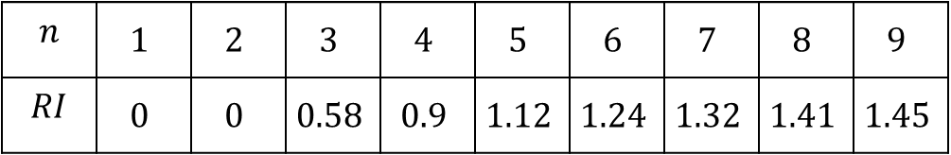





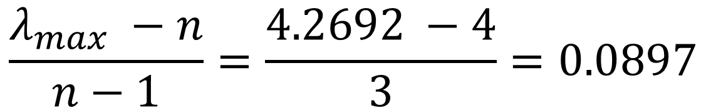
$$λ_{max}=4.2692$$
Consistency index ( $CI$ )
$$\frac{λ_{max} −n}{n−1}=\frac{4.2692 −4}{3}=0.0897$$
Random Consistency Index( $RI$ )
$$n$$ | $$1$$ | $$2$$ | $$3$$ | $$4$$ | $$5$$ | $$6$$ | $$7$$ | $$8$$ | $$9$$
$$RI$$ | $$0$$ | $$0$$ | $$0.58$$ | $$0.9$$ | $$1.12$$ | $$1.24$$ | $$1.32$$ | $$1.41$$ | $$1.45$$
Consistency ratio ( $CR$ )
$$\frac{CI}{RI}=\frac{0.0897}{0.9}=0.0997<10\%$$

Slide 13
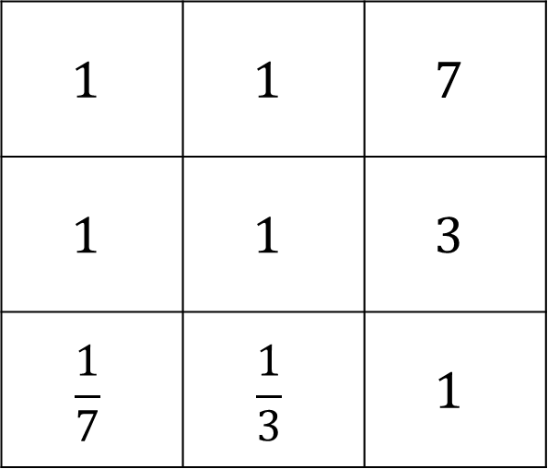
Comparison Matrices and local priorities
1
Size of house
A
B
C
$$1$$ | $$1$$ | $$7$$
$$1$$ | $$1$$ | $$3$$
$$\frac{1}{7}$$ | $$\frac{1}{3}$$ | $$1$$
A
B
C

Slide 14
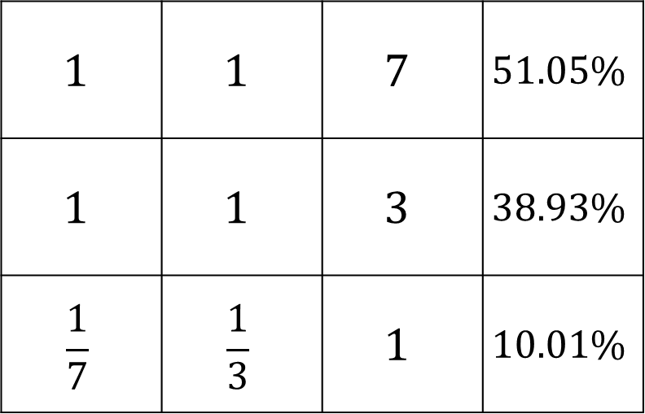
Comparison Matrices and local priorities
1
Size of house
Priority
Vector
A
B
C
$$1$$ | $$1$$ | $$7$$ | $$51.05\%$$
$$1$$ | $$1$$ | $$3$$ | $$38.93\%$$
$$\frac{1}{7}$$ | $$\frac{1}{3}$$ | $$1$$ | $$10.01\%$$
A
B
C

Slide 15
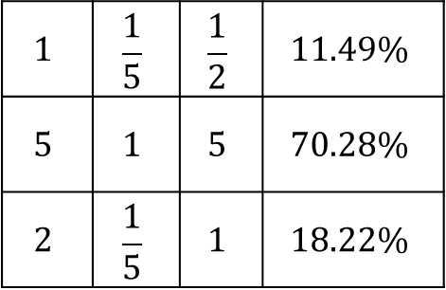
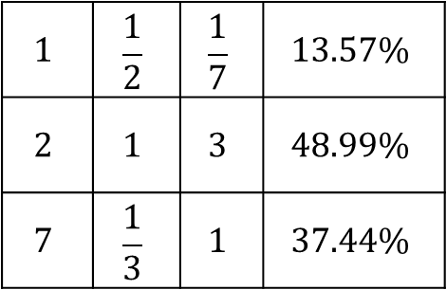
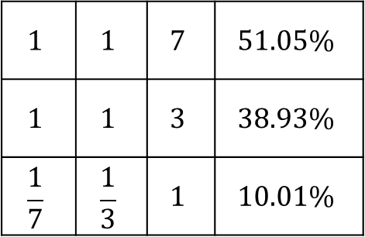
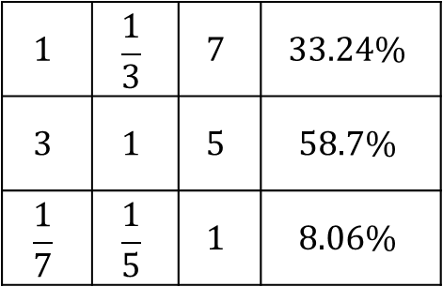
Size of house
Transportation
A
B
C
Priority
Vector
Priority
Vector
A
B
C
A
$$1$$ | $$1$$ | $$7$$ | $$51.05\%$$
$$1$$ | $$1$$ | $$3$$ | $$38.93\%$$
$$\frac{1}{7}$$ | $$\frac{1}{3}$$ | $$1$$ | $$10.01\%$$
A
$$1$$ | $$\frac{1}{5}$$ | $$\frac{1}{2}$$ | $$11.49\%$$
$$5$$ | $$1$$ | $$5$$ | $$70.28\%$$
$$2$$ | $$\frac{1}{5}$$ | $$1$$ | $$18.22\%$$
B
B
C
C
Age of house
Financing
A
B
C
Priority
Vector
A
B
C
Priority
Vector
A
$$1$$ | $$\frac{1}{3}$$ | $$7$$ | $$33.24\%$$
$$3$$ | $$1$$ | $$5$$ | $$58.7\%$$
$$\frac{1}{7}$$ | $$\frac{1}{5}$$ | $$1$$ | $$8.06\%$$
A
$$1$$ | $$\frac{1}{2}$$ | $$\frac{1}{7}$$ | $$13.57\%$$
$$2$$ | $$1$$ | $$3$$ | $$48.99\%$$
$$7$$ | $$\frac{1}{3}$$ | $$1$$ | $$37.44\%$$
B
B
C
C

Slide 16
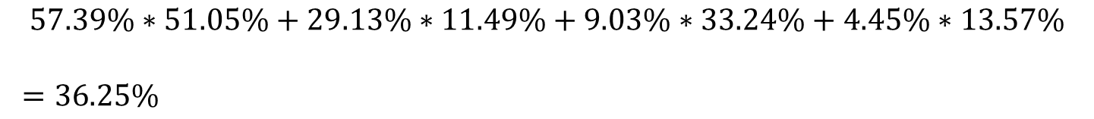
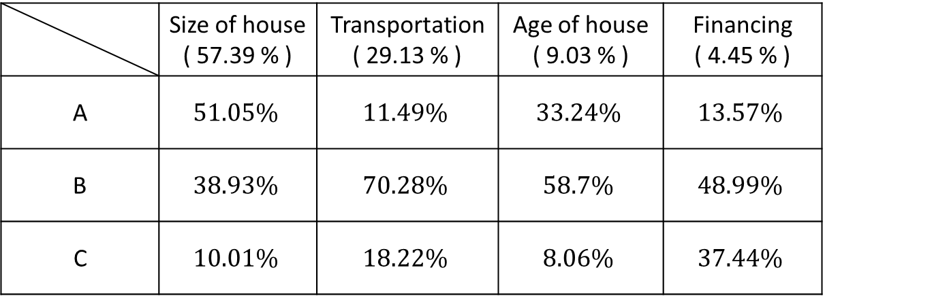
Global priorities
 | Size of house ( 57.39 % ) | Transportation ( 29.13 % ) | Age of house ( 9.03 % ) | Financing ( 4.45 % )
A | $$51.05\%$$ | $$11.49\%$$ | $$33.24\%$$ | $$13.57\%$$
B | $$38.93\%$$ | $$70.28\%$$ | $$58.7\%$$ | $$48.99\%$$
C | $$10.01\%$$ | $$18.22\%$$ | $$8.06\%$$ | $$37.44\%$$
$$57.39\%∗51.05\%+29.13\%∗11.49\%+9.03\%∗33.24\%+4.45\%∗13.57\%$$
$=36.25\%$

Slide 17
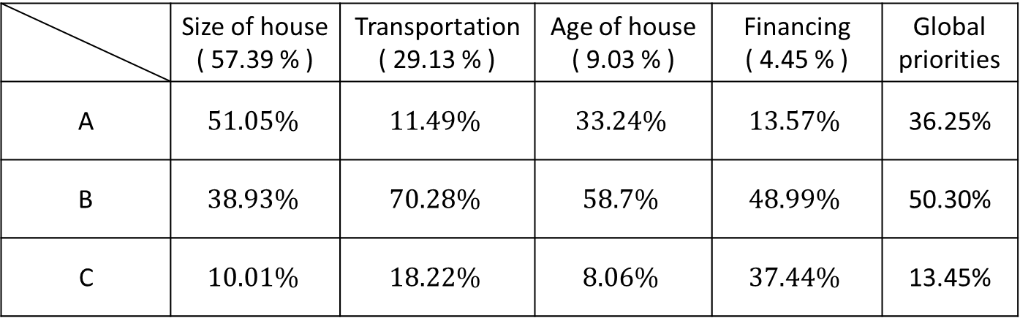
Global priorities
 | Size of house ( 57.39 % ) | Transportation ( 29.13 % ) | Age of house ( 9.03 % ) | Financing ( 4.45 % ) | Global priorities
A | $$51.05\%$$ | $$11.49\%$$ | $$33.24\%$$ | $$13.57\%$$ | 36.25%
B | $$38.93\%$$ | $$70.28\%$$ | $$58.7\%$$ | $$48.99\%$$ | 50.30%
C | $$10.01\%$$ | $$18.22\%$$ | $$8.06\%$$ | $$37.44\%$$ | 13.45%

Slide 18
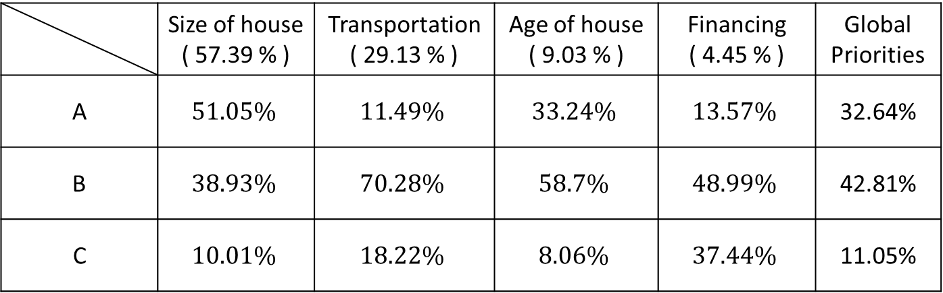
Global priorities
 | Size of house ( 57.39 % ) | Transportation ( 29.13 % ) | Age of house ( 9.03 % ) | Financing ( 4.45 % ) | Global Priorities
A | $$51.05\%$$ | $$11.49\%$$ | $$33.24\%$$ | $$13.57\%$$ | 32.64%
B | $$38.93\%$$ | $$70.28\%$$ | $$58.7\%$$ | $$48.99\%$$ | 42.81%
C | $$10.01\%$$ | $$18.22\%$$ | $$8.06\%$$ | $$37.44\%$$ | 11.05%

Slide 19
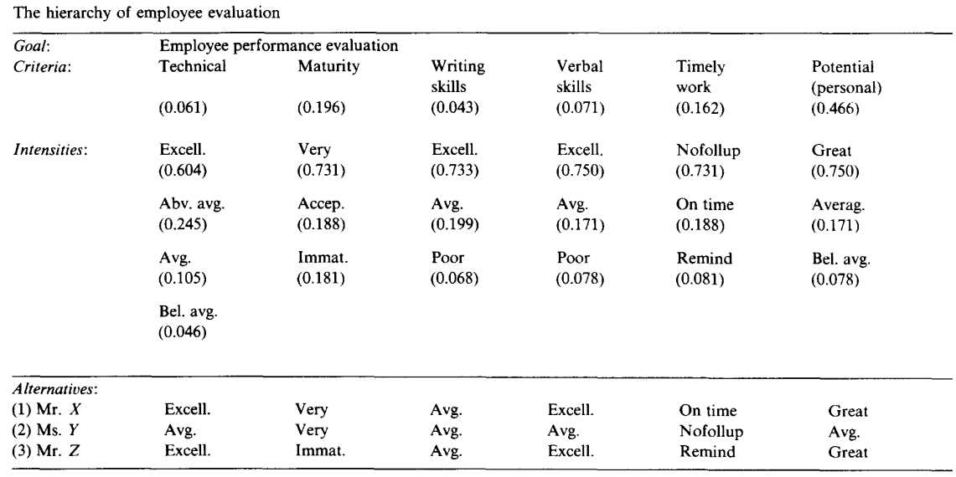
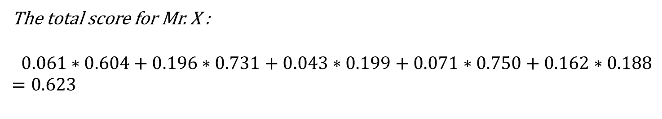
Absolute measurement
The total score for Mr. X :
$$0.061∗0.604+0.196∗0.731+0.043∗0.199+0.071∗0.750+0.162∗0.188$$
$$=0.623$$

Slide 20
The Catastrophe hierarchy
GOAL
NORMAL
(0.990)
ACCIDENT
(0.010)
SIZE
(0.051)
OPERCOST
(0.135)
SYTLE
(0.269)
LOWPRICE
(0.535)
OLDWRECK
(0.002)
CHEVY
(0.009)
HONDA
(0.013)
TOYOTA
(0.026)

Slide 21
The Catastrophe hierarchy
GOAL
NORMAL
(0.990)
ACCIDENT
(0.010)
Priorities
TOYOTA | 0.408
HONDA | 0.345
CHEVY | 0.197
OLDWRECK | 0.049
Priorities
TOYOTA | 0.142
HONDA | 0.115
CHEVY | 0.166
OLDWRECK | 0.576

