Slide 1
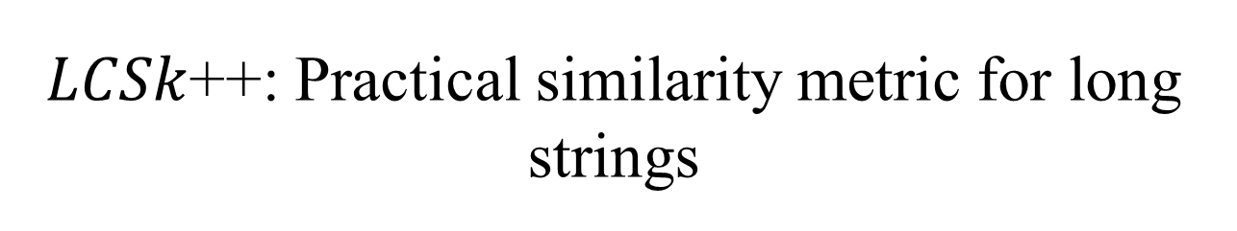
$LCSk$++: Practical similarity metric for long strings
Filip Pavetić, Goran Žužić, and Mile Šikić
arXiv, Data Structures and Algorithms, 2014
Presenter: Bi-Shiang Lin
Date:2017/2/21

Slide 2
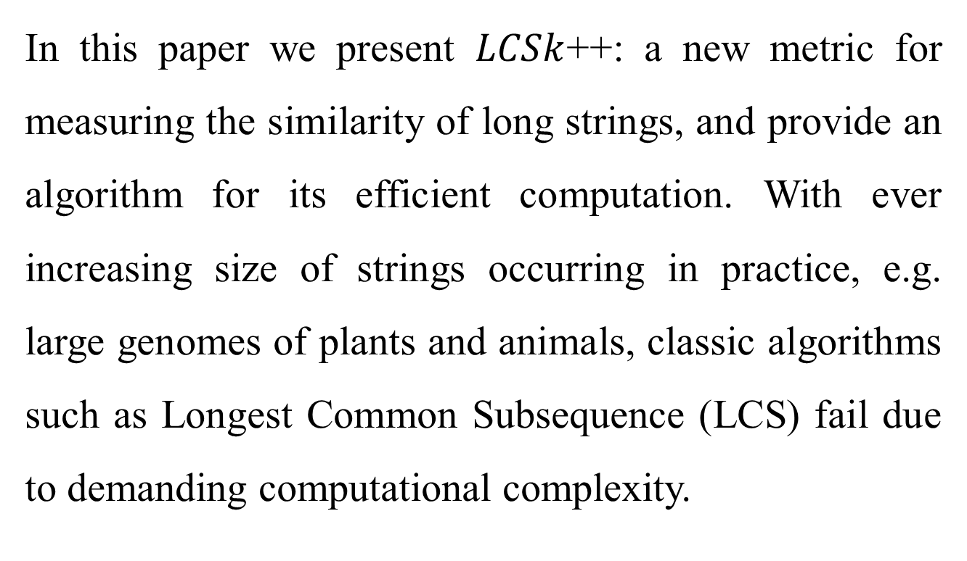
Abstract(1/3)
In this paper we present $LCSk$++: a new metric for measuring the similarity of long strings, and provide an algorithm for its efficient computation. With ever increasing size of strings occurring in practice, e.g. large genomes of plants and animals, classic algorithms such as Longest Common Subsequence (LCS) fail due to demanding computational complexity.

Slide 3
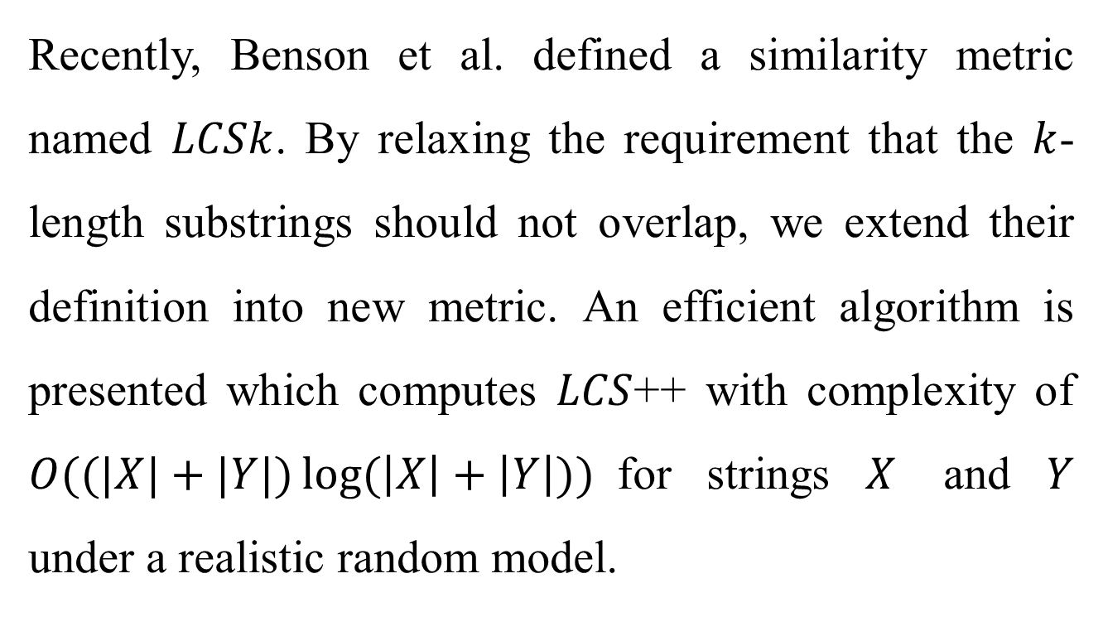
Abstract(2/3)
Recently, Benson et al. defined a similarity metric named $LCSk$. By relaxing the requirement that the $k$-length substrings should not overlap, we extend their definition into new metric. An efficient algorithm is presented which computes $LCS$++ with complexity of $O((|X|+|Y|)\log{(\left|X\right|+\left|Y\right|)})$for strings $X$ and $Y$ under a realistic random model.

Slide 4
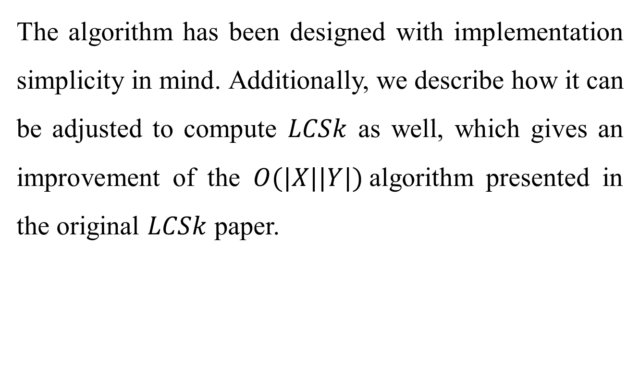
Abstract(3/3)
The algorithm has been designed with implementation simplicity in mind. Additionally, we describe how it can be adjusted to compute $LCSk$ as well, which gives an improvement of the $O(|X||Y|)$algorithm presented in the original $LCSk$ paper.

Slide 5
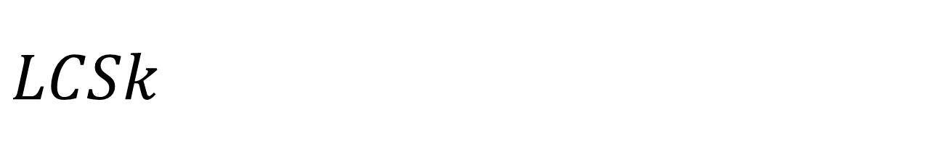
$$LCSk$$
X = ABCCACAB
Y = BABCCCAB
LCS3(X,Y) = 2 ( ABC CAB )
---------------------------
X = ABCBA
Y = ABCBA
Z = ABCDE
LCS3(X,Y) = 1 ( ABC )
LCS3(X,Z) = 1 ( ABC )

Slide 6
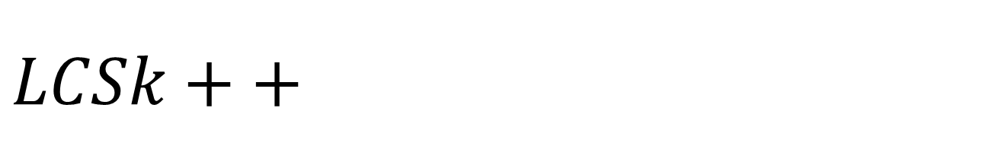
$$LCSk++$$
X = ABCCACAB
Y = BABCCCAB
LCS3++(X,Y) = 7 ( ABCC CAB )
---------------------------
X = ABCBA
Y = ABCBA
Z = ABCDE
LCS3++(X,Y) = 5 ( ABCDE )
LCS3++(X,Z) = 3 ( ABC )

Slide 7
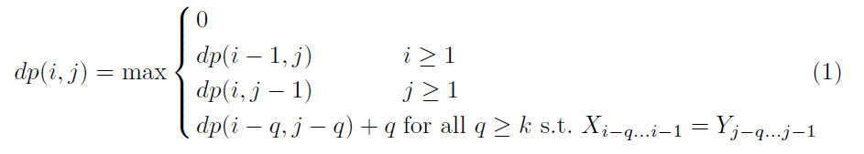

Basic dynamic programming
$O(nm∙min⁡(n,m))$

Slide 8
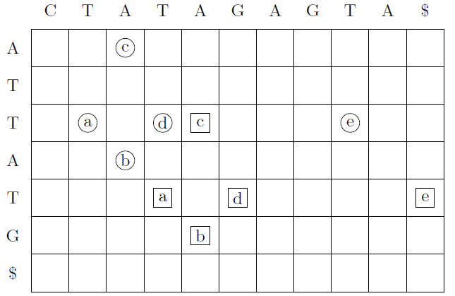
Two types of match pairs
e precedes c
b continues a

Slide 9
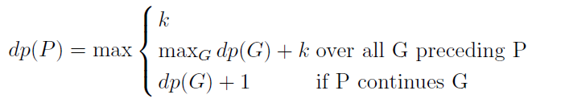
Two types of match pairs

Slide 10
Two types of match pairs
0 | 0 | 0 | 0 | 0 | 0 | 0 | 0 | 0 | 0 | 0
dp(c)=2 dp(a)=2 dp(d)=2

Slide 11
Two types of match pairs
0 | 0 | 0 | 0 | 2 | 0 | 0 | 0 | 0 | 0 | 0
dp(c)=2

Slide 12
Two types of match pairs
0 | 0 | 0 | 0 | 2 | 0 | 0 | 0 | 0 | 0 | 0
dp(e)=2+2=4

Slide 13
Two types of match pairs
0 | 0 | 0 | 2 | 2 | 0 | 0 | 0 | 0 | 0 | 0
dp(a)=2

Slide 14
Two types of match pairs
0 | 0 | 0 | 3 | 3 | 2 | 0 | 0 | 0 | 0 | 4
dp(b)=max(dp(b),dp(a)+1)=3

Slide 15
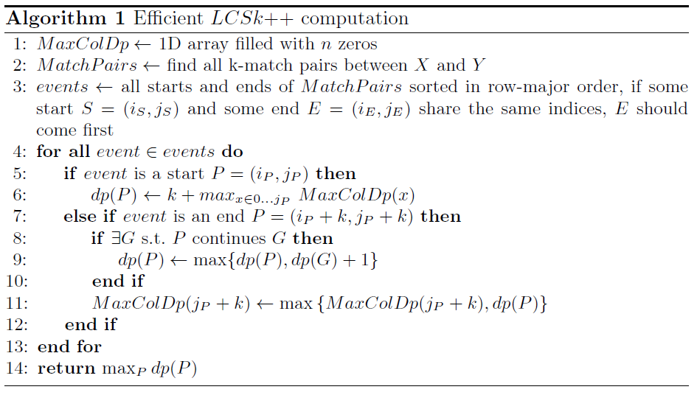

Algorithm
$O\left(m+n+r\log{r}+r\log{n}\right) time$

Slide 16
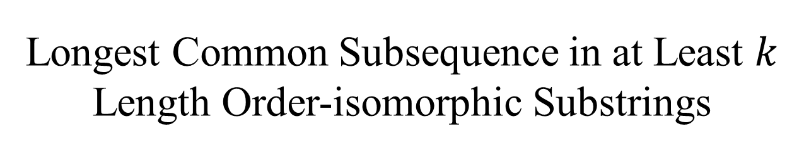
Longest Common Subsequence in at Least $k$ Length Order-isomorphic Substrings
Yohei Ueki, Diptarama, Masatoshi Kurihara, Yoshiaki Matsuoka, Kazuyuki Narisawa, Ryo Yoshinaka, Hideo Bannai, Shunsuke Inenaga, and Ayumi Shinohara
43rd International Conference on Current Trends in Theory and Practice of Informatics, Limerick, Ireland, 2017, pp. 363-374
Presenter: Bi-Shiang Lin
Date:2017/2/21

Slide 17
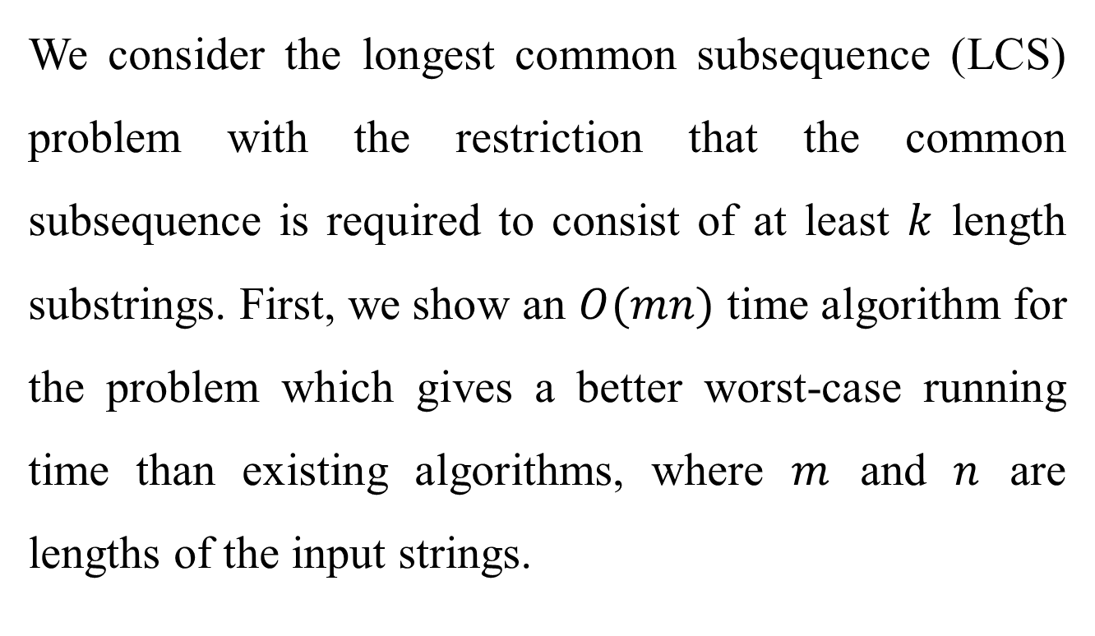
Abstract(1/2)
We consider the longest common subsequence (LCS) problem with the restriction that the common subsequence is required to consist of at least $k$ length substrings. First, we show an $O(mn)$ time algorithm for the problem which gives a better worst-case running time than existing algorithms, where $m$ and $n$ are lengths of the input strings.

Slide 18
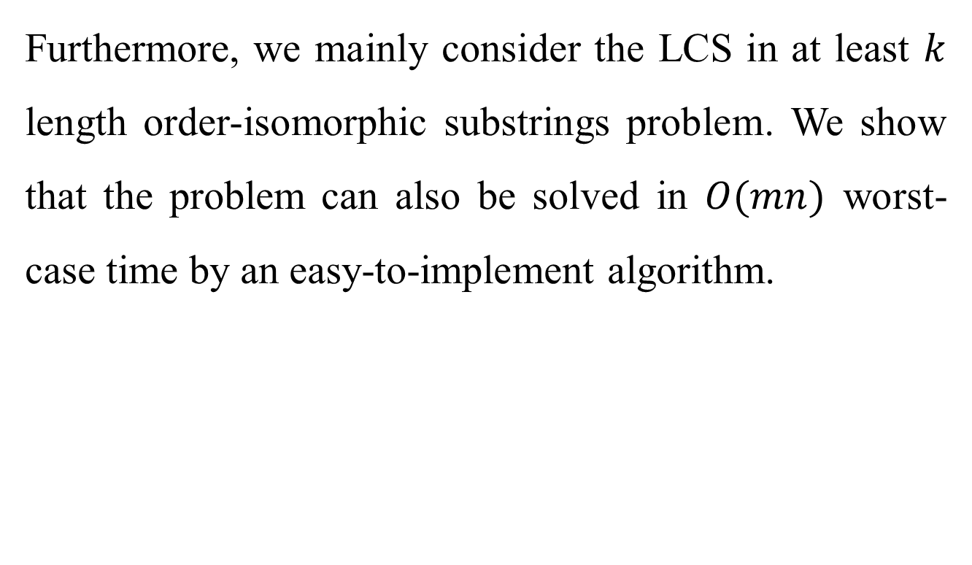
Abstract(2/2)
Furthermore, we mainly consider the LCS in at least $k$ length order-isomorphic substrings problem. We show that the problem can also be solved in $O(mn)$ worst-case time by an easy-to-implement algorithm.

Slide 19
op-LCSk+
X = (14,84,82,31,74,68,87,11,20,32)
Y = (21,64,2,83,73,51,5,29,7,71)
Z = (1,3,2,31,74,68,87)
satisfy before concatenation

Slide 20
LCSk+
k=3 |  |  | a | b | c | b | c | d | e | f
 |  | 0 | 1 | 2 | 3 | 4 | 5 | 6 | 7 | 8
 | 0
a | 1 |  | 1
b | 2 |  |  | 2 |  | 1
c | 3 |  |  |  | 3 |  | 2
d | 4 |  |  |  |  |  |  | 3
e | 5 |  |  |  |  |  |  |  | 4
f | 6 |  |  |  |  |  |  |  |  | 5

Slide 21
LCSk+
k=3 |  |  | a | b | c | b | c | d | e | f
 |  | 0 | 1 | 2 | 3 | 4 | 5 | 6 | 7 | 8
 | 0 | 0 | 0 | 0 | 0 | 0 | 0 | 0 | 0 | 0
a | 1 | 0 | 0 | 0 | 0 | 0 | 0 | 0 | 0 | 0
b | 2 | 0 | 0 | 0 | 0 | 0 | 0 | 0 | 0 | 0
c | 3 | 0 | 0 | 0 | 3 3 | 3 -1
d | 4
e | 5
f | 6

Slide 22
LCSk+
k=3 |  |  | a | b | c | b | c | d | e | f
 |  | 0 | 1 | 2 | 3 | 4 | 5 | 6 | 7 | 8
 | 0 | 0 | 0 | 0 | 0 | 0 | 0 | 0 | 0 | 0
a | 1 | 0 | 0 | 0 | 0 | 0 | 0 | 0 | 0 | 0
b | 2 | 0 | 0 | 0 | 0 | 0 | 0 | 0 | 0 | 0
c | 3 | 0 | 0 | 0 | 3 | 3 | 3 | 3 | 3 | 3
d | 4 | 0 | 0 | 0 | 3 | 3 | 3 | 3 3 | 3 | 3
e | 5 | 0 | 0 | 0 | 3 | 3 | 3 | 3 | 4 4
f | 6 | 0 | 0 | 0 | 3 | 3 | 3 | 3

Slide 23
LCSk+
k=3
1
 | 2
 |  | 3
 |  |  | 4
 |  |  |  | 5

Slide 24
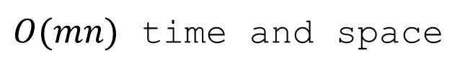
LCSk+
k=3 |  |  | a | b | c | b | c | d | e | f
 |  | 0 | 1 | 2 | 3 | 4 | 5 | 6 | 7 | 8
 | 0 | 0 | 0 | 0 | 0 | 0 | 0 | 0 | 0 | 0
a | 1 | 0 | 0 | 0 | 0 | 0 | 0 | 0 | 0 | 0
b | 2 | 0 | 0 | 0 | 0 | 0 | 0 | 0 | 0 | 0
c | 3 | 0 | 0 | 0 | 3 | 3 | 3 | 3 | 3 | 3
d | 4 | 0 | 0 | 0 | 3 | 3 | 3 | 3 | 3 | 3
e | 5 | 0 | 0 | 0 | 3 | 3 | 3 | 3 | 4 | 4
f | 6 | 0 | 0 | 0 | 3 | 3 | 3 | 3 | 4 | 6
$O(mn)$ time and space

Slide 25
op-LCSk+
X = (32,40,4,16,27)
Y = (28,32,12,20,25)
X’ = (32,40,4,16,27,41)
Y’ = (28,32,12,20,25,26)
How to achieve this query?

Slide 26

Z-table
$O(n\log{n})$ time to compute
total $O(n^{2}\log{n})$ time for op-LCSk+
by concatenate two strings.
i | 1 | 2 | 3 | 4 | 5 | 6 | 7 | 8
S[i] | 12 | 43 | 68 | 3 | 52 | 77 | 5 | 16
Z[i] | 6 | 1 | 0 | 3 | 1 | 0 | 1 | 0

Slide 27
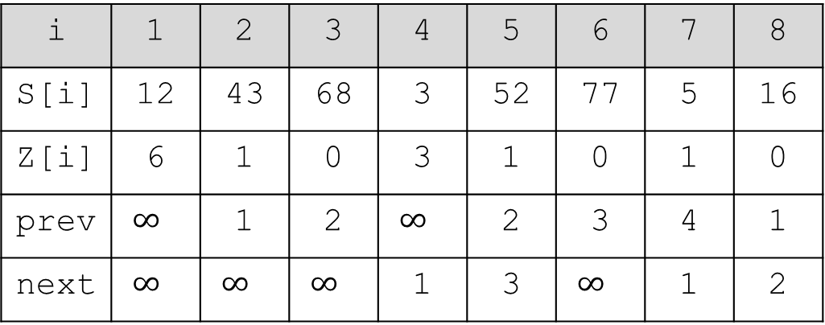
Z-table
i | 1 | 2 | 3 | 4 | 5 | 6 | 7 | 8
S[i] | 12 | 43 | 68 | 3 | 52 | 77 | 5 | 16
Z[i] | 6 | 1 | 0 | 3 | 1 | 0 | 1 | 0
prev | $$∞$$ | 1 | 2 | $$∞$$ | 2 | 3 | 4 | 1
next | $$∞$$ | $$∞$$ | $$∞$$ | 1 | 3 | $$∞$$ | 1 | 2
with prev and next calculated, Z can be calculated in O(n) time.

Slide 28
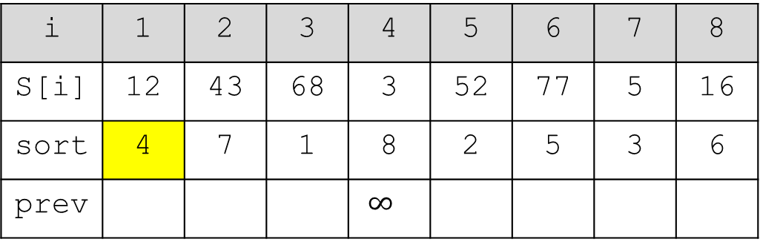
Prev array
i | 1 | 2 | 3 | 4 | 5 | 6 | 7 | 8
S[i] | 12 | 43 | 68 | 3 | 52 | 77 | 5 | 16
sort | 4 | 7 | 1 | 8 | 2 | 5 | 3 | 6
prev |  |  |  | $$∞$$
4

Slide 29
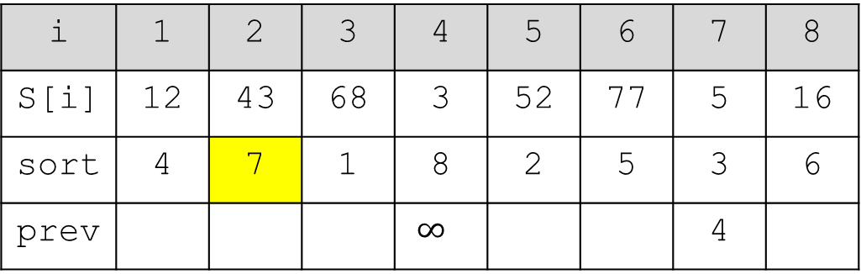
Prev array
i | 1 | 2 | 3 | 4 | 5 | 6 | 7 | 8
S[i] | 12 | 43 | 68 | 3 | 52 | 77 | 5 | 16
sort | 4 | 7 | 1 | 8 | 2 | 5 | 3 | 6
prev |  |  |  | $$∞$$ |  |  | 4
4
7
4

Slide 30
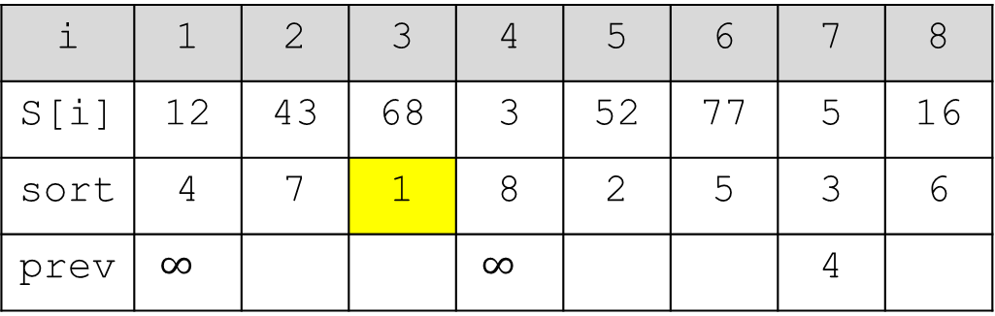
Prev array
i | 1 | 2 | 3 | 4 | 5 | 6 | 7 | 8
S[i] | 12 | 43 | 68 | 3 | 52 | 77 | 5 | 16
sort | 4 | 7 | 1 | 8 | 2 | 5 | 3 | 6
prev | $$∞$$ |  |  | $$∞$$ |  |  | 4
7
4
1

Slide 31
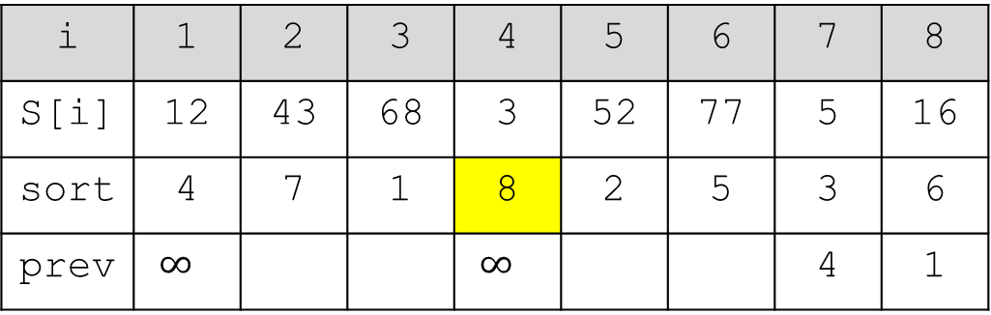
Prev array
i | 1 | 2 | 3 | 4 | 5 | 6 | 7 | 8
S[i] | 12 | 43 | 68 | 3 | 52 | 77 | 5 | 16
sort | 4 | 7 | 1 | 8 | 2 | 5 | 3 | 6
prev | $$∞$$ |  |  | $$∞$$ |  |  | 4 | 1
1
8
1

Slide 32
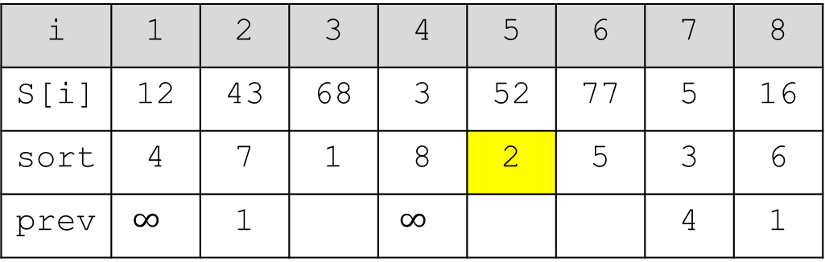
Prev array
i | 1 | 2 | 3 | 4 | 5 | 6 | 7 | 8
S[i] | 12 | 43 | 68 | 3 | 52 | 77 | 5 | 16
sort | 4 | 7 | 1 | 8 | 2 | 5 | 3 | 6
prev | $$∞$$ | 1 |  | $$∞$$ |  |  | 4 | 1
8
1
2
1

Slide 33
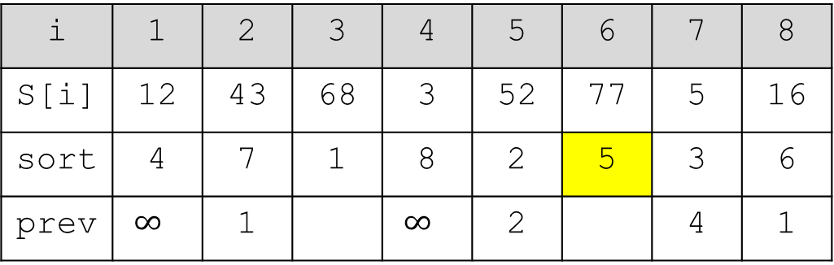
Prev array
i | 1 | 2 | 3 | 4 | 5 | 6 | 7 | 8
S[i] | 12 | 43 | 68 | 3 | 52 | 77 | 5 | 16
sort | 4 | 7 | 1 | 8 | 2 | 5 | 3 | 6
prev | $$∞$$ | 1 |  | $$∞$$ | 2 |  | 4 | 1
2
1
5
2
1

Slide 34
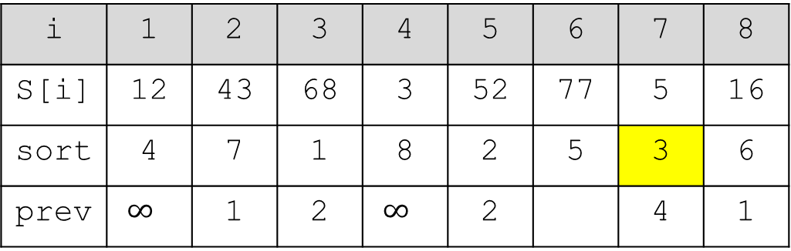
Prev array
i | 1 | 2 | 3 | 4 | 5 | 6 | 7 | 8
S[i] | 12 | 43 | 68 | 3 | 52 | 77 | 5 | 16
sort | 4 | 7 | 1 | 8 | 2 | 5 | 3 | 6
prev | $$∞$$ | 1 | 2 | $$∞$$ | 2 |  | 4 | 1
5
2
1
3
2
1

Slide 35
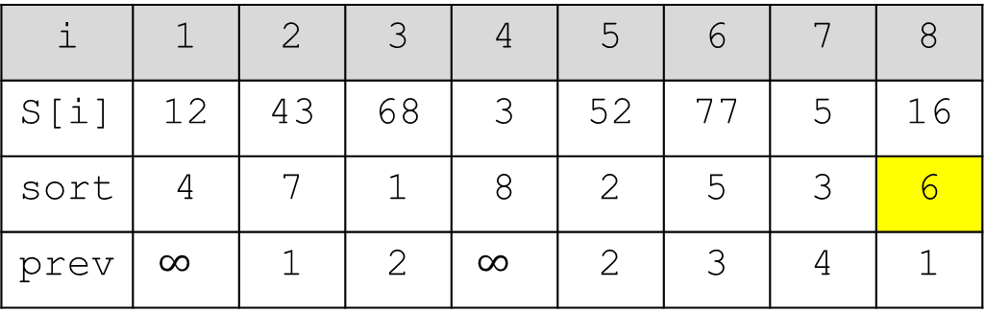
Prev array
i | 1 | 2 | 3 | 4 | 5 | 6 | 7 | 8
S[i] | 12 | 43 | 68 | 3 | 52 | 77 | 5 | 16
sort | 4 | 7 | 1 | 8 | 2 | 5 | 3 | 6
prev | $$∞$$ | 1 | 2 | $$∞$$ | 2 | 3 | 4 | 1
3
2
1
6
3
2
1

Slide 36
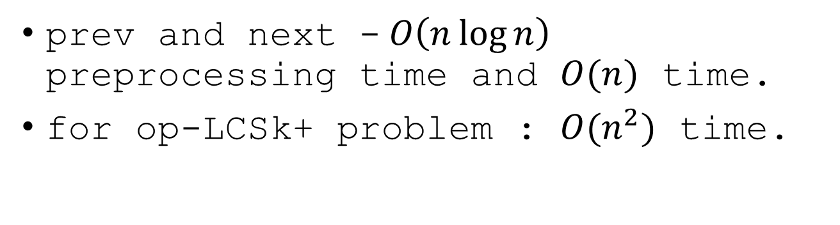
Z-table
i | 1 | 2 | 3 | 4 | 5 | 6 | 7 | 8
S[i] | 12 | 43 | 68 | 3 | 52 | 77 | 5 | 16
Z[i] | 6 | 1 | 0 | 3 | 1 | 0 | 1 | 0
prev | $$∞$$ | 1 | 2 | $$∞$$ | 2 | 3 | 4 | 1
next | $$∞$$ | $$∞$$ | $$∞$$ | 1 | 3 | $$∞$$ | 1 | 2
prev and next -$O\left(n\log{n}\right)$ preprocessing time and $O(n)$ time.
for op-LCSk+ problem : $O(n^{2})$ time.

Slide 37
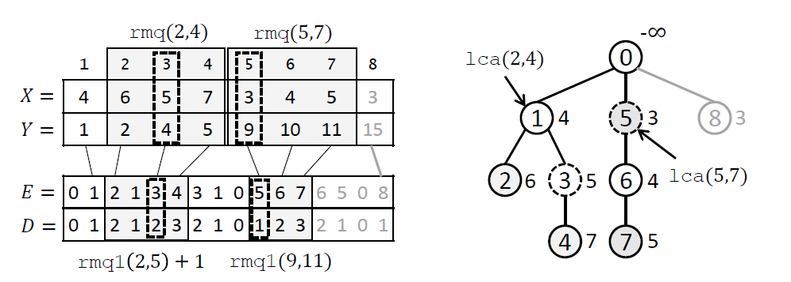

op-LCSk+
update and query : semi-dynamic range minimum query, total $O\left(n^{2}\right)$ time preprocessing.

Slide 38
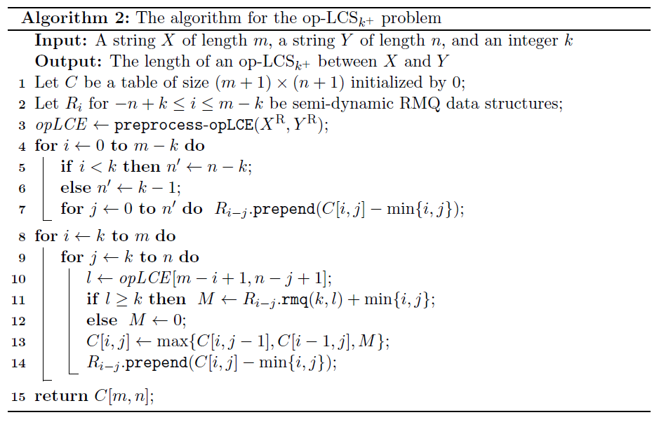
op-LCSk+
$O(mn)$ time and space

