Slide 1
A Space-Efficient Algorithm for the CPSA Problem
Dan He and Abdullah N. Arslan
Genome Informatics
Vol. 16, No. 2, pp.237-246, 2005
Presenter：Siang-Huai Hung
Date：2017/03/07

Slide 2
Abstract(1/2)
The constrained pairwise sequence alignment (CPSA) problem aims to align two given sequences by aligning their similar subsequences in the same region under the guidance of a given pattern (constraint). Let the lengths of the sequences be m, and n where n ≤ m, and let r ≤ n be the length of the given pattern. The optimum constrained pairwise alignment score can be computed using O(rn) space by a naive dynamic programming solution. If an optimal alignment path is desired then the space requirement of the naive dynamic programming algorithm is O(rnm). There is a divide-and-conquer algorithm that reduces the memory requirement of finding an optimal alignment for the CPSA problem to O(rn).

Slide 3
Abstract(2/2)
In this paper, we present a space-efficient CPSA algorithm that returns an optimal alignment. Our analysis on real protein sequences suggests that our algorithm requires only O(n) space in practice. This algorithm is not only space efficient but also very fast. A generalization of the CPSA problem for multiple sequences is called the constrained multiple sequence alignment (CMSA) problem. Our CPSA algorithm also improves the space requirement
of progressive CMSA algorithms that use solutions of CPSA problems.

Slide 4
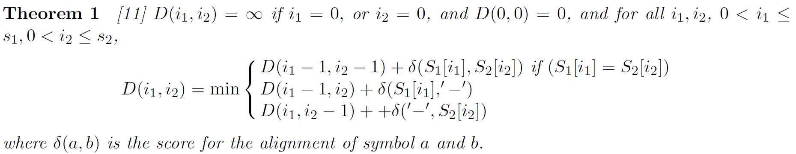

Pairwise Sequence Alignment(PSA)
Given two sequences S₁, S₂ with lengths $n ≤ m,$ respectively, the $pairwise sequence alignment$ (PSA) problem is to find the optimum alignment score for these two sequences. The problem can be solved according to the following recurrence:
It requires $O\left(nm\right)$ time and $O(n)$ space since at one time we only need to record the current row, the preceding row, and after every iterations the current row is moved onto the preceding row.

Slide 5
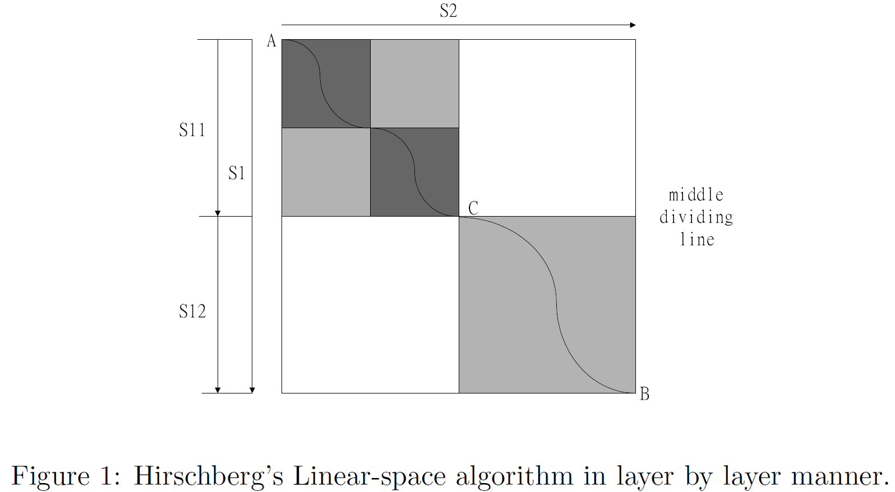

Hirschberg’s Optimal Solution of PSA
Solving the PSA problem in $O(n)$ space by binary-recursion.
Computing mid-point of an optimal alignment along one string whose length is $m$, and recursing on the two halves.
Obtaining an optimal alignment by merging the series of mid-points.

Slide 6
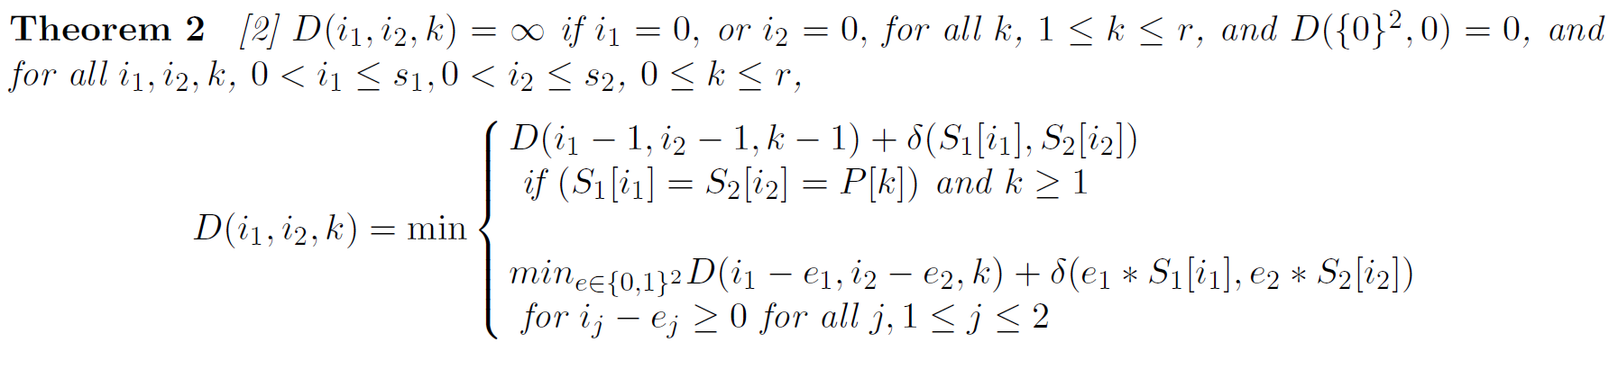
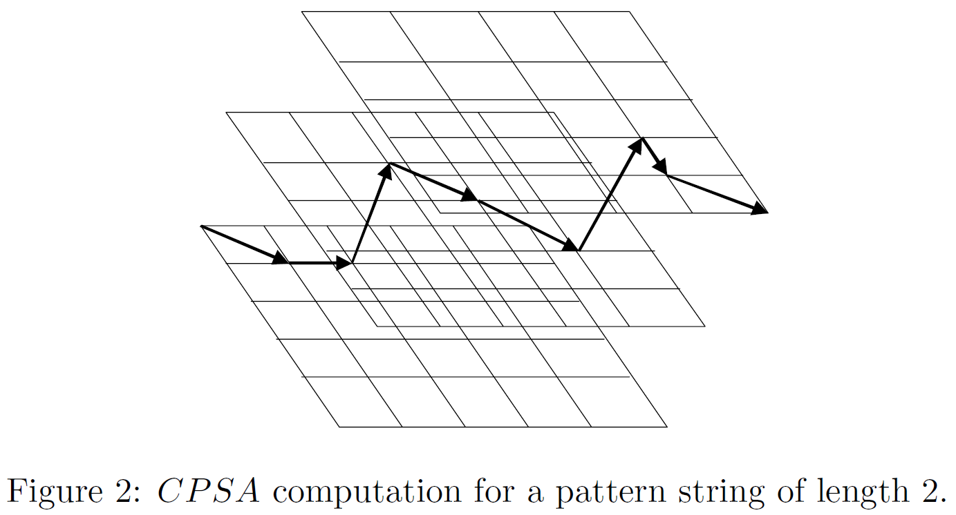
DP formulation of Chin et al. for CPSA Problem
where e_{j} = 0 or 1, e_{j} * S_{j}[i_{j}] with e_{j} = 0 represents a space character ‘-’, and S_{j}[i_{j}] when e_{j} = 1.

Slide 7
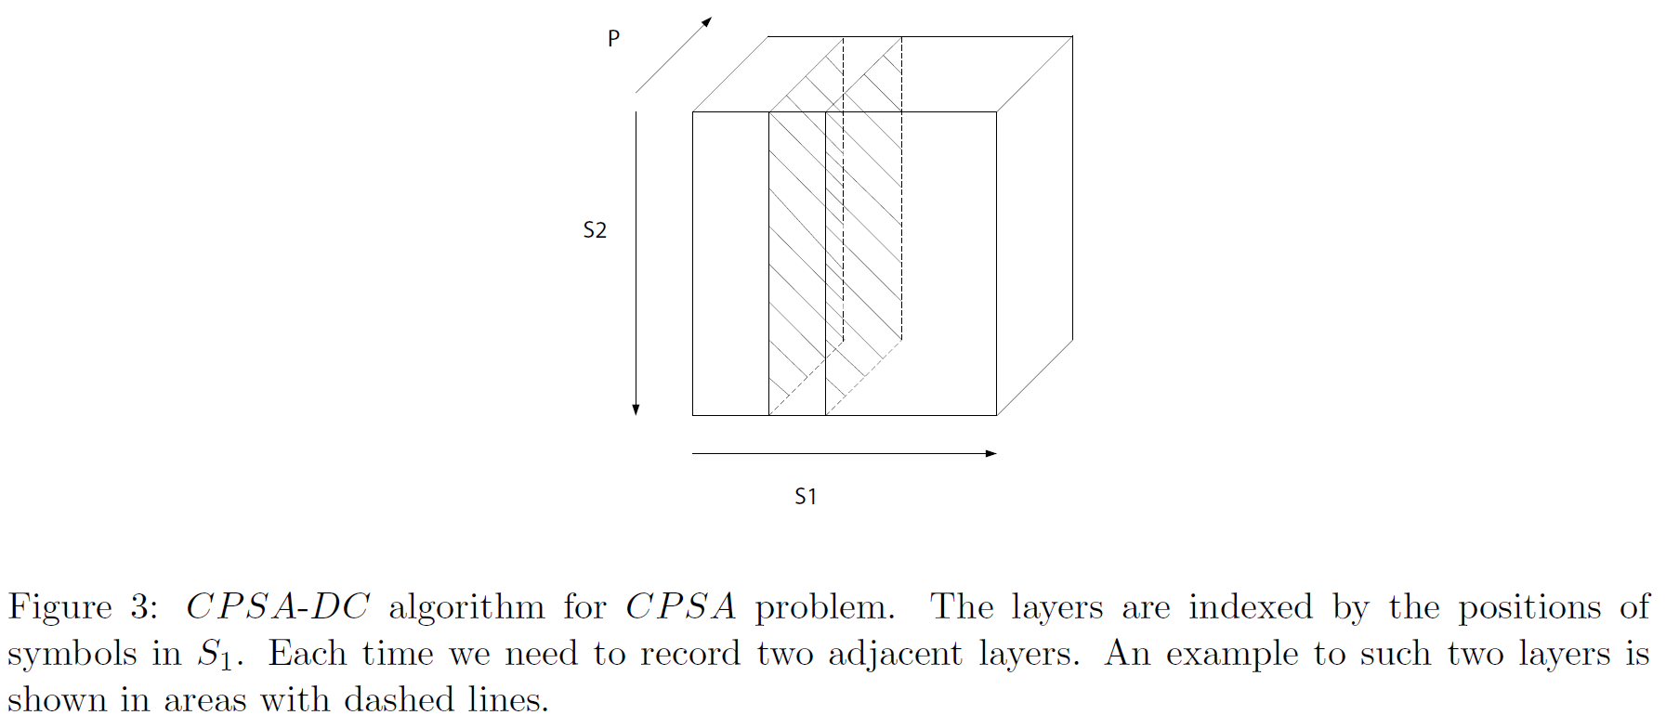
CPSA-DC Algorithm

Slide 8
Algorithm of Layer-DC
Divide-and-conquer approach in a layer-by-layer manner and linear-space algorithm on each layer.
1. Precomputing all of the candidate entry and exit vertices(entry vertex set and exit vertex set).
2. Using the divide-and-conquer approach.
3. Concatenating the series of mid-points to get the optimal solution.

Slide 9
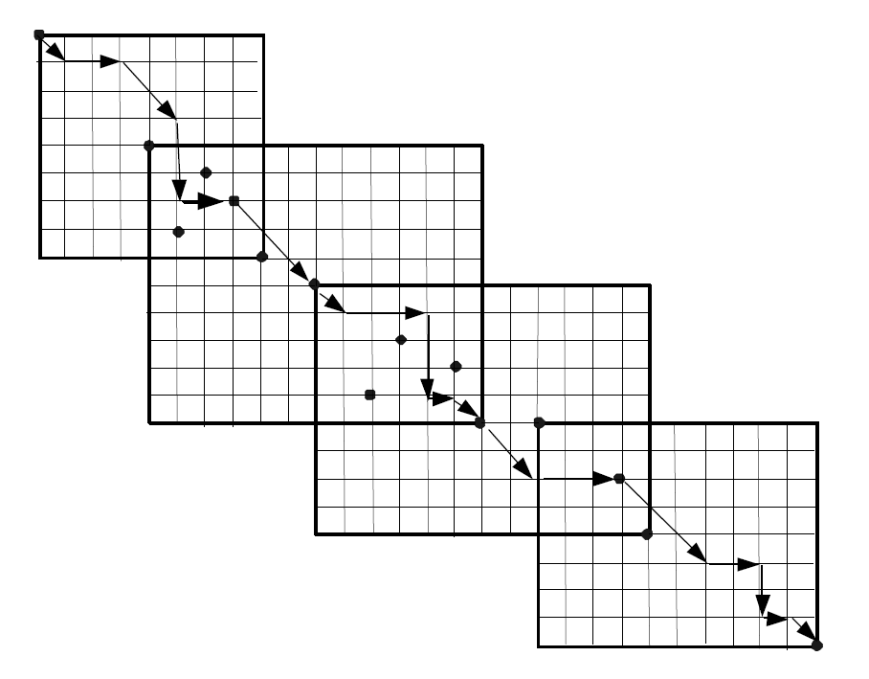
For the CPSA problem with pattern string of length 3, a global shortest path passing through entry and exit vertices, and connecting sub-paths on each layer.

Slide 10
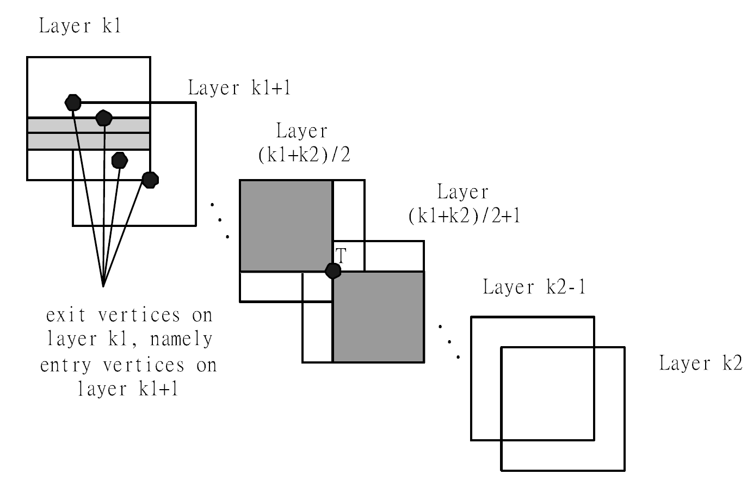

Slide 11
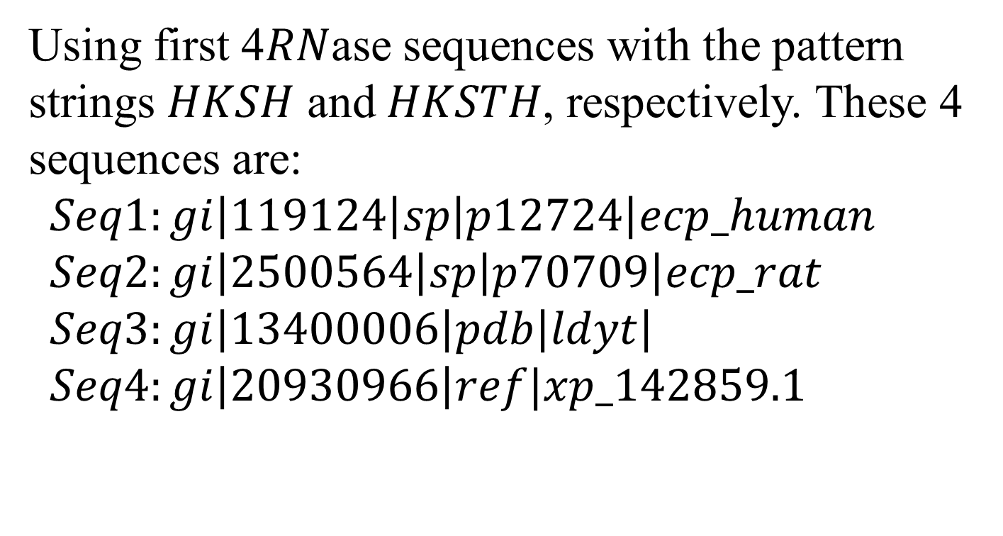
Space Requirement of Algorithm Layer-DC
Using first 4$RN$ase sequences with the pattern strings $HKSH$ and $HKSTH$, respectively. These 4 sequences are:
$$Seq1:gi\left|119124\right|sp\left|p12724\right|ecp_human$$
$$Seq2:gi\left|2500564\right|sp\left|p70709\right|ecp_rat$$
$$Seq3:gi\left|13400006\right|pdb\left|ldyt\right|$$
$$Seq4:gi\left|20930966\right|ref|xp_142859.1$$

Slide 12
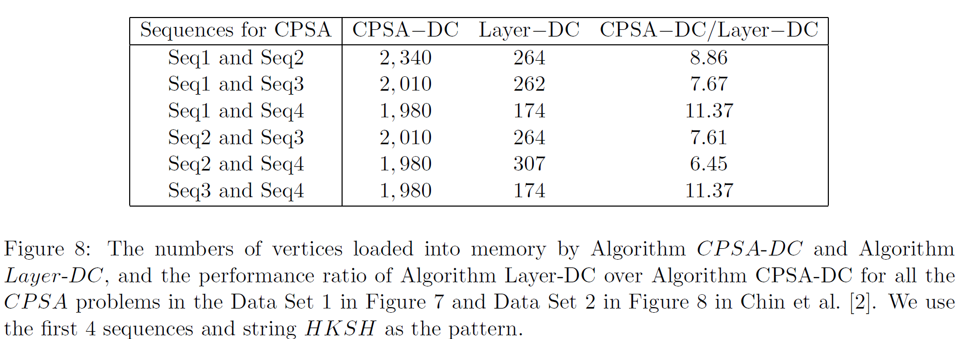
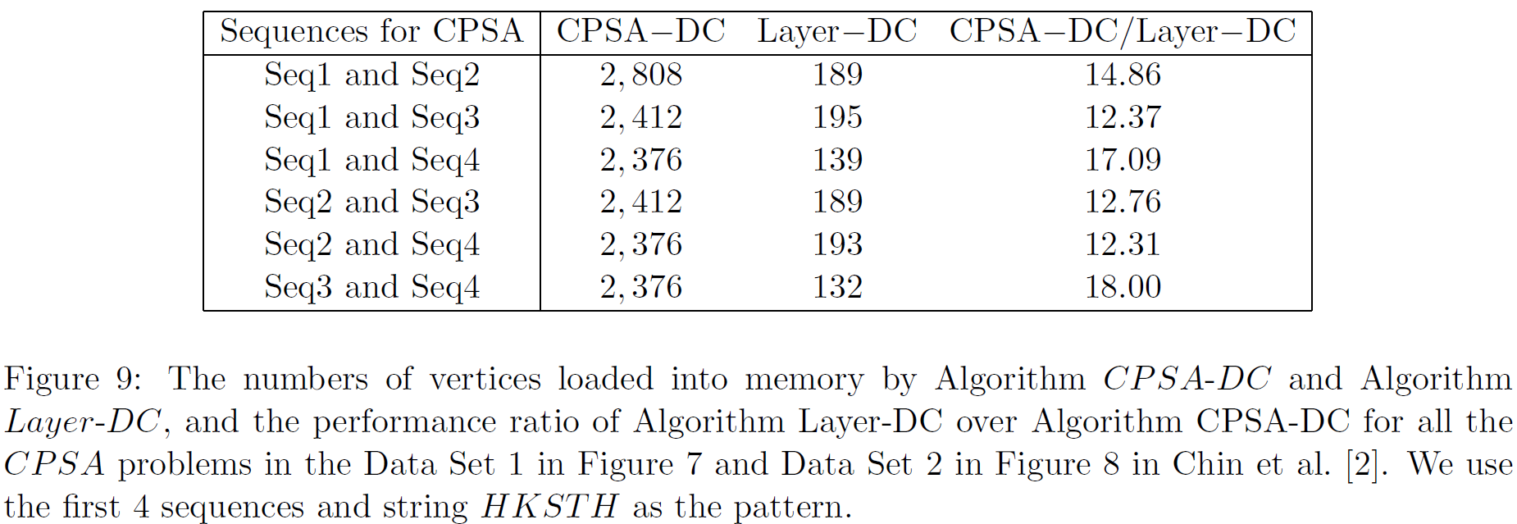

Slide 13
Thanks for listening

