Slide 1
Algorithms for Strings and Sequences: Pairwise Alignment
StefanoBeretta
University of Milan-Biocca, Milan, Italy
Encyclopedia of Bioinformatics and Computational Biology, Volume 1, 2019, Pages 22-29
Speaker: Guan-Zhi Chen
Date: 2019.01.22
Notes:
https://books.google.com.tw/books?hl=zh-TW&lr=&id=rs51DwAAQBAJ&oi=fnd&pg=PA22&dq=algorithms+for+strings+and+sequences+pairwise+alignment&ots=qZY01gYoOZ&sig=l6X1wDzL4-Si1-HrLxpaszyAqS0&redir_esc=y#v=onepage&q=algorithms%20for%20strings%20and%20sequences%20pairwise%20alignment&f=false

Slide 2
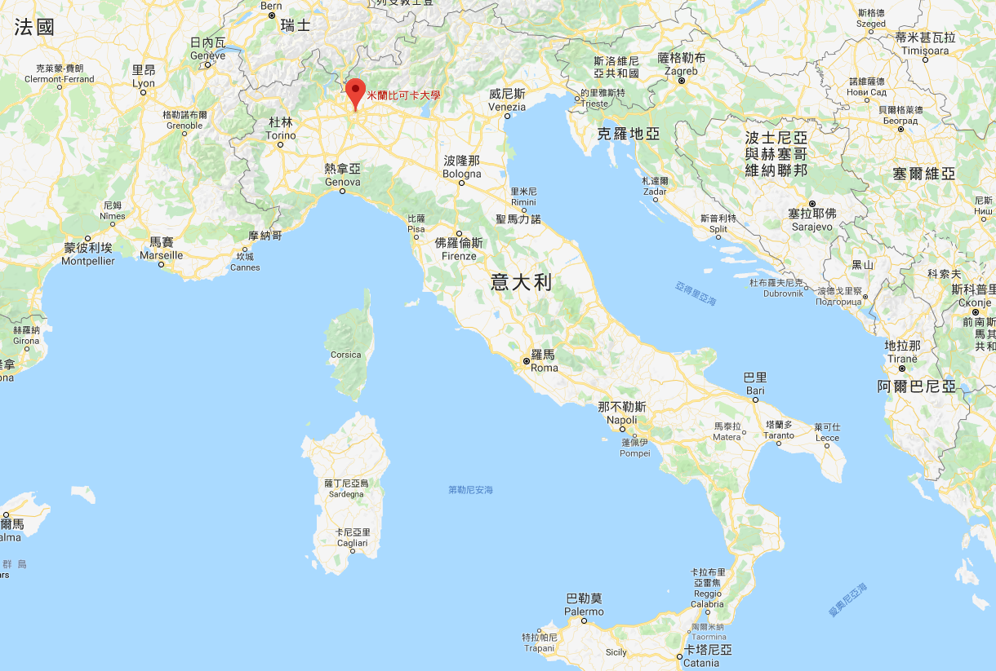
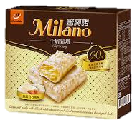
米蘭
Milano
Notes:
米蘭比可卡大學

Slide 3
Abstract (1/2)
Pairwise alignment between two biological sequences, such as DNA, RNA, or proteins, is a classical and well studied bioinformatic problem. In fact, this latter problem can be found in many biological analyses such as those involving data coming from sequencing processes.
In this work we will formalize the computational problem, and we will present the two most common variants, which are the global and the local versions.

Slide 4
Abstract (2/2)
More precisely, we will describe the dynamic programming algorithm proposed by Needleman and Wunsch for finding the optimal global pairwise alignment between two strings with respect to a given scoring function, and also the algorithm of Smith and Waterman for the local version.
Here, we will provide the details of both the algorithmic procedures and some examples showing their usage in reconstructing optimal alignments. Finally, we will also discuss some alternative scoring functions that are used in practice to deal with the pairwise alignment of biological sequences.

Slide 5
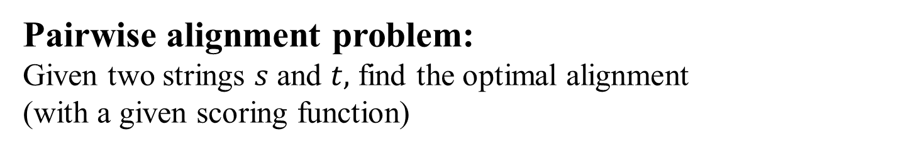
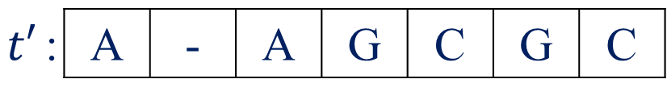
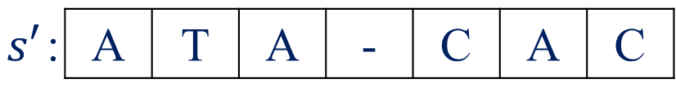


Definition (1/2)
Pairwise alignment problem:
Given two strings $s$ and $t,$ find the optimal alignment
(with a given scoring function)
Score:
⑴ Match: 1
⑵ Mismatch: -1
⑶ Insertion: -1
⑷ Deletion: -1
$s$: | A | T | A | C | A | C
$t$: | A | A | G | C | G | C
$s′$: | A | T | A | - | C | A | C
$t′$: | A | - | A | G | C | G | C
type | ⑴ | ⑷ | ⑴ | ⑶ | ⑴ | ⑵ | ⑴
score | +1 | -1 | +1 | -1 | +1 | -1 | +1 | = 1
Notes:
delta

Slide 6
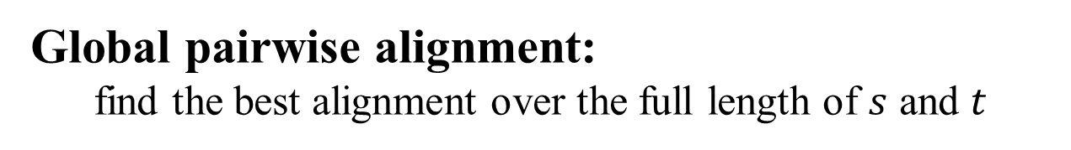
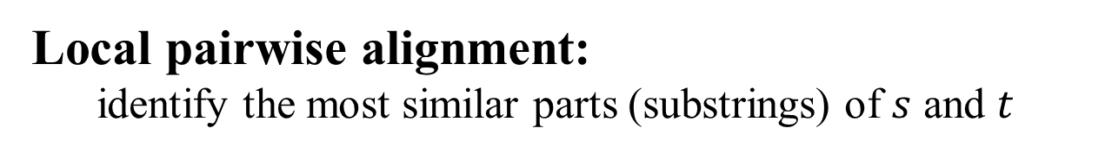
Definition (2/2)
Global pairwise alignment:
find the best alignment over the full length of $s$ and $t$
Local pairwise alignment:
identify the most similar parts (substrings) of $s$ and $t$
Needleman, S.B., Wunsch, C.D., “A general method applicable to the search for similarities in the amino acid sequence of two proteins”, Journal of Molecular Biology 48, 443–453, 1970.
Smith, T.F., Waterman, M.S., “Identification of common molecular subsequences”, Journal of Molecular Biology 147, 195–197, 1981

Slide 7
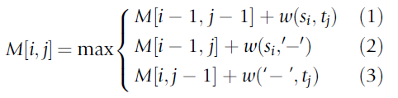
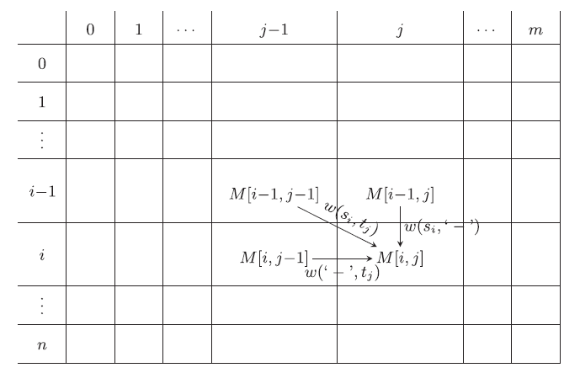
Global type (1/4) < DP >

Slide 8

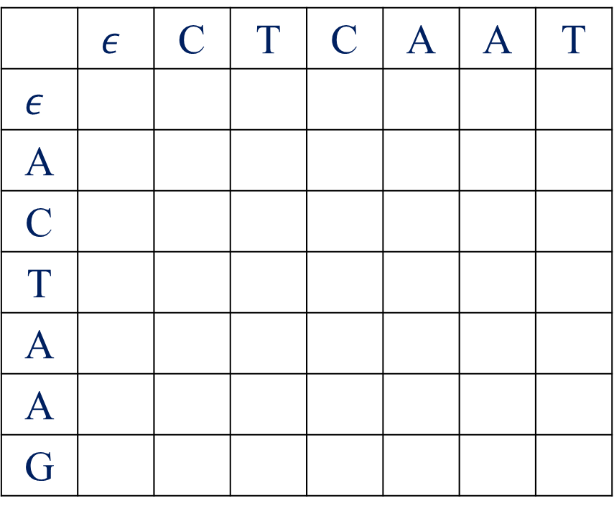

Global type (2/4) < score matrix >
$s$: | A | C | T | A | A | G
$t$: | C | T | C | A | A | T
 | $$ε$$ | C | T | C | A | A | T
$$ε$$
A
C
T
A
A
G

Slide 9
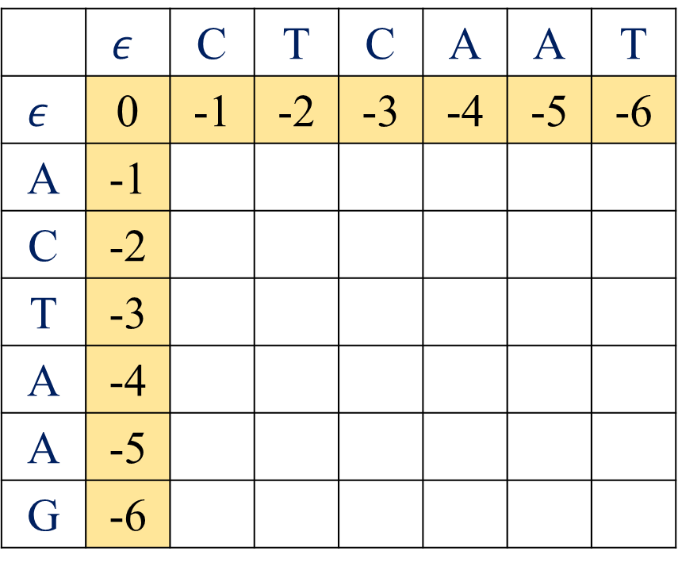
Global type (2/4) < score matrix >
$s$: | A | C | T | A | A | G
$t$: | C | T | C | A | A | T
 | $$ε$$ | C | T | C | A | A | T
$$ε$$ | 0 | -1 | -2 | -3 | -4 | -5 | -6
A | -1
C | -2
T | -3
A | -4
A | -5
G | -6

Slide 10
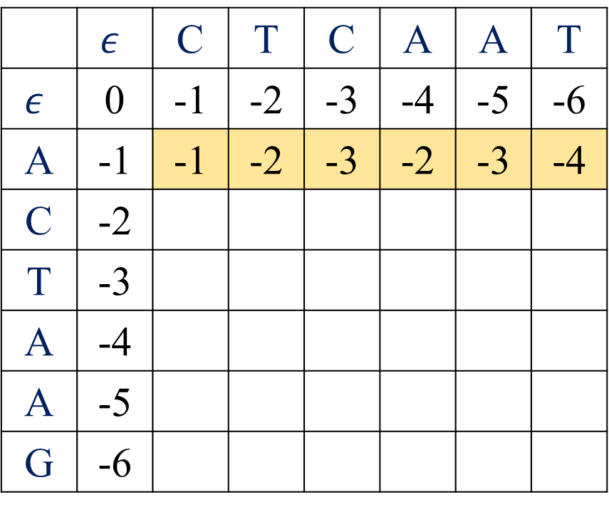
Global type (2/4) < score matrix >
$s$: | A | C | T | A | A | G
$t$: | C | T | C | A | A | T
 | $$ε$$ | C | T | C | A | A | T
$$ε$$ | 0 | -1 | -2 | -3 | -4 | -5 | -6
A | -1 | -1 | -2 | -3 | -2 | -3 | -4
C | -2
T | -3
A | -4
A | -5
G | -6

Slide 11
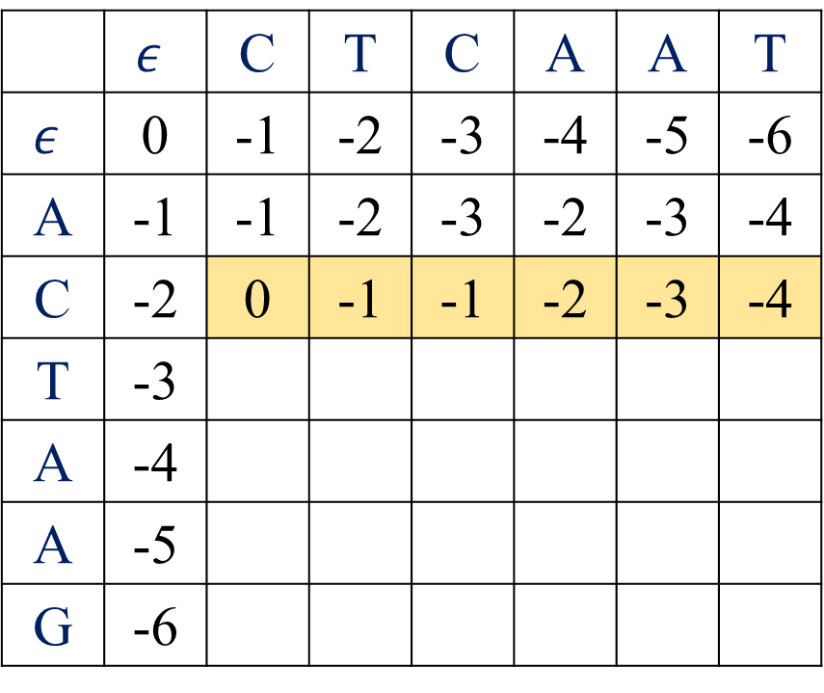
Global type (2/4) < score matrix >
$s$: | A | C | T | A | A | G
$t$: | C | T | C | A | A | T
 | $$ε$$ | C | T | C | A | A | T
$$ε$$ | 0 | -1 | -2 | -3 | -4 | -5 | -6
A | -1 | -1 | -2 | -3 | -2 | -3 | -4
C | -2 | 0 | -1 | -1 | -2 | -3 | -4
T | -3
A | -4
A | -5
G | -6

Slide 12
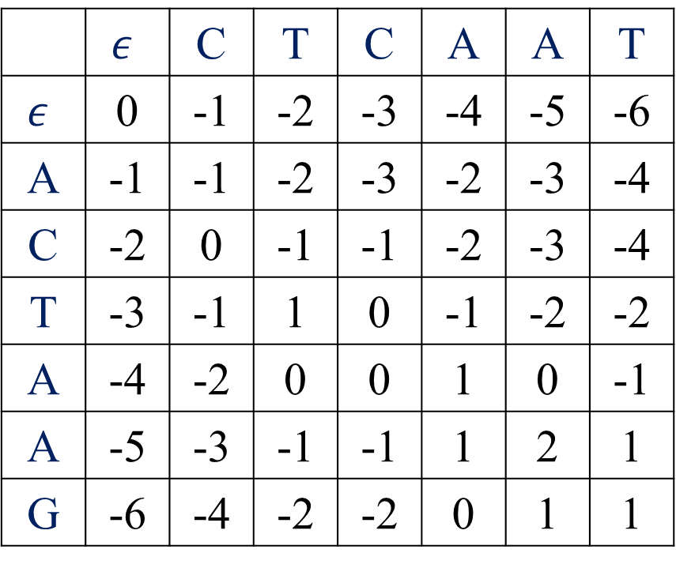
Global type (2/4) < score matrix >
$s$: | A | C | T | A | A | G
$t$: | C | T | C | A | A | T
 | $$ε$$ | C | T | C | A | A | T
$$ε$$ | 0 | -1 | -2 | -3 | -4 | -5 | -6
A | -1 | -1 | -2 | -3 | -2 | -3 | -4
C | -2 | 0 | -1 | -1 | -2 | -3 | -4
T | -3 | -1 | 1 | 0 | -1 | -2 | -2
A | -4 | -2 | 0 | 0 | 1 | 0 | -1
A | -5 | -3 | -1 | -1 | 1 | 2 | 1
G | -6 | -4 | -2 | -2 | 0 | 1 | 1

Slide 13
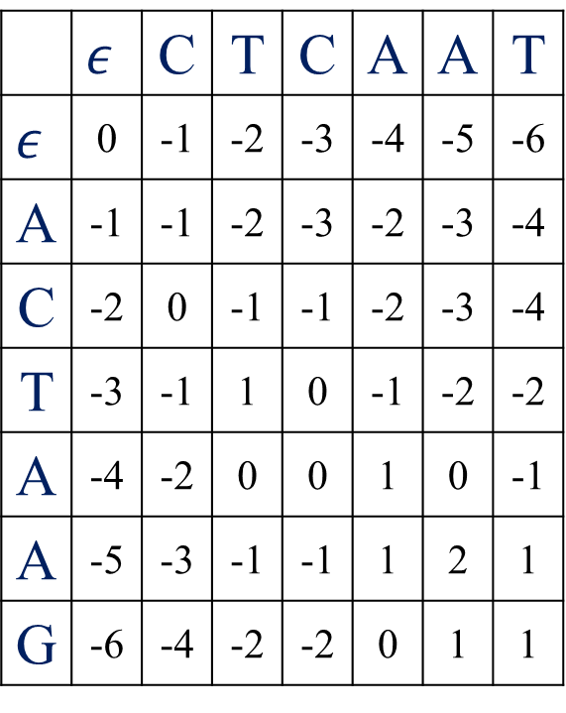

Global type (3/4) < arrow matrix >
$s$: | A | C | T | A | A | G
$t$: | C | T | C | A | A | T
 | $$ε$$ | C | T | C | A | A | T
$$ε$$ | 0 | -1 | -2 | -3 | -4 | -5 | -6
A | -1 | -1 | -2 | -3 | -2 | -3 | -4
C | -2 | 0 | -1 | -1 | -2 | -3 | -4
T | -3 | -1 | 1 | 0 | -1 | -2 | -2
A | -4 | -2 | 0 | 0 | 1 | 0 | -1
A | -5 | -3 | -1 | -1 | 1 | 2 | 1
G | -6 | -4 | -2 | -2 | 0 | 1 | 1
 | $$ε$$ | C | T | C | A | A | T
$$ε$$ | . | ← | ← | ← | ← | ← | ←
A | ↑
C | ↑
T | ↑
A | ↑
A | ↑
G | ↑

Slide 14
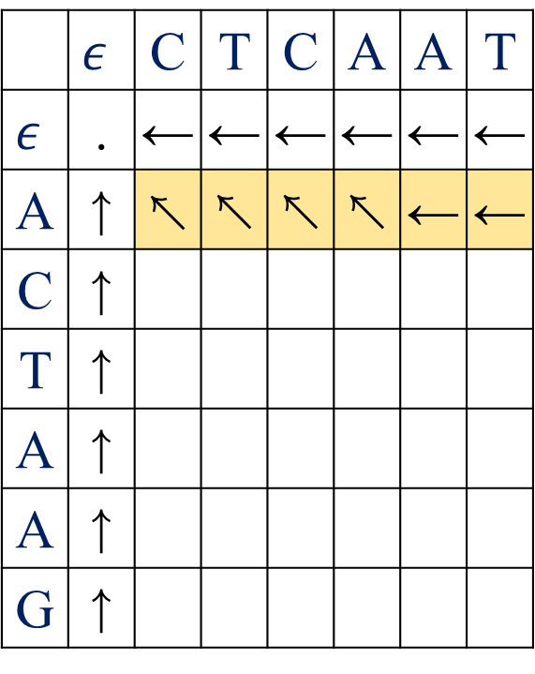
Global type (3/4) < arrow matrix >
$s$: | A | C | T | A | A | G
$t$: | C | T | C | A | A | T
 | $$ε$$ | C | T | C | A | A | T
$$ε$$ | 0 | -1 | -2 | -3 | -4 | -5 | -6
A | -1 | -1 | -2 | -3 | -2 | -3 | -4
C | -2 | 0 | -1 | -1 | -2 | -3 | -4
T | -3 | -1 | 1 | 0 | -1 | -2 | -2
A | -4 | -2 | 0 | 0 | 1 | 0 | -1
A | -5 | -3 | -1 | -1 | 1 | 2 | 1
G | -6 | -4 | -2 | -2 | 0 | 1 | 1
 | $$ε$$ | C | T | C | A | A | T
$$ε$$ | . | ← | ← | ← | ← | ← | ←
A | ↑ | ↖ | ↖ | ↖ | ↖ | ← | ←
C | ↑
T | ↑
A | ↑
A | ↑
G | ↑

Slide 15
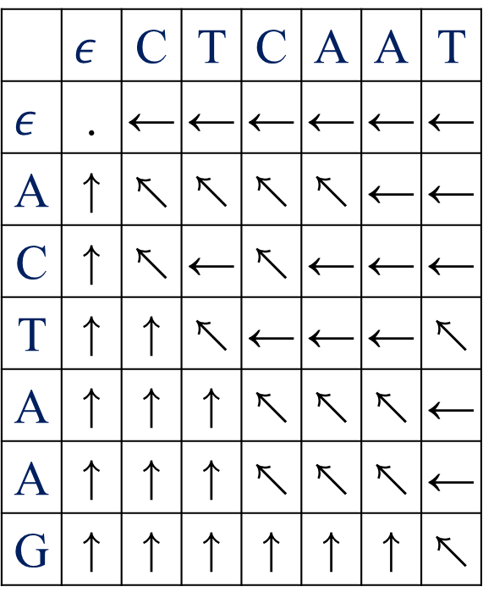
Global type (3/4) < arrow matrix >
$s$: | A | C | T | A | A | G
$t$: | C | T | C | A | A | T
 | $$ε$$ | C | T | C | A | A | T
$$ε$$ | 0 | -1 | -2 | -3 | -4 | -5 | -6
A | -1 | -1 | -2 | -3 | -2 | -3 | -4
C | -2 | 0 | -1 | -1 | -2 | -3 | -4
T | -3 | -1 | 1 | 0 | -1 | -2 | -2
A | -4 | -2 | 0 | 0 | 1 | 0 | -1
A | -5 | -3 | -1 | -1 | 1 | 2 | 1
G | -6 | -4 | -2 | -2 | 0 | 1 | 1
 | $$ε$$ | C | T | C | A | A | T
$$ε$$ | . | ← | ← | ← | ← | ← | ←
A | ↑ | ↖ | ↖ | ↖ | ↖ | ← | ←
C | ↑ | ↖ | ← | ↖ | ← | ← | ←
T | ↑ | ↑ | ↖ | ← | ← | ← | ↖
A | ↑ | ↑ | ↑ | ↖ | ↖ | ↖ | ←
A | ↑ | ↑ | ↑ | ↖ | ↖ | ↖ | ←
G | ↑ | ↑ | ↑ | ↑ | ↑ | ↑ | ↖

Slide 16
Global type (4/4) < traceback >
$s$: | A | C | T | A | A | G
$t$: | C | T | C | A | A | T
 | $$ε$$ | C | T | C | A | A | T
$$ε$$ | 0 | -1 | -2 | -3 | -4 | -5 | -6
A | -1 | -1 | -2 | -3 | -2 | -3 | -4
C | -2 | 0 | -1 | -1 | -2 | -3 | -4
T | -3 | -1 | 1 | 0 | -1 | -2 | -2
A | -4 | -2 | 0 | 0 | 1 | 0 | -1
A | -5 | -3 | -1 | -1 | 1 | 2 | 1
G | -6 | -4 | -2 | -2 | 0 | 1 | 1
 | $$ε$$ | C | T | C | A | A | T
$$ε$$ | . | ← | ← | ← | ← | ← | ←
A | ↑ | ↖ | ↖ | ↖ | ↖ | ← | ←
C | ↑ | ↖ | ← | ↖ | ← | ← | ←
T | ↑ | ↑ | ↖ | ← | ← | ← | ↖
A | ↑ | ↑ | ↑ | ↖ | ↖ | ↖ | ←
A | ↑ | ↑ | ↑ | ↖ | ↖ | ↖ | ←
G | ↑ | ↑ | ↑ | ↑ | ↑ | ↑ | ↖

Slide 17

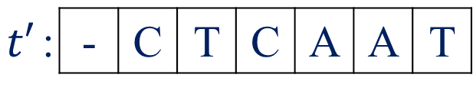

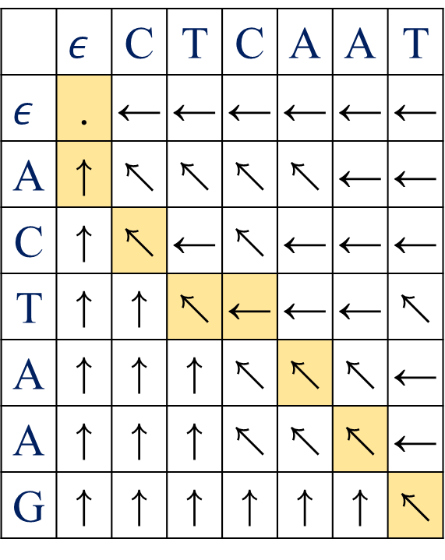

Global type (4/4) < traceback >
 | $$ε$$ | C | T | C | A | A | T
$$ε$$ | . | ← | ← | ← | ← | ← | ←
A | ↑ | ↖ | ↖ | ↖ | ↖ | ← | ←
C | ↑ | ↖ | ← | ↖ | ← | ← | ←
T | ↑ | ↑ | ↖ | ← | ← | ← | ↖
A | ↑ | ↑ | ↑ | ↖ | ↖ | ↖ | ←
A | ↑ | ↑ | ↑ | ↖ | ↖ | ↖ | ←
G | ↑ | ↑ | ↑ | ↑ | ↑ | ↑ | ↖
$s$: | A | C | T | A | A | G
$t$: | C | T | C | A | A | T
$s′$: | A | C | T | - | A | A | G
$t′$: | - | C | T | C | A | A | T

Slide 18
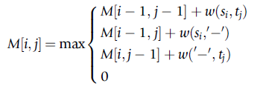
Local type (1/4) < DP >

Slide 19

Local type (2/4) < score matrix >
$s$: | A | C | T | A | A | G
$t$: | C | T | C | A | A | T
 | $$ε$$ | C | T | C | A | A | T
$$ε$$ | 0 | 0 | 0 | 0 | 0 | 0 | 0
A | 0
C | 0
T | 0
A | 0
A | 0
G | 0

Slide 20
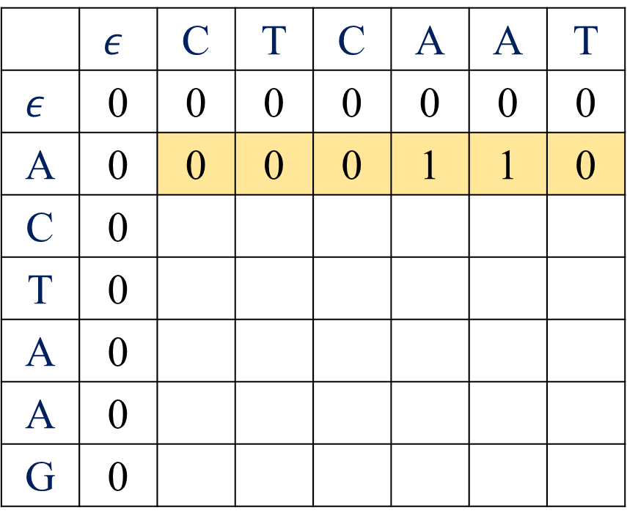
Local type (2/4) < score matrix >
$s$: | A | C | T | A | A | G
$t$: | C | T | C | A | A | T
 | $$ε$$ | C | T | C | A | A | T
$$ε$$ | 0 | 0 | 0 | 0 | 0 | 0 | 0
A | 0 | 0 | 0 | 0 | 1 | 1 | 0
C | 0
T | 0
A | 0
A | 0
G | 0

Slide 21
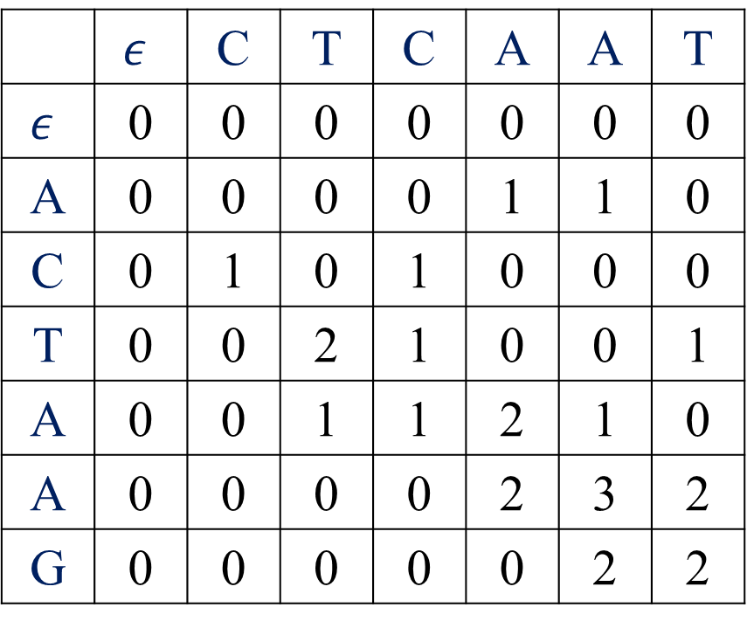
Local type (2/4) < score matrix >
$s$: | A | C | T | A | A | G
$t$: | C | T | C | A | A | T
 | $$ε$$ | C | T | C | A | A | T
$$ε$$ | 0 | 0 | 0 | 0 | 0 | 0 | 0
A | 0 | 0 | 0 | 0 | 1 | 1 | 0
C | 0 | 1 | 0 | 1 | 0 | 0 | 0
T | 0 | 0 | 2 | 1 | 0 | 0 | 1
A | 0 | 0 | 1 | 1 | 2 | 1 | 0
A | 0 | 0 | 0 | 0 | 2 | 3 | 2
G | 0 | 0 | 0 | 0 | 0 | 2 | 2

Slide 22
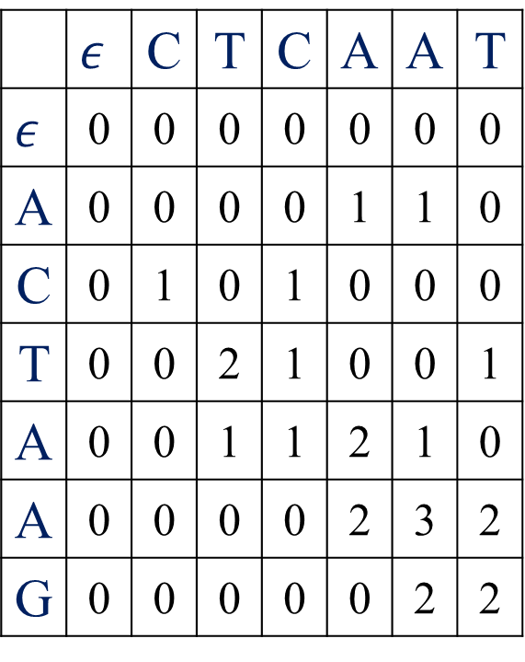

Local type (3/4) < arrow matrix >
$s$: | A | C | T | A | A | G
$t$: | C | T | C | A | A | T
 | $$ε$$ | C | T | C | A | A | T
$$ε$$ | 0 | 0 | 0 | 0 | 0 | 0 | 0
A | 0 | 0 | 0 | 0 | 1 | 1 | 0
C | 0 | 1 | 0 | 1 | 0 | 0 | 0
T | 0 | 0 | 2 | 1 | 0 | 0 | 1
A | 0 | 0 | 1 | 1 | 2 | 1 | 0
A | 0 | 0 | 0 | 0 | 2 | 3 | 2
G | 0 | 0 | 0 | 0 | 0 | 2 | 2
 | $$ε$$ | C | T | C | A | A | T
$$ε$$ | . | . | . | . | . | . | .
A | .
C | .
T | .
A | .
A | .
G | .

Slide 23
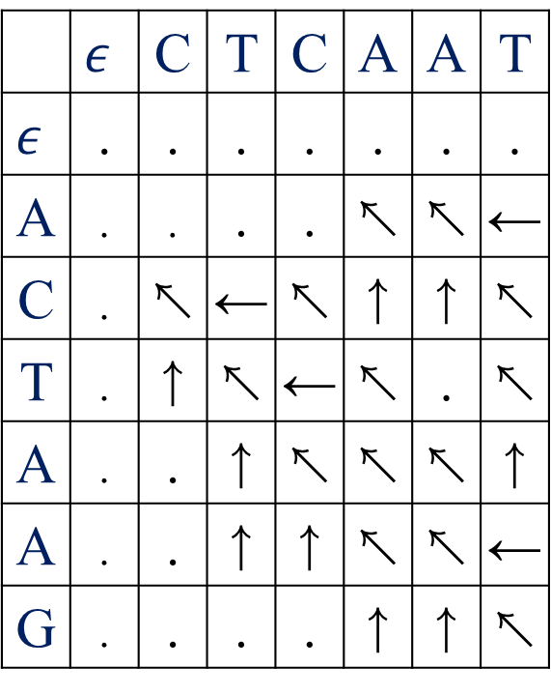
Local type (3/4) < arrow matrix >
$s$: | A | C | T | A | A | G
$t$: | C | T | C | A | A | T
 | $$ε$$ | C | T | C | A | A | T
$$ε$$ | 0 | 0 | 0 | 0 | 0 | 0 | 0
A | 0 | 0 | 0 | 0 | 1 | 1 | 0
C | 0 | 1 | 0 | 1 | 0 | 0 | 0
T | 0 | 0 | 2 | 1 | 0 | 0 | 1
A | 0 | 0 | 1 | 1 | 2 | 1 | 0
A | 0 | 0 | 0 | 0 | 2 | 3 | 2
G | 0 | 0 | 0 | 0 | 0 | 2 | 2
 | $$ε$$ | C | T | C | A | A | T
$$ε$$ | . | . | . | . | . | . | .
A | . | . | . | . | ↖ | ↖ | ←
C | . | ↖ | ← | ↖ | ↑ | ↑ | ↖
T | . | ↑ | ↖ | ← | ↖ | . | ↖
A | . | . | ↑ | ↖ | ↖ | ↖ | ↑
A | . | . | ↑ | ↑ | ↖ | ↖ | ←
G | . | . | . | . | ↑ | ↑ | ↖

Slide 24
Local type (4/4) < trackback >
$s$: | A | C | T | A | A | G
$t$: | C | T | C | A | A | T
 | $$ε$$ | C | T | C | A | A | T
$$ε$$ | 0 | 0 | 0 | 0 | 0 | 0 | 0
A | 0 | 0 | 0 | 0 | 1 | 1 | 0
C | 0 | 1 | 0 | 1 | 0 | 0 | 0
T | 0 | 0 | 2 | 1 | 0 | 0 | 1
A | 0 | 0 | 1 | 1 | 2 | 1 | 0
A | 0 | 0 | 0 | 0 | 2 | 3 | 2
G | 0 | 0 | 0 | 0 | 0 | 2 | 2
 | $$ε$$ | C | T | C | A | A | T
$$ε$$ | . | . | . | . | . | . | .
A | . | . | . | . | ↖ | ↖ | ←
C | . | ↖ | ← | ↖ | ↑ | ↑ | ↖
T | . | ↑ | ↖ | ← | ↖ | . | ↖
A | . | . | ↑ | ↖ | ↖ | ↖ | ↑
A | . | . | ↑ | ↑ | ↖ | ↖ | ←
G | . | . | . | . | ↑ | ↑ | ↖

Slide 25


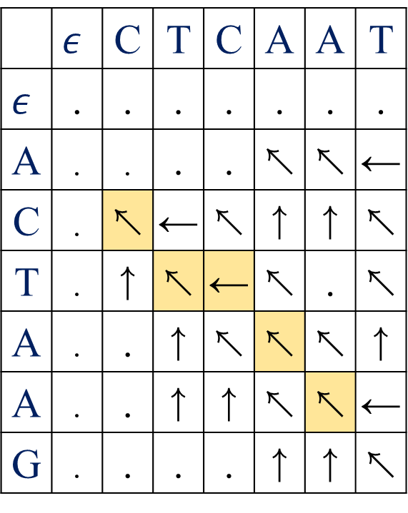
Local type (4/4) < traceback >
 | $$ε$$ | C | T | C | A | A | T
$$ε$$ | . | . | . | . | . | . | .
A | . | . | . | . | ↖ | ↖ | ←
C | . | ↖ | ← | ↖ | ↑ | ↑ | ↖
T | . | ↑ | ↖ | ← | ↖ | . | ↖
A | . | . | ↑ | ↖ | ↖ | ↖ | ↑
A | . | . | ↑ | ↑ | ↖ | ↖ | ←
G | . | . | . | . | ↑ | ↑ | ↖
$s$: | A | C | T | A | A | G
$t$: | C | T | C | A | A | T
$s′$: | C | T | - | A | A
$t′$: | C | T | C | A | A

Slide 26

Local type (3/4) < arrow matrix >
$s$: | A | C | T | A | A | G
$t$: | C | T | C | A | A | T
 | $$ε$$ | C | T | C | A | A | T
$$ε$$ | 0 | 0 | 0 | 0 | 0 | 0 | 0
A | 0 | 0 | 0 | 0 | 1 | 1 | 0
C | 0 | 1 | 0 | 1 | 0 | 0 | 0
T | 0 | 0 | 2 | 1 | 0 | 0 | 1
A | 0 | 0 | 1 | 1 | 2 | 1 | 0
A | 0 | 0 | 0 | 0 | 2 | 3 | 2
G | 0 | 0 | 0 | 0 | 0 | 2 | 2
 | $$ε$$ | C | T | C | A | A | T
$$ε$$ | . | . | . | . | . | . | .
A | . | ↖ | ←
C | . | ↑ | ↖
T | .
A | .
A | .
G | .

