Slide 1
A Survey on Transfer Learning
Sinno Jialin Pan and Qiang Yang Fellow, IEEE´
IEEE TRANSACTIONS ON KNOWLEDGE AND DATA ENGINEERING, VOL. 22, NO. 10, OCTOBER 2010
Presenter: Ke-Xin Zhu
Date: 2019/01/29

Slide 2
Abstract (1/2)
A major assumption in many machine learning and data mining algorithms is that the training and future data must be in the same feature space and have the same distribution. However, in many real-world applications, this assumption may not hold. For example, we sometimes have a classification task in one domain of interest, but we only have sufficient training data in another domain of interest, where the latter data may be in a different feature space or follow a different data distribution. In such cases, knowledge transfer, if done successfully, would greatly improve the performance of learning by avoiding much expensive data labeling efforts.

Slide 3
Abstract (2/2)
In recent years, transfer learning has emerged as a new learning framework to address this problem. This survey focuses on categorizing and reviewing the current progress on transfer learning for classification, regression and clustering problems. In this survey, we discuss the relationship between transfer learning and other related machine learning techniques such as domain adaptation, multi- task learning and sample selection bias, as well as co-variate shift. We also explore some potential future issues in transfer learning research

Slide 4
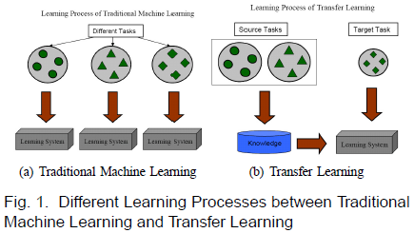
INTRODUCTION
Web-document classification;
Indoor WiFI localization;
sentiment classification.

Slide 5
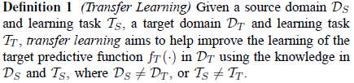
Notations and Definitions
The ability of a system to recognize and apply knowledge and skills learned in previous tasks to novel tasks.

Slide 6
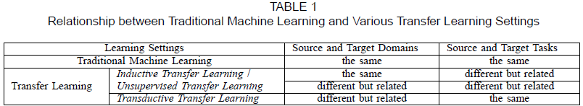
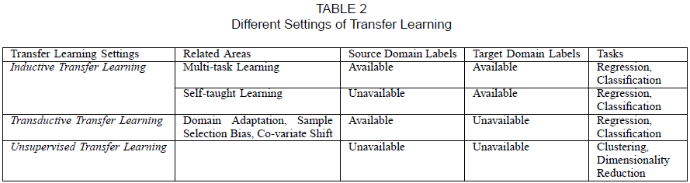
A Categorization of Transfer Learning Techniques (1/3)

Slide 7
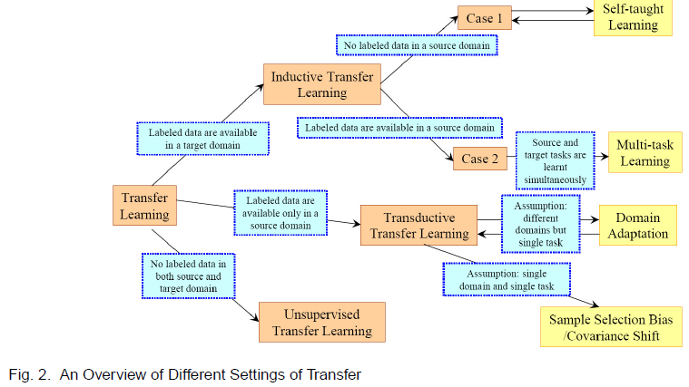
A Categorization of Transfer Learning Techniques (2/3)

Slide 8
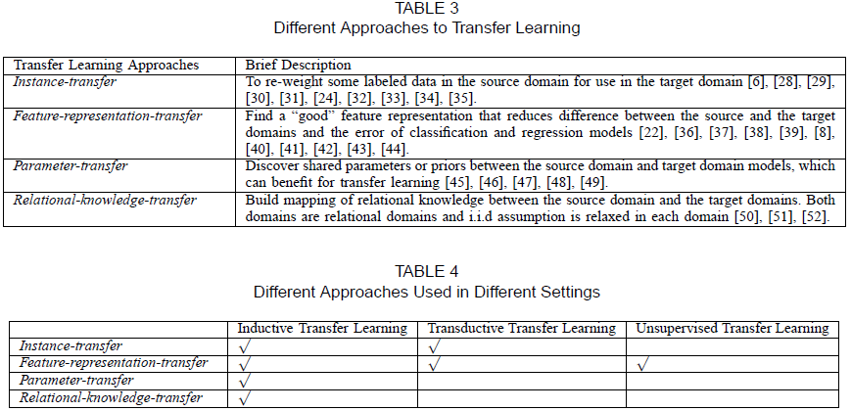
A Categorization of Transfer Learning Techniques (3/3)

Slide 9
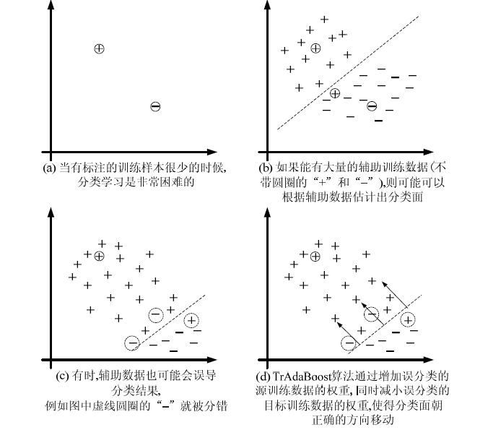
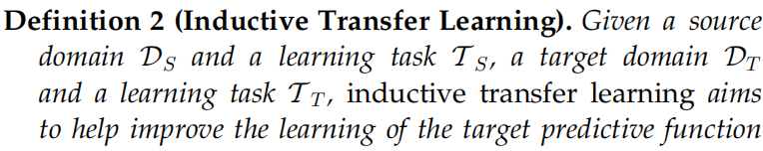
INDUCTIVE TRANSFER LEARNING (1/3)
1.Transferring Knowledge of Instances:

Slide 10



INDUCTIVE TRANSFER LEARNING (2/3)
2.Transferring Knowledge of Feature Representations:
2..Supervised Feature Construction:
2.2.Unsupervised Feature Construction:

Slide 11
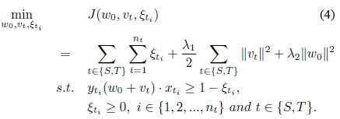
INDUCTIVE TRANSFER LEARNING (3/3)
3.Transferring Knowledge of Parameters:
4.Transferring Relational Knowledge:
Networked data and social network data;
Mapping from professorstudent relationship to the manager-worker relationship.

Slide 12
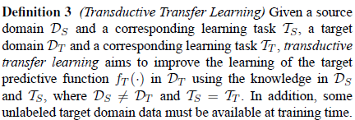

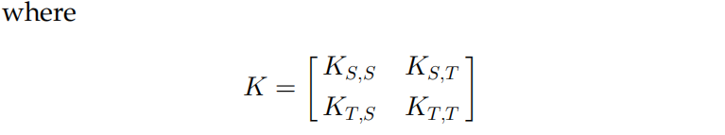
TRANSDUCTIVE TRANSFER LEARNING (1/3)
1.Transferring the Knowledge of Instances：

Slide 13
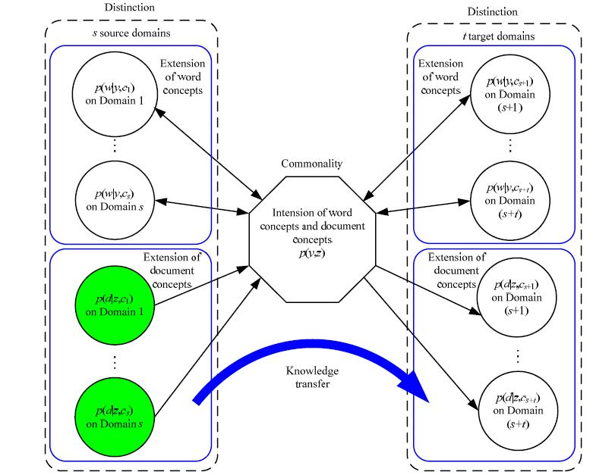
TRANSDUCTIVE TRANSFER LEARNING (2/3)
2.Transferring Knowledge of Feature Representations：

Slide 14
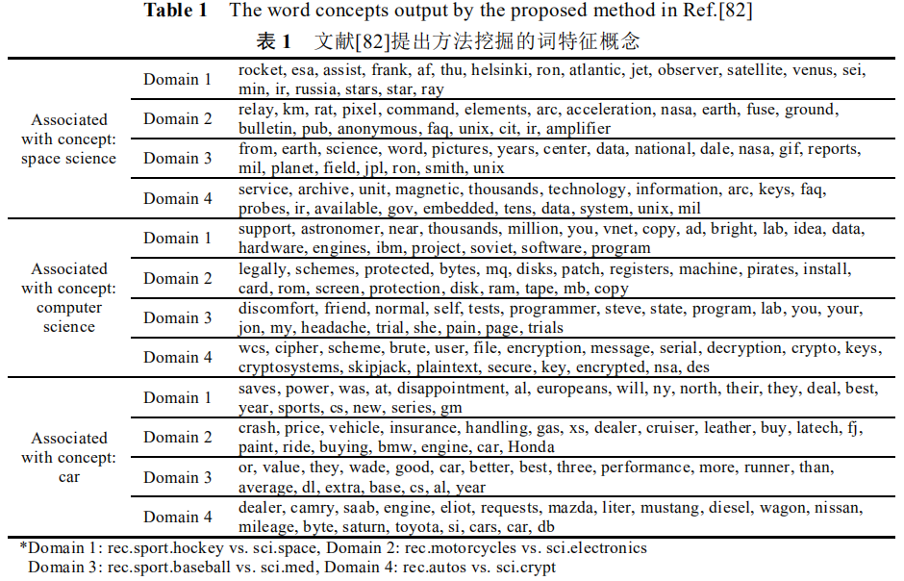
TRANSDUCTIVE TRANSFER LEARNING (3/3)
2.Transferring Knowledge of Feature Representations：

Slide 15
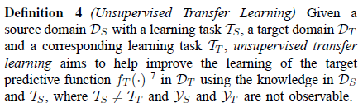


UNSUPERVISED TRANSFER LEARNING

Slide 16
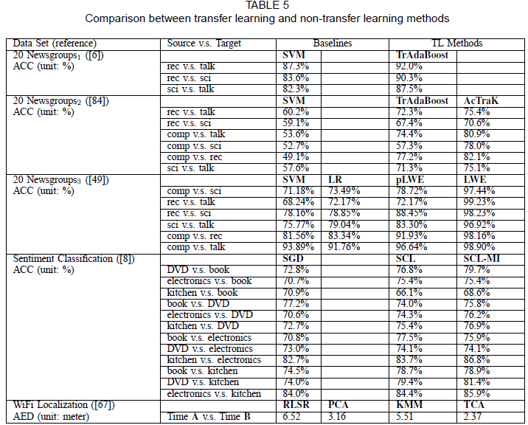
APPLICATIONS OF TRANSFER LEARNING

