Slide 1
VoxelNet:
End-to-End Learning for Point Cloud
Based 3D Object Detection
Yin Zhou, Oncel Tuzel
Apple Inc, Nov 17, 2017
Presenter : Chia-Lin, Chen
Feb. 12, 2019
Notes:
作者: 中國人 土耳其人
2013, Apple公司進軍汽車領域，發表”iOS in the Car”軟體，也就是”Car Play”
2014, 據說Apple公司進行了一秘密計畫—Project Titan
甚至一度傳出該計畫員工人數高達2700人
2015年10月，在MarkMonitorInc網站上也可查到Apple公司註冊的apple.car, apple.cars, apple.auto三個域名，雖然這三個域名至今未啟用。
可見造車計畫所言不虛。
2016年開始，公司內部造車團隊似有分歧，擱置整車製造，專注於自動駕駛。
2017年4月，蘋果公司獲加州自動駕駛測試許可，以lexus RX450h為原型改造的測試車上路進行路測。
2018年，測試車車輛達70台。

Slide 2
Abstract(1/2)
Accurate detection of objects in 3D point clouds is a central problem in many applications, such as autonomous navigation, housekeeping robots, and augmented/virtual reality. To interface a highly sparse LiDAR point cloud with a region proposal network (RPN), most existing efforts have focused on hand-crafted feature representations, for example, a bird’ s eye view projection. In this work, we remove the need of manual feature engineering for 3D point clouds and propose VoxelNet, a generic 3D detection network that uniﬁes feature extraction and bounding box prediction into a single stage, end-to-end trainable deep network.

Slide 3
Abstract(2/2)
Speciﬁcally, VoxelNet divides a point cloud into equally spaced 3D voxels and transforms a group of points within each voxel into a uniﬁed feature representation through the newly introduced voxel feature encoding (VFE) layer. In this way, the point cloud is encoded as a descriptive volumetric representation, which is then connected to a RPN to generate detections. Experiments on the KITTI car detection benchmark show that VoxelNet outperforms the state-of-the-art LiDAR based 3D detection methods by a large margin. Furthermore, our network learns an effective discriminative representation of objects with various geometries, leading to encouraging results in 3D detection of pedestrians and cyclists, based on only LiDAR.

Slide 4
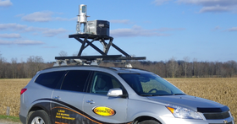
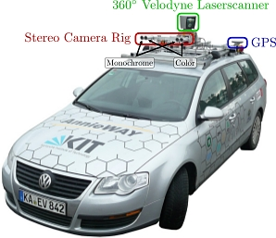
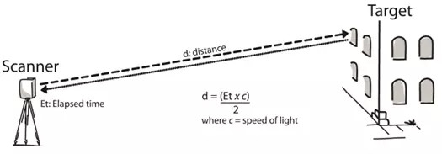
What is LiDAR? Light + raDAR

Slide 5
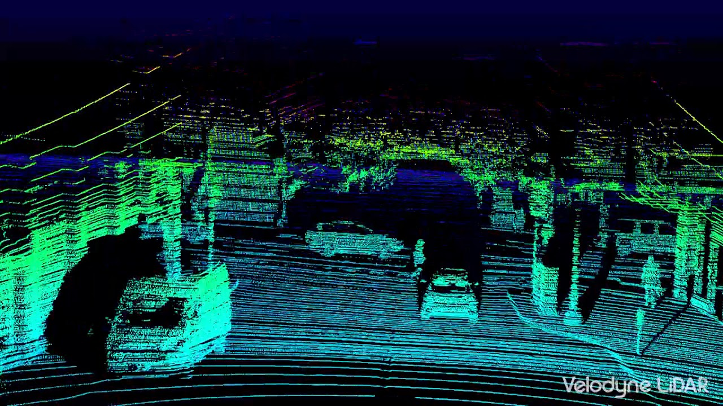

Slide 6
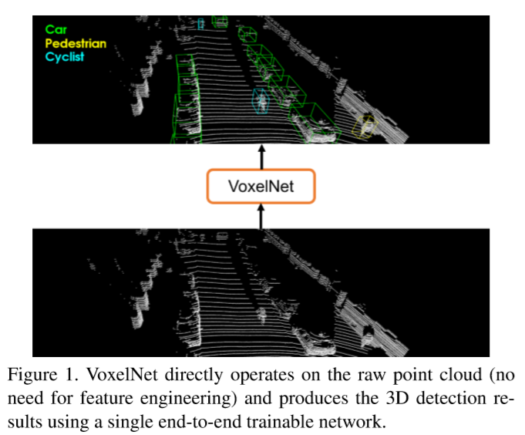
What is VoxelNet?
Notes:
LiDAR運作是依靠感測器，接受反射回來的資料點，從而做周遭環境360度的掃瞄。
然而這樣的方式容易受物體表面反射面材質的影響(許多物體表面容易造成散射)
因此傳統LiDAR收集資料點常需要人工將點雲調整過後取特徵。
此外，過往的自駕車或自動駕駛計程車用的LiDAR技術，
美國政府為了保護人人眼，制定LiDAR的射程必須在30-40公尺內，
這對於高速行駛自駕車太不安全，必須在200公尺就得偵測到前方是否有物體。
然而Tesla並沒有使用LiDAR，Tesla在它的V8 V9內裝的系統Autopilot 用的技術是radar+超聲波+被動影像(雖然比較便宜)。
所以去年一月Tesla撞了消防車…with it’s autopilot system.
總之LiDAR仍有地方可以突破。

Slide 7
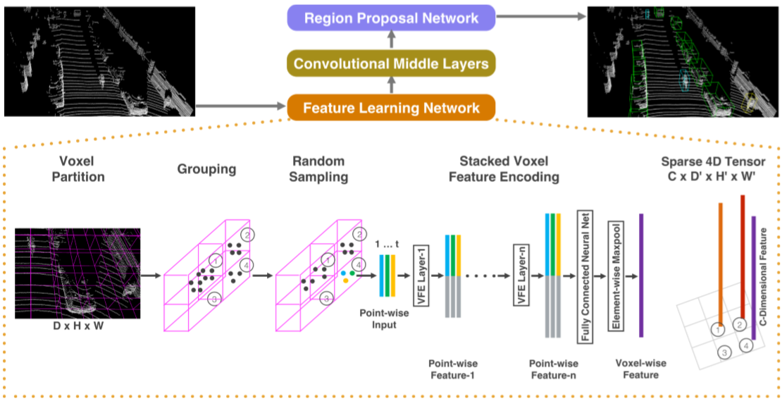

Slide 8
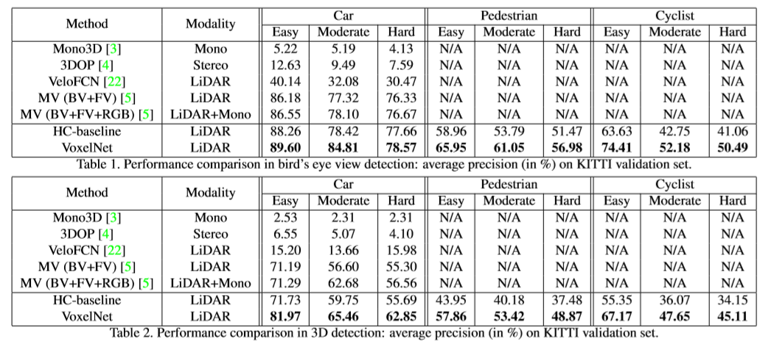
Result

Slide 9
Contribution
1.Only need to use raw point cloud, and without hand-craft featuring.
2.Can be trained by end-to-end.

