Slide 1
A Simple Linear Space Algorithm for Computing Nonoverlapping Inversion and Transposition Distance in Quadratic Average Time
XIAODONG WANG and LEI WANG
JOURNAL OF COMPUTATIONAL BIOLOGY Volume 25, Number 6,
pp. 1-13, 2018
Presenter: Guo-Fong Huang
Date: 2019/02/12

Slide 2
Abstract(1/2)
In the sequence alignment problem, it is important to compare DNA sequences to retrieve relevant information and align these sequences. An inversion and a translocation are important operations in comparing DNA sequences in biosequence analysis. The alignment problem with nonoverlapping inversions and translocations is to find an alignment with nonoverlapping inversions and translocations for the given two strings X and Y. This problem has interesting application for finding a common sequence from two mutated sequences.

Slide 3
Abstract(2/2)
A linear space and quadratic average time algorithm to compute the mutation distance between two strings of the same length under nonoverlapping inversions and transpositions is presented in this article. The recursive formula for this purpose is novel to the best of our knowledge. The space costs of the algorithms to solve the same problem are typically quadratic, and thus, our original algorithm is the first linear space algorithm to solve the mutation distance problem.

Slide 4
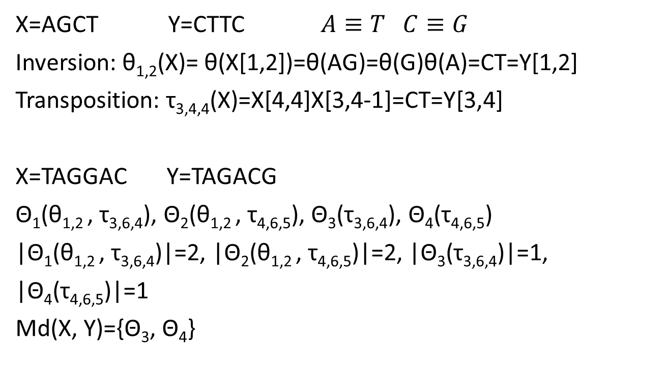
Preliminaries
X=AGCT Y=CTTC $A≡T C≡G$
Inversion: θ_{1,2}(X)= θ(X[1,2])=θ(AG)=θ(G)θ(A)=CT=Y[1,2]
Transposition: τ_{3,4,4}(X)=X[4,4]X[3,4-1]=CT=Y[3,4]
X=TAGGAC Y=TAGACG
Θ₁(θ_{1,2} , τ_{3,6,4}), Θ₂(θ_{1,2} , τ_{4,6,5}), Θ₃(τ_{3,6,4}), Θ₄(τ_{4,6,5})
|Θ₁(θ_{1,2} , τ_{3,6,4})|=2, |Θ₂(θ_{1,2} , τ_{4,6,5})|=2, |Θ₃(τ_{3,6,4})|=1,
|Θ₄(τ_{4,6,5})|=1
Md(X, Y)={Θ₃, Θ₄}

Slide 5
Longest common suffix
X=AGCGTGC Y=CTACGCG
Z=θ_{1,n}(X)=GCACGCT
longest common suffix: lcs(4,5,X,Y)=2 (AGCG,CTACG)
X Y | C | T | A | C | G | C | G
A | 0 | 0 | 1 | 0 | 0 | 0 | 0
G | 0 | 0 | 0 | 0 | 1 | 0 | 0
C | 1 | 0 | 0 | 1 | 0 | 2 | 0
G | 0 | 0 | 0 | 0 | 2 | 0 | 3
T | 0 | 1 | 0 | 0 | 0 | 0 | 0
G | 0 | 0 | 0 | 0 | 1 | 0 | 1
C | 1 | 0 | 0 | 1 | 0 | 2 | 0

Slide 6

Inversion
X=AGCGTGC Y=CTACGCG
Z=GCACGCT
longest common suffix:
$$ε\left(i,j\right)>0 iff lcs\left(n−i+1,j,Z,Y\right)≥j−i+1$$
Z Y | C | T | A | C | G | C | G
G | 0 | 0 | 0 | 0 | 1 | 0 | 1
C | 1 | 0 | 0 | 1 | 0 | 2 | 0
A | 0 | 0 | 1 | 0 | 0 | 0 | 0
C | 1 | 0 | 0 | 2 | 0 | 1 | 0
G | 0 | 0 | 0 | 0 | 3 | 0 | 2
C | 1 | 0 | 0 | 1 | 0 | 4 | 0
T | 0 | 2 | 0 | 0 | 0 | 0 | 0

Slide 7

Transposition
X=CCGTCA Y=CACCGT
Transposition:
η(i,j)=k>0 iff $\left\{\begin{aligned}lcs\left(i+j−k,j,X,Y\right)≥j−k+1 \\ lcs\left(j,k−1,X,Y\right)≥k−i\end{aligned}\right.$
X Y | C | A | C | C | G | T
C | 1 | 0 | 1 | 1 | 0 | 0
C | 1 | 0 | 1 | 2 | 0 | 0
G | 0 | 0 | 0 | 0 | 3 | 0
T | 0 | 0 | 0 | 0 | 0 | 4
C | 1 | 0 | 1 | 1 | 0 | 0
A | 0 | 2 | 0 | 0 | 0 | 0

Slide 8
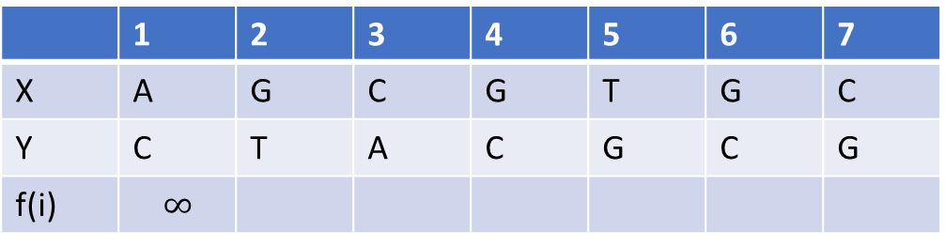
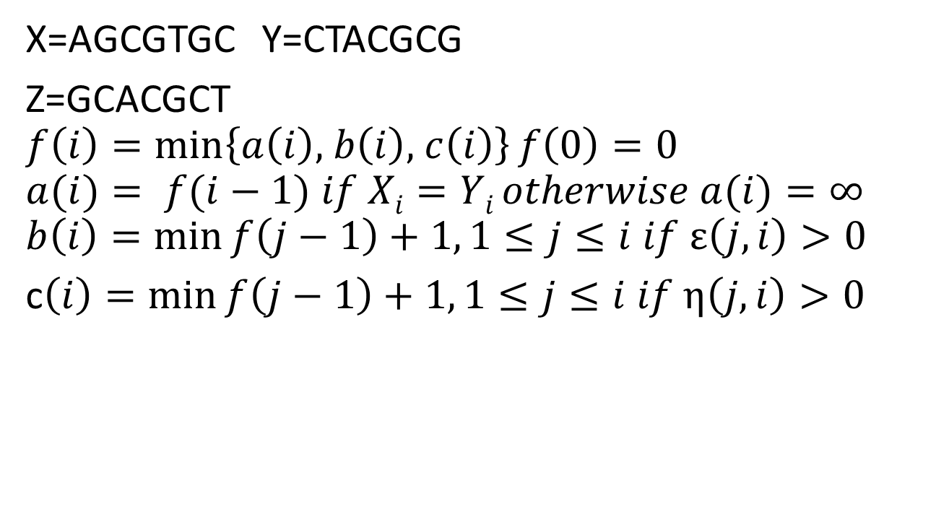
Nonoverlapping mutation
X=AGCGTGC Y=CTACGCG
Z=GCACGCT
$$f\left(i\right)=\min\left\{a\left(i\right)‚ b\left(i\right)‚ c\left(i\right)\right\}f\left(0\right)=0$$
$$a(i)= f(i−1) if Xi=Yi otherwise a(i)=∞$$
$$b\left(i\right)=\min{f\left(j−1\right)}+1, 1≤j≤i if ε\left(j,i\right)>0$$
c$\left(i\right)=\min{f\left(j−1\right)}+1, 1≤j≤i if η\left(j,i\right)>0$
 | 1 | 2 | 3 | 4 | 5 | 6 | 7
X | A | G | C | G | T | G | C
Y | C | T | A | C | G | C | G
f(i) | $$∞$$

Slide 9
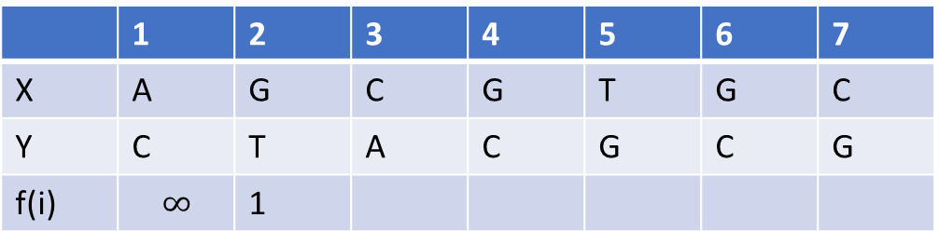
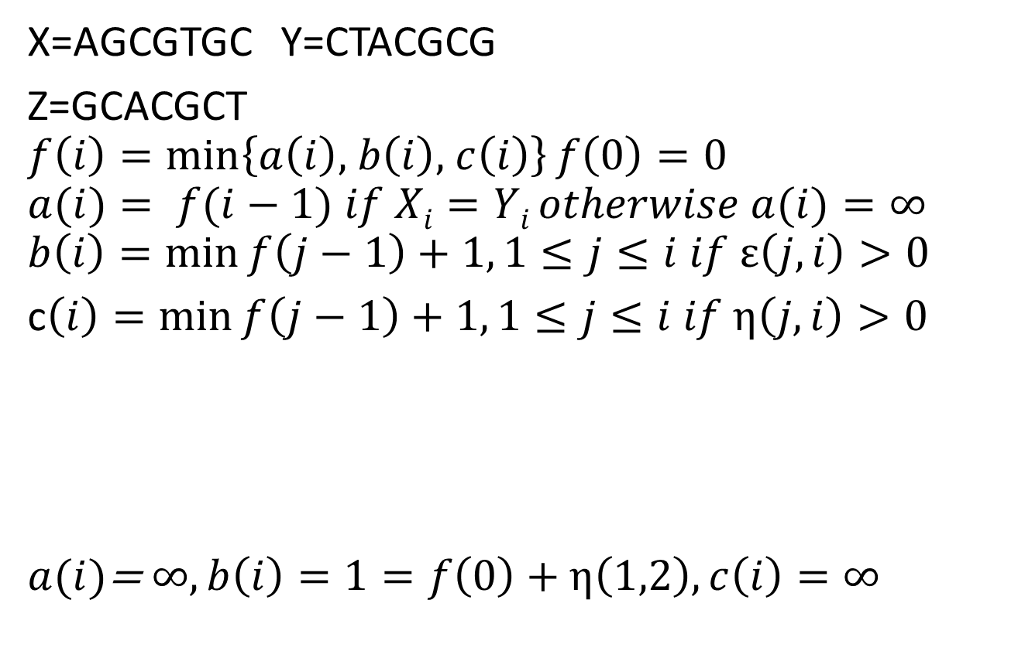
Nonoverlapping mutation
X=AGCGTGC Y=CTACGCG
Z=GCACGCT
$$f\left(i\right)=\min\left\{a\left(i\right)‚ b\left(i\right)‚ c\left(i\right)\right\}f\left(0\right)=0$$
$$a(i)= f(i−1) if Xi=Yi otherwise a(i)=∞$$
$$b\left(i\right)=\min{f\left(j−1\right)}+1, 1≤j≤i if ε\left(j,i\right)>0$$
c$\left(i\right)=\min{f\left(j−1\right)}+1, 1≤j≤i if η\left(j,i\right)>0$
$a(i)$= $∞, b\left(i\right)=1=f\left(0\right)+η\left(1,2\right), c\left(i\right)=∞$
 | 1 | 2 | 3 | 4 | 5 | 6 | 7
X | A | G | C | G | T | G | C
Y | C | T | A | C | G | C | G
f(i) | $$∞$$ | 1

Slide 10
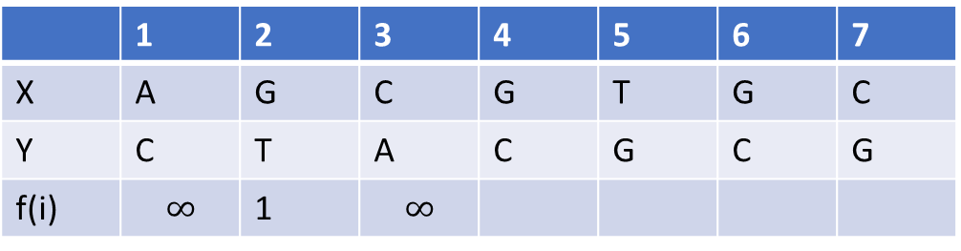
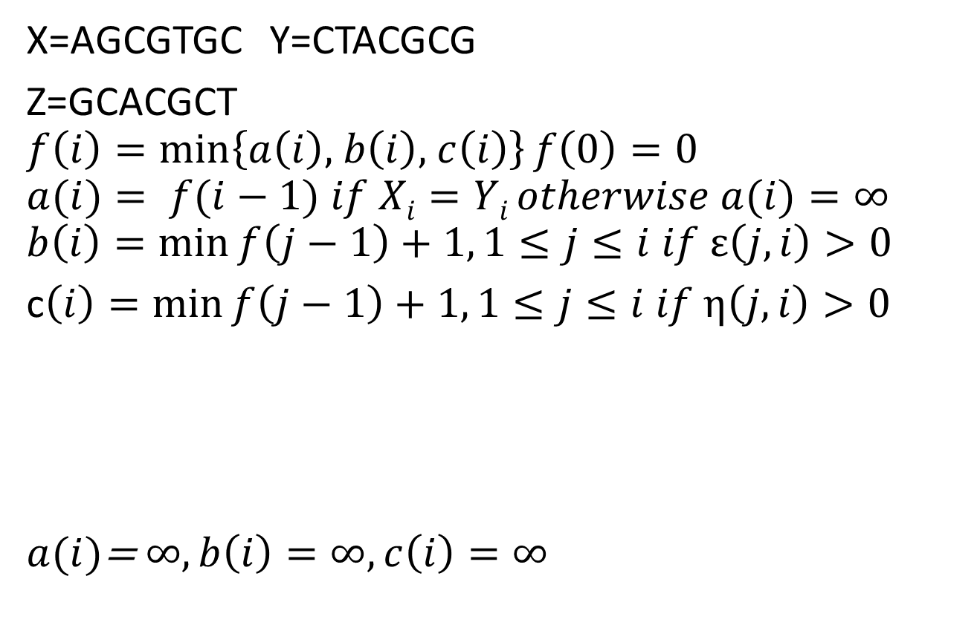
Nonoverlapping mutation
X=AGCGTGC Y=CTACGCG
Z=GCACGCT
$$f\left(i\right)=\min\left\{a\left(i\right)‚ b\left(i\right)‚ c\left(i\right)\right\}f\left(0\right)=0$$
$$a(i)= f(i−1) if Xi=Yi otherwise a(i)=∞$$
$$b\left(i\right)=\min{f\left(j−1\right)}+1, 1≤j≤i if ε\left(j,i\right)>0$$
c$\left(i\right)=\min{f\left(j−1\right)}+1, 1≤j≤i if η\left(j,i\right)>0$
$a(i)$= $∞, b\left(i\right)=∞, c\left(i\right)=∞$
 | 1 | 2 | 3 | 4 | 5 | 6 | 7
X | A | G | C | G | T | G | C
Y | C | T | A | C | G | C | G
f(i) | $$∞$$ | 1 | $$∞$$

Slide 11
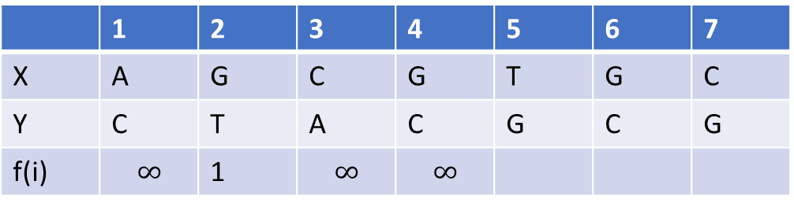
Nonoverlapping mutation
X=AGCGTGC Y=CTACGCG
Z=GCACGCT
$$f\left(i\right)=\min\left\{a\left(i\right)‚ b\left(i\right)‚ c\left(i\right)\right\}f\left(0\right)=0$$
$$a(i)= f(i−1) if Xi=Yi otherwise a(i)=∞$$
$$b\left(i\right)=\min{f\left(j−1\right)}+1, 1≤j≤i if ε\left(j,i\right)>0$$
c$\left(i\right)=\min{f\left(j−1\right)}+1, 1≤j≤i if η\left(j,i\right)>0$
$a(i)$= $∞, b\left(i\right)=∞, c\left(i\right)=∞$
 | 1 | 2 | 3 | 4 | 5 | 6 | 7
X | A | G | C | G | T | G | C
Y | C | T | A | C | G | C | G
f(i) | $$∞$$ | 1 | $$∞$$ | $$∞$$

Slide 12
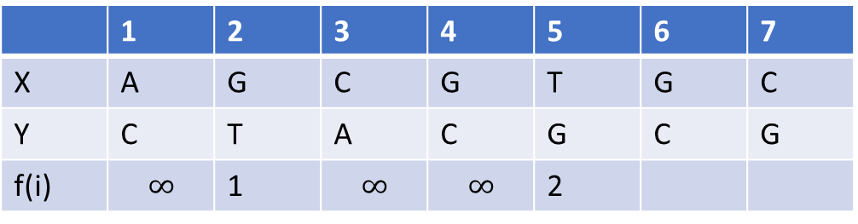
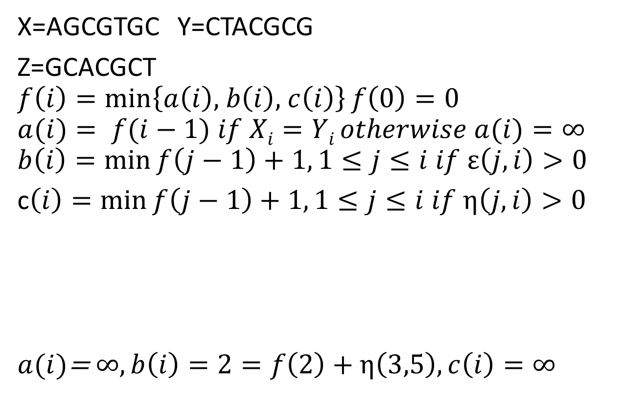
Nonoverlapping mutation
X=AGCGTGC Y=CTACGCG
Z=GCACGCT
$$f\left(i\right)=\min\left\{a\left(i\right)‚ b\left(i\right)‚ c\left(i\right)\right\}f\left(0\right)=0$$
$$a(i)= f(i−1) if Xi=Yi otherwise a(i)=∞$$
$$b\left(i\right)=\min{f\left(j−1\right)}+1, 1≤j≤i if ε\left(j,i\right)>0$$
c$\left(i\right)=\min{f\left(j−1\right)}+1, 1≤j≤i if η\left(j,i\right)>0$
$a(i)$= $∞, b\left(i\right)=2=f\left(2\right)+η\left(3,5\right), c\left(i\right)=∞$
 | 1 | 2 | 3 | 4 | 5 | 6 | 7
X | A | G | C | G | T | G | C
Y | C | T | A | C | G | C | G
f(i) | $$∞$$ | 1 | $$∞$$ | $$∞$$ | 2

Slide 13
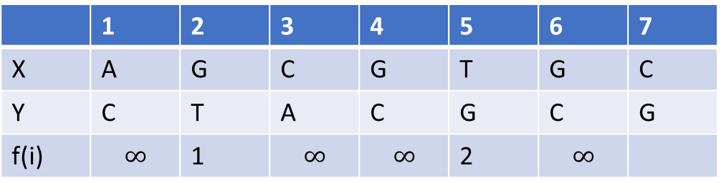
Nonoverlapping mutation
X=AGCGTGC Y=CTACGCG
Z=GCACGCT
$$f\left(i\right)=\min\left\{a\left(i\right)‚ b\left(i\right)‚ c\left(i\right)\right\}f\left(0\right)=0$$
$$a(i)= f(i−1) if Xi=Yi otherwise a(i)=∞$$
$$b\left(i\right)=\min{f\left(j−1\right)}+1, 1≤j≤i if ε\left(j,i\right)>0$$
c$\left(i\right)=\min{f\left(j−1\right)}+1, 1≤j≤i if η\left(j,i\right)>0$
$a(i)$= $∞, b\left(i\right)=∞, c\left(i\right)=∞$
 | 1 | 2 | 3 | 4 | 5 | 6 | 7
X | A | G | C | G | T | G | C
Y | C | T | A | C | G | C | G
f(i) | $$∞$$ | 1 | $$∞$$ | $$∞$$ | 2 | $$∞$$

Slide 14
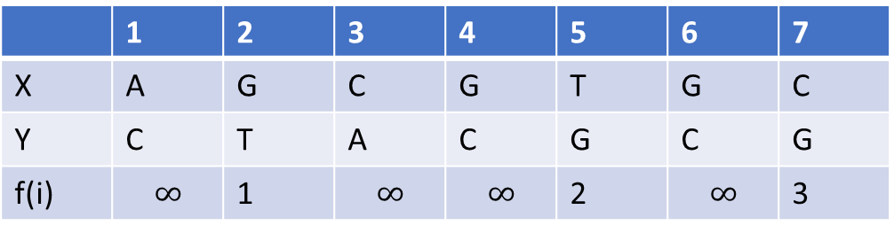
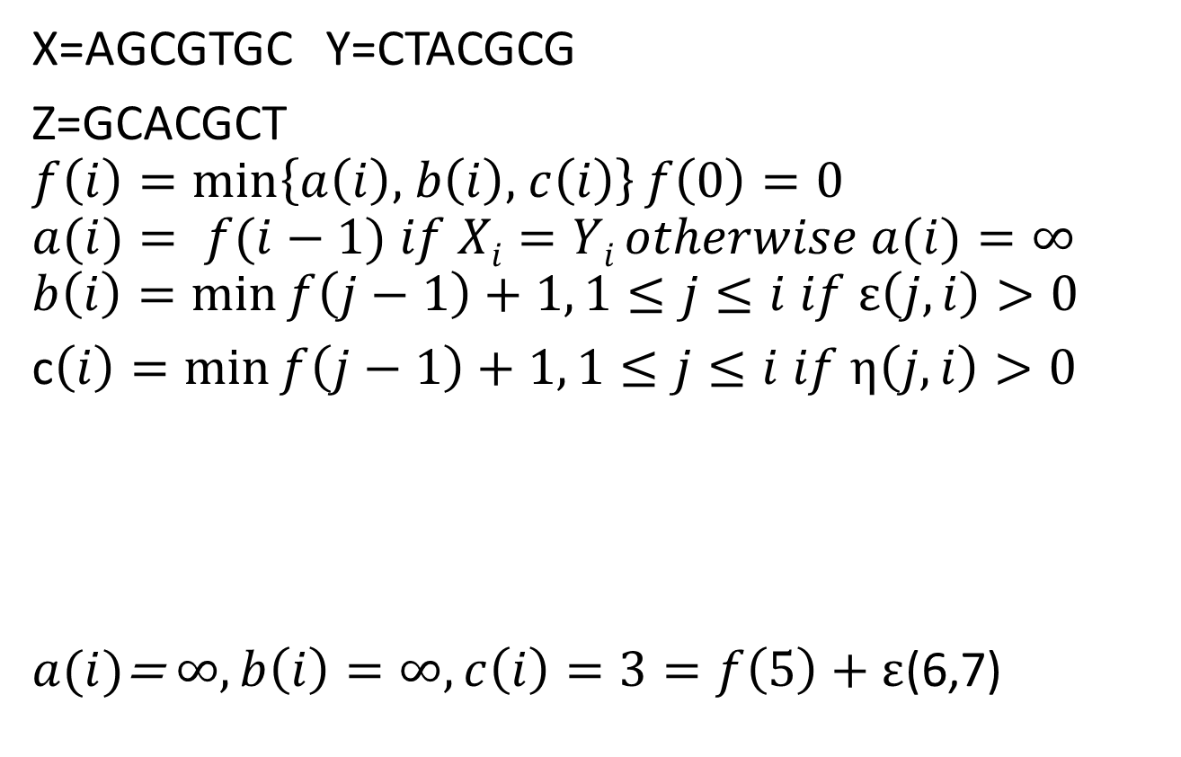
Nonoverlapping mutation
X=AGCGTGC Y=CTACGCG
Z=GCACGCT
$$f\left(i\right)=\min\left\{a\left(i\right)‚ b\left(i\right)‚ c\left(i\right)\right\}f\left(0\right)=0$$
$$a(i)= f(i−1) if Xi=Yi otherwise a(i)=∞$$
$$b\left(i\right)=\min{f\left(j−1\right)}+1, 1≤j≤i if ε\left(j,i\right)>0$$
c$\left(i\right)=\min{f\left(j−1\right)}+1, 1≤j≤i if η\left(j,i\right)>0$
$a(i)$= $∞, b\left(i\right)=∞, c\left(i\right)=3=f\left(5\right)+ε$(6,7)
 | 1 | 2 | 3 | 4 | 5 | 6 | 7
X | A | G | C | G | T | G | C
Y | C | T | A | C | G | C | G
f(i) | $$∞$$ | 1 | $$∞$$ | $$∞$$ | 2 | $$∞$$ | 3

Slide 15
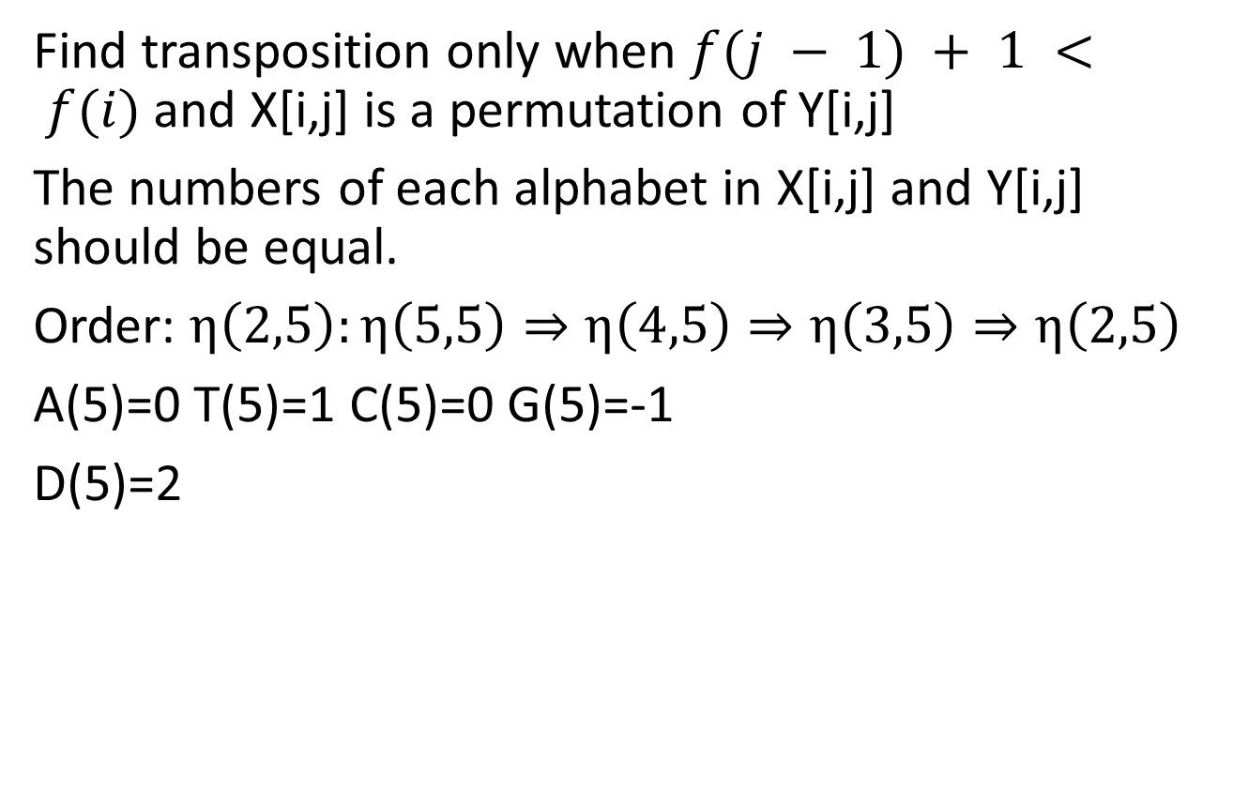
Reduction
Find transposition only when $f(j − 1) + 1 < f(i)$and X[i,j] is a permutation of Y[i,j]
The numbers of each alphabet in X[i,j] and Y[i,j] should be equal.
Order: $η\left(2,5\right):η\left(5,5\right)⇒η\left(4,5\right)⇒η\left(3,5\right)⇒η\left(2,5\right)$
A(5)=0 T(5)=1 C(5)=0 G(5)=-1
D(5)=2
 | 1 | 2 | 3 | 4 | 5 | 6 | 7
X | A | G | C | G | T | G | C
Y | C | T | G | C | G | C | G

Slide 16
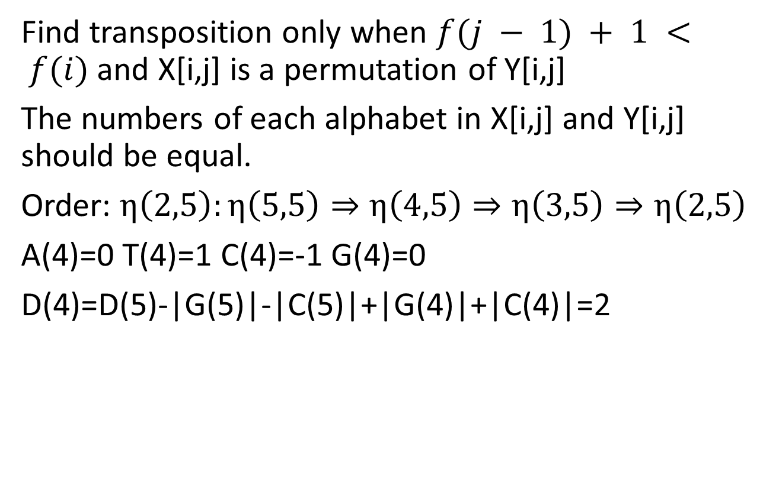
Reduction
Find transposition only when $f(j − 1) + 1 < f(i)$and X[i,j] is a permutation of Y[i,j]
The numbers of each alphabet in X[i,j] and Y[i,j] should be equal.
Order: $η\left(2,5\right):η\left(5,5\right)⇒η\left(4,5\right)⇒η\left(3,5\right)⇒η\left(2,5\right)$
A(4)=0 T(4)=1 C(4)=-1 G(4)=0
D(4)=D(5)-|G(5)|-|C(5)|+|G(4)|+|C(4)|=2
 | 1 | 2 | 3 | 4 | 5 | 6 | 7
X | A | G | C | G | T | G | C
Y | C | T | G | C | G | C | G

Slide 17
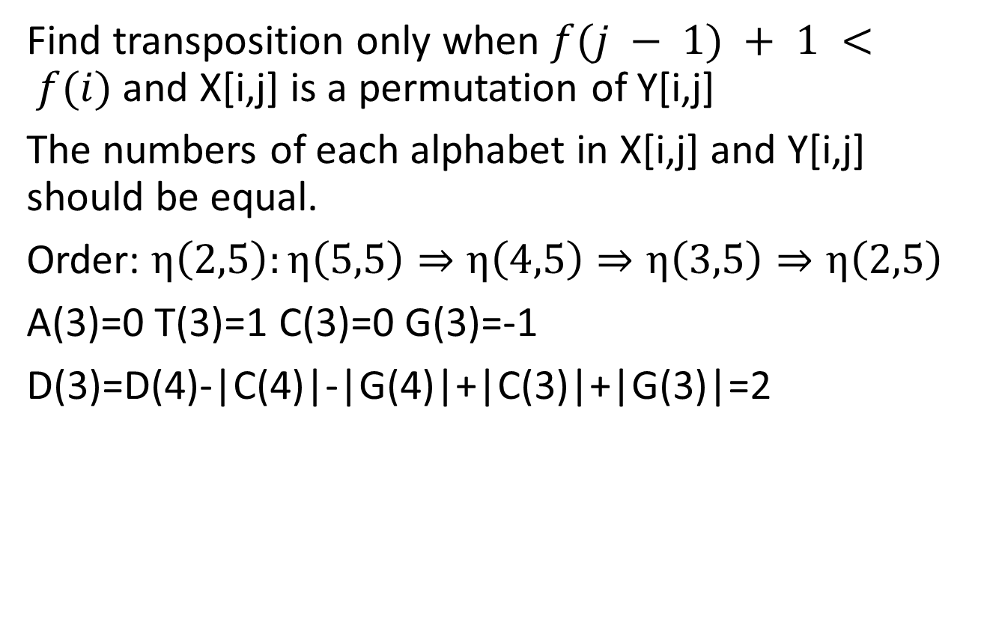
Reduction
Find transposition only when $f(j − 1) + 1 < f(i)$and X[i,j] is a permutation of Y[i,j]
The numbers of each alphabet in X[i,j] and Y[i,j] should be equal.
Order: $η\left(2,5\right):η\left(5,5\right)⇒η\left(4,5\right)⇒η\left(3,5\right)⇒η\left(2,5\right)$
A(3)=0 T(3)=1 C(3)=0 G(3)=-1
D(3)=D(4)-|C(4)|-|G(4)|+|C(3)|+|G(3)|=2
 | 1 | 2 | 3 | 4 | 5 | 6 | 7
X | A | G | C | G | T | G | C
Y | C | T | G | C | G | C | G

Slide 18
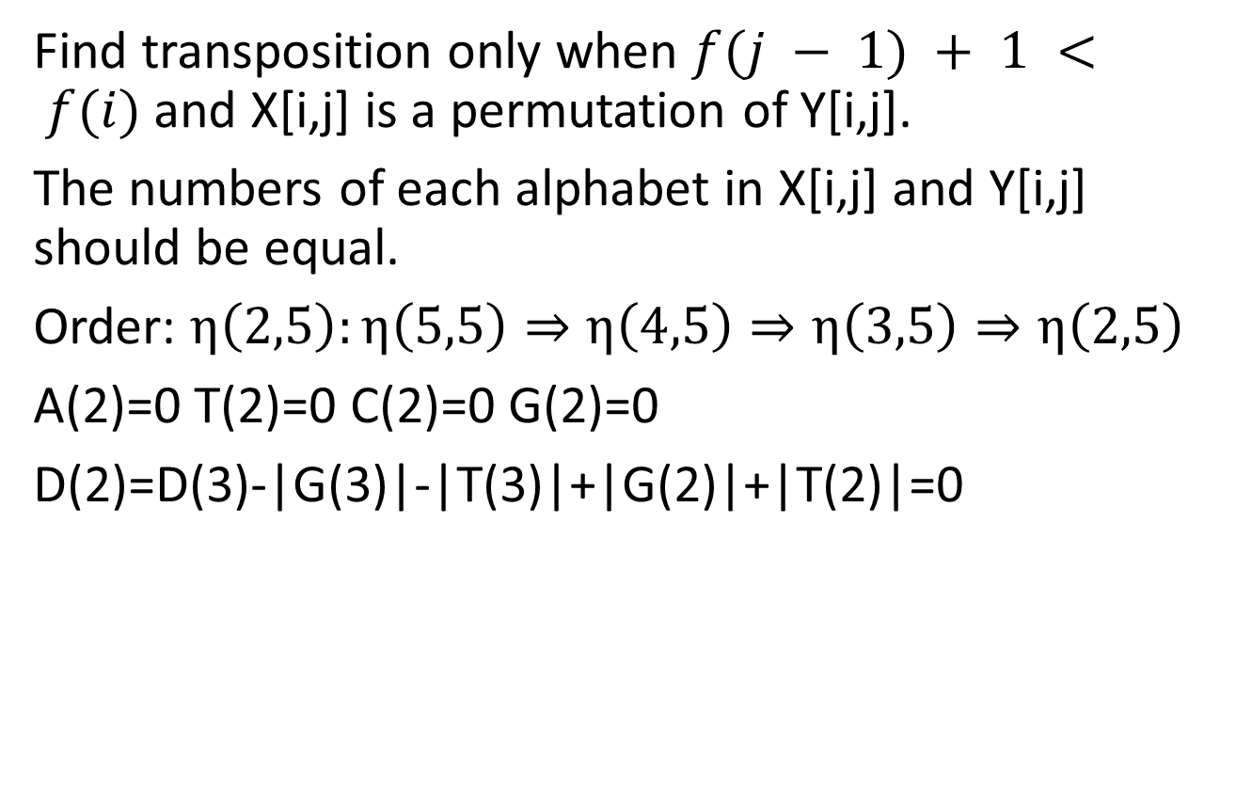
Reduction
Find transposition only when $f(j − 1) + 1 < f(i)$and X[i,j] is a permutation of Y[i,j].
The numbers of each alphabet in X[i,j] and Y[i,j] should be equal.
Order: $η\left(2,5\right):η\left(5,5\right)⇒η\left(4,5\right)⇒η\left(3,5\right)⇒η\left(2,5\right)$
A(2)=0 T(2)=0 C(2)=0 G(2)=0
D(2)=D(3)-|G(3)|-|T(3)|+|G(2)|+|T(2)|=0
 | 1 | 2 | 3 | 4 | 5 | 6 | 7
X | A | G | C | G | T | G | C
Y | C | T | G | C | G | C | G

