Slide 1
Generating Code from a Graphical User Interface Screenshot
Tony Beltramelli
In EICS ’18: ACM SIGCHI Symposium on Engineering Interactive Computing Systems, June 19–22, 2018, Paris, France.
Presenter : Feng-Yang Tsai
Date: Feb. 12, 2019
Notes:
https://www.google.com/maps/place/Uizard+Technologies/@55.2209723,12.0156949,6.06z/data=!4m5!3m4!1s0x4652535f9f014421:0xf48a598d78efbe36!8m2!3d55.677108!4d12.569503

Slide 2
Abstract
Transforming a graphical user interface screenshot created by a designer into computer code is a typical task conducted by a developer in order to build customized software, websites, and mobile applications. In this paper, we show that deep learning methods can be leveraged to train a model end-to-end to automatically reverse engineer user interfaces and generate code from a single input image with over 77% of accuracy for three different platforms (i.e. iOS, Android and web-based technologies).

Slide 3
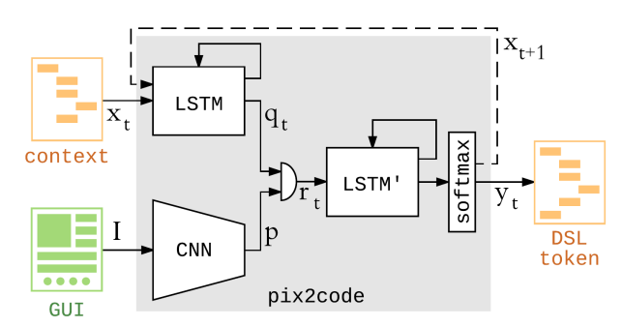
Vision Model:

Slide 4
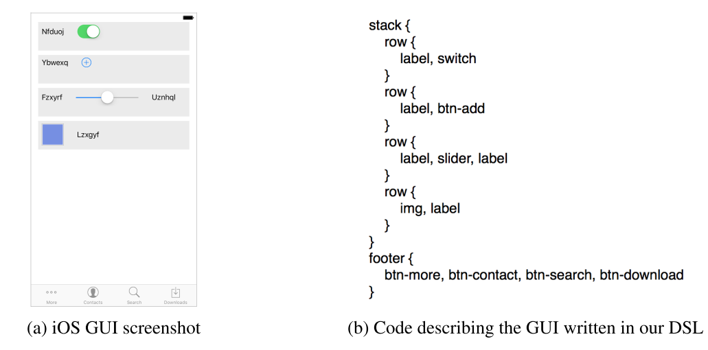
Language Model:
Domain-Specific Language

Slide 5
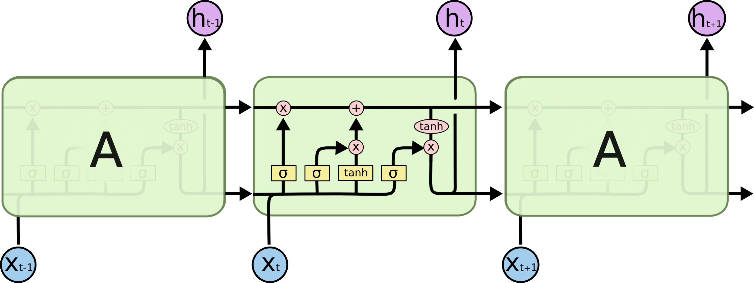
LSTM:

Slide 6
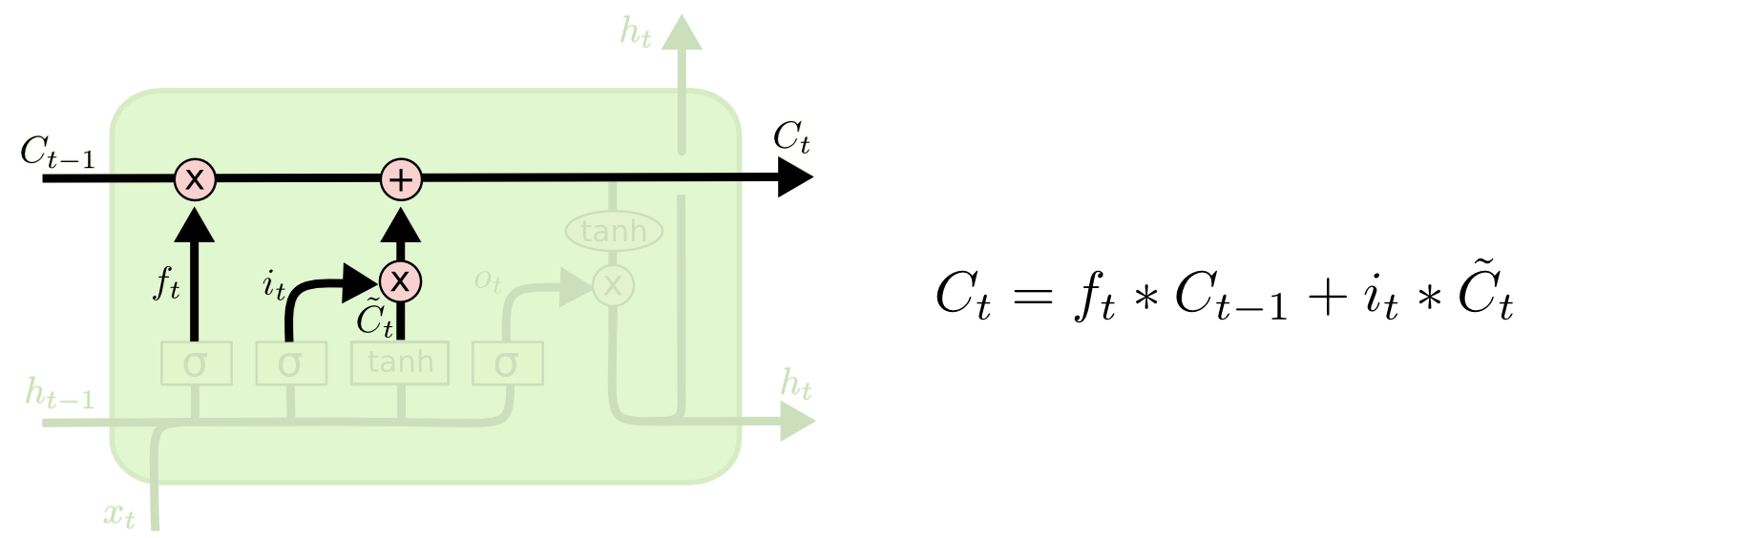
LSTM:

Slide 7
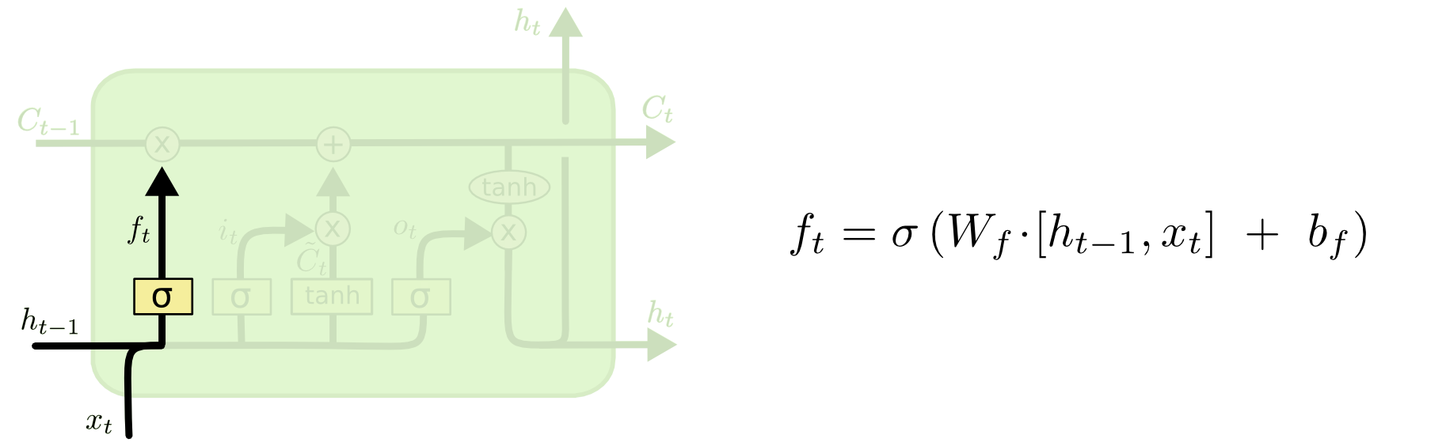
LSTM:

Slide 8
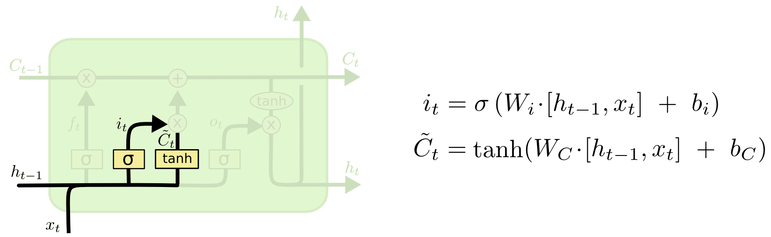
LSTM:

Slide 9
LSTM:

Slide 10
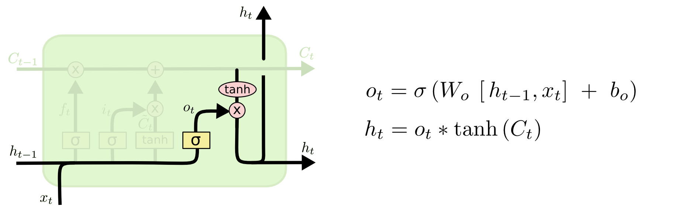
LSTM:

Slide 11
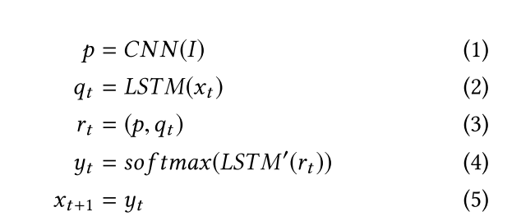
Decoder:
Notes:
输出(0, 1)代表“是”，输出(1, 0)代表“否”
Softmax可能输出(0.3, 0.7)，代表算法认为“是”的概率是0.7，“否”的概率是0.3，相加为1
Sigmoid的输出可能是(0.4, 0.8)，它们相加不为1，解释来说就是Sigmoid认为输出第一位为1的概率是0.4，第一位不为1的概率是0.6（1-p），第二位为1的概率是0.8，第二位不为1的概率是0.2。

Slide 12
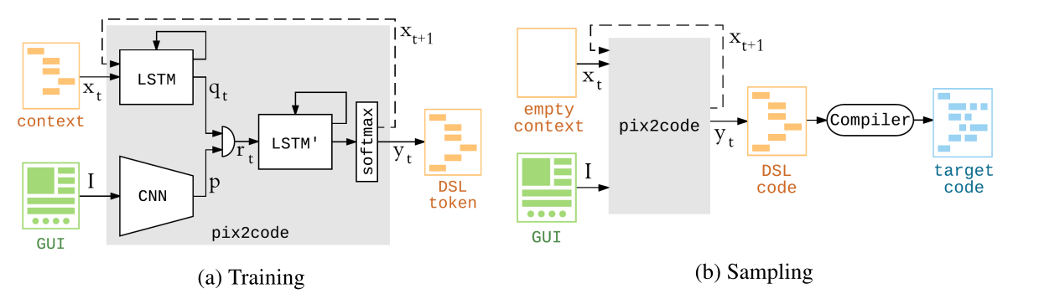
Sampling:

Slide 13
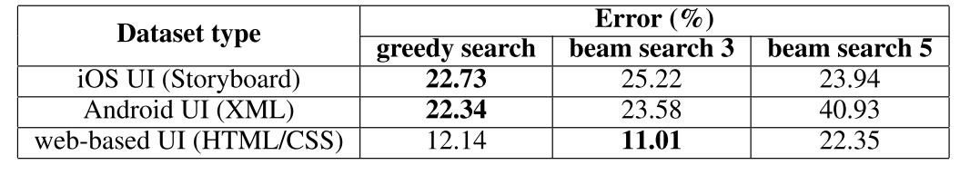
Experiments:

Slide 14
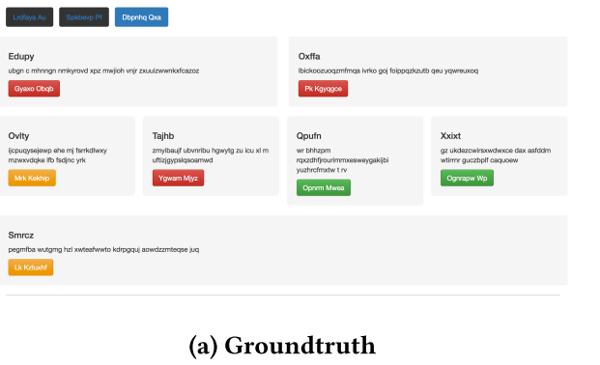
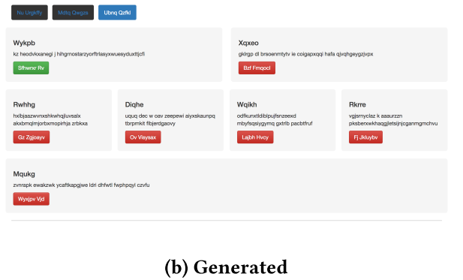
Experiments:

Slide 15
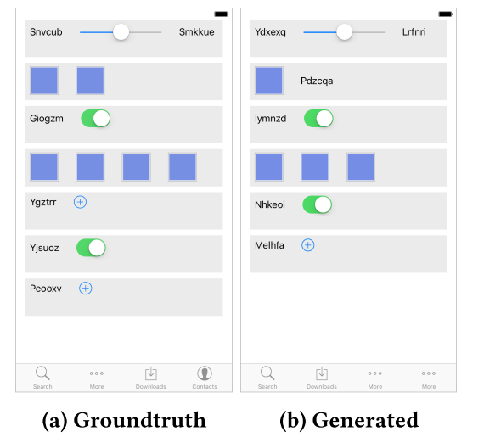
Experiments:

