Slide 1
Inception-v4, Inception-ResNet and the Impact of Residual Connections on Learning
Christian Szegedy, Sergey Ioffe, Vincent Vanhoucke, Alexander A. Alemi
Proceedings of the 31st AAAI Conference on Artificial Intelligence
February 4–9,2017 at the Hilton San Francisco, San Francisco, California, USA
Presenter : Chia-Lin, Chen
April 23, 2019

Slide 2
Abstract(1/3)
Very deep convolutional networks have been central to the largest advances in image recognition performance in recent years. One example is the Inception architecture that has been shown to achieve very good performance at relatively low computational cost. Recently, the introduction of residual connections in conjunction with a more traditional architecture has yielded state-of-the-art performance in the 2015 ILSVRC challenge; its performance was similar to the latest generation Inception-v3 network.
Inception-v4, Inception-ResNet and the
Impact of Residual Connections on Learning

Slide 3
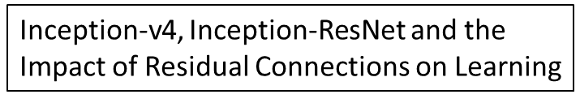
Abstract(2/3)
This raises the question: Are there any beneﬁts to combining Inception architectures with residual connections? Here we give clear empirical evidence that training with residual connections accelerates the training of Inception networks signiﬁcantly. There is also some evidence of residual Inception networks outperforming similarly expensive Inception networks without residual connections by a thin margin. We also present several new streamlined architectures for both residual and nonresidual Inception networks.

Slide 4
Abstract(3/3)
These variations improve the single-frame recognition performance on the ILSVRC 2012 classiﬁcation task signiﬁcantly. We further demonstrate how proper activation scaling stabilizes the training of very wide residual Inception networks. With an ensemble of three residual and one Inception-v4 networks, we achieve 3.08% top-5 error on the test set of the Image Net classiﬁcation(CLS)challenge.
Inception-v4, Inception-ResNet and the
Impact of Residual Connections on Learning

Slide 5
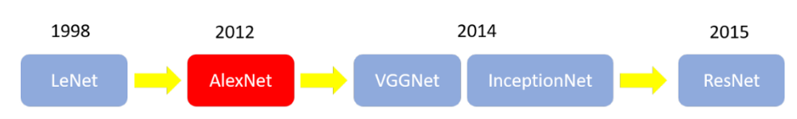
History(1/1)
ImageNet
ILSVRC( champion team’s top5 accuracy: 73% )
AlexNet(champion team’s top5 accuracy came to
83%, add ReLU function )
GoogLeNet(Inception-v1) won the championship
VGGNet won the second place
Inception-v4, Inception-ResNet and the
Impact of Residual Connections on Learning

Slide 6
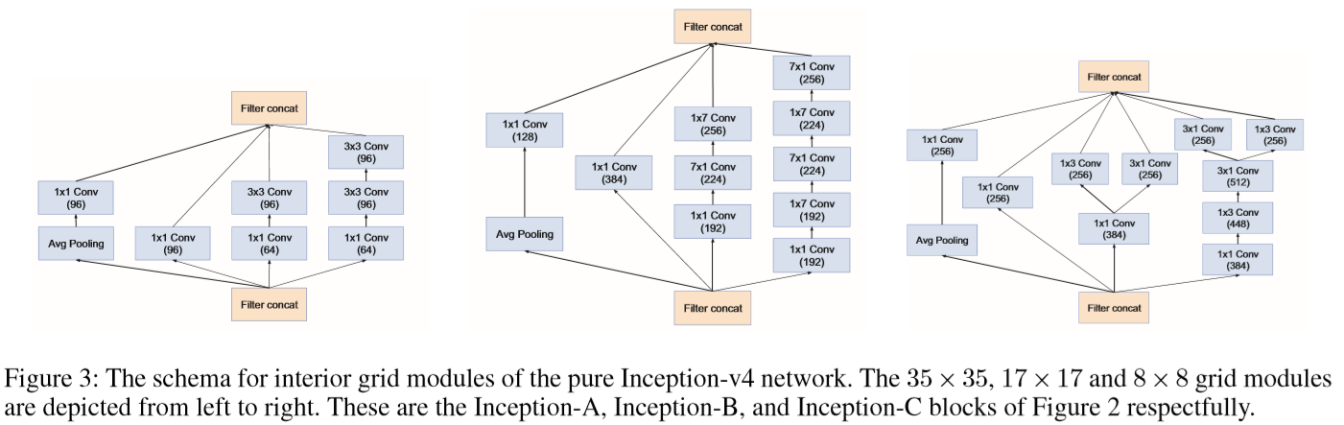
Architecture(1/3)
Inception-v4, Inception-ResNet and the
Impact of Residual Connections on Learning

Slide 7
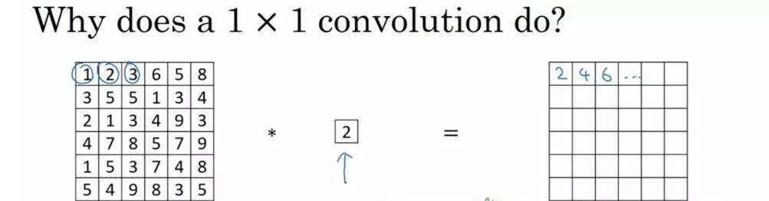
here filter = 2
6x6 matrix
1x1 convolution
6x6 matrix
Inception-v4, Inception-ResNet and the
Impact of Residual Connections on Learning

Slide 8
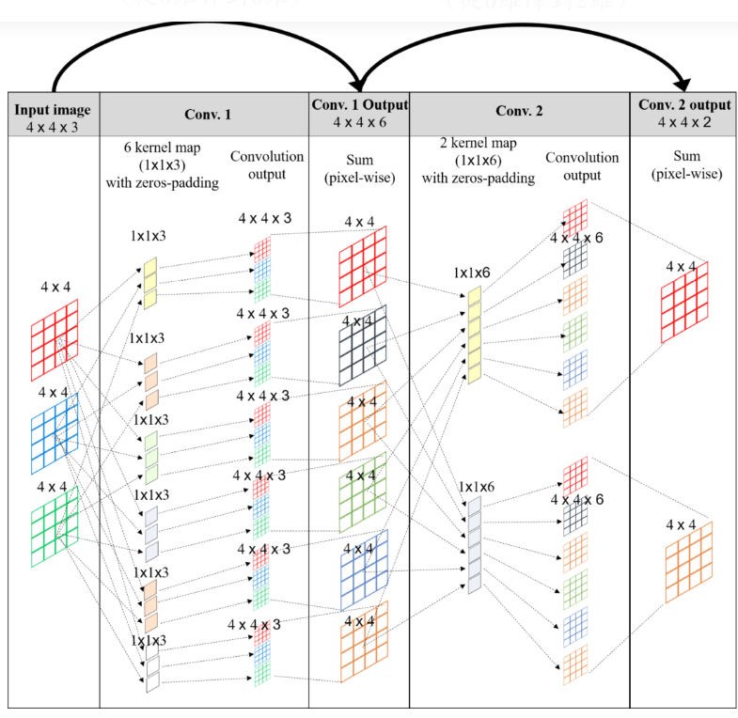
height x weight x channels

Slide 9
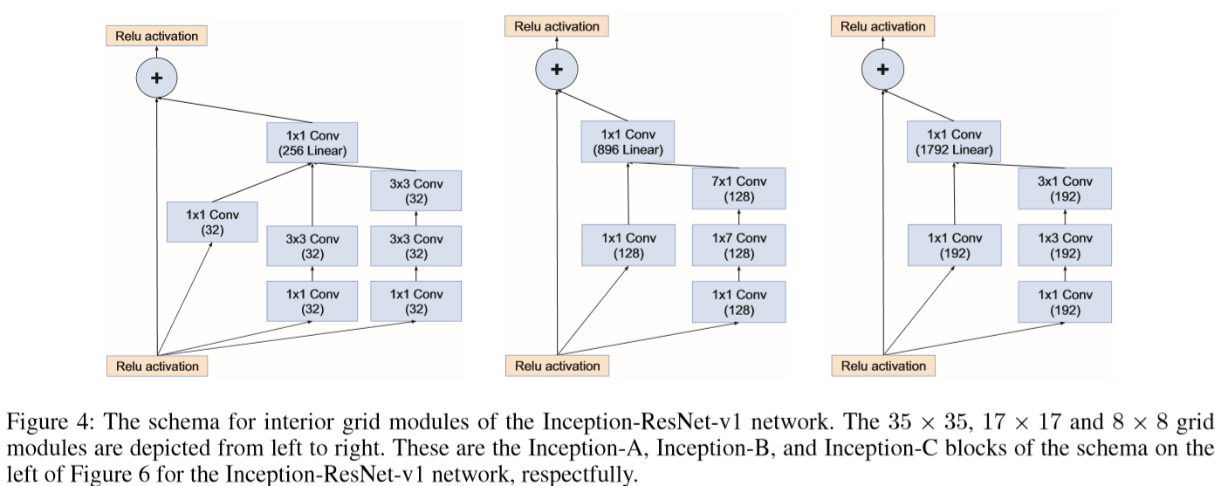
Architecture(2/3)
Inception-v4, Inception-ResNet and the
Impact of Residual Connections on Learning

Slide 10
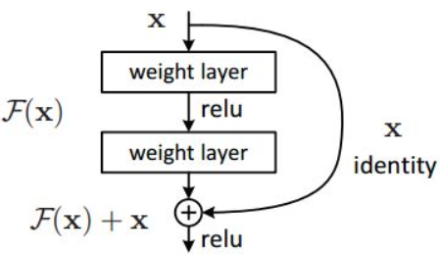

Important concept of ResNet:residual network
2014, VGG:14 layers
2015: ResNet:152layers
Inception-v4, Inception-ResNet and the
Impact of Residual Connections on Learning

Slide 11
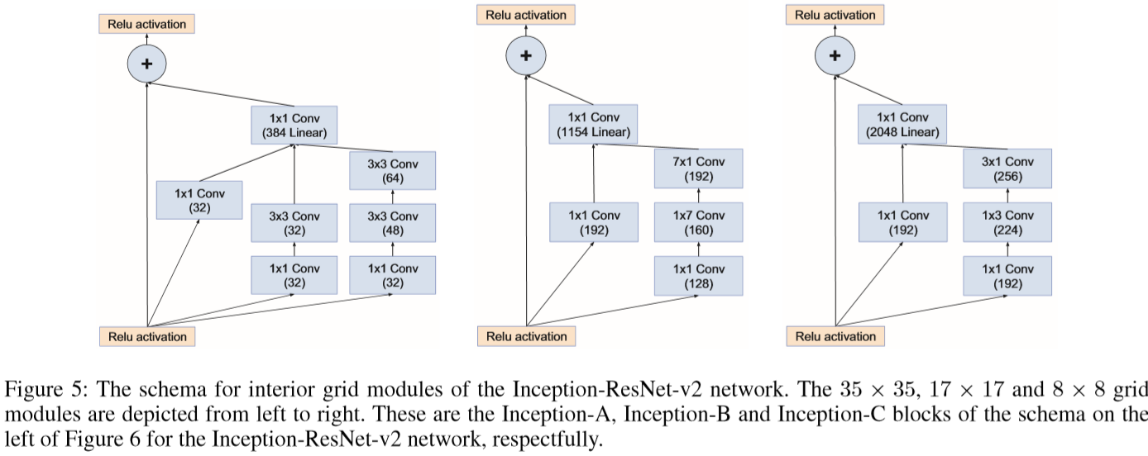
Architecture(3/3)
Inception-v4, Inception-ResNet and the
Impact of Residual Connections on Learning

Slide 12
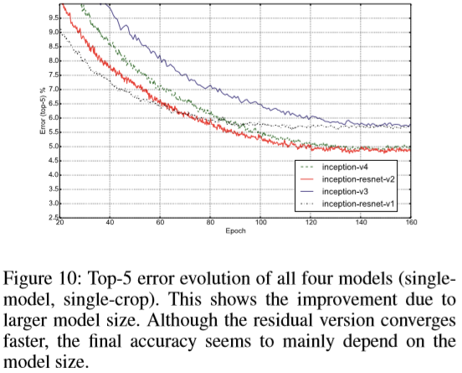
Experimental Results(1/5)

Slide 13
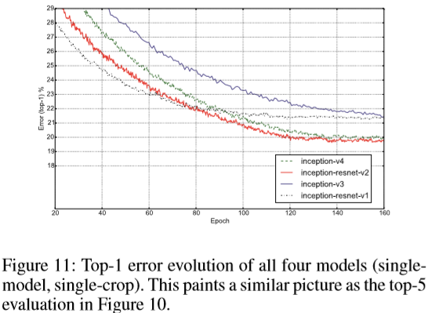
Experimental Results(2/5)

Slide 14
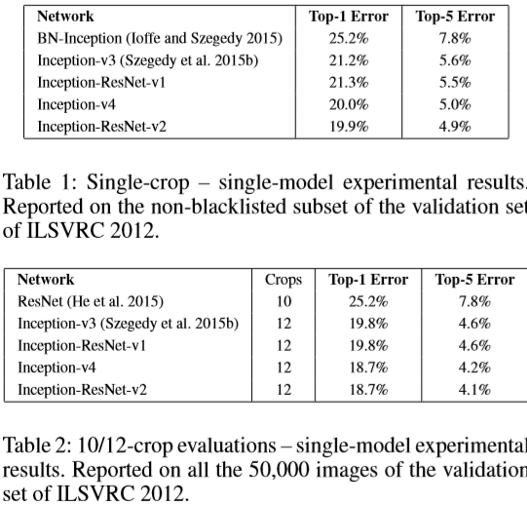
Experimental Results(3/5)

Slide 15
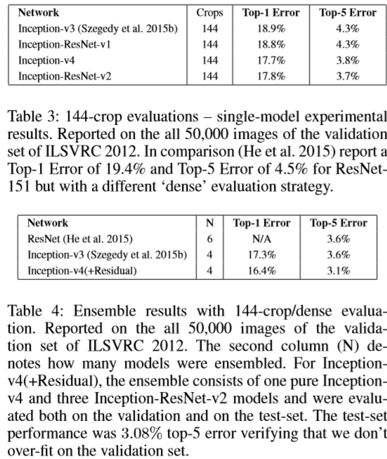
Experimental Results(4/5)

Slide 16
Experimental Results(5/5)

Slide 17
Thank you!

