Slide 1
Fast Exact Dynamic Time Warping on Run-Length Encoded Time Series
Vincent Froese and Brijnesh Jain
arXiv:1903.03003
March 9, 2019
Presenter: Shan-Ru Liu
Date: April 23, 2019

Slide 2
Abstract (1/2)
Dynamic Time Warping (DTW) is a well-known similarity measure for time series. The standard dynamic programming approach to compute the dtw-distance of two length-n time series, however, requires O(n²) time, which is often too slow in applications. Therefore, many heuristics have been proposed to speed up the dtw computation. These are often based on approximating or bounding the true dtw-distance or considering special inputs (e.g. binary or piecewise constant time series).

Slide 3
Abstract (1/2)
In this paper, we present a fast and exact algorithm to compute the dtw-distance of two run-length encoded time series. This might be used for fast and accurate indexing and classification of time series in combination with preprocessing techniques such as piecewise aggregate approximation (PAA).

Slide 4
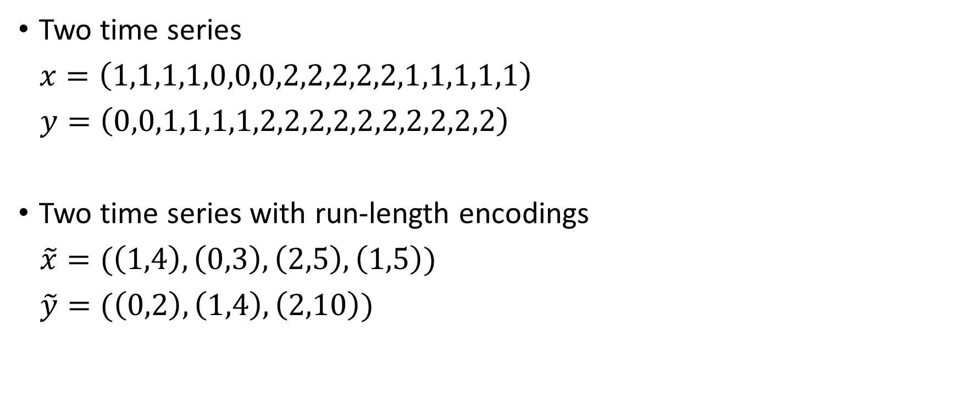
Run-Length Encode
Two time series
$x=\left(1,1,1,1,0,0,0,2,2,2,2,2,1,1,1,1,1\right)$
$y=\left(0,0,1,1,1,1,2,2,2,2,2,2,2,2,2,2\right)$
Two time series with run-length encodings
$\tilde{x}=(\left(1,4\right),\left(0,3\right),\left(2,5\right),\left(1,5\right))$
$\tilde{y}=(\left(0,2\right),\left(1,4\right),\left(2,10\right))$

Slide 5
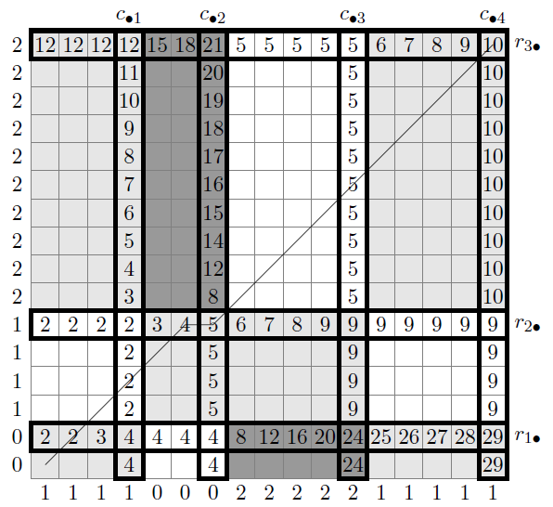
Example of a local cost matrix
Colors indicate the local costs (x_{i}−y_{j})²
(white = 0, light gray = 1, dark gray = 4)

Slide 6
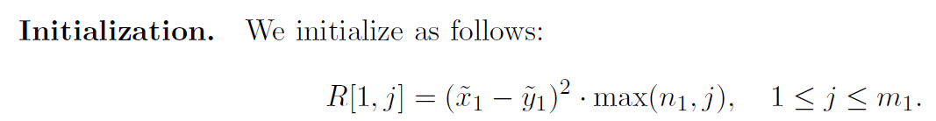
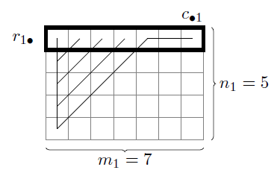
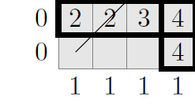
Filling the first m₁ columns of row r_{1•} (1/2)
c_{•1}
R[1,1]= 1*max(2,1) = 2
R[1,2]= 1*max(2,2) = 2
R[1,3]= 1*max(2,3) = 3
R[1,4]= 1*max(2,4) = 4
r_{1•}
n₁ = 2
m₁ = 4

Slide 7
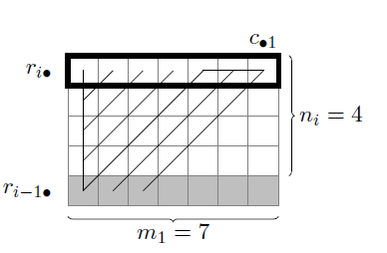
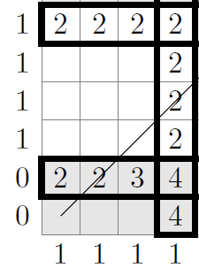
Filling the first m₁ columns of row r_{1•} (2/2)
c_{•1}
r_{2•}
M= min(4,4+1) = 4
δ = (1-1)² = 0
R[2,1]= R[1,1]+4*0 = 2
R[2,2]= R[1,1]+4*0 = 2
R[2,3]= R[1,1]+4*0 = 2
R[2,4]= R[1,1]+4*0 = 2
n₂ = 4
r_{1•}
m₁ = 4

Slide 8
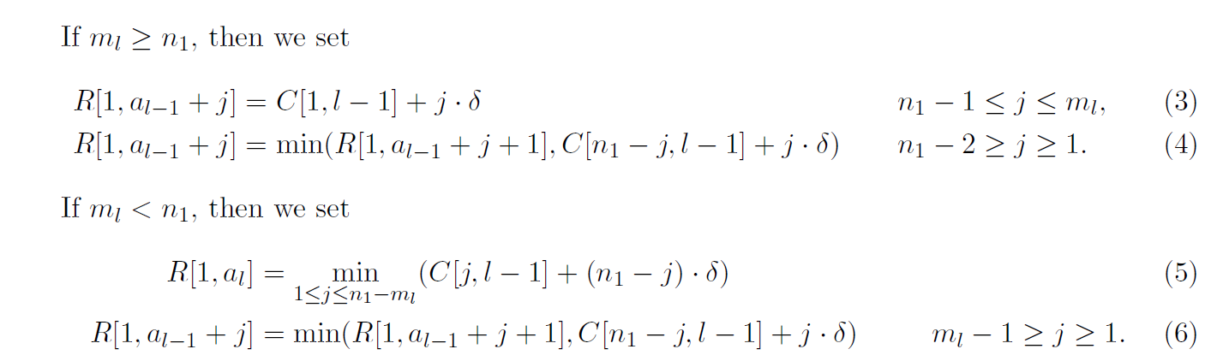
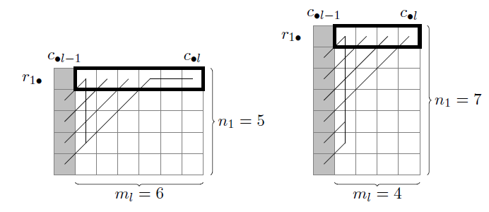
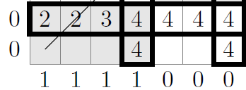
Filling columns a_{l}−1 + 1, . . . , a_{l} of row r_{i•} (1/2)
m₂ ≥ n₁
δ = (1-1)² = 0
R[1,5]=C[1,1]+1*0=4
R[1,6]=C[1,1]+2*0=4
R[1,7]=C[1,1]+3*0=4
c_{•1}
c_{•2}
r_{1•}
n₁ = 2
m₂ = 3

Slide 9
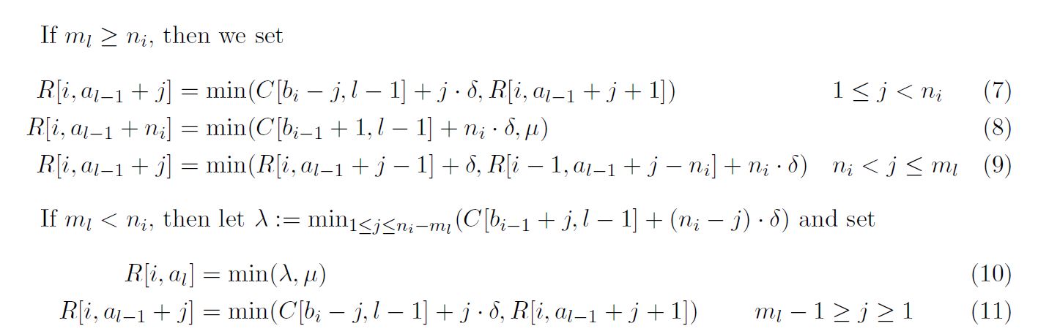
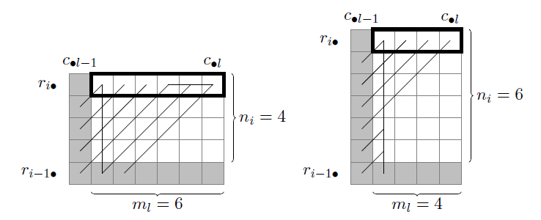
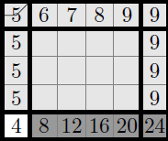
Filling columns a_{l}−1 + 1, . . . , a_{l} of row r_{i•} (2/2)
c_{•2}
c_{•3}
r_{2•}
n₂ = 4
r_{1•}
m₃ = 5

Slide 10
Conclusion
Time complexity : O(mn) -> O(kn+lm)
Space complexity: O(mn) -> O(m+n)

